Slide 1
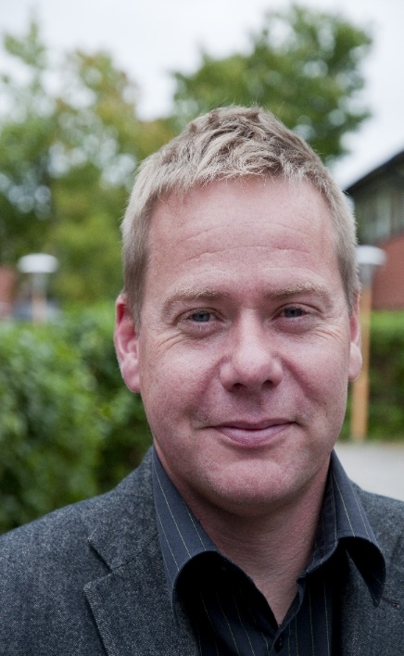
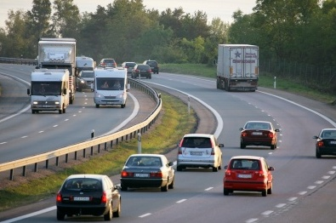
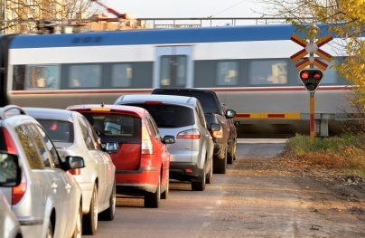

Matts-Åke Belin PhD
Adj. Professor Royal Institute of Technology (KTH)
Swedish Transport Administration
Vision Zero Academy matts-ake.belin@trafikverket.se

Slide 2
Vision Zero a policy innovation
Traditional
Vision Zero
Accidents
Fatalities and serious injuries
What is the problem?
Human factors
Humans make mistakes
Humans are fragile
What causes the problem?
Individual road users
System designers
Responsibility?
People don’t want safety
People want safety
Peoples demand for road safety?
Optimum number of fatalities and serious injuries
Eliminate fatalities and
serious injuries
What is the appropriate goal?

