Slide 1
Growing Vision — and Action — for Safe Mobility

Slide 2
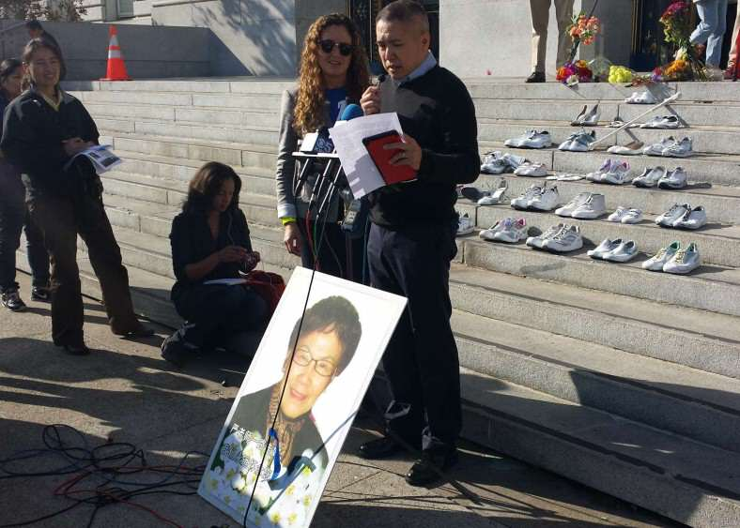

Slide 7
Vision Zero Denver

Slide 11
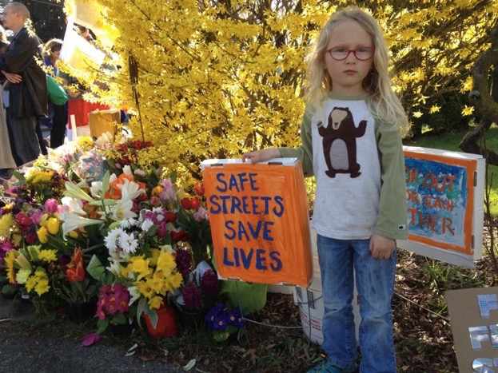
11

