Slide 1



The Urgency of Now
Why Action is Needed Now to Reverse the Rise in Preventable Road Traffic Deaths and Serious Injuries
David Ward, Secretary General, Global New Car Assessment Programme
Coalition Meeting, Washington DC
October 13, 2017

Slide 2
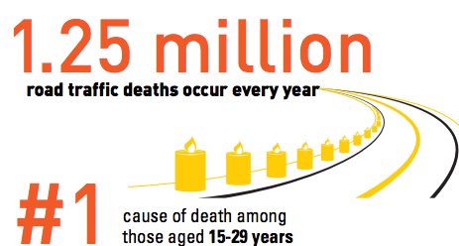
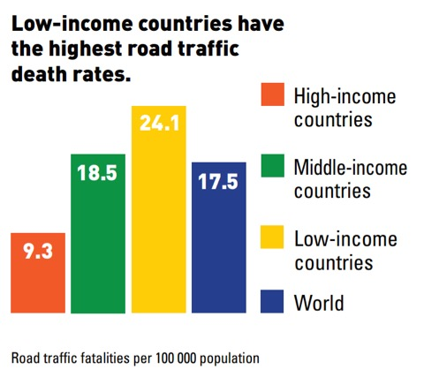




Global Commitments to Road Safety Action
Over 3500 people are killed daily in road crashes.
3% of GDP is lost worldwide and road crashes are
the number 1 killer of young people.
Low and middle income countries account for
90% of global road deaths and have fatality rates
twice that of high income nations.
UN Decade of Action for Road Safety (2011-2020)
was launched with the aim to ‘stabilize and then
reduce the level of road fatalities’.
UN’s Sustainable Developments Goals for Health
and Cities include road safety with a target to
halve road traffic deaths and injuries by 2020.
These are the UN’s strongest ever global mandates
for action on road injury prevention.

Slide 3

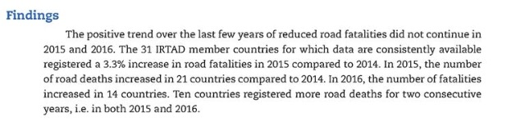
New OECD/ITF Report records rise in road traffic deaths in many countries in 2015-2016.
A Wake Up Call!

Slide 4
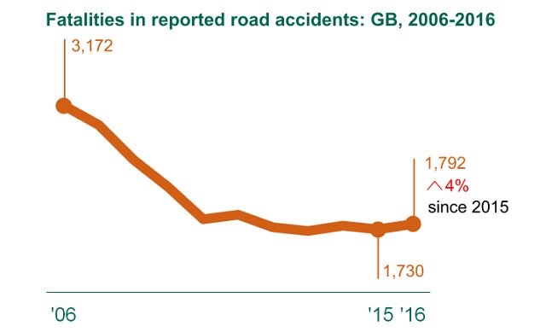

Slide 5
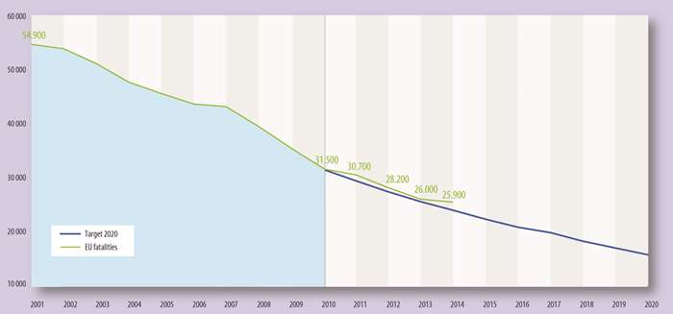
EU Target to Halve Road Deaths by 2020 – Progress Stalled

Slide 6
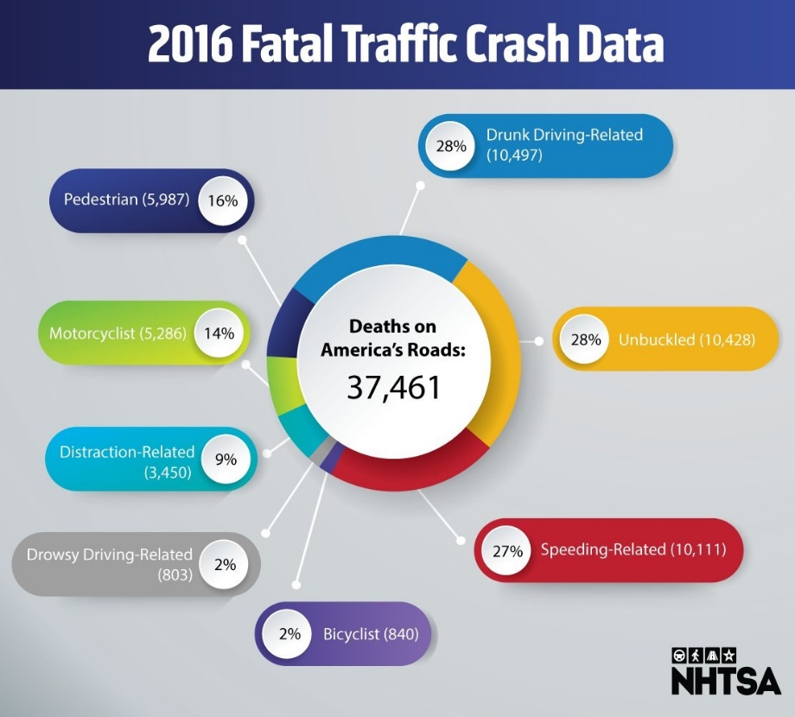
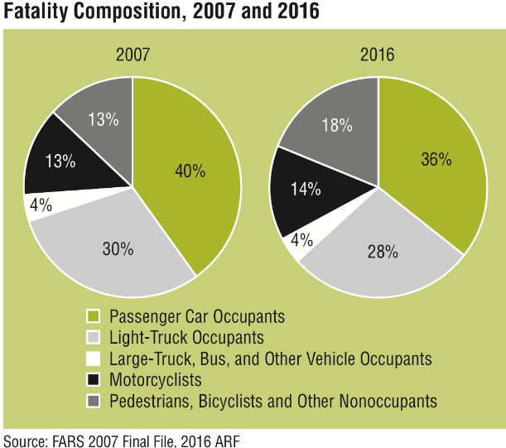
US Fatality Rate - Largest Two Year Hike in Decades

Slide 7
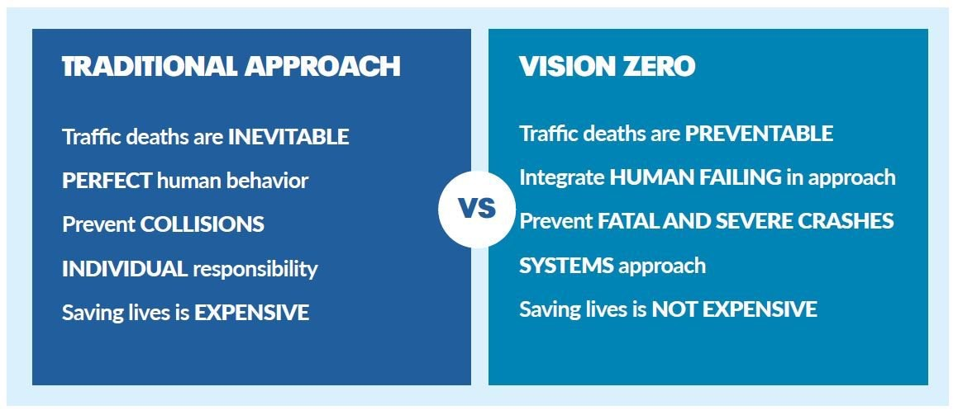
Time for a New Vision & Paradigm Shift

Slide 8

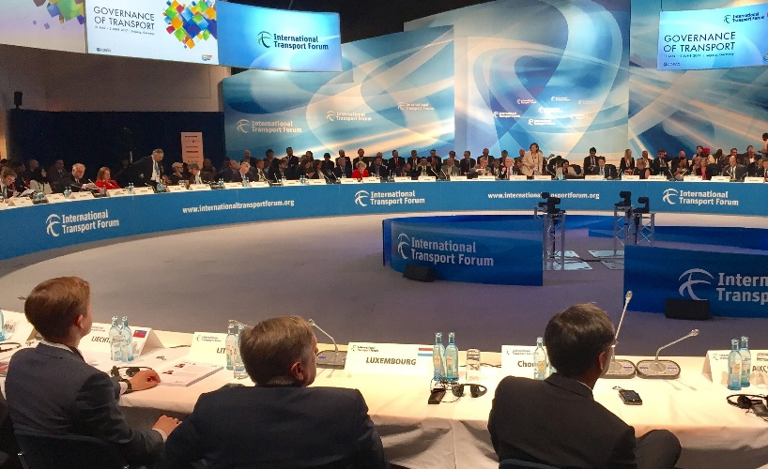
Building Global Policy Consensus
The International Transport Forum (ITF) at
the OECD in Paris researches best practices
in road safety policy and is a leading
proponent of the ‘safe systems approach’.
In 2008 they issued the ‘Towards Zero’ report
which endorsed safe systems and advocated
setting ambitious casualty reduction targets.
In 2006 the ITF published ‘Zero Road Deaths
and Serious Injuries’ report which calls for a
Paradigm shift in favour of a safe system.
The ITF hosts an annual Ministerial Summit in Leipzig, Germany which in 2018 (23-25 May) will take Safety & Security as its major theme.

Slide 9
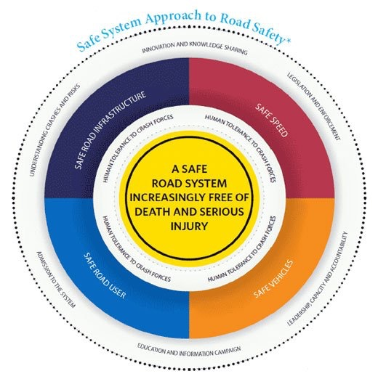
Four Principles of the Safe System
People make mistakes that lead to road crashes.
The human body has a limited physical ability to tolerate crash forces before
harm occurs.
There is shared responsibility
amongst those who design, build,
operate, and use roads and vehicles
to prevent crashes that result in
serious injury or death.
All parts of the system must be strengthened in combination to multiply their effects, and if one part fails, road users are still protected.

Slide 10
Why The Safe System?
As simple as A, B, C,
Avoids default to primary reliance on behavioural measures & blaming victim.
Builds technology & infrastructure to ‘hard wire’ sustainable road safety.
Challenges weak demand for safety, poor risk perception, & tolerance of trauma.
Demands constant improvement reducing risk of policy fatigue and complacency.
Engages all stakeholders in a co-operative, transparent, and shared strategy.
Future orientated as it encourages innovation and integration of technologies promoting road injury prevention.

Slide 11
Policy Instrument Burden Sharing: ‘Traditional’ vs Safe System

Slide 12
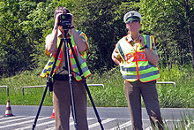

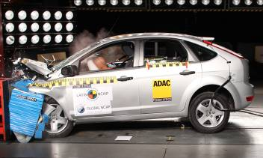
The Challenges & Opportunities of Policy Rebalancing
Behavioural measures (primarily enforcement) have
an immediate impact but are costly and hard to sustain.
Infrastructure measures require ‘up front’ investment
but can achieve permanent reductions in road injury.
Vehicle measures can secure permanent improvements
but take at least fifteen years to fully penetrate the
vehicle fleet.
Increasingly integration opportunities exist across these
three pillars. Overall the ambition should be to gradually
reduce the reliance on behavioural instruments.
Shared ‘road maps’ are needed to encourage a rebalancing
of policy instruments in support of a safe system and
zero fatalities.

Slide 13
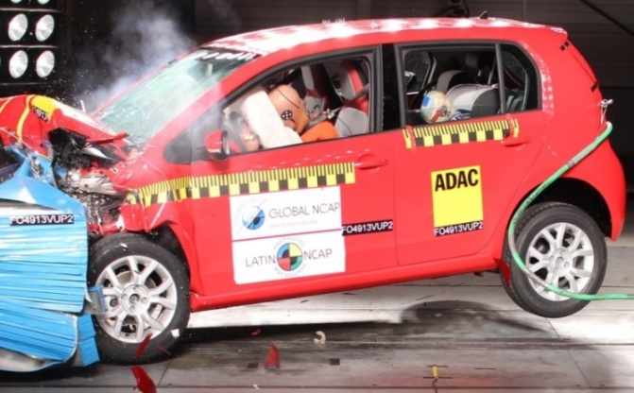
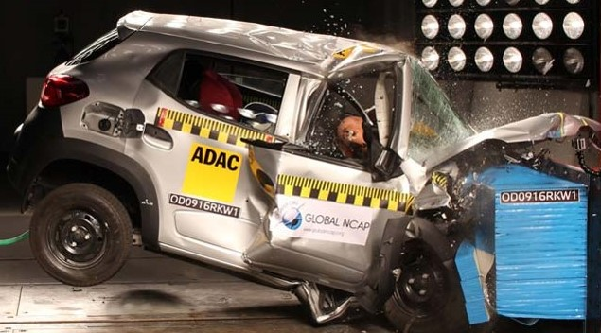
Global NCAP’s 2020 Vision…
In 2016 from a total of 72 million new cars as many as 20% fail to meet UN minimum safety standards, lacking air bags, anti-lock brakes, or electronic stability control.
By 2020 at the latest Global NCAP wants all new cars to meet UN crash test standards with air bags, ABS and ESC fitted as standard.
This needs government action to apply UN vehicle safety standards more widely and greater effort to stimulate customer demand for safer motor vehicles.

Slide 14
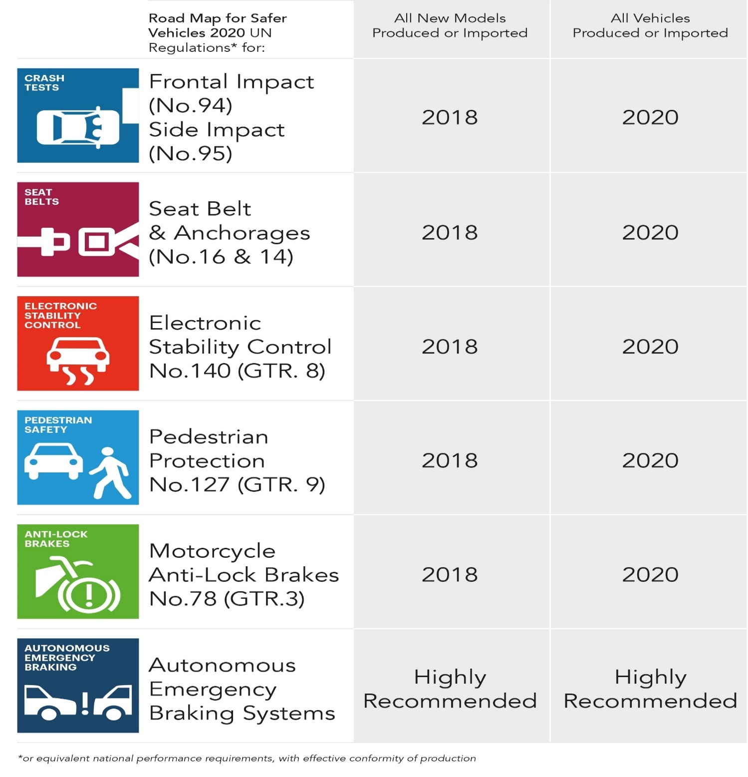


Slide 15
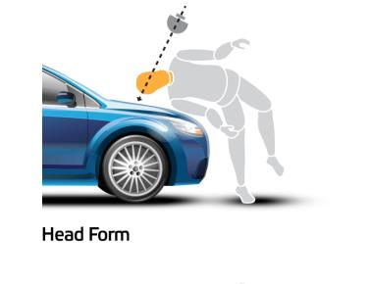
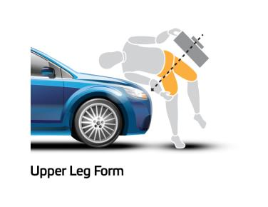
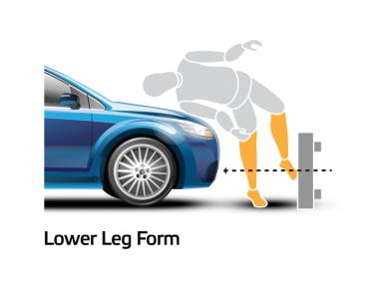
Crashworthiness for Pedestrians
Since the mid 1990s there has been a significant
action to mitigate pedestrian injury during an impact
with a passenger car.
Standards have been adopted in Japan, the European
Union and in the United Nations (World Forum
WP29- GTR No.9) to promote the design of softer and
more forgiving car fronts.
Crash rating for pedestrian protection has also
been strongly promoted notably by the European New
Car Assessment Programme (Euro NCAP).
A series of tests replicate impacts involving child and
adult pedestrians where impacts occur at 40kph
(25mph). Impact sites are then assessed and the
protection offered is rated as fair, marginal or poor.

Slide 16
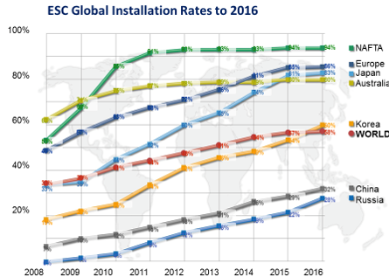

Slide 17
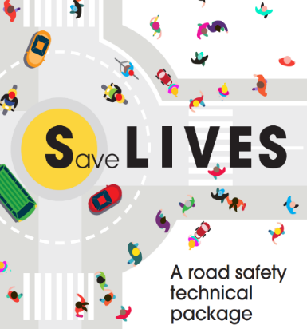


UN Mandate for Safer Cars 2020 – Time for Action
In April 2016 UN General Assembly adopted resolution (A/Res/70/260) which encourages Member States to adopt:
Policies and measures to implement United Nations vehicle safety regulations or equivalent national standards to ensure that all new motor vehicles, meet applicable minimum regulations for occupant and other road users protection, with seat belts, air bags and active safety systems as standard.
The World Health Organization has also just released the Save LIVES policy package that includes recommendations for UN Member States on vehicle safety that are fully aligned with Global NCAP’s Road Map.
Michael Bloomberg, WHO Ambassador for NCD’s, is calling on vehicle manufacturers to apply voluntarily the UN minimum crash test standards. Jean Todt, UN Special Envoy for Road Safety, is also advocating an industry self commitment to safer vehicles.

Slide 18
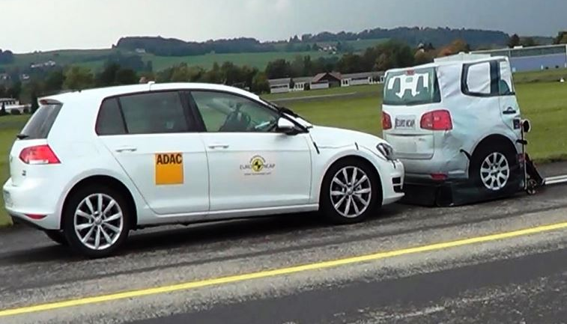
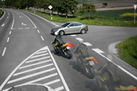

Agenda 2030 – What Are the Vehicle Safety Priorities?
Implement Global NCAPs Road Map recommendations such as 100% global new car penetration of ESC with further incentive & regulatory actions required in emerging markets.
Promote Autonomous Emergency Braking, Intelligent Speed Adaption, and Motorcycle Anti-Lock Brakes through a combination of incentive & regulatory action.
Encourage Fleet managers to choose ‘five star’ safety rated vehicles and act as catalyst for fitment of best available technologies.
Encourage innovation in Autonomous Vehicles through an enabling regulatory environment justified with evidence based research and independent validation to promote user acceptability

Slide 19
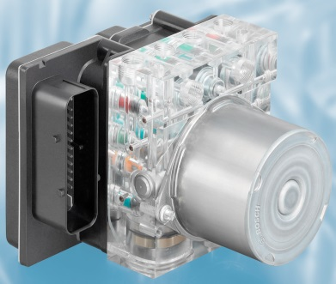
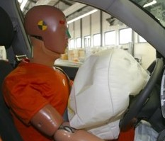
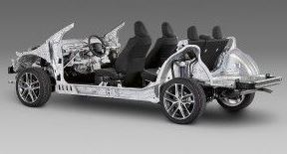
Technology Innovation Cycle – Overcoming Market Failure
Innovative safety systems are initially deployed in high end vehicle classes where profit margins are largest. Availability gradually extends to mid range vehicles but then fitment rates tend to stall because price sensitivity deters OEMs from fitting systems to smaller vehicle classes where margins are tightest.
This is a market failure preventing standardisation which is a clear public interest. To overcome market failure, policy options for 100% fitment include:
  Voluntary OEM agreement for 100% fitment
  Mandatory requirement through rule making
  Fiscal incentives
Positive outcome of intervention is maximisation of safety benefit and reduced unit costs due to economies of scale especially with international harmonisation in an era of global platforms.

Slide 20
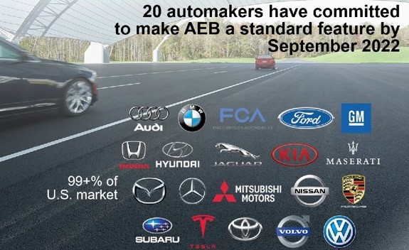

IIHS - Voluntary Commitment
AEB Standardization Forecast

Slide 21


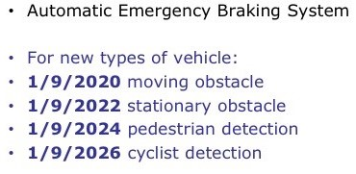
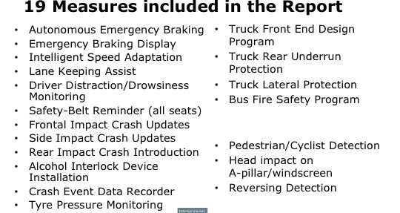
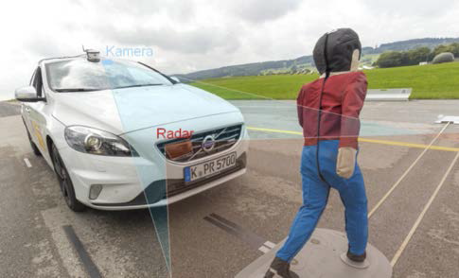

Proposed New EU Regulatory Action on Vehicle Safety
https://ec.europa.eu/info/consultations/public-consultation-revision-vehicle-general-safety-regulation-and-pedestrian-safety-regulation_en

Slide 22
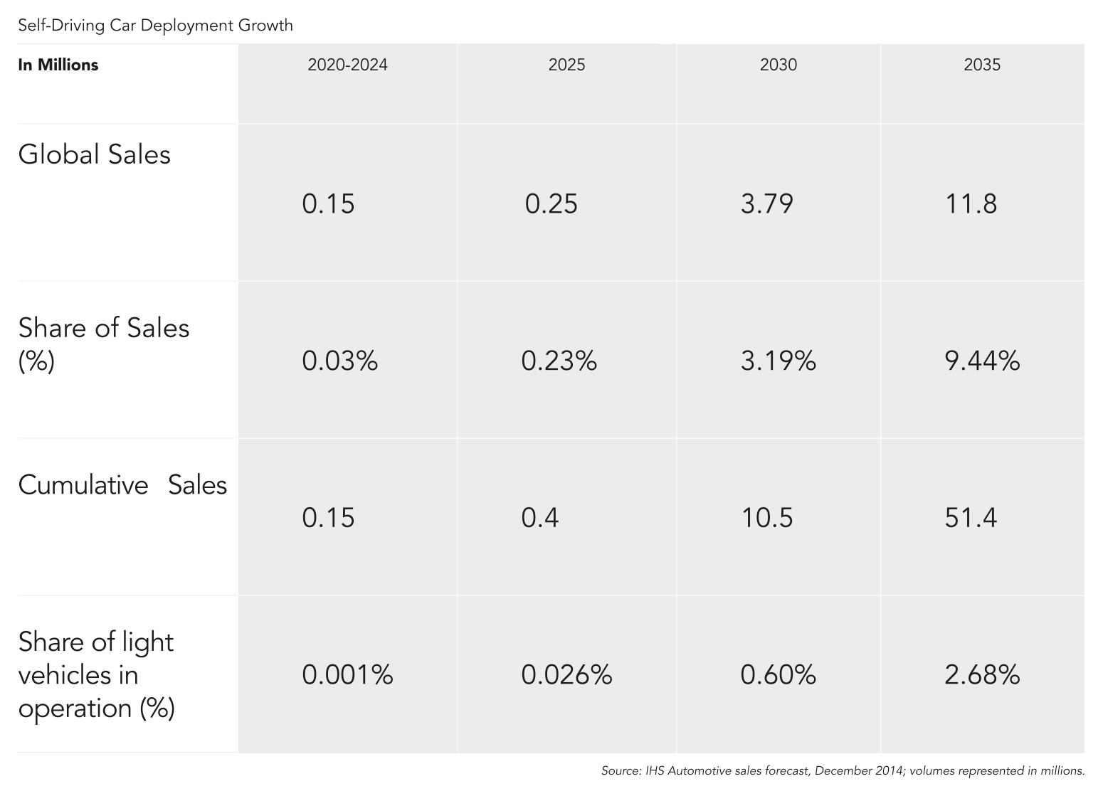
Safety Gains from Autonomous Vehicles…Still Decades Away

Slide 23
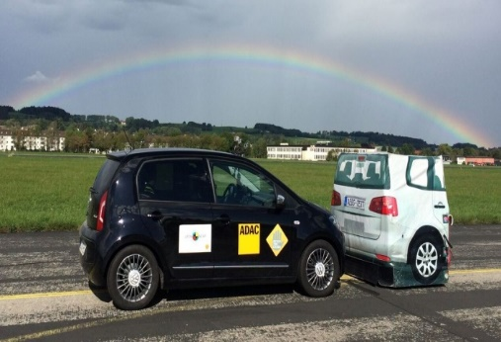
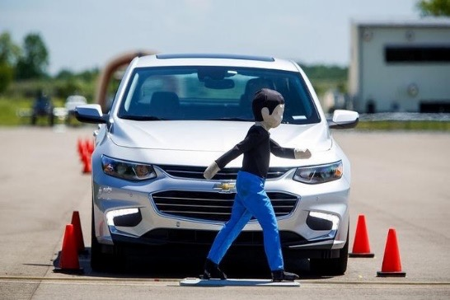
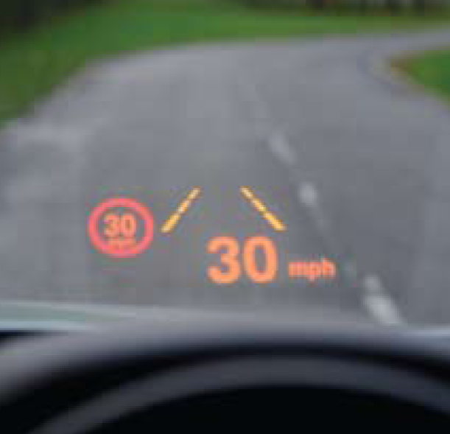

Autonomous Cars and Zero Fatalities…Beyond the Hype
Autonomous Vehicles (AV) will have zero positive impact on road injury prevention by 2030. There are still major issues with software, consumer acceptance, cyber security, regulatory approvals, transition periods, etc.
There is a real risk that ‘hype’ about the safety impact of self driving cars will divert attention from technologies with the best potential to achieve road injury reduction to 2030 and beyond. These are:
Electronic Stability Control (in emerging markets)
Autonomous Emergency Braking Systems
Intelligent Speed Assistance
The policy priority now should be to accelerate fitment of these available driver assistance systems to reverse the rising level of fatalities. These technologies are building blocks towards more autonomous vehicles and will build consumer confidence.

Slide 24

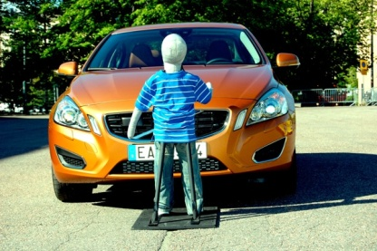
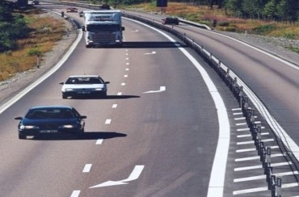
Don’t be Distracted by Silver Bullet Syndrome
Waiting for driverless cars is like hoping for a perfect vaccine to eliminate a road death epidemic that we can already control with known treatments.
So we must stop magical thinking leading to ‘business as usual’ which would by 2030 would cause:
374,000 extra deaths in the USA
237,000 extra deaths in the EU
17,900 extra deaths in the UK
To avoid this preventable tragedy we need accelerated fitment of life saving technologies that are already available, effective, and affordable… used in road environments that are more forgiving, self explaining and self enforcing. All of which would make life easier for driver less cars when they eventually arrive…
That is the Road to Zero Fatalities!

Slide 25



Thank You!
is pleased to acknowledge support from:

