Slide 1
Getting To Zero Debbie Hersman

Slide 2
How We Get to ZERO:
Double Down on What Works
Accelerate Technology
Change Culture

Slide 3
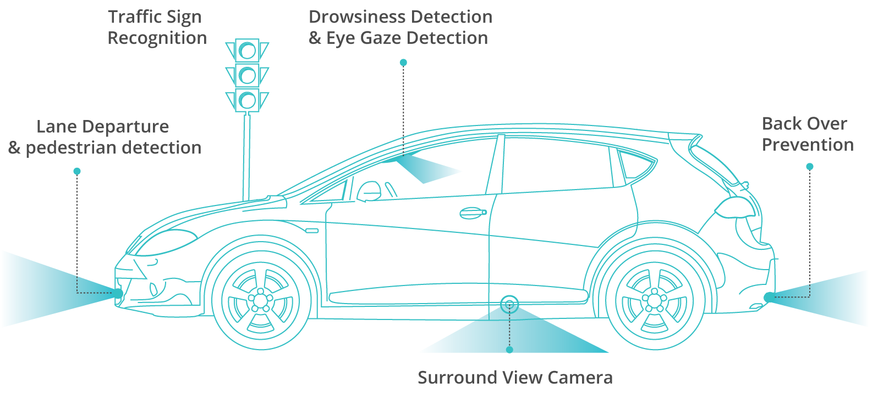
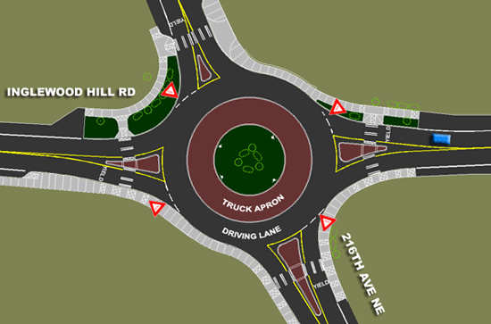
The Future of ZERO

Slide 6
What can YOU do to reach ZERO?
NSC.org/RoadtoZero

