Slide 1
Keeping Our Minds and Eyes on the Road
(and hands on the steering wheel, also)
Robert L. Sumwalt
Presentation to the National Road to Zero Coalition
October 13, 2017

Slide 2
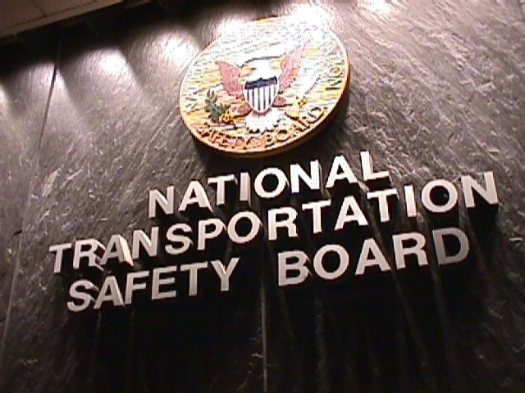
NTSB is an independent federal agency
  investigate transportation accidents and crashes
  determine probable cause
  issue safety recommendations

Slide 3
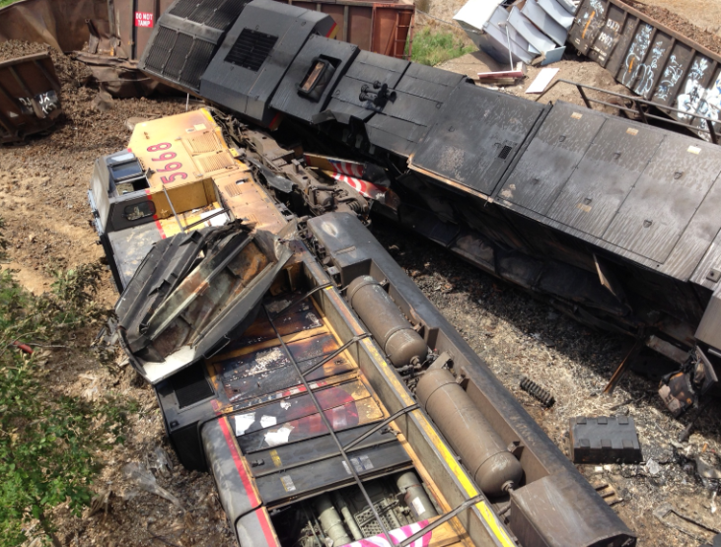
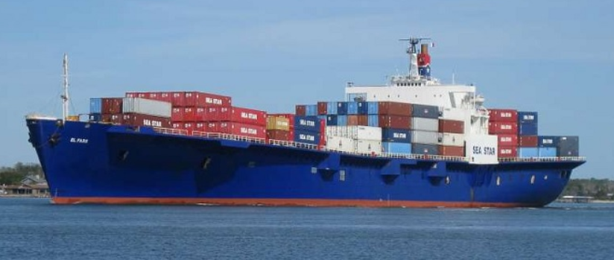
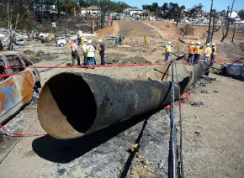
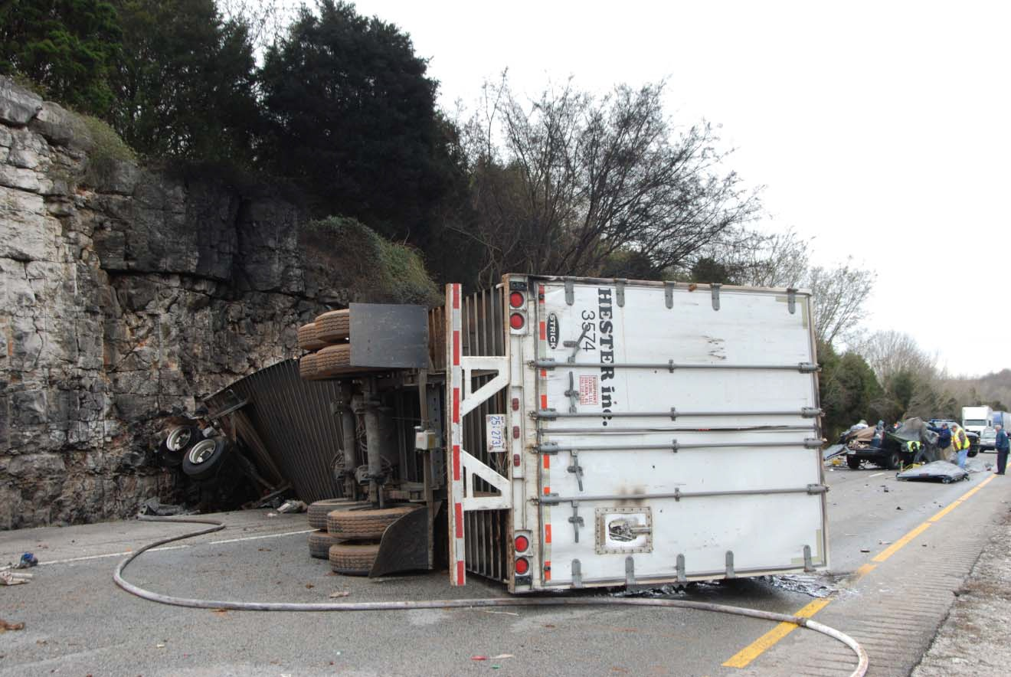
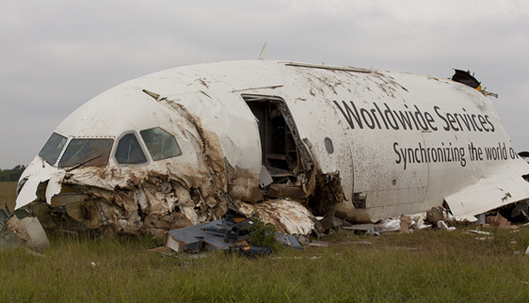

Slide 4
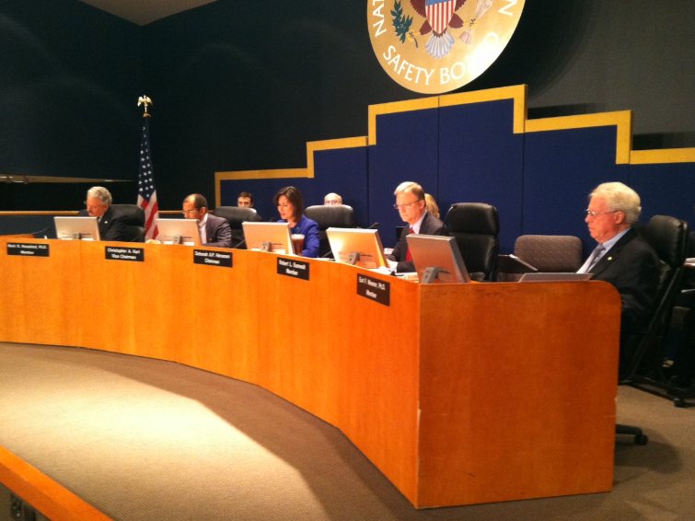
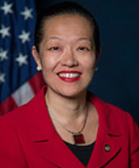
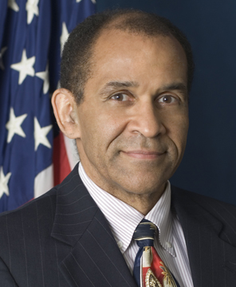
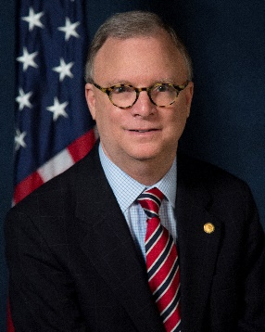

The Board
Bella Dinh-Zarr
Chris Hart
Robert Sumwalt
Earl Weener

Slide 5
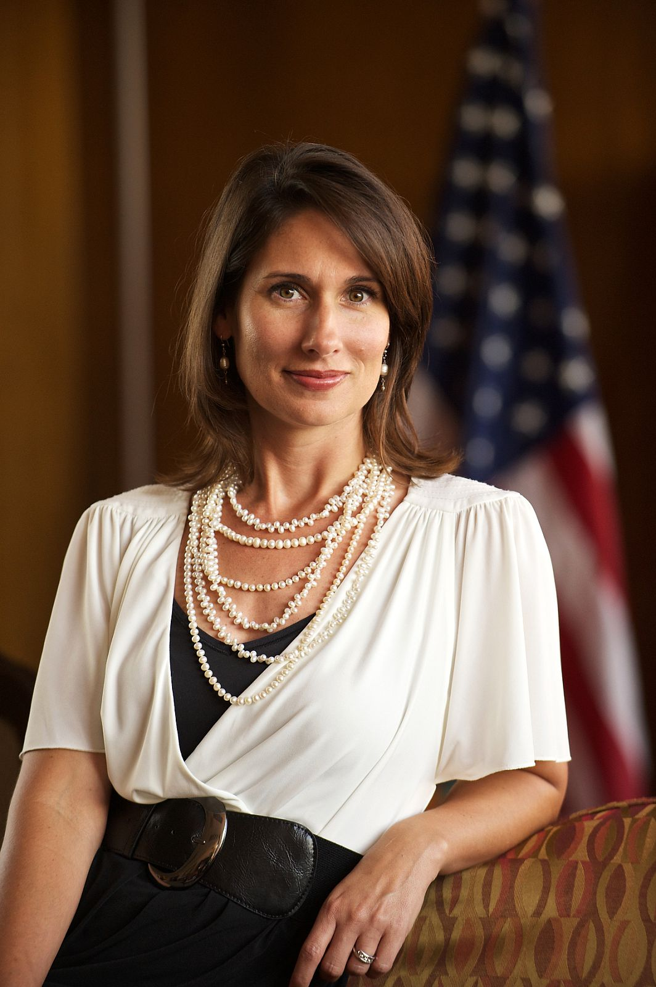

Slide 6
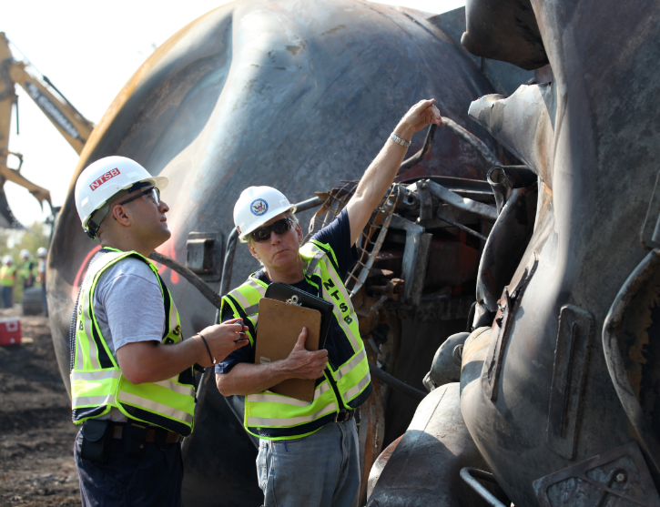
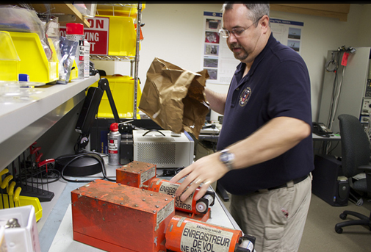
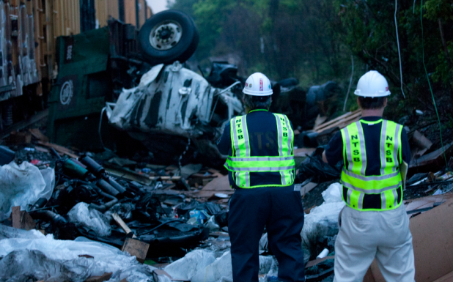
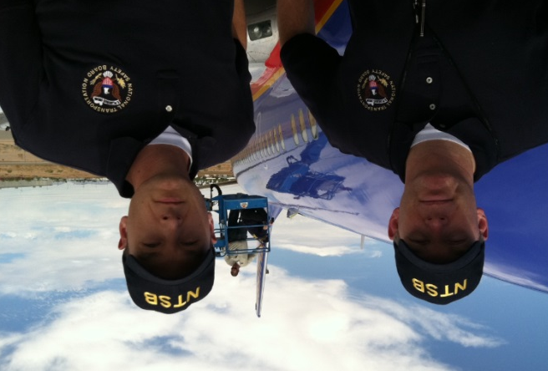
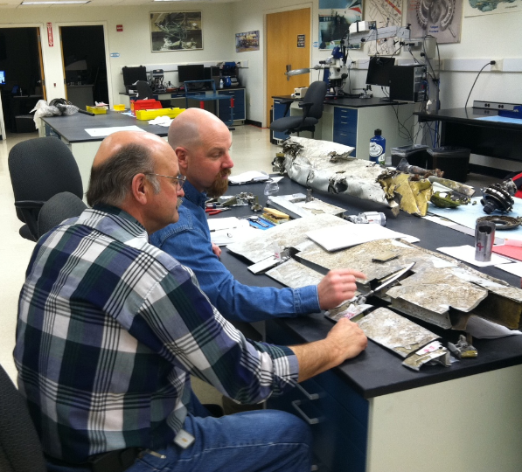
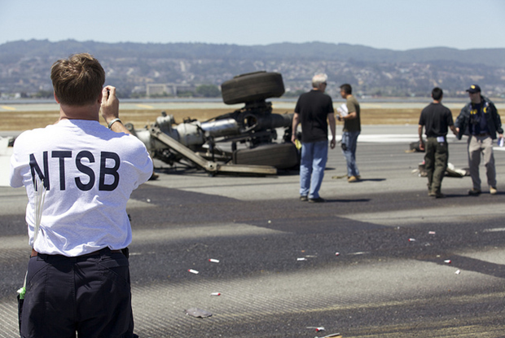

Slide 7
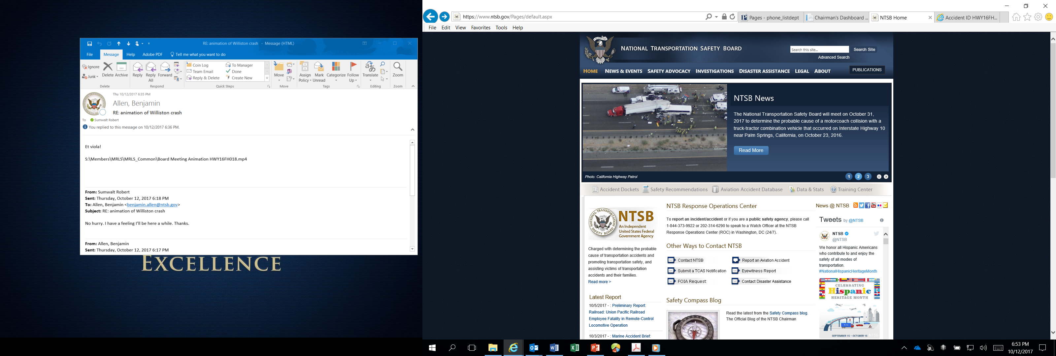

Slide 8
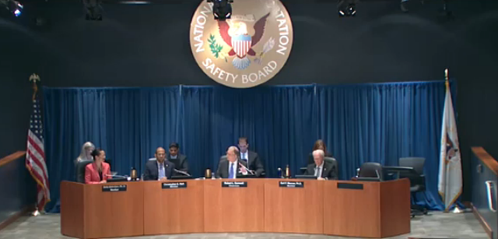
Presentation Outline
Discussion of two recent Board products
  2016 Tesla crash
  Speeding study
NTSB Most Wanted List

Slide 9
Presentation Outline
Discussion of two recent Board products
  2016 Tesla crash
  Speeding study
NTSB Most Wanted List

Slide 10
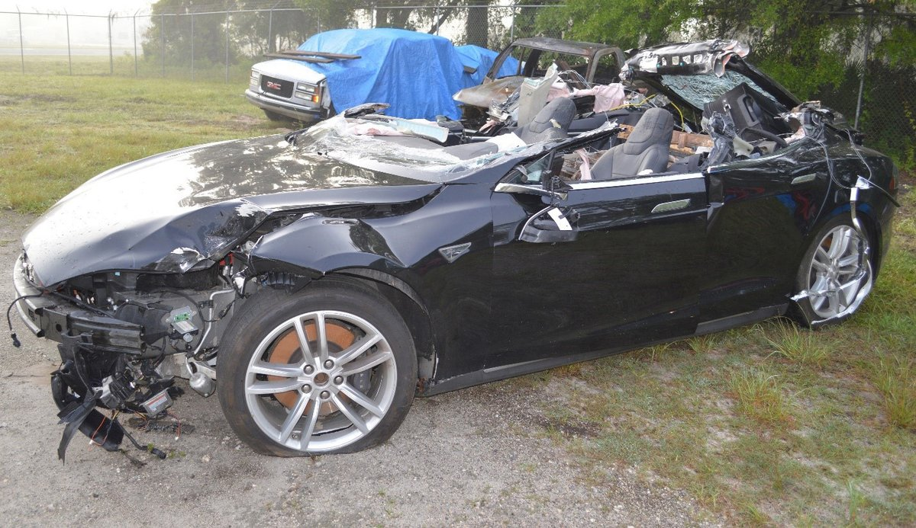
Partially Automated Vehicle Crash
Near Williston, Florida
May 7, 2016

Slide 11
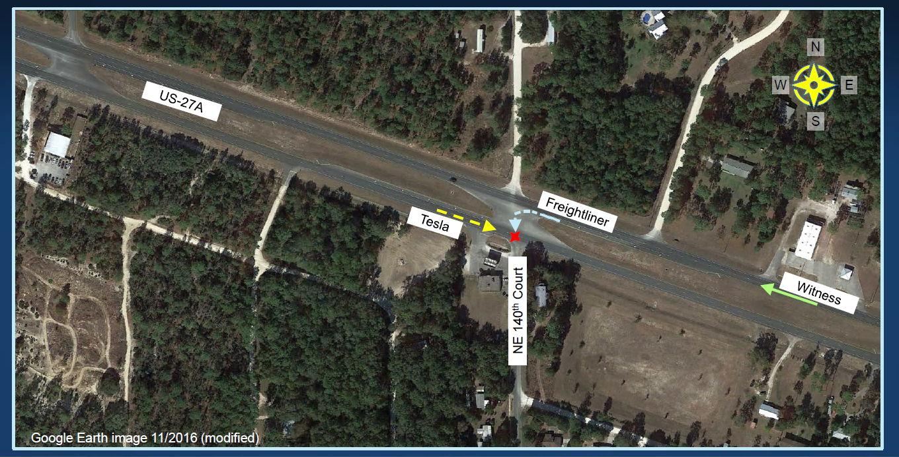

Slide 12
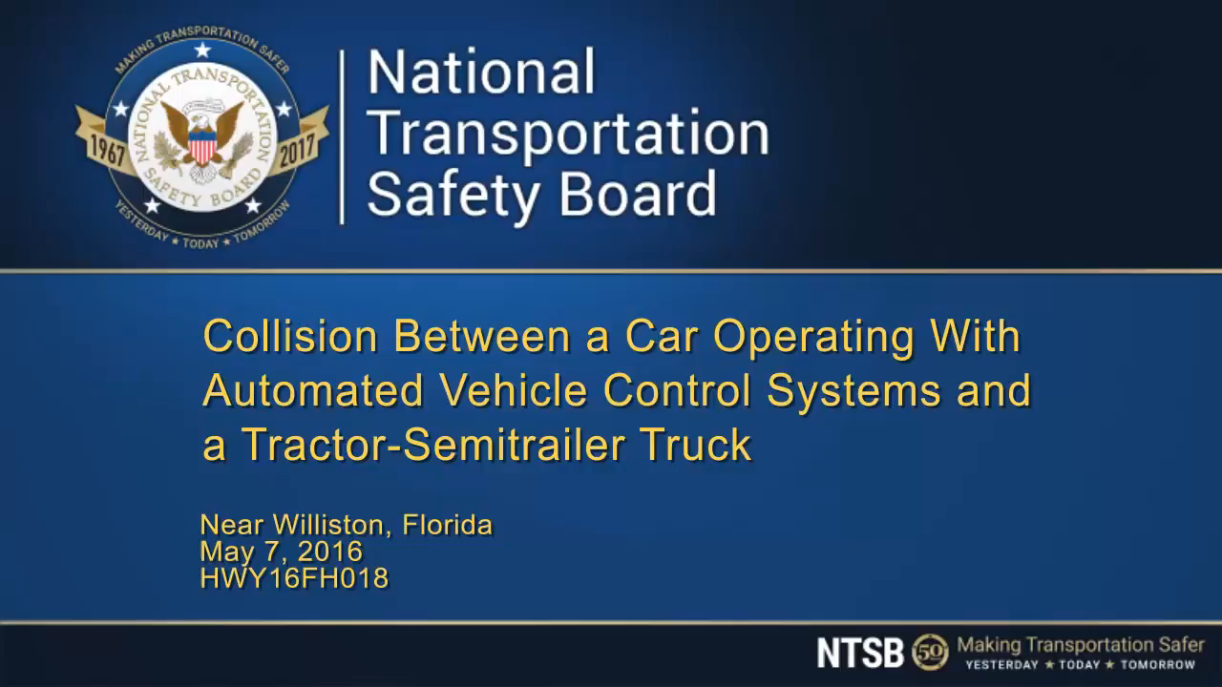

Slide 13
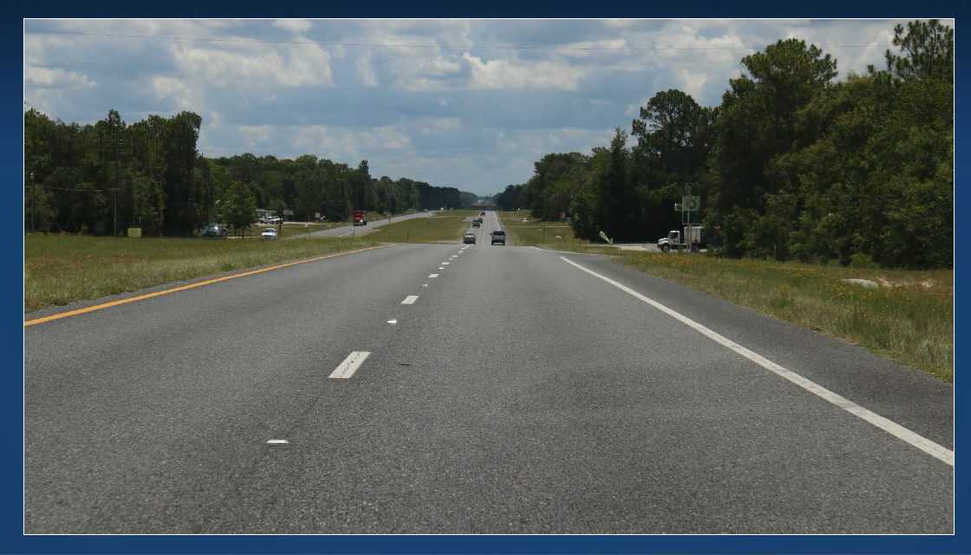
Highway Eastbound (Tesla)

Slide 14
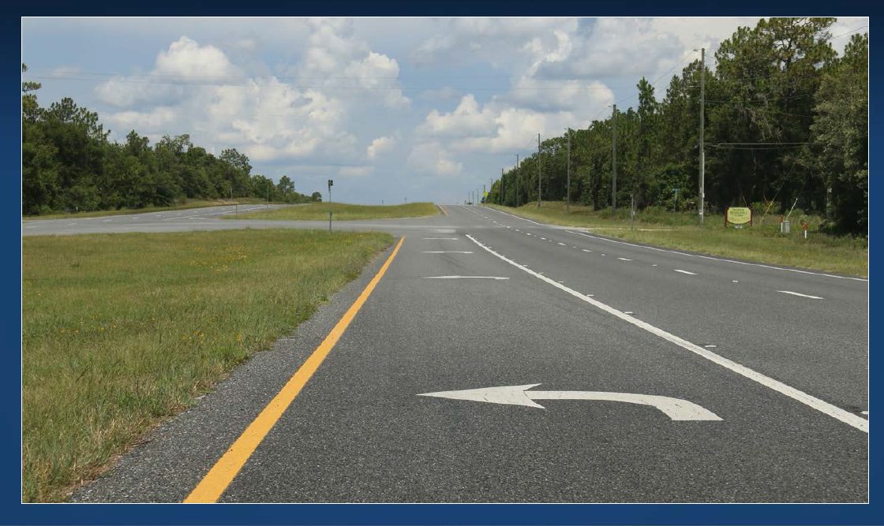
Highway Westbound (Truck)

Slide 15
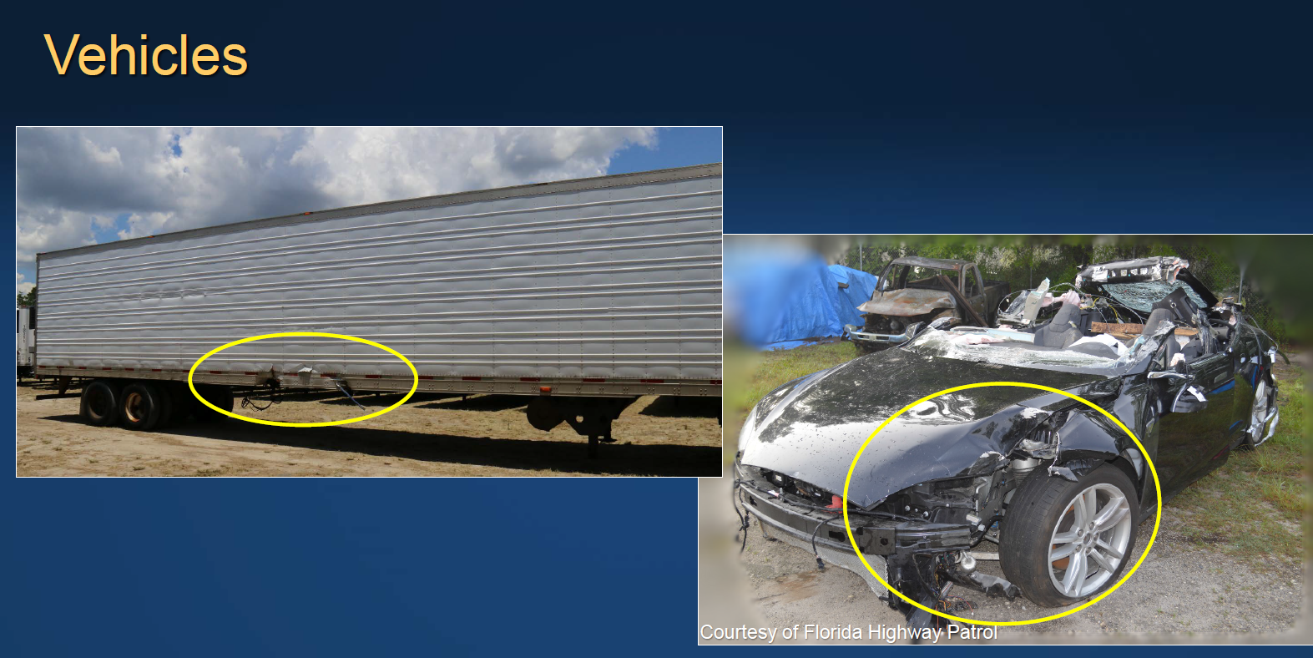

Slide 16
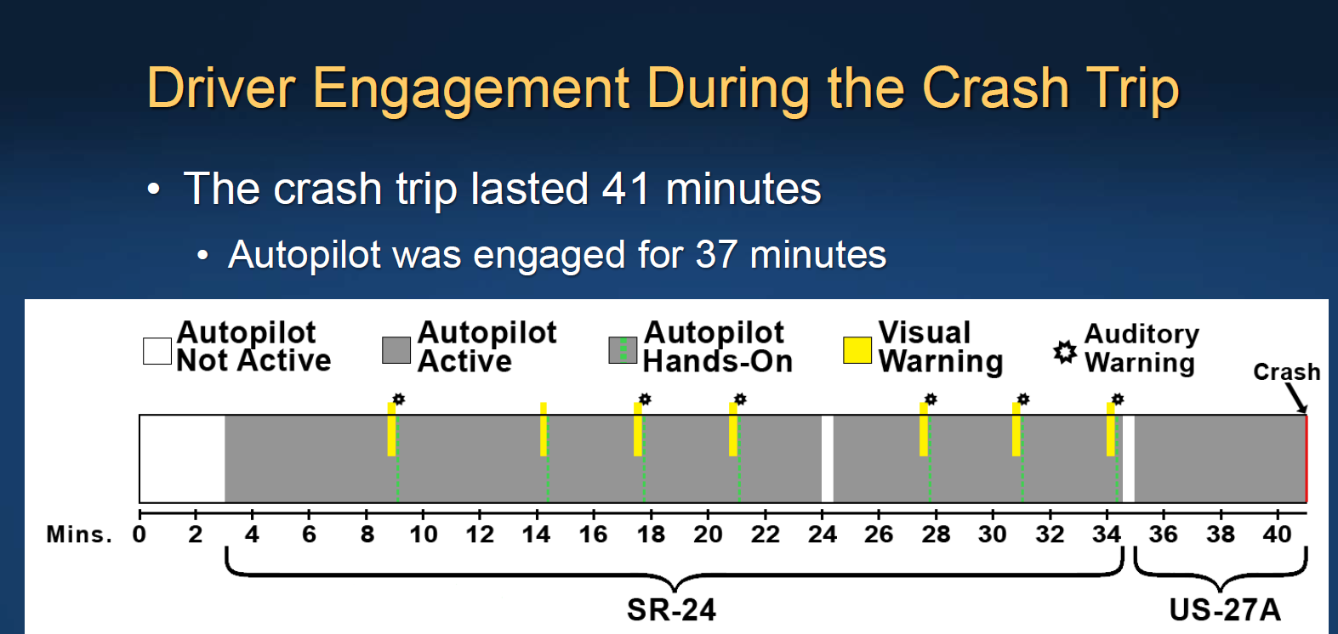
Hands on steering wheel for a total of 25 seconds.
Lack of responsiveness indicates overreliance on automation

Slide 17
SAE/NHTSA Levels of Automation
Source: SAE International J3016
Notes:
[Slide – SAE graphic, levels of automation]
The Tesla was not a self-driving car. As of right now, you can’t buy a self-driving car. The ones that claim to be self-driving are all experimental.
The Tesla had Level 2 automation. It could do things like stay within a well-marked lane by itself, and adjust its own speed based on the car in front of it.
But the human was responsible for making sure it did what it should do in the environment.
At Level 3 the system begins to be responsible for this.
Level 5 is the true self-driving car, with no brake pedal and no steering wheel.
That’s great. But how many drivers know about the different levels of automation?
Fast-forward: what becomes of driver intervention skills once most of the driving is done by the vehicle?
In aviation, de-skilling happened.
In the Asiana crash, the pilot did not try to land the plane himself, in good conditions, with more than 2 miles of runway. (If you’re not a pilot, 2 miles is a lot of runway.)
The NTSB recommended that Asiana provide more manual flying time. And that’s after 99 years of successful automation.
So what happens in the future, when the car is doing more of the driving? Can we expect more “de-skilling” crashes?
When self-driving cars are perfect, we’ll all just be passengers. And you don’t take Driver’s Ed to take the bus.
But between now and then, how will human drivers get practice driving the car?
Remember the good news: The building-blocks of automated vehicles, like forward collision avoidance, already do save lives. More automation of tasks can reduce human error.
But drivers will be expected to passively watch the vehicle’s performance and the environment. We know from other modes that humans aren’t good at that.
Then, when a novel situation confuses the automation, drivers will take on a less and less familiar role. They will be called on to take control of the vehicle for the first time, at the worst possible time.
And these scenarios are on the way to a public that does not yet understand the cars that they will increasingly drive.

Slide 18
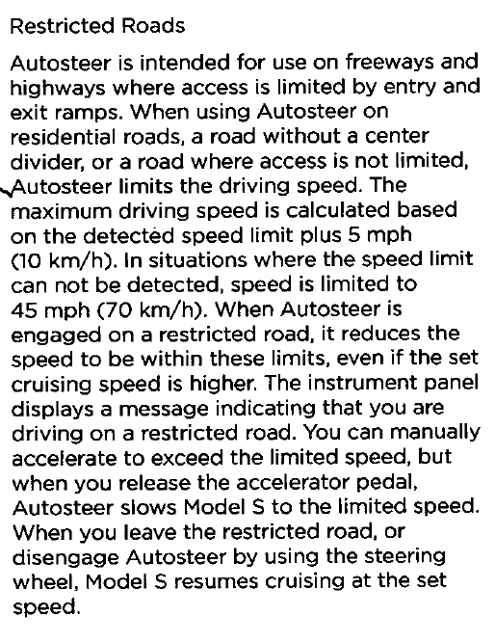
Conflicting information?
The autosteer was not intended for use on this roadway type, but the system allowed it to be used on these roads.

Slide 19
Probable cause
Truck driver’s failure to yield right of way, combined with...
The car driver’s inattention due to overreliance on vehicle automation, which resulted in the car driver’s lack of reaction to the presence to the truck.
Contributing to the car driver’s overreliance on the vehicle automation was its operational design, which permitted his prolonged disengagement from the driving task and his use of the automation in ways inconsistent with guidance and warnings from the manufacturer.

Slide 20
Recommendations
Manufacturers: A better way to measure driver engagement than torque on the steering wheel
Manufacturers: only allow use of vehicle control systems in conditions they’re designed for
NHTSA (reiterated): Develop standards for/require connected vehicle technology
DOT/NHTSA: Develop parameters/collect data for use by investigators

Slide 21
From 2005 – 2014, speeding related crashes accounted for over 112,000 fatalities.
That’s around 31% of all traffic fatalities.

Slide 22
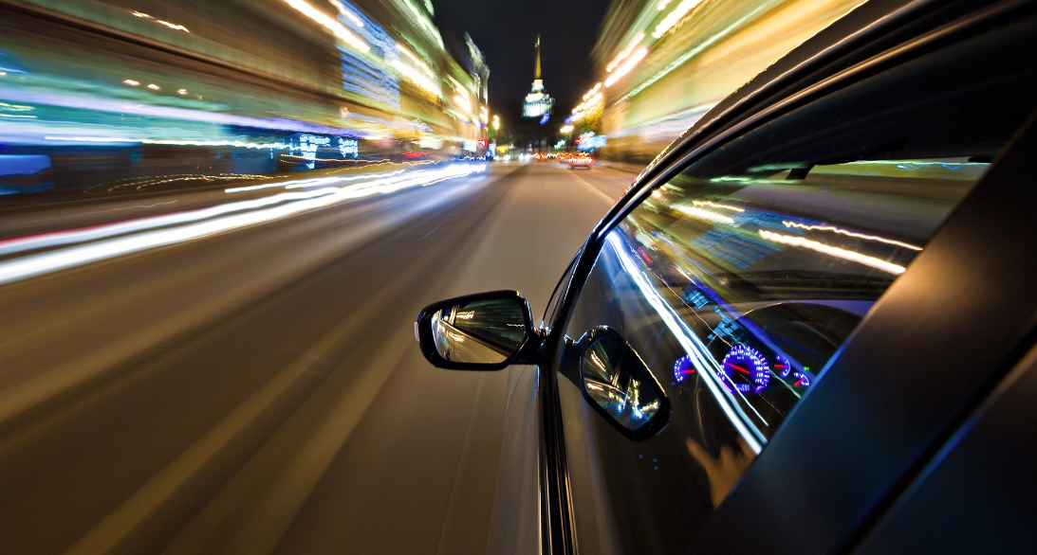
Speeding increases crash risk
Increased likelihood of being involved in a crash
Increased severity of injuries by all road users

Slide 23
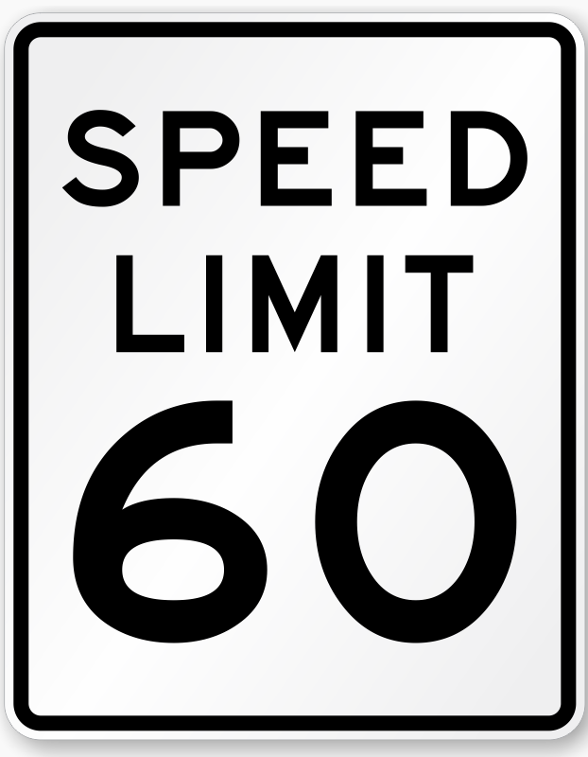
Setting speed limits to match 85th percentile speed can result in unintended consequences.
  Can lead to higher operating speeds
No strong evidence that the 85th percentile speed equates to the speed with the lowest crash involvement rate

Slide 24

Automatic Speed Enforcement (ASE)
ASE is an effective countermeasure to reducing speeding related crashes, fatalities, and injuries.
  Used only in 14 states and D.C.
  Many states prohibit it

Slide 25
19 safety recommendations
DOT (1)
NHTSA (8)
FHWA (4)
GHSA (1)
IACP (1)
National Sheriff’s Association (1)
Various states (3)

Slide 26
Presentation Outline
Discussion of two recent Board products
  2016 Tesla crash
  Speeding study
NTSB Most Wanted List

Slide 27
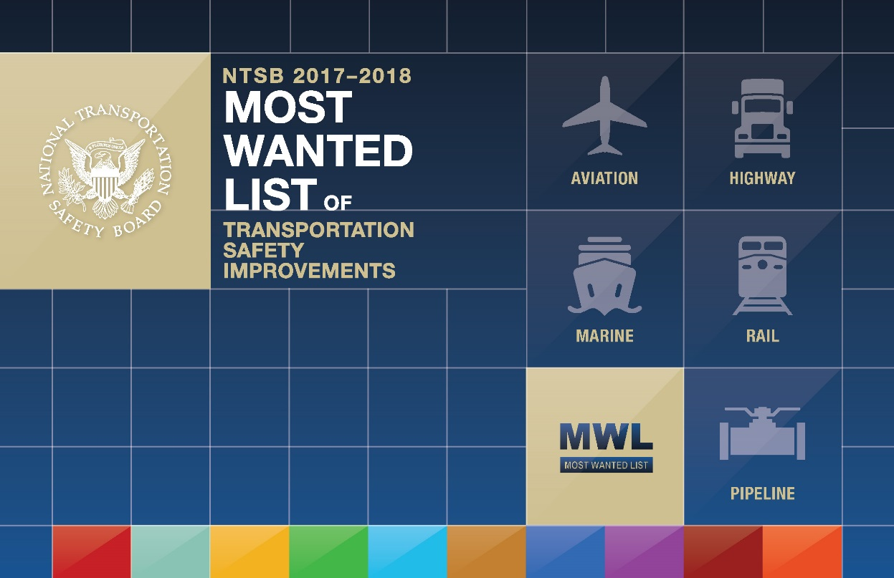
Eliminate Distractions
Require Medical Fitness
Expand Recorders Use to Enhance Safety
Reduce Fatigue-Related Accidents
End Alcohol and Other Drug Impairment
Improve Rail Transit Safety Oversight
Ensure the Safe Shipment of Hazardous Materials
Increase Implementation of Collision Avoidance Technologies
Strengthen Occupant Protection
Prevent Loss of Control In Flight In General Aviation
Notes:
For more than 25 years, the NTSB has issued its Most Wanted List of critical transportation safety improvements.
In 1990, we created the Most Wanted List to draw attention to the 10 most critical safety improvements needed to reduce transportation accidents and save lives. Every year, we evaluate what we have learned in crash investigations and issue a new Most Wanted list.
Every year, industry, government, safety advocates, and members of the public do their part to make transportation a little bit safer.
But little by little, we continue to take new steps on the transportation safety journey. Transportation is safer today than it was in the past.
The 2016 Most Wanted List is our roadmap to making transportation even safer this coming year.
The List includes many issues that appeared in previous years, because these issues still need more work.

Slide 28
Eliminate Distractions
Require Medical Fitness
Expand Recorders Use to Enhance Safety
Reduce Fatigue-Related Accidents
End Alcohol and Other Drug Impairment
Improve Rail Transit Safety Oversight
Ensure the Safe Shipment of Hazardous Materials
Increase Implementation of Collision Avoidance Technologies
Strengthen Occupant Protection
Prevent Loss of Control In Flight In General Aviation
Notes:
For more than 25 years, the NTSB has issued its Most Wanted List of critical transportation safety improvements.
In 1990, we created the Most Wanted List to draw attention to the 10 most critical safety improvements needed to reduce transportation accidents and save lives. Every year, we evaluate what we have learned in crash investigations and issue a new Most Wanted list.
Every year, industry, government, safety advocates, and members of the public do their part to make transportation a little bit safer.
But little by little, we continue to take new steps on the transportation safety journey. Transportation is safer today than it was in the past.
The 2016 Most Wanted List is our roadmap to making transportation even safer this coming year.
The List includes many issues that appeared in previous years, because these issues still need more work.

Slide 29
Eliminate Distractions
Require Medical Fitness
Expand Recorders Use to Enhance Safety
Reduce Fatigue-Related Accidents
End Alcohol and Other Drug Impairment
Improve Rail Transit Safety Oversight
Ensure the Safe Shipment of Hazardous Materials
Increase Implementation of Collision Avoidance Technologies
Strengthen Occupant Protection
Prevent Loss of Control In Flight In General Aviation
Notes:
For more than 25 years, the NTSB has issued its Most Wanted List of critical transportation safety improvements.
In 1990, we created the Most Wanted List to draw attention to the 10 most critical safety improvements needed to reduce transportation accidents and save lives. Every year, we evaluate what we have learned in crash investigations and issue a new Most Wanted list.
Every year, industry, government, safety advocates, and members of the public do their part to make transportation a little bit safer.
But little by little, we continue to take new steps on the transportation safety journey. Transportation is safer today than it was in the past.
The 2016 Most Wanted List is our roadmap to making transportation even safer this coming year.
The List includes many issues that appeared in previous years, because these issues still need more work.

Slide 30
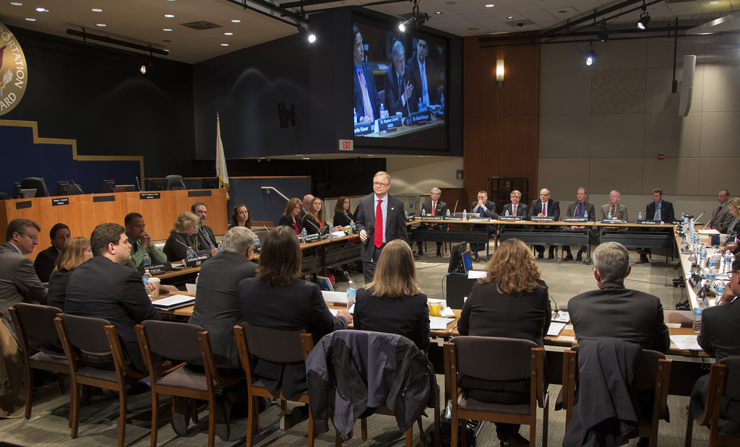
Roundtable Discussions (2015 & 2017)

Slide 31
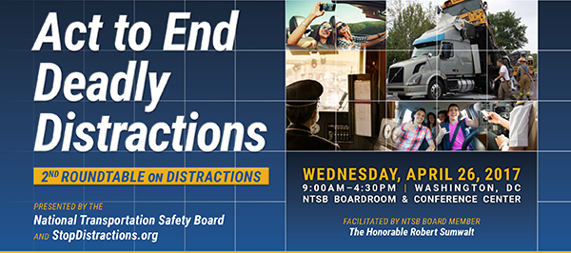

Slide 32


Slide 33
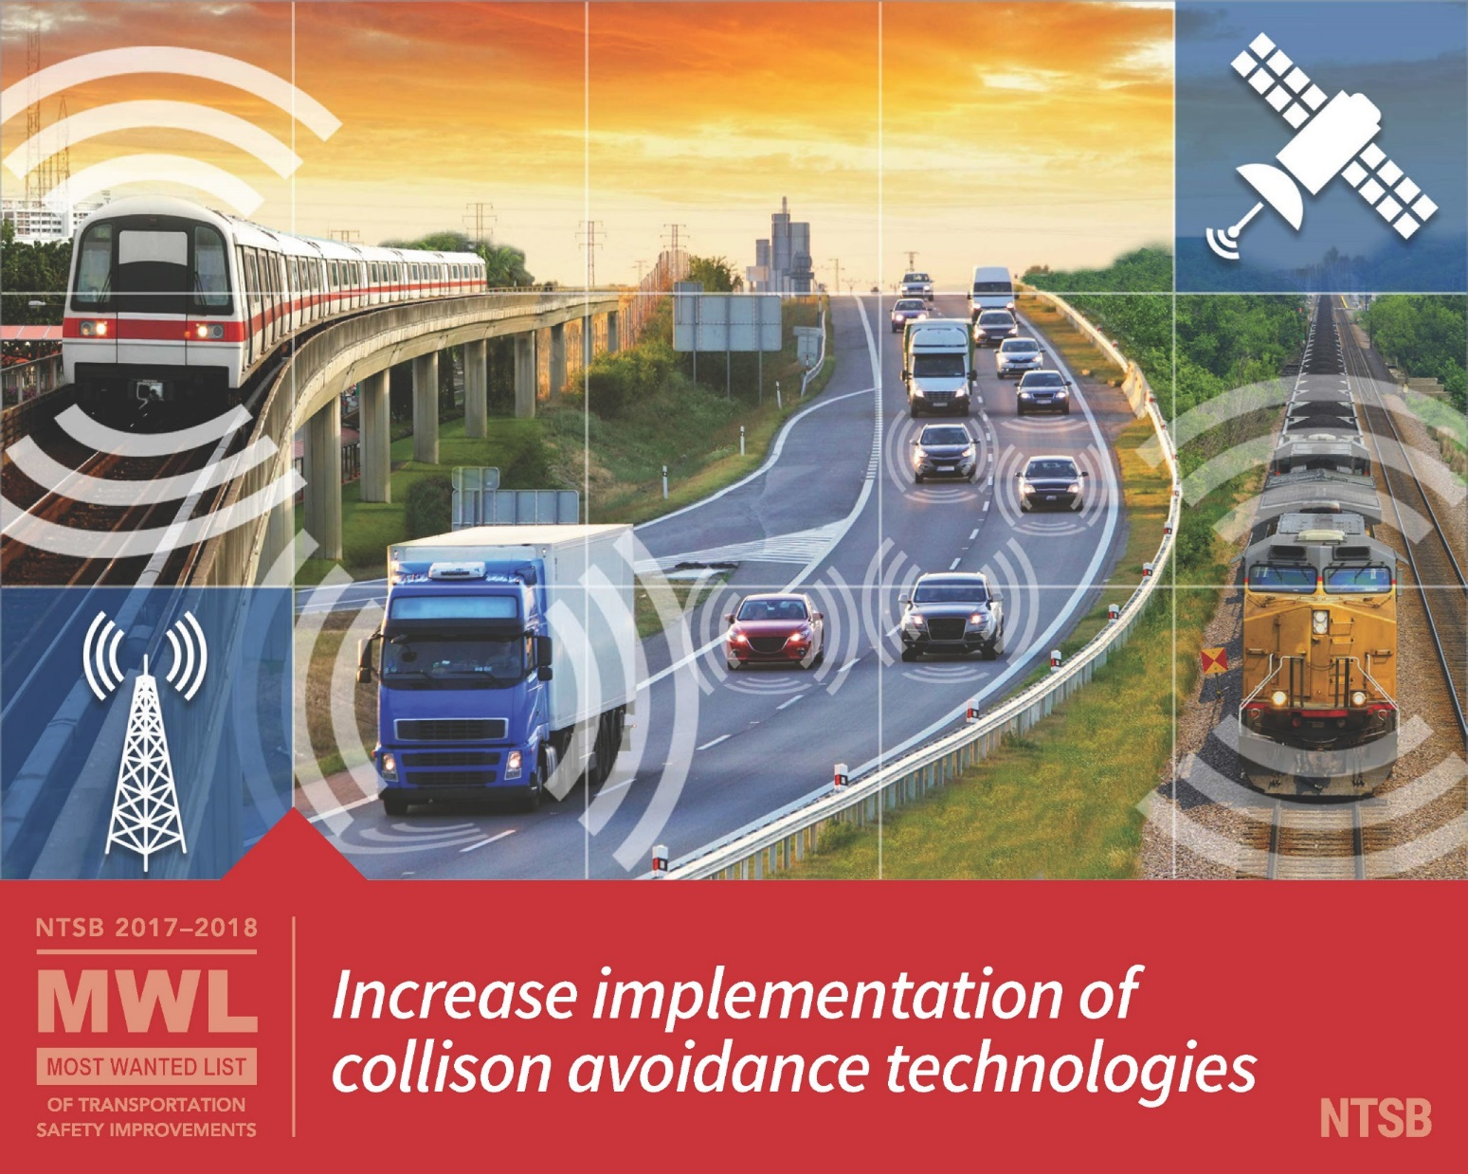

Slide 34
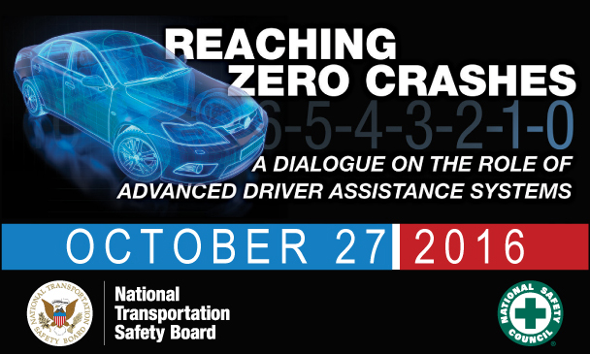
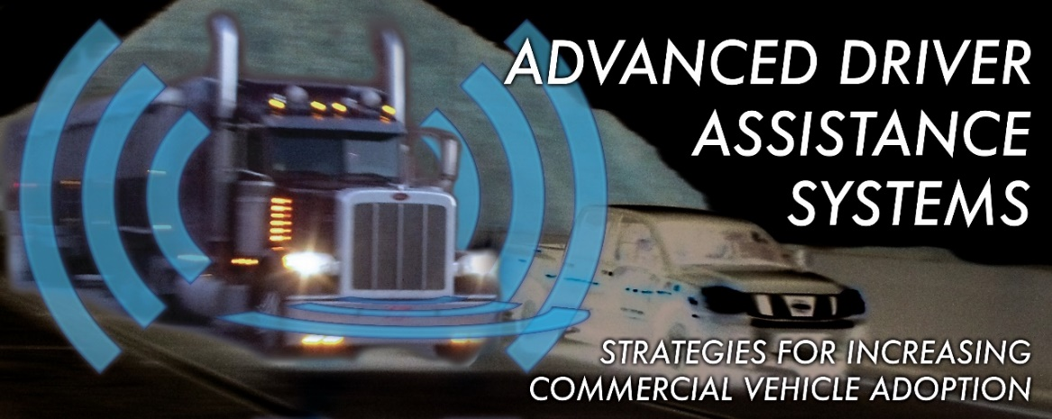
2016
2015
2017

Slide 35
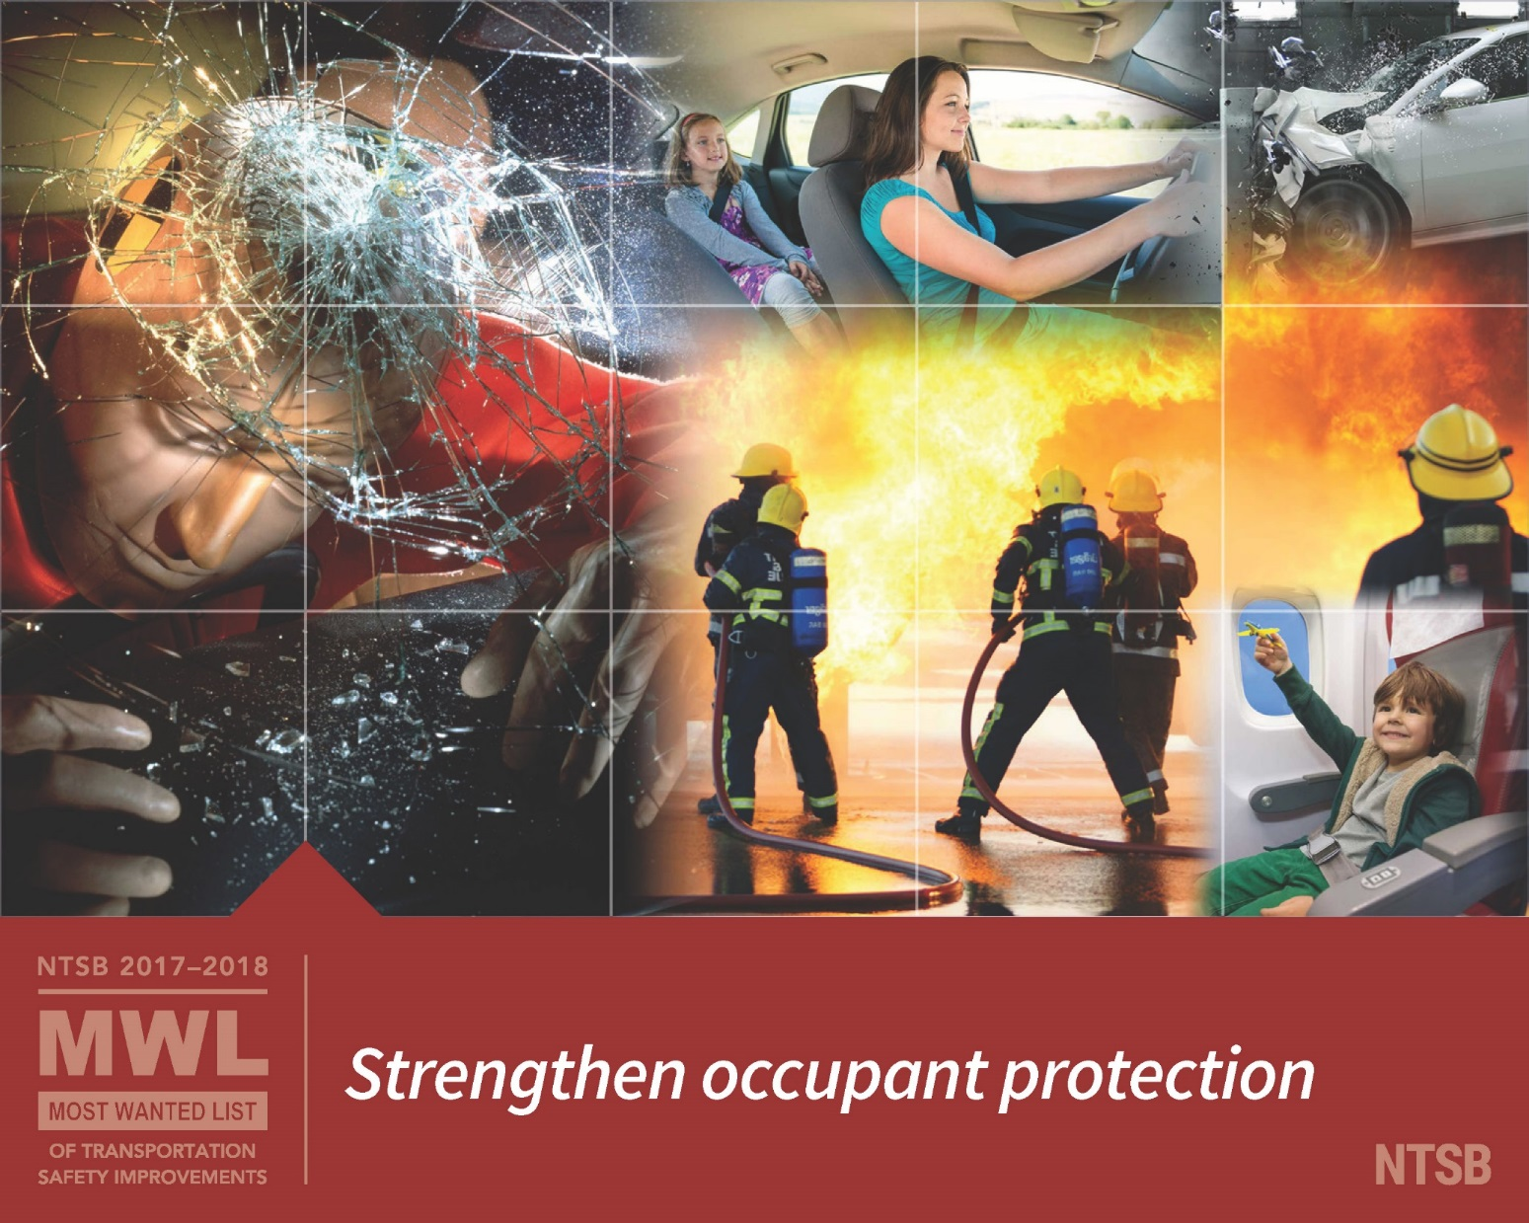

Slide 36
Restraint Use on Limos/Buses/Motorcoaches
Cranbury, NJ
Orland, CA

Slide 37
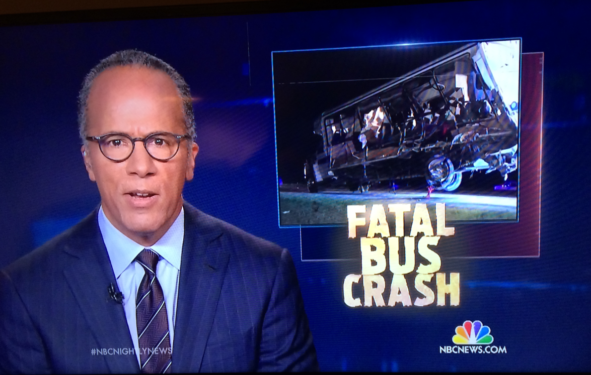
Restraint Use on Limos/Buses/Motorcoaches
Davis, OK
Good News: Lap-Shoulder Belts in All New Buses > 26,000 lbs.

Slide 38
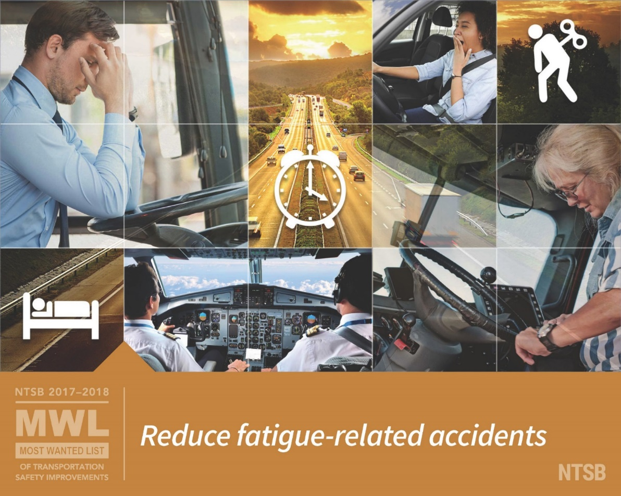

Slide 40
