Slide 1
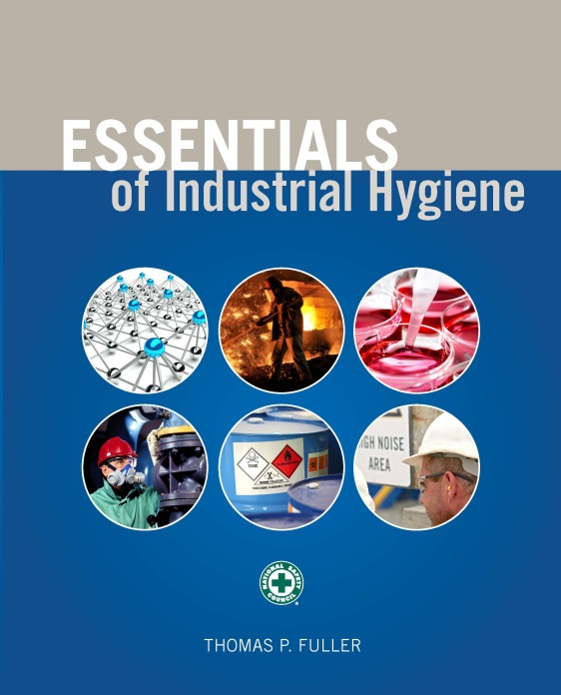
CHAPTER 3
Management Systems

Slide 2
Learning Objectives
Describe the basic business activities and tools necessary to implement successful industrial hygiene programs.
Discuss the relationship between quality assurance and industrial hygiene management.
Understand the importance of industry standards and their relevance to industrial hygiene.
Use various business models such as Total Quality Management, Value Strategy Manual, and Six Sigma to improve industrial hygiene program management.

Slide 3
Management’s Role in Industrial Hygiene
Supports efficient and effective operations
Ensures ethical organizations including protection of financial assets and investments, the environment, and workers
Clarifies lines of communication and responsibility
Ensures smooth coordination of integrated company departments
Promotes a culture of safety in the organization

Slide 4
Regulations
Rules, standards, and laws that require certain activities or facilities
Management practices designed to meet and exceed the requirements to find maximum efficiencies and minimize losses
Best practices lead to highest levels of quality and efficiency

Slide 5
Policies
Straightforward and concise management ideals that reflect the company’s or organization’s goals and objectives
Simple philosophies that guide the direction and future of the organization
State how worker health and safety and environmental protection coordinate with and support the overall institutional objectives and goals

Slide 6
Programs
Address the objectives of the company in specific areas such as functional areas of industrial hygiene, geographical areas of the company, or even departments within the company
Describe the scope of safety in the organization as well as where and when the safety policy is to be applied or adhered to

Slide 7
Sample IH Programs
Respiratory Protection
Hearing Conservation
Bloodborne Pathogens
Chemical Hygiene
Radiation Protection
Laser Safety
Emergency Management
Asbestos Management

Slide 8
Procedures
Provide details for day-to-day operations that support program requirements and describe in a step-by-step, easily understood manner how the job is to be done

Slide 9
Sample Respiratory
Protection Procedures
Job hazard analysis
Selection and assignment of respirators
Medical clearance forms
Respiratory fit testing
Training
Respirator decontamination, storage and maintenance
Record keeping and documentation
Program evaluation

Slide 10
Quality Assurance
A standard business practice in which an independent oversight body reviews company policies, programs, and procedures to evaluate whether they meet regulatory requirements and company objectives in its day-to-day operations

Slide 11
Quality Assurance (cont.)
Program reviews
Audits
Surveillance
Vendor audits
  special quality assurance activities extended beyond the walls of the organization to materials suppliers and vendors to ensure that materials used in the final product also meet design specifications

Slide 12
New Directions in Management
American National Standards Institute
  Safety colors
  Laser safety
  Safety signs
  Occupational Health and Safety Management Systems

Slide 13
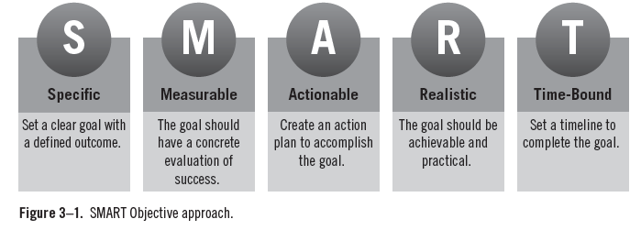
ANSI Z10 – Management Systems

Slide 14
Total Quality Management
Seven elements of TQM:
  policy, planning, and administration
  product design and design change control
  control of purchased material
  production quality control
  user contact and field performance
  corrective action
  employee selection, training, and motivation

Slide 15
Total Quality Management (cont.)
Essential business principles:
  customer-oriented
  employees are involved
  communications
  process-centered
  integrated systems
  quality control
  systematic approaches
  continuous improvement

Slide 16
Cause and Effect

Slide 17
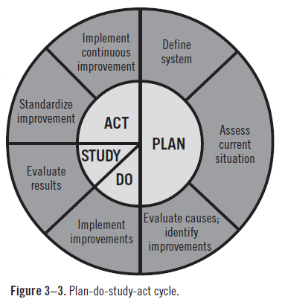
Plan-Do-Study-Act Cycle

Slide 18
Six Sigma
Quality improvement program
  uses various management techniques and statistical analyses to evaluate and guide organizational performance
  from the statistical corollary that at six standard deviations from product specifications, there is a 99.9999 percent chance that the product will not have any defects

Slide 19
Six Sigma (cont.)
Progressive management phases
  Define process goals or requirements.
  Measure key aspects of the existing process and collect data.
  Analyze the data to examine and verify cause-and-effect relationships.
  Determine the root cause of the defect under investigation.
  Use the results of data analysis to make changes to improve existing processes.
  Pilot proposed changes and collect new data to ensure feasibility of new processes.
  Continuously reevaluate and monitor the process, and make changes accordingly.

Slide 20
AIHA – Value Strategy Manual
Step-by-step instructions for analyzing risk, identifying alternatives, and quantifying the financial and nonfinancial benefits of making changes or improvements

Slide 21
International Standards Organization
ISO 9001 – Quality Management
ISO 14001 – Environmental Management
ISO 31000 – Risk Management

Slide 22
Voluntary Protection Program Criteria
Star
  These companies have exemplary systems for the prevention and control of health and safety hazards. They implement continuous improvement as routine parts of their management programs.
Merit
  Organizations at the Merit level have good health and safety management systems but need to complete additional actions to a achieve Star status.
Demonstration
  These companies operate effective health and safety programs, but their management systems differ from currently approved VPP approaches.

Slide 23
The Role of Industrial Hygienists in Alternative Solutions
When searching for an alternative to a hazardous process, chemical, or environment, follow these basic steps:
  Become familiar with processes and hazardous chemicals or agents.
  Inventory and prioritize the hazards.
  Identify alternative processes or chemicals.
  Assess the possible alternatives and impacts of costs, performance, safety.
  Select the best alternative to pilot in the field, complete evaluation documentation.
  If the pilot is successful, implement the alternative.

