Slide 1
CHAPTER 15
Biological Hazards

Slide 2
Learning Objectives
Identify the industries where workers are at risk of exposure to hazardous biological agents and infectious diseases.
Describe the common pathways and routes of exposure of hazardous biological agents.
Identify different characteristics of diseases that affect their abilities to harm workers.
Understand the human defense systems against infectious diseases.
Describe the workplace controls that can minimize and eliminate the spread of infectious agents.
Identify types and levels of cleaning, disinfection, and sterilization.
Describe the different levels of biological laboratory safety and equipment and handling practices.

Slide 3
Infectious Diseases
Viruses
Bacteria
Fungi/Mold
Zoonotic
Parasitic

Slide 4
Pathways of Exposure
Air
Water
Food
People
Animals
Insects
Surfaces/inanimate objects

Slide 5
Routes of Exposure
Inhalation
Dermal
Ingestion
Percutaneous

Slide 6
Factors of Infection
Environmental viability
Infectiveness
Virulence

Slide 7
Epidemiology Of Biological Agents
Epidemic
The widespread occurrence of a disease in a particular geographical area that affects an unusually large number of population members and is beyond what is normally expected or encountered (as in endemic diseases).

Slide 8
Epidemiology of Biological Agents (cont.)
Pandemic
Epidemics that spread to geographical areas where the disease is not typically expected to occur affecting a much larger population.

Slide 9
Workplace Exposures
Agriculture
Healthcare
Law enforcement/prisons

Slide 10
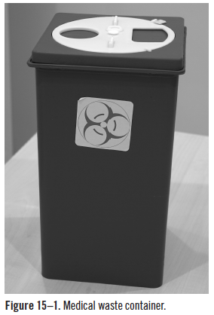
Bloodborne Pathogen Standard
29 CFR 1910.1030
Exposure control plan
Record keeping, vaccination, training, procedures
Environmental controls
Medical waste
Safe needle devices
Cleaning, disinfection, sterilization

Slide 11
Biological Laboratories and Infectious Disease Research
OSHA
American Biological Safety Association
Centers for Disease Prevention and Control
Bureau of Labor and Statistics

Slide 12
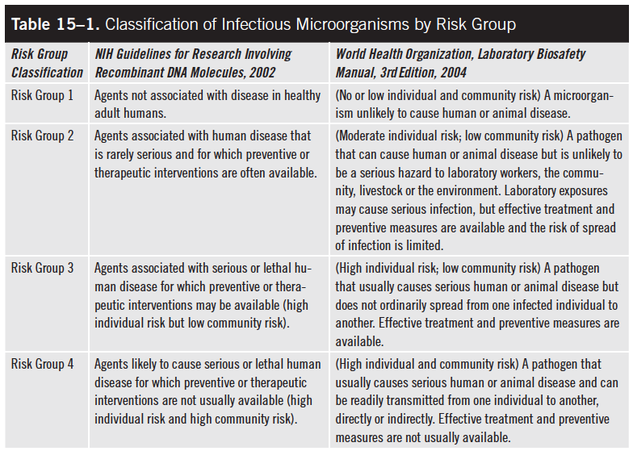
Basic Risk Group Classifications

Slide 13
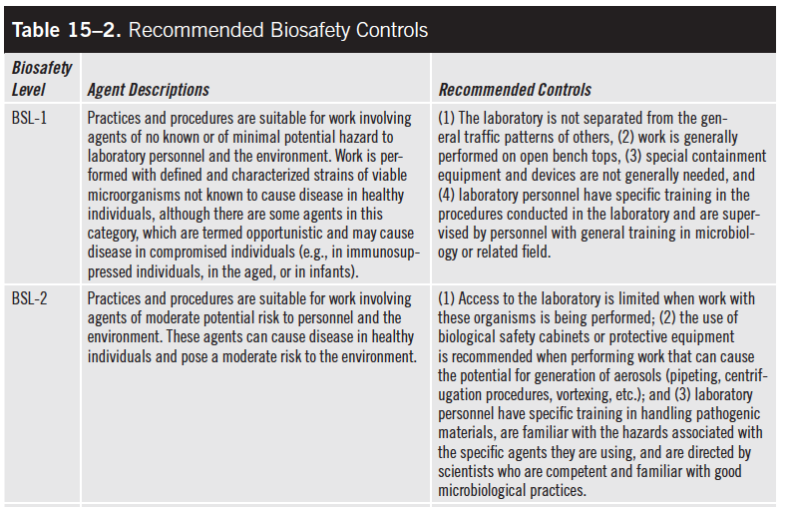
Biosafety Levels and Controls
Continued

Slide 14
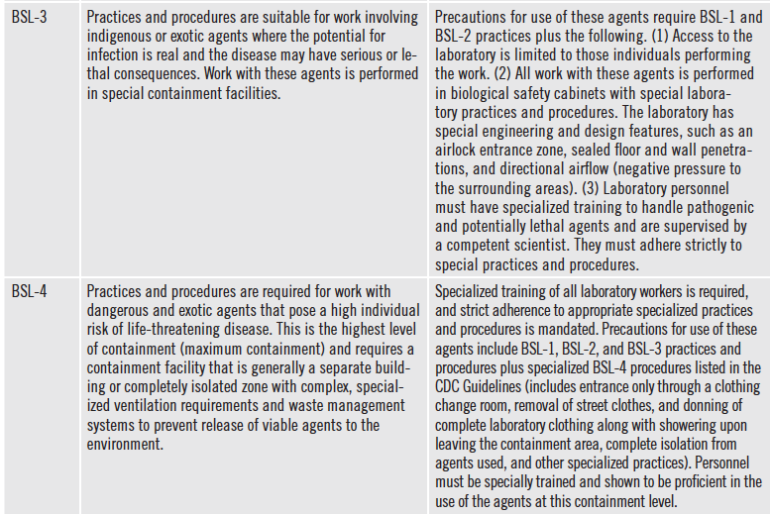
Biosafety Levels and Controls (cont.)
Source: ABSA/OSHA 2009

Slide 15
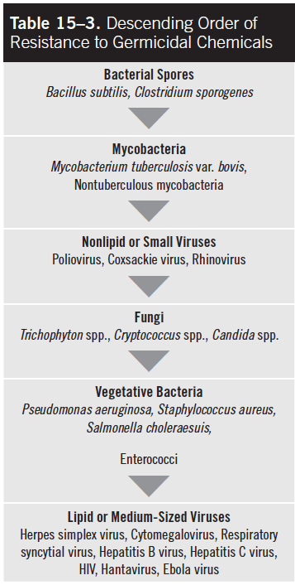
Resistance in Germicidal Chemicals

