Slide 1

Chapter 1
Introduction to
Industrial Hygiene

Slide 2
Learning Objectives
Briefly explain the relevance and importance of the practice of industrial hygiene in society today and throughout history.
Explain the types of sciences and studies that comprise the field of industrial hygiene.
Describe the differences between pathways of exposure and routes of exposure to hazardous agents.
List general types of workplace hazards.
Identify the basic health effects of hazardous exposures in the workplace.
Describe the concept of risk and the fundamental principles that it is based upon.
Discuss the basic tenets of industrial hygiene hazard assessment and control.
Recognize the types of careers and industries available for professional industrial hygienists.
Briefly describe the various government agencies and professional organizations with roles in industrial hygiene.

Slide 3
Industrial Hygiene Definition
“That science and art devoted to the anticipation, recognition, evaluation, and control of those environmental factors or stresses arising in or from the workplace that may cause sickness, impaired health and wellbeing, or significant discomfort among workers or among the citizens of the community” (AIHA).
Notes:
Ask about science vs. art.
Review anticipation, recognition, evaluation, and control

Slide 4
Industrial Hygiene Today
Chemistry
Physics
Physiology
Anatomy
Toxicology
Mathematics
Biology
Statistics
Epidemiology
Engineering
Psychology/organizational behavior
Social science
Ergonomics
Risk assessment
Management
Ethics

Slide 5
Pathways of Exposure
Air
Water
Food
Animals
People
Surfaces

Slide 6
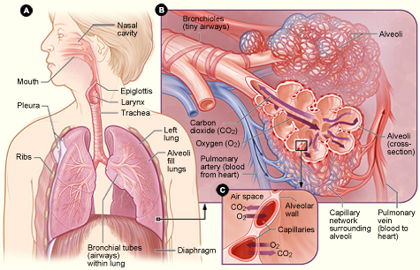
Significant Routes of Exposure
Inhalation
Skin and eye absorption
  What does skin notation mean?
Ingestion
Percutaneous
Source: National Institutes of Health, http://www.nhlbi.nih.gov/health/health-topics/topics/hlw/system
Notes:
Skin notation means it can be a significant pathway.

Slide 7
Chemical Hazards
Flammable
Reactive
Corrosive
Toxic
Explosive
Carcinogenic
Sensitizing

Slide 8
Physical Hazards
Noise
Ionizing radiation
Nonionizing radiation
Thermal stress (hot/cold)
Vibration

Slide 9
Musculoskeletal Hazards
Force
Duration
Awkward posture
Repetitive

Slide 10
Biological Hazards
Infectious
Disease causing

Slide 11
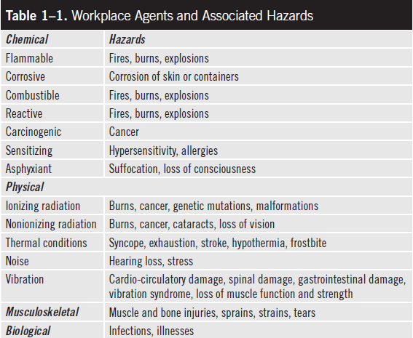
Workplace Agents and Hazards

Slide 12
Injury versus Disease
Injury = direct physical outcome
Disease = may involve a progression

Slide 13
Acute Exposure
An exposure that occurs over a short period

Slide 14
Chronic Exposure
A lower level exposure that occurs over a long period of time
Days, weeks, months, years

Slide 15
Acute Health Effects
Seen shortly after exposure
May be reversible
Hearing loss
Headache
Dizziness
Skin redness

Slide 16
Chronic Health Effects
May take a long time to occur or notice
Cancer
Bone degeneration
Hearing loss
Silicosis
Emphysema

Slide 17
Risk
Probability
  a branch of mathematics that measures and describes the relative likelihood or frequency of an event and looks at the distributions of the event’s occurrences within a given population.
Severity
  The level of hazard associated with a possible exposure

Slide 18
Anticipation
Identifying potential or actual hazards through knowledge of materials, operations, processes, and conditions in the workplace.
Using available information from a variety of sources.

Slide 19
Recognition
The observation and discovery of the hazardous materials and conditions in the workplace.
Using observation and process mapping to understand and document processes and possible exposures to workplace hazards.

Slide 20
Evaluation
Measure exposures and doses, and comparing the measurements to regulatory, professional, and other exposure standards and limits.
Measures could include air monitoring, ergonomic observations, review of accident and injury records, and worker interviews.
Quantitatively evaluate and document levels of exposure.
Prioritize jobs with the most significant hazards.

Slide 21
Control of Hazards
The elimination or reduction of identified and measured hazards.
Use the hierarchy of controls to eliminate or reduce hazards.

Slide 22
Elimination and Substitution
Completely eliminate the hazard from the workplace.
Stop the use of a particular toxic or flammable chemical used in the process or product.
Reduce the quantity of a particular hazardous chemical used.
Change the chemical to a safer or less hazardous one.
Change the work process to cut out the hazardous activity or materials used.

Slide 23
Engineering Controls
Structures, systems, or devices that physically separate, or protect the worker from the hazard.
Barriers, walls, enclosures, covers, guards, shields.
Ventilation systems, fume hoods.
Distance (moving the hazard farther away from the workers).

Slide 24
Administrative Controls
Programs
Policies
Procedures
Labels
Warning signs or lights
Training

Slide 25
Personal Protective Equipment
Respirators
Gloves
Lab coats
Eyewear
Footwear
Lead aprons
Face shields
Ear muffs

Slide 26
Industry Careers
• Manufacturing
• Health care
• Research/education
• Transportation
• Insurance
• Agriculture
• Public utilities
• Construction
• Energy
• Waste management
• Mining

Slide 27
Government Careers
Environmental Protection Agency
Federal Communications Commission
Nuclear Regulatory Commission
National Institutes of Health’s Center for Disease Control and Prevention
Public Health Service
Chemical Safety Board
National Institute for Environmental Health Studies
Consumer Product Safety Commission
Department of Energy
Mine Safety and Health Administration
National Transportation Safety Board

Slide 28
Job Paths
Consulting
Laboratory analysis
Management
Exposure assessment and control
Research
Policy and regulation development and analysis
Quality assurance
Ergonomics
Noise assessment and control
Radiation safety

Slide 29
Professional Organizations
American Industrial Hygiene Association
American Society of Safety Engineers
American Conference of Governmental Industrial Hygienists
National Safety Council
Health Physics Society
Human Factors and Ergonomics Society
American National Standards Institute

