Slide 1
Fundamentals of Industrial Hygiene 6th Edition
Chapter 17:
Direct-Reading Instruments
for Gases, Vapors, and
Particulates
Compiled by Allen Sullivan,
Assistant Professor, Safety and Health Management Central Washington University

Slide 2
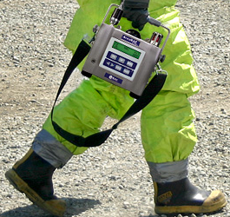
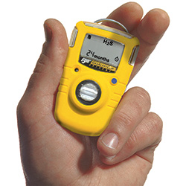
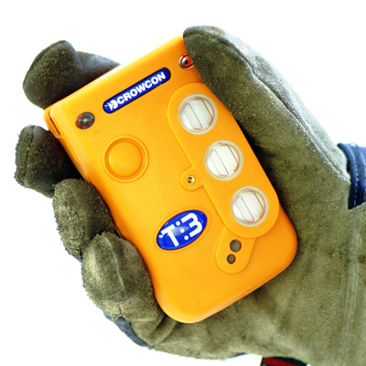
Introduction
Identify and/or quantify the concentration of many gases, vapors, and particulates in air—in real-time or near real-time.
May be used to quickly assess the exposure of workers to hazardous chemicals.
level 1 (small, hand-held, simple)
level 2 (small, hand-held)
level 3 (person-portable)
level 4 (transportable)

Slide 3
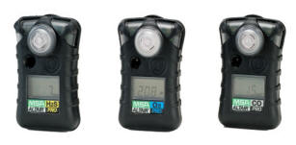
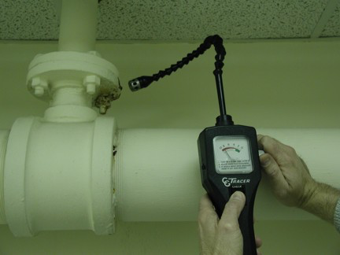
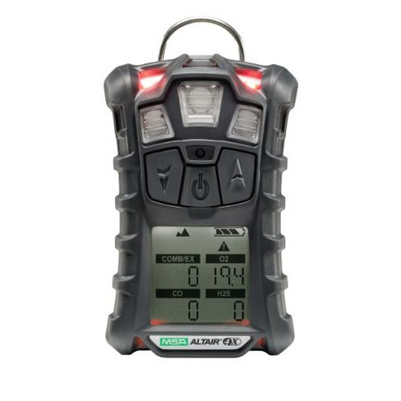
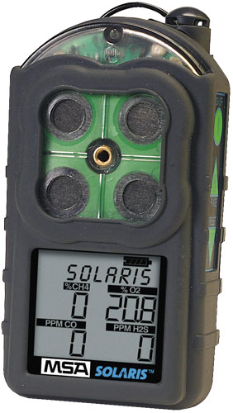
Common Types of Instruments
General Types
compound-specific monitors (single compound)
non-specific monitors (leak detectors, known contaminant)
broad-range monitors (multiple compounds)

Slide 4
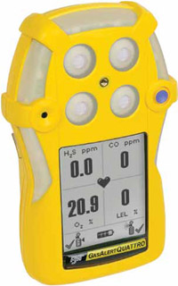
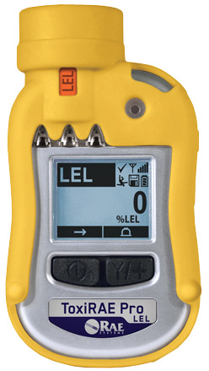
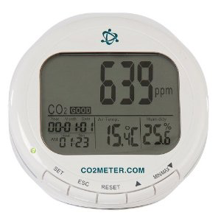
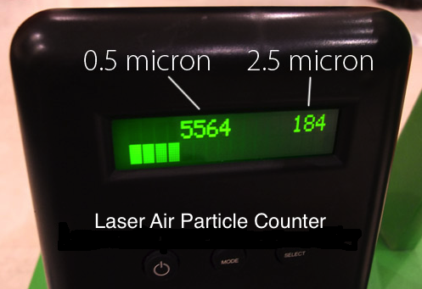
Common Types of Instruments (cont.)
Specific Types
combustible gas/multiple gas (combustible gas (LEL), O₂, CO, H₂S)
explosive (flammable) limits
indoor air quality monitors (temp., relative humidity, CO₂, other gas)
particle counters (obscuration, deposition, condensation nuclei)

Slide 5
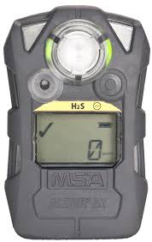
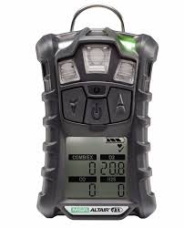
Flammable Gas Meter Concerns
instrument design
must be intrinsically safe for use with flammable gases
zero adjustment
contaminant free area
purified air
interpretations of meter readings
low vapor pressure liquids
high vapor pressure liquids
catalyst poisoning
interferences

Slide 6
Sensing Technologies
A variety of direct-reading instruments are available:
catalytic combustible gas sensors
electrochemical detectors
thermal conductivity detectors
flame ionization detectors
photoionization detectors
solid state resistors
photo-acoustic spectrometers
surface acoustic wave detectors
electron capture detectors

Slide 7
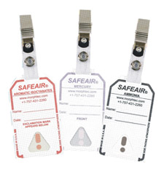
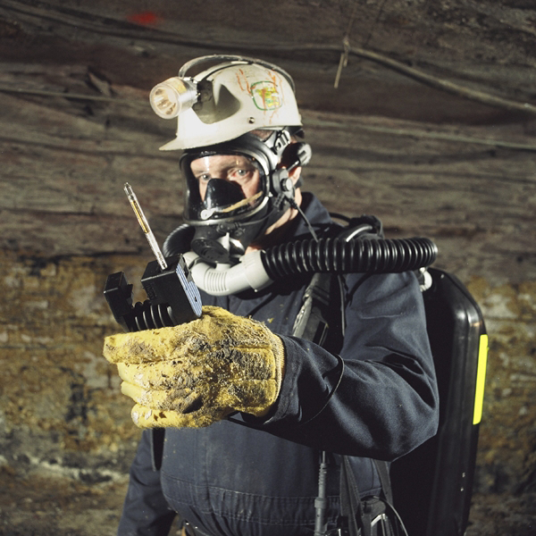
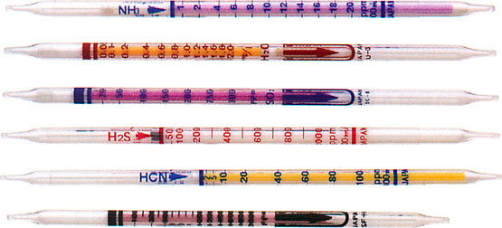
Sensing Technologies (cont.)
colorimetric
detector tubes (short- and long-term, active and passive)
badges
glove breakthrough indicators
tape samplers (levels, durations, and time of exposures)
potential issues with colorimetric devices
interpreting results (stain fade, ability to read)
specificity (interferences, reaction rates)
shelf life

Slide 8
Calibration
All direct-reading instruments must be calibrated before use, and at intervals during use.
An instrument’s response to a concentration of a substance can shift as a result of:
chemical degradation of sensors
physical damage
drift in electronic components
exposure to extreme environmental conditions (temp., humidity)
extremely high contaminant exposures
exposures to poisons or inhibitors
Note: Do not confuse calibration with zeroing-out.

Slide 9
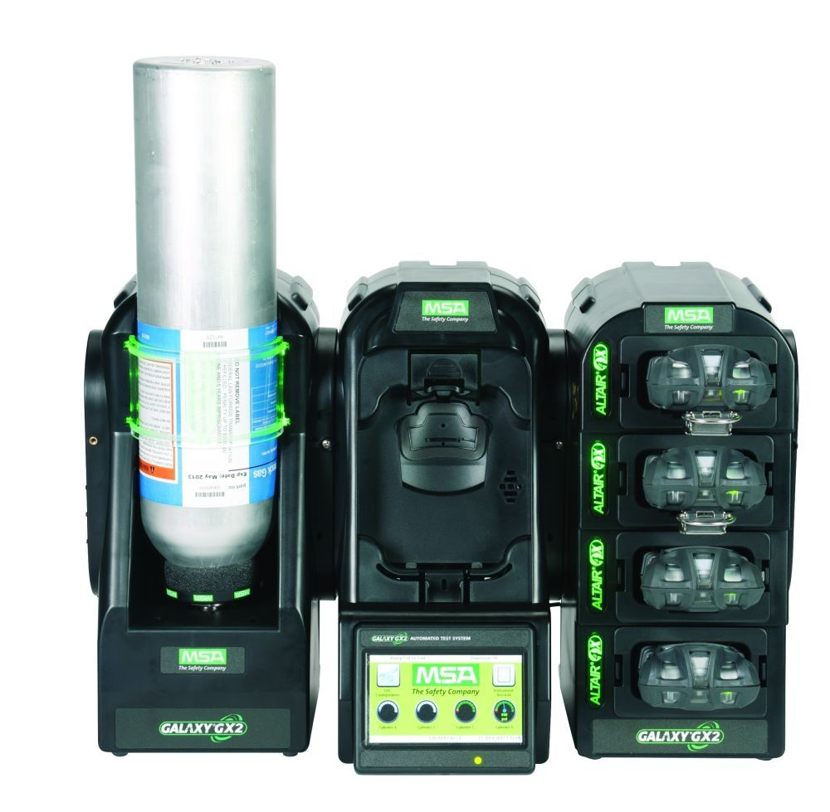
Calibration (cont.)
Full calibration
use cylinders filled with a known concentration of a gas
Functional calibration/bump test
briefly expose instrument to a concentration above the instrument’s lowest alarm set point

