Slide 1
Fundamentals of Industrial Hygiene 6th Edition
Part V: Control of Hazards
Chapter 18:
Methods of Control
Compiled by Allen Sullivan,
Assistant Professor, Safety and Health Management Central Washington University

Slide 2
Introduction
The types of industrial hygiene control measures to be instituted depend on:
the nature of the substance
its route(s) of entry
traditional industrial settings
non-traditional workplaces
To lower exposures, the industrial hygienist must determine:
the contaminant source
the path it travels to the worker
the employee’s work pattern and use of PPE

Slide 3
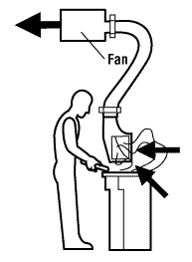
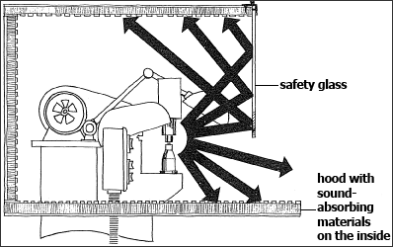
Methods of Control
Engineering controls
remove or reduce the hazard
ventilation
isolation
substitution
Administrative controls
minimize workers’ exposure
scheduling reduced work times
good work practices
training
Personal protective equipment
last line of defense

Slide 4
Engineering Controls at Design Stage
The best time to introduce engineering controls is when facility is in its design phase, because controls can be:
integrated more readily
reconciled with regulations
less costly than retrofitting
design so airborne contaminants are kept below OELs
isolate process equipment and vent to a collector/incinerator
remotely control process from a protected room
accumulation
concurrent activities

Slide 5
Design
In processes where toxic, reactive, flammable, or explosive chemicals are involved, OSHA requires a process hazard analysis (29 CFR 1910.19).
Design factors to be addressed include:
can hazardous residues be removed before equipment is opened?
how can system be designed to be maintenance-free?
can a closed-system be used?
can process be conducted automatically (no worker involvement)?
can system be cleaned automatically?
what precautions can be taken to prevent/detect unplanned releases?

Slide 6
Design (cont.)
When air contaminants are created, generated, or released in concentrations that can injure, ventilation is the usual method of control.
Design factors to be addressed include:
has building been designed to effectively control moisture?
is fresh air intake located away from contaminant source?
can HVAC system deliver an appropriate volume of air?
is local exhaust ventilation required in any special-use areas?
are special filters required?
if smoking is permitted, is it located away from doors, windows, etc.?

Slide 7
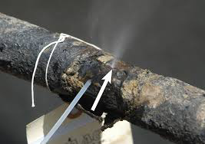
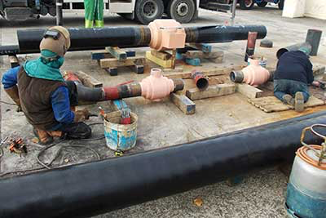
Maintenance
Untoward events leading to the release of contaminants fall into two general classes:
continuous leaks
low-level background exposures
becomes more serious as equipment wears
momentary openings
brief, high-level exposures
adjustments, lubrication, cleaning
sampling
filter replacement

Slide 8
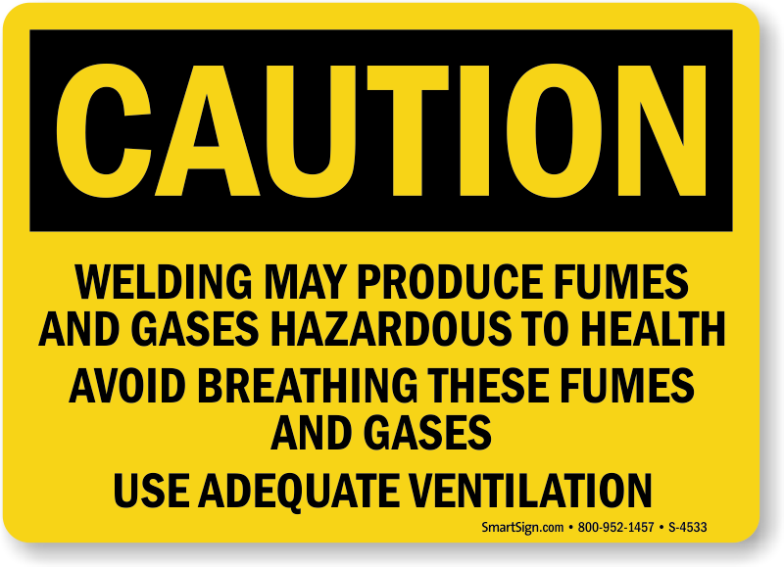
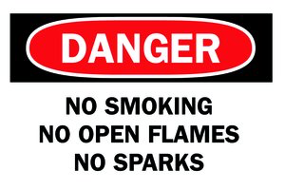
Hazardous Materials
Some materials must be handled carefully because of their toxicity, flammability, corrosiveness, or reactivity.
Federal codes (OSHA and others) impose stringent controls regulating:
mutual process proximity
ventilation
sources of ignition
facility/process design

Slide 9
Industrial Hygiene Control Measures
Industrial hygiene control methods include:
engineering controls
substitution
change or alteration of the process
isolation or enclosure of process or operation
local exhaust ventilation
general (dilution) ventilation
shielding
administrative controls
good housekeeping and maintenance
wet work-methods
employee training ( including emergency response training)
waste treatment and disposal
continuous monitoring (with pre-set alarms)
personal protective equipment

Slide 10
Principles of Engineering Controls
Substitution
changing the material (e.g., less toxic or non-toxic for a highly toxic)
changing the process (e.g., reduce dust/fume dispersion)
Isolation
physical barrier (e.g., acoustic panels)
time (e.g., remote control equipment)
separation (e.g., isolating hazardous operations from other work areas)
containment (e.g., isolate hazardous materials in airtight enclosures)
scheduling (minimize number of workers exposed . . . mine blasting)
Ventilation
general ventilation (dilute contaminants)
local exhaust ventilation (capture and remove contaminants)

Slide 11
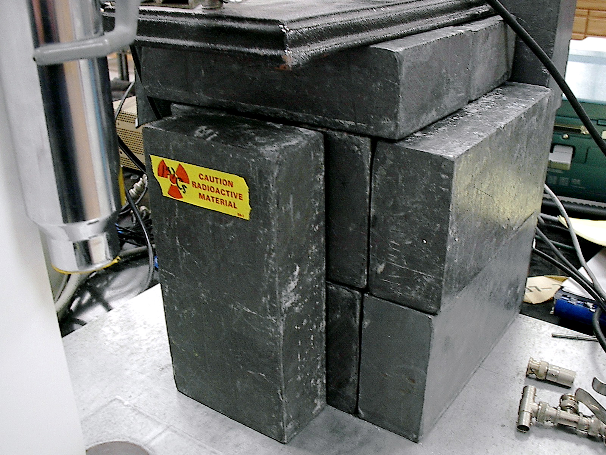
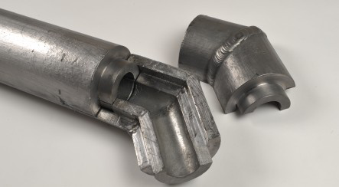
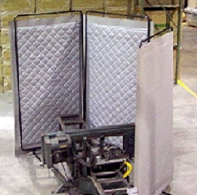
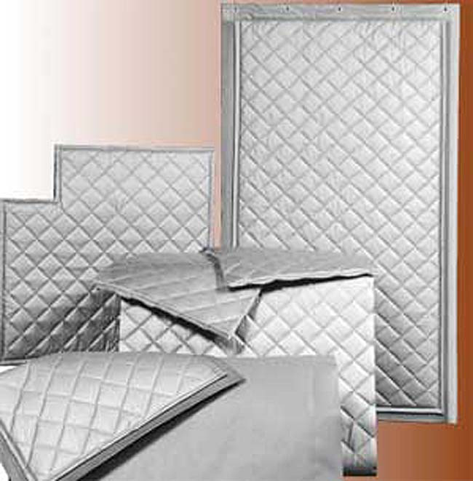
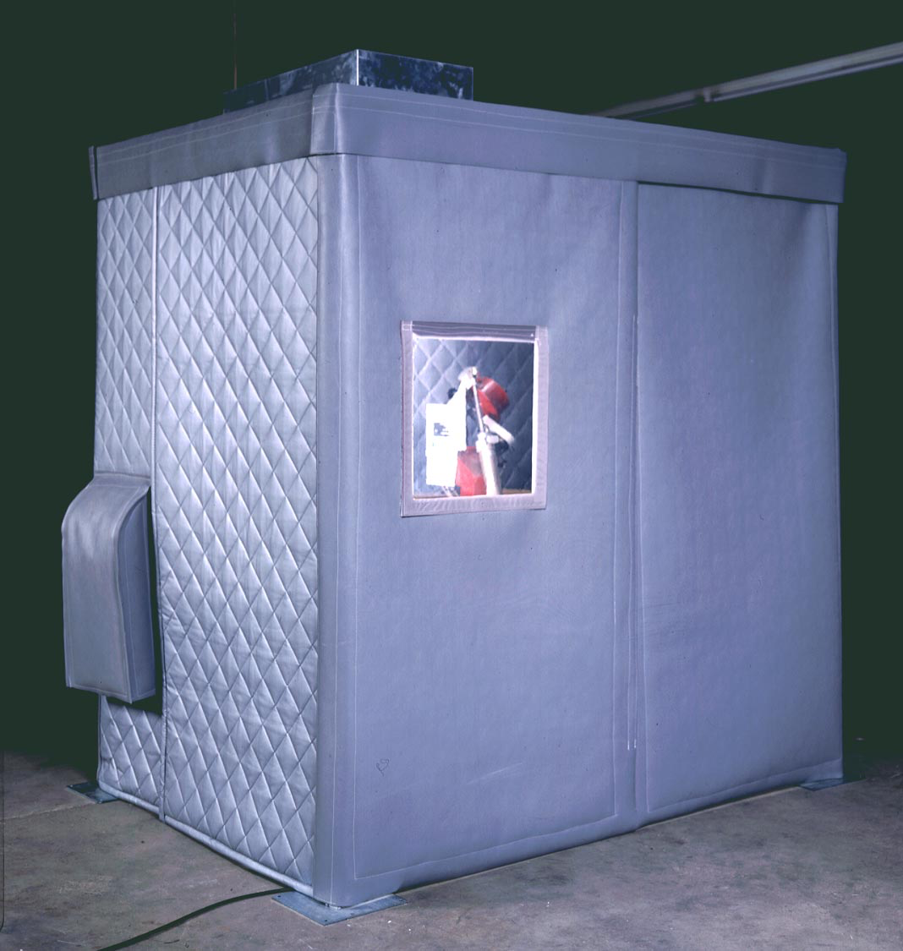
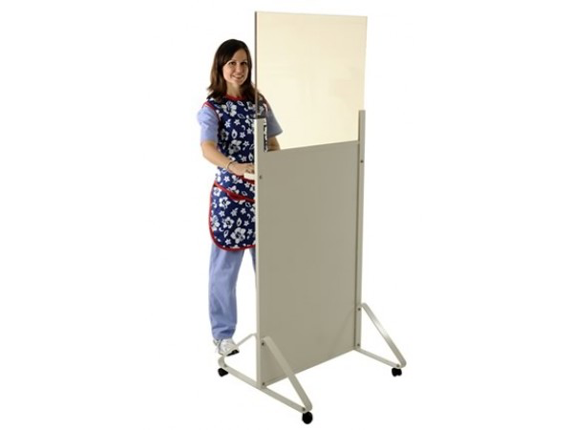
Principles of Engineering Controls (cont.)
Shielding
eliminate exposures to physical hazards
heat (reflective panels)
ionizing radiation (lead or concrete walls)
non-ionizing radiation (Faraday cages, grounding)
noise (acoustical barriers)

Slide 12
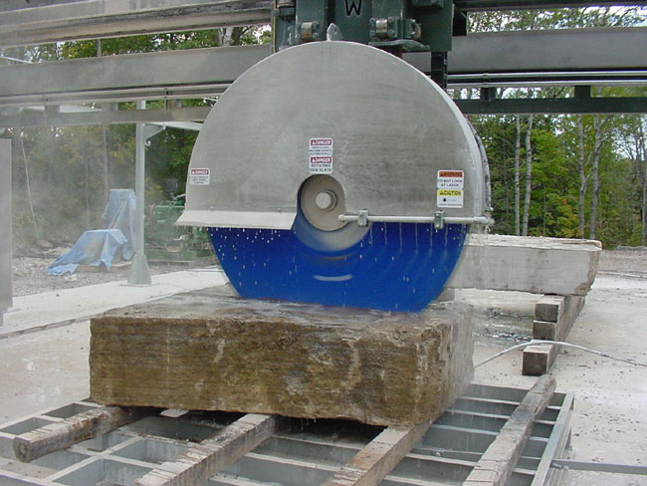
Principles of Administrative Controls
Reduction of work periods
use caution (exposes more workers to the hazard)
Note: Not permitted by certain OSHA standards for highly
toxic materials (e.g., asbestos).
Wet-work methods
wetting to control dust
may need to add surfactants
Housekeeping
often mandated by OSHA standards
remove dust on overhead ledges and floors (re-suspension)
immediate cleanup of spills
all absorbents placed in airtight receptacles and emptied daily

Slide 13
Principles of Administrative Controls (cont.)
Personal hygiene
provision of hand-washing facilities, showers, eyewash stations
prohibition of using compressed air
re-suspends contaminant
may cause hearing damage
can result in physical injury
may result in injection
prohibition on eating, drinking, or food storage in areas where toxic materials are used

Slide 14
Maintenance Provisions
Large-scale, periodic equipment and process shutdown typically results in employees from many crafts working to clean and repair equipment.
anticipate exposure of all workers to contaminants
clean equipment/piping systems before dismantling
implement short-term exposure controls before disassembly
decontaminate equipment, tools, and PPE before removal from worksite
conduct air monitoring

Slide 15
Waste Disposal
Most wastes are regulated by complex requirements of federal, state, and local agencies.
Development of an appropriate waste-management plan requires employers to determine:
are potentially regulated wastes generated on-site?
have wastes been tested to determine their characteristics?
what types of wastes are generated (e.g., hazardous, toxic, infectious)?
can wastes be treated and rendered safe prior to disposal?
can wastes be recycled?
what quantities of wastes are generated (i.e., small-quantity vs. large-quantity generator)
is facility a waste generator, transporter, or treatment-storage-disposal facility (TSDF).

