Slide 1
Fundamentals of Industrial Hygiene 6th Edition
Chapter 22:
Respiratory Protection
Compiled by Allen Sullivan,
Assistant Professor, Safety and Health Management Central Washington University

Slide 2
Introduction
If the work environment is still not completely safe after engineering and administrative controls have been implemented, it will be necessary to use respirators.
OSHA has established 29 CFR 1910.134: Respiratory Protection, for regulating the use of respiratory-protective equipment.
Respirators are the least satisfactory means of exposure control:
some employees may not be able to wear a respirator;
respirators can be cumbersome to use and hot to wear
respirators may reduce vision and interfere with communication

Slide 3
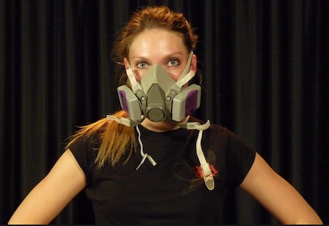
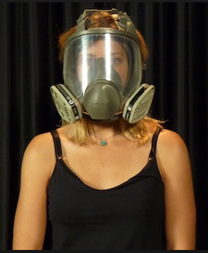
Respiratory Protection Programs
29 CFR 1910.134 requires a written program be developed when respiratory protection is required.
Should include worksite-specific procedures covering:
exposure assessment;
proper selection of equipment;
medical evaluation of respirator wearers;
fit testing of workers;
proper respirator use (routine, emergency, and rescue operations);
schedules (cleaning, storing, inspection, repairing, and discarding);
regular program evaluation.

Slide 4
Respiratory Protection Programs (cont.)
Worksite-specific procedures
procedures must cover each element in enough detail so it is clear exactly how each element will be accomplished
should include disciplinary policies regarding failure to use respirators and facial hair
Exposure assessment
identify the need for respirators
identify the level of protection required
establish required change schedule for chemical cartridge respirators

Slide 5
Respiratory Protection Programs (cont.)
Proper selection
hazard to which worker is exposed
exposure assessment
relevant workplace and use factors
Medical evaluation
physiological stresses associated with respirator use
type of respirator (types and weights)
job/task being performed (work activities, physical effort, duration)
workplace conditions (additional PPE, environmental conditions)

Slide 6
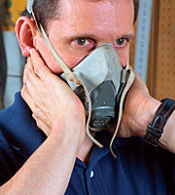
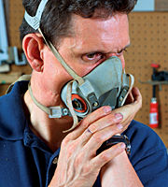
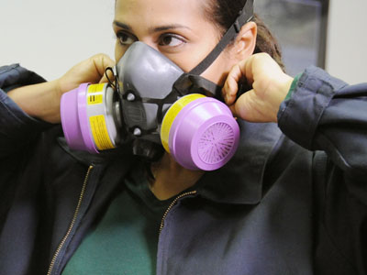
Respiratory Protection Programs (cont.)
Respirator fit
workers using tight-fitting respirators must be fit tested
Respirator use
respirator wearers must check seal before entering harmful atmospheres
not a substitute for a qualitative or quantitative fit test

Slide 7
Respiratory Protection Programs (cont.)
Training
upon initial assignment
annual retraining
retrain when:
changes in workplace or respirator type
inadequacies in worker knowledge or use of respirator
any other situation where retraining appears necessary
wearer must be able to demonstrate
why respirator is necessary
limitations and capabilities of respirator
how to use respirator in emergency situations
to to inspect, don & doff, use, and check seals
Note: Must include an opportunity for each wearer to handle the respirator and include demonstrations and practice.
how to recognize signs and symptoms that may prevent respirator use
general requirements of the OSHA standard

Slide 8
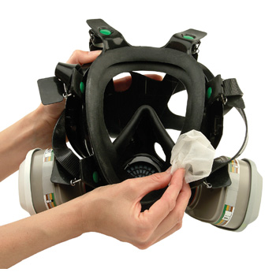
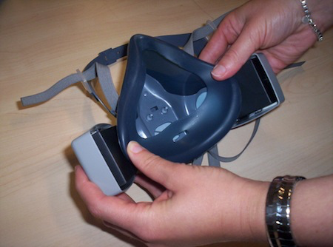
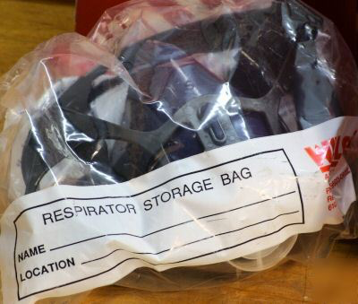
Respiratory Protection Programs (cont.)
Respirator maintenance
cleaning and disinfecting
inspection for defects
proper storage
Exposure assessment
identify the need for respirators
identify the level of protection required
establish required change schedule for chemical cartridge respirators

Slide 9
Respiratory Program Administration
Responsibility for program must be assigned to one person who may have the assistance of others.
must have sufficient knowledge of:
current issue
advances in technology
regulatory changes
responsibilities include:
conducting exposure assessments
selecting appropriate respirators
maintaining records and written procedures
evaluating program effectiveness (ongoing surveillance)

Slide 10
Classes of Respirators
Respiratory-protective devices can be categorized into three classes based on the capabilities and limitations:
air-purifying devices
atmosphere-supplying devices
combination air-purifying and atmosphere supplying devices
HVAC systems also provide for odor control and maintenance of oxygen and carbon dioxide levels.

Slide 11
Air-Purifying Devices
Function to cleanse the contaminated atmosphere before breathing.
limited to use in atmospheres containing sufficient oxygen and contaminant level is within devices ability to cleanse
useful life is limited:
concentration of contaminants
breathing rate of wearer
temperature and humidity levels in workplace
removal capacity of air-purifying medium
aerosol-removing respirators
gas/vapor-removing respirators
combination
powered air-purifying respirators (PAPRs)

Slide 12
Aerosol-Removing Respirators
Offer protection against airborne particulate matter, but do not protect against gases, vapors, and oxygen deficiency
nine classes of filter respirators allowed:
type of aerosol
N-series
R-series
P-series
filter efficiency
95%
99%
99.97%

Slide 13
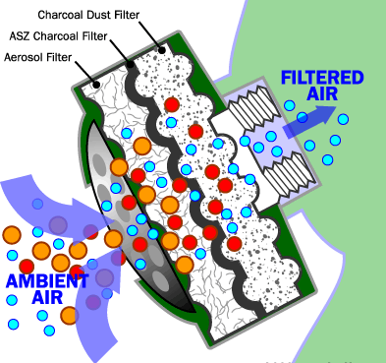
Gas/Vapor-Removing Respirators
Protect against certain gases and vapors by using various chemical filters
adsorption
chemosorption
service life depends on several factors:
high contaminant concentrations
high breathing rate
high humidity levels

Slide 14
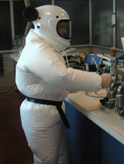
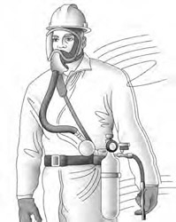
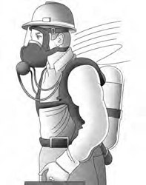
Atmosphere-Supplying Respirators
Provide a respirable atmosphere to wearer independent of ambient air.
air-line respirators (non-IDLH atmospheres only)
demand mode (negative pressure on inhalation)
pressure mode (positive pressure at all times
continuous flow (used where ample air supply is available)
self-contained breathing apparatus (SCBA) respirators
closed-circuit
open-circuit
combination air-line and SCBA respirators
primary airline
auxillary SCBA
≤ 10-minute (escape only)
> 15-minute (emergency entry)

Slide 15
Combination Air-Purifying and Atmosphere-Supplying Devices
Can be used in either air-purifying or air-line mode.
limitations include
cannot be used in IDLH atmospheres
cannot be used in oxygen-deficient atmospheres
must use hose lengths and pressure ranges specified by manufacturer
can only be used in atmospheres for which the air-purifying element is approved

Slide 16
Respirator Selection
Proper selection starts with an assessment of the inhalation hazards present in the workplace.
29 CFR 1910.134 states that respirators shall be selected on the basis of respiratory hazard(s) in the workplace and relevant workplace and user factors:
nature of hazardous operation or process
type of respiratory hazard
location of hazardous area (in relation to nearest respirable air source)
time period respirators must be worn
worker activities

Slide 17
Hazard Determination
The steps for hazard determination are:
If the potential for an oxygen-deficient atmosphere exists, measure the oxygen level.
Determine what contaminant(s) may be present.
Determine if any OELs exist for the contaminant(s).
Determine if any IDLH concentrations for contaminant(s) exist.
Measure the concentration of the contaminant(s).
Determine if the contaminant(s) can be absorbed through the skin, cause skin irritation, or be irritating or corrosive to the eyes or skin.
For gases/vapors, determine if there is a known taste, odor, or irritation threshold.

Slide 18
Warning Properties
Warning properties rely on human senses, and those senses are not foolproof.
variation of odor threshold of general population
(two orders of magnitude)
shift in odor threshold
(caused by extended exposure to low concentrations)
shifts in odor threshold
(caused by simple colds or other illnesses)
failure to notice odors
(distractions in workplace)

Slide 19
Immediately Dangerous to Life and Health
Numerous definitions have been presented, but the common theme is that exposure to IDLH atmospheres would affect workers acutely as opposed to chronically.
OHSA defines IDLH as an atmosphere that:
poses an immediate threat to life
would cause irreversible adverse health effects
would impair an individual’s ability to escape
Note: The only two devices that can be used in IDLH atmospheres are the full facepiece pressure-demand SCBA (minimum 30 minutes) and the combination full facepiece air-line with auxiliary SCBA (minimum 10-minute).

Slide 20
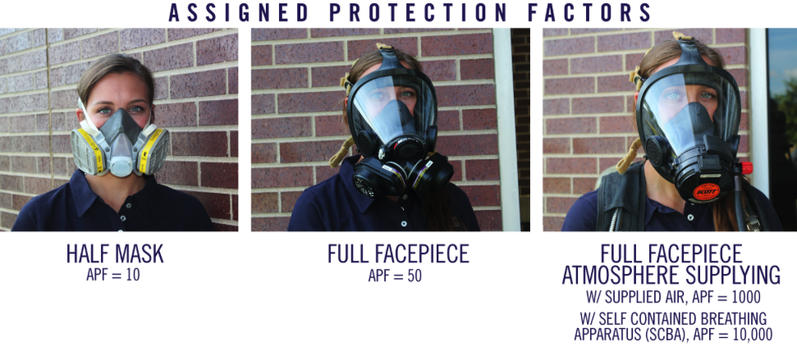
Assigned Protection Factors
The expected workplace level of respiratory protection provided by a properly functioning respirator that was properly fitted to a trained user.
Established by OSHA (see Table 22-G in text).
Note: An APF of 10 means the respirator will reduce the concentration of contaminant actually breathed by the worker by 10 times compared to actual airborne contamination.

Slide 21
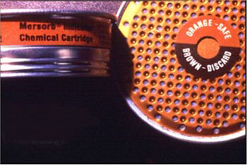
Change Schedules
Unless the cartridge has an end-of-service indicator built in, the only method available for replacing cartridges before breakthrough is by a cartridge change schedule.
Unless OSHA has established a change schedule, a documented, pre-determined interval must be established based on:
specific respirator and cartridge to be used
airborne concentration of contaminant(s)
temperature and humidity in workplace
pattern of respirator use (hours/shift, shifts/week)
expected work rate

Slide 22
Respirator Selection Steps
if atmosphere is oxygen-deficient
a respirator approved for IDLH atmospheres must be selected
if potential contaminant(s) could not be identified
a respirator approved for IDLH atmospheres must be selected
if no OEL is available and estimates of toxicity cannot be determined
a respirator approved for IDLH atmospheres must be selected
if concentration of contaminant(s) exceed published IDLH
a respirator approved for IDLH atmospheres must be selected

Slide 23
Respirator Selection Steps (cont.)
divide the contaminant concentration by the exposure limit to obtain a hazard ratio
if substance-specific standards exist for the contaminant(s), consider those guidelines
if more than one contaminant is present, consider potential additive/synergistic effects
use the ACGIH TLV for mixtures
select a filter with an APF greater than the hazard ratio

Slide 24
Respirator Selection Steps (cont.)
if contaminant(s) is an particle
a respirator with a particulate filter must be selected
proper series (N, R, P)
proper efficiency (95%, 99%, 99.97%)
if contaminant is a gas/vapor
a respirator with an effective cartridge must be selected
establish a change schedule

Slide 25
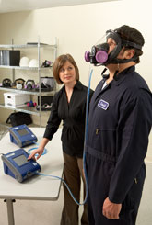
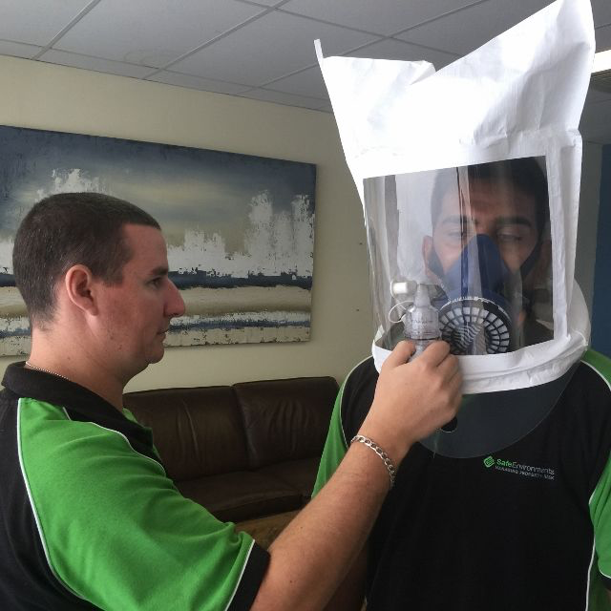
Respirator Fit Testing
Proper protection will not be provided if the respirator facepiece does not fit the wearer properly.
All tight-fitting (half- and full-facepiece) respirators (whether positive or negative pressure) must be fit tested.
qualitative fit testing
relies on wearer’s subjective response to detection of a test agent
quantitative fit testing
measures for actual leakage of a test agent

