Slide 1
Driver Safety
For use in conjunction with 5-Minute Safety Talk
Notes:
Driver Safety

Slide 2
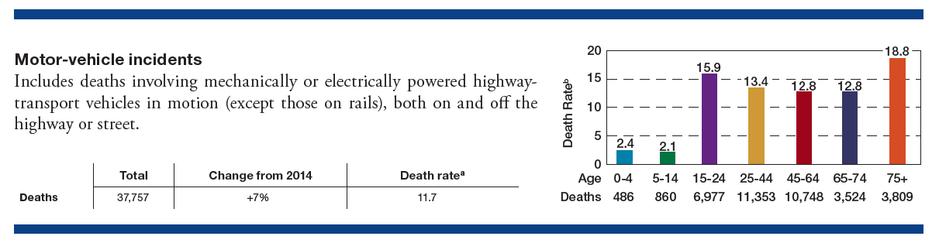
Fleet Safety
a -Deaths per 100,000 population.
Taken from Injury Facts®, 2017 Edition.
More than 35,000 people die in crashes every year on U.S. roads, approximately 96 deaths per day or 4 deaths every hour
More than 90% driver error – therefore, PREVENTABLE
Notes:
More than 35,000 people die in crashes every year on U.S. roads. That comes to about 96 deaths every day – or four deaths every hour. Many of those deaths are the result of incidents that take place during the workday or during the commute to-and-from work. More than 90% of crashes are the result of driver error and, therefore, are preventable.

Slide 3
Lost Work Days
Higher Insurance Premiums
Cost of Injuries
$$$
Impact on Employee & Family
Notes:
Employers absorb the brunt of costs for injuries that occur both on and off the job through items such as lost work days and insurance premiums. Whether you manage a fleet of vehicles, oversee a mobile sales force or simply employ commuters, by implementing a driver safety program in the workplace, you can greatly reduce risks faced by your employees and their families while protecting your company’s bottom line.

Slide 4
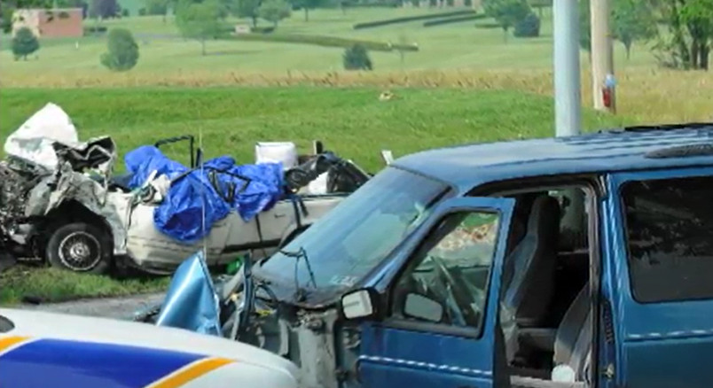
Distracted Driving Thousands die
every year…
Many employers use cell phone driving policies which ask employees to:
Program/start GPS equipment prior to starting vehicle or pull over/park if changes need to be made
Turn off smartphones or other devices before starting vehicle
Inform clients, associates and business partners that calls will be
returned when they are not driving
Pull over to a safe location and put vehicle in park if a call must be made
Notes:
Thousands die every year in incidents involving smartphones and distractions from dashboard infotainment systems. Many employers have enacted cell phone driving policies. Typically, these policies ask employees to:
• Program/start GPS equipment prior to starting the vehicle or pull over and park if changes need to be made
• Turn off smartphones or other devices before starting the vehicle
• Inform clients, associates and business partners that calls will be returned when they are not driving
• Pull over to a safe location and put their vehicle in park if a call must be made

Slide 5

Cell Phone Blocking Apps & Devices
Help drivers stay focused on driving by preventing:
making calls
accepting calls
texting
accessing internet
Notes:
Many drivers continue to use phones even when they are aware of the crash risk associated with distraction. Cell phone blocking apps and devices can help drivers stay focused on driving. They prevent drivers from making or accepting calls, texting or accessing the internet.

Slide 6
Drunk and Drugged Driving
Safe Driving Requires:
          Comprehension
          Concentration
          Coordination
          Quick reflexes
Drinking and drugs - including marijuana -
affect all of these skills
Notes:
Drunk and drugged driving
One-third of traffic fatalities involve alcohol. Impairment begins with the first drink. Mental faculties such as judgment are the first to be diminished. This can make it difficult for a driver to reason and respond in an emergency situation. Taking over-the-counter or prescription medications can put drivers at risk, too. Safe driving requires comprehension, concentration, coordination and quick reflexes. Drugs (including marijuana) affect all of these skills.

Slide 7


Aggressive Driving Road Rage
The best offense is a solid defense:
Teach & promote defensive driving skills
Talk about risks
Encourage employees to adopt safe driving habits
Notes:
Aggressive driving
Speeding is one of the three biggest contributing factors in fatalities on our nation’s roads. Aggressive driving behaviors also can include frequent and unnecessary lane changes, tailgating and running red or yellow lights. All of these behaviors can lead to road rage, which is a physical assault of a person or vehicle as a result of a traffic incident.
Here, the best offense is a solid defense, as in teaching and promoting defensive driving skills. Talk to employees about risks. Encourage them to adopt safe driving habits.

Slide 8
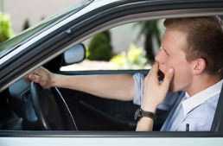
Drowsy Driving
CDC reports more than 1/3 of U.S. adults sleep less than seven hours
Drowsy driving occurs when people take the wheel despite feeling sleepy or fatigued
More than 5,000 people died in drowsy driving related crashed in 2015
Notes:
Drowsy driving
The Centers for Disease Control and Prevention reports more than one-third of U.S. adults sleep less than seven hours a day. Drowsy driving occurs when people take the wheel despite experiencing feelings of sleepiness and fatigue. The consequences can be deadly. More than 5,000 people died in drowsy driving-related crashes in 2015.

Slide 9

Make sure your drivers know how to use the safety features in their vehicles.
Learn more at: MyCarDoesWhat.org
Notes:
Some vehicles today are equipped with technology that can detect when a driver is about to nod off and deliver a warning signal. Make sure your drivers know how to use all the safety features in their vehicles. Introduce them to learning opportunities provided by sites such as MyCarDoesWhat.org to fill in knowledge gaps.

Slide 10
If tired…
Pull over
Schedule travel breaks
Drink a caffeinated beverage
Take a 20 minute
nap
Notes:
Remember, you are still your vehicle’s best safety feature. If you are tired, pull over. Three more ideas to share at your workplace:
• Take a nap (20 minutes of sleep can alleviate feelings of drowsiness, at least temporarily)
• Drink a caffeinated beverage (coffee or cola)
• Schedule travel breaks

Slide 11
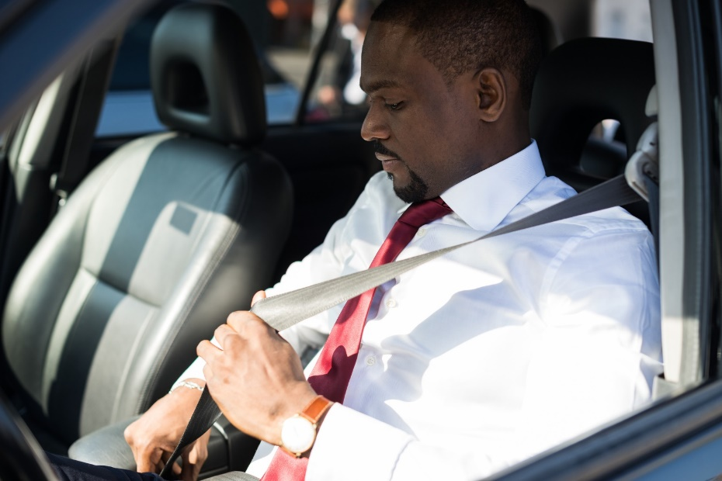
Passenger Restraint
Seat belts are inexpensive
and effective. They save lives
and reduce injuries.
Employees who are in the
habit of using a safety belt
during work hours also are
more likely to buckle up when they are off the clock.
More than half of teens and adults who die in crashes are reported as unrestrained at the time of the crash, according to the CDC.
Notes:
Passenger restraint
Seat belts are inexpensive and effective. They save lives and reduce injuries. Employees who are in the habit of using a safety belt during work hours also are more likely to buckle up when they are off the clock.
More than half of teens and adults who die in crashes are reported as unrestrained at the time of the crash, according to the CDC.

Slide 12
NETS, NHTSA & OSHA Report Indicates:
The average crash costs an employer more than $16,000
When a worker has an on-the-job crash that results in an injury, the cost to their employer jumps to more than $70,000
Costs can exceed $500,000 when a fatality is involved
Notes:
The Network of Employers for Traffic Safety, the National Highway Traffic Safety Administration and the Occupational Safety & Health Administration produced a report indicating the average crash costs an employer more than $16,000. Furthermore, when a worker has an on-the-job crash that results in an injury, the cost to their employer jumps to more than $70,000. Costs can exceed $500,000 when a fatality is involved, according to the report.
Bottom line: No organization can afford to ignore traffic safety because of the impact on personnel and budget.

Slide 13
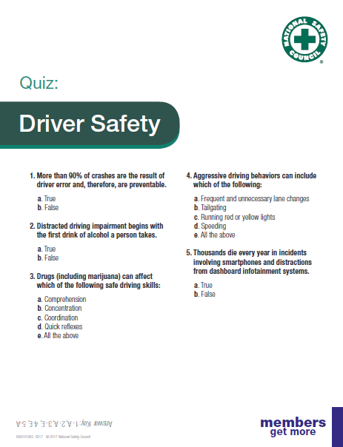
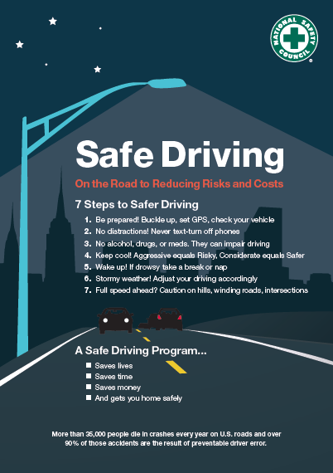
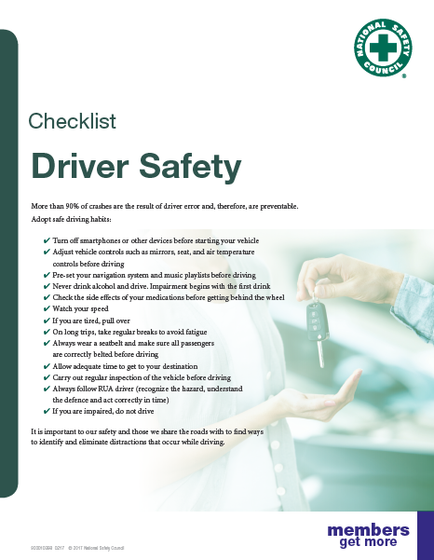
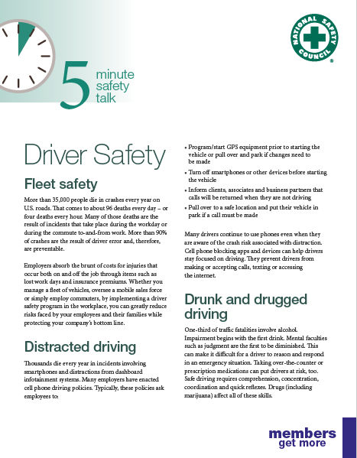
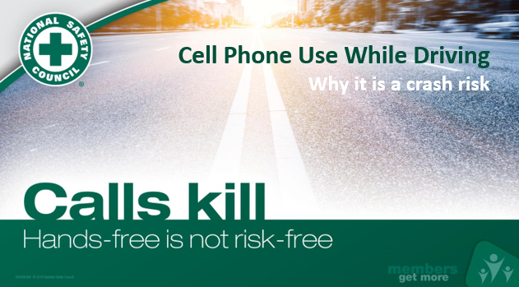
Driver Safety Toolkit
Presentation
Notes:
This Driver Safety Toolkit is located at nsc.org/members under Workplace Safety Team Toolkits.

Slide 14
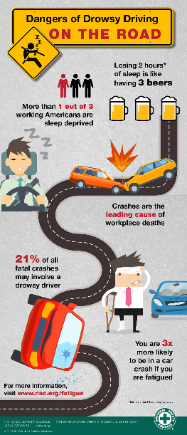
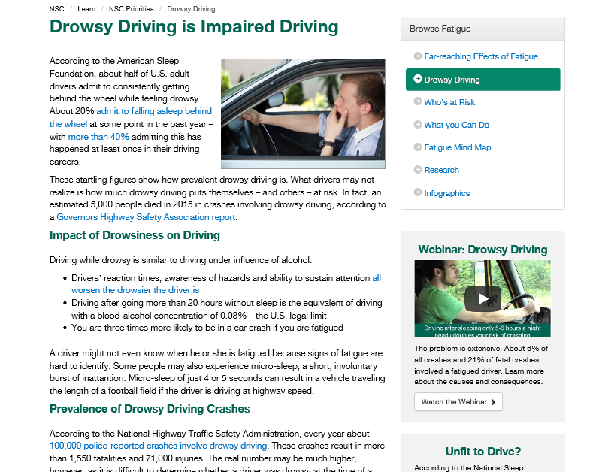
Learn more about Drowsy Driving by visiting nsc.org and type Drowsy Driving in the Search Box or visit: http://www.nsc.org/learn/NSC-Initiatives/Pages/Fatigue-Drowsy-Driving.aspx
Infographic
Notes:
More resources about Drowsy Driving are available at nsc.org when your type Drowsy Driving in the Search Box or visit: http://www.nsc.org/learn/NSC-Initiatives/Pages/Fatigue.aspx

Slide 15
For more member-exclusive safety presentations, webinars, posters and resources sign in at nsc.org/members
Customer Service – (800) 621-7619
Outside U.S. – +1-630-775-2056
Email us at:
MEMBERSHIPINFO@nsc.org
Notes:
Find more member-exclusive safety presentations, webinars, posters and resources at nsc.org/members.
For discussion:
Questions
Observations & Concerns
Safety Action Plan

