Slide 1
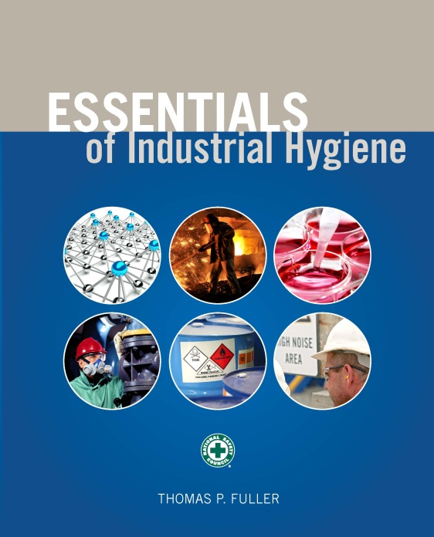
CHAPTER 4
Basic Concepts in Industrial Toxicology

Slide 2
Learning Objectives
Define the study of toxicology and explain why it is important to the practice of industrial hygiene.
List different mechanisms and modes of toxic chemical action and the various methods used to measure and document toxicity.
Explain various criteria for causation of toxic effects.
Describe toxicokinetics.
Identify and list routes of toxic agent exposure in the human body.
Understand toxic chemical absorption, distribution, metabolism, and elimination.
Explain the concept of dose response.
Describe the toxic effects typical in the major organ systems.

Slide 3
Toxicology
A broad field that studies the effects of chemical, biological, and physical agents on the health of an organism.
Includes studies at the molecular basis of the biological response up to and including evaluations at the cellular, tissue, organ, organ system, and whole body levels.
Integrates several areas of science, including chemistry, biology, physiology, and pathology.

Slide 4
Mechanisms of Action
Detailed descriptions of the process involved in an agent’s toxic effects, from initial exposure to the development of adverse reactions

Slide 5
Key Events in a Mode of Action
An empirically observable step that is a necessary element of the mode of action or is a biologically based marker for such an element

Slide 6
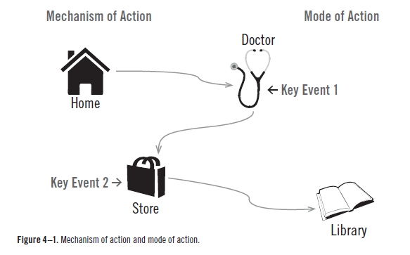
Mechanism of Action and Mode of Action

Slide 7
Establishing Mechanisms of Action
Epidemiological studies
Laboratory studies
Animal studies

Slide 8
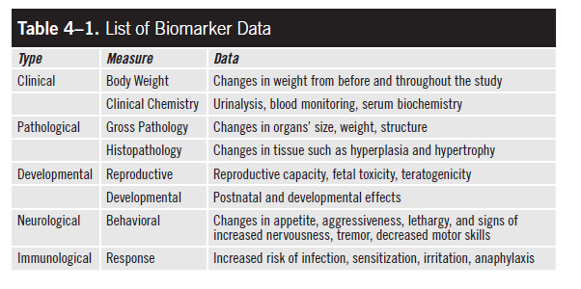
Biomarkers of Effects

Slide 9
Weight of Evidence
Strength
Consistency
Specificity
Temporality of events
Coherence and plausibility
Dose-response relationship

Slide 10
Toxicokinetics
The ways chemicals are taken into the body, move throughout the body, and are removed from the body
The behavior of a chemical is reflected in a series of processes—including absorption, distribution, metabolism, and elimination (ADME).

Slide 11
Routes of Exposure
Ingestion
Inhalation
Dermal
Percutaneous

Slide 12
Routes of Exposure (cont.)

Slide 13
Absorption
Internal dose: the amount of an agent absorbed into the body
Dependent on the properties of the chemical such as lipid solubility, molecular size, and concentration gradients

Slide 14
Rate of Chemical Absorption, Tmax
Indicated by the time it takes for the chemical to reach peak blood concentrations after exposure

Slide 15
Percent Bioavailability
The amount of an agent recovered from excreta divided by the total dose
The amount left behind in the body to cause damage
Useful when extrapolating toxicity data from one route of exposure to another

Slide 16
Distribution
How a chemical moves through the body once it is absorbed
Partition coefficients: ratios at equilibrium between the blood and varying tissues of the body
describe agent’s affinity for a particular tissue or organ

Slide 17
Metabolism
The process by which the body transforms a molecule, be it a toxicant, nutrient, or normal physiological (i.e., endogenous) chemical or molecule
For toxicants, metabolism often serves to transform the agent into a form that is more easily removed from the body = biotransformation

Slide 18
Elimination
How the body removes agents from the body
urine
feces
respiration
sweat

Slide 19
Biological Half-Life
The time it takes for the concentration of a chemical in the body to decrease by half

Slide 20
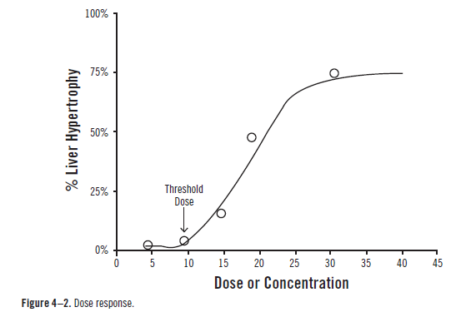
Dose Response

Slide 21
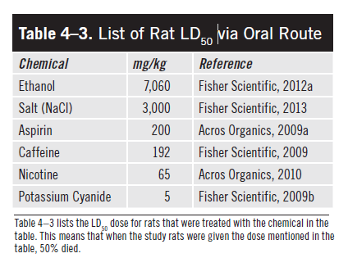
Lethal Dose

Slide 22
Liver Toxicity
First-pass metabolism
One of the most common sites of toxicity because it processes many chemicals, including those whose metabolic products are toxic

Slide 23
Kidney Toxicity
The kidney plays vital roles in removing metabolic waste, regulating body fluid volumes, maintaining electrolyte balance, and ensuring proper body pH

Slide 24
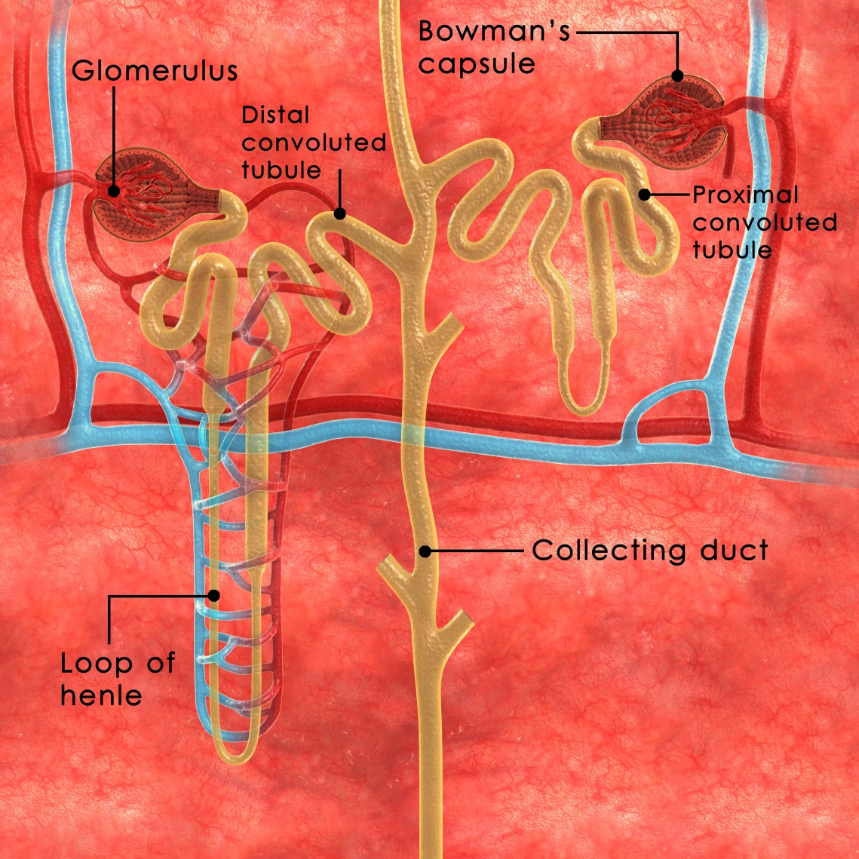
Kidney Toxicity (cont.)
(Source: 7activestudio/iStock)

Slide 25
Lung Anatomy
Upper respiratory tract
Trachea
Bronchi
Alveoli

Slide 26
Lung Function Measures
Total Lung Volume (TLV) – the total volume of air the lung can hold
Vital Capacity (VC) – the amount of air moved into and out of the lungs when taking the largest possible breath
Tidal Volume (TV) – the amount of air moved into and out of the lungs into a typical resting breath

Slide 27
Health Effects
Edema – an accumulation of fluids in the pulmonary tissues
Fibrosis – lung tissue scarring decreases the surface area available for gas exchange and causes the lungs to become less compliant (stiffer), making it harder to draw air into the pulmonary region of the lungs
Emphysema – destruction of the gas exchange surfaces of the alveoli, causes inefficient exchange of gases and results in larger pockets filled with air
Cancer

Slide 28
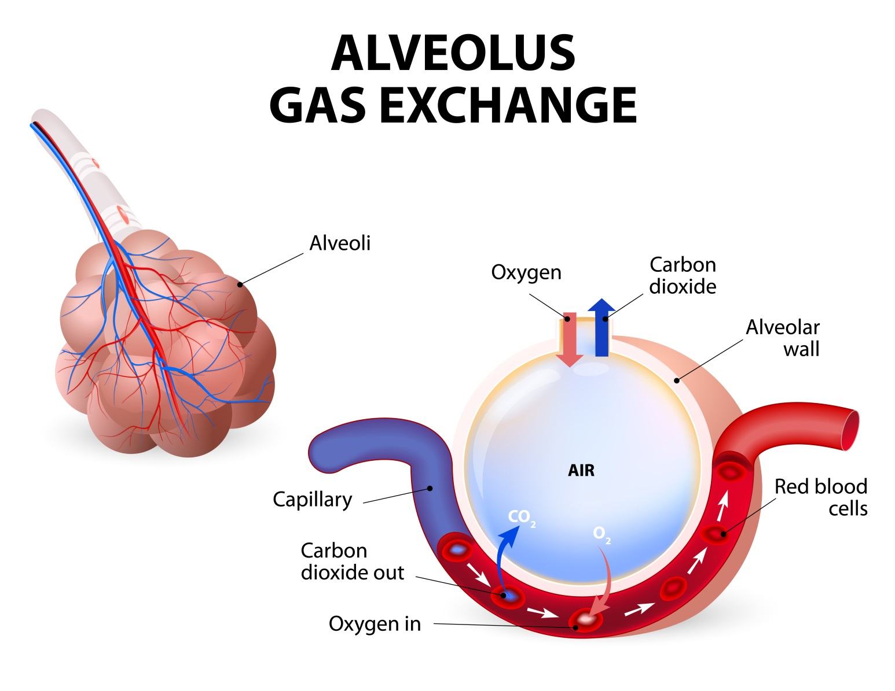
Gas Exchange
(Source: ttsz/iStock)

Slide 29
Neurotoxicity
Toxic chemicals interfere with the transmission of numerous signals in the body that control motion as well as autonomous body functions.

Slide 30
Neurotoxicity Signals
Pupil dilation and altered breathing rates. Other signs of autonomic dysfunction include tremors or convulsions, gait abnormalities, decreased grip strength, or a decreased ability to remain upright.
Pathological examinations can discover changes in axon length, decreases in the amount of myelin surrounding axons, or deaths of neuronal cells.

Slide 31
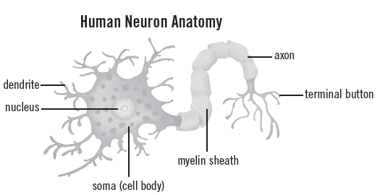
Neurotoxicity Signals (cont.)
(Source: blueringmedia/iStock)

Slide 32
Reproductive and Developmental Toxicity
Reduced ability to reproduce
Damage to offspring
Disruption of germ development
Impacts on the embryo and fetus

Slide 33
Immunotoxicity
Toxic agents that affect the immune system through functional immunosuppression, which prevents the immune system from protecting the body

Slide 34
Skin Toxicity
Nonallergic irritation
Allergic contact dermatitis
Corrosive chemical burns
Chemical-induced photosensitivity

Slide 35
Carcinogenesis and Genotoxicity
Neoplasia – originates from inheritable changes in cell growth that lead to the loss of normal control processes. Classified as begin or malignant
Metastasis – the movement of neoplastic cells to locations beyond the primary site of origin
The term cancer refers to malignant neoplasms

