Slide 1
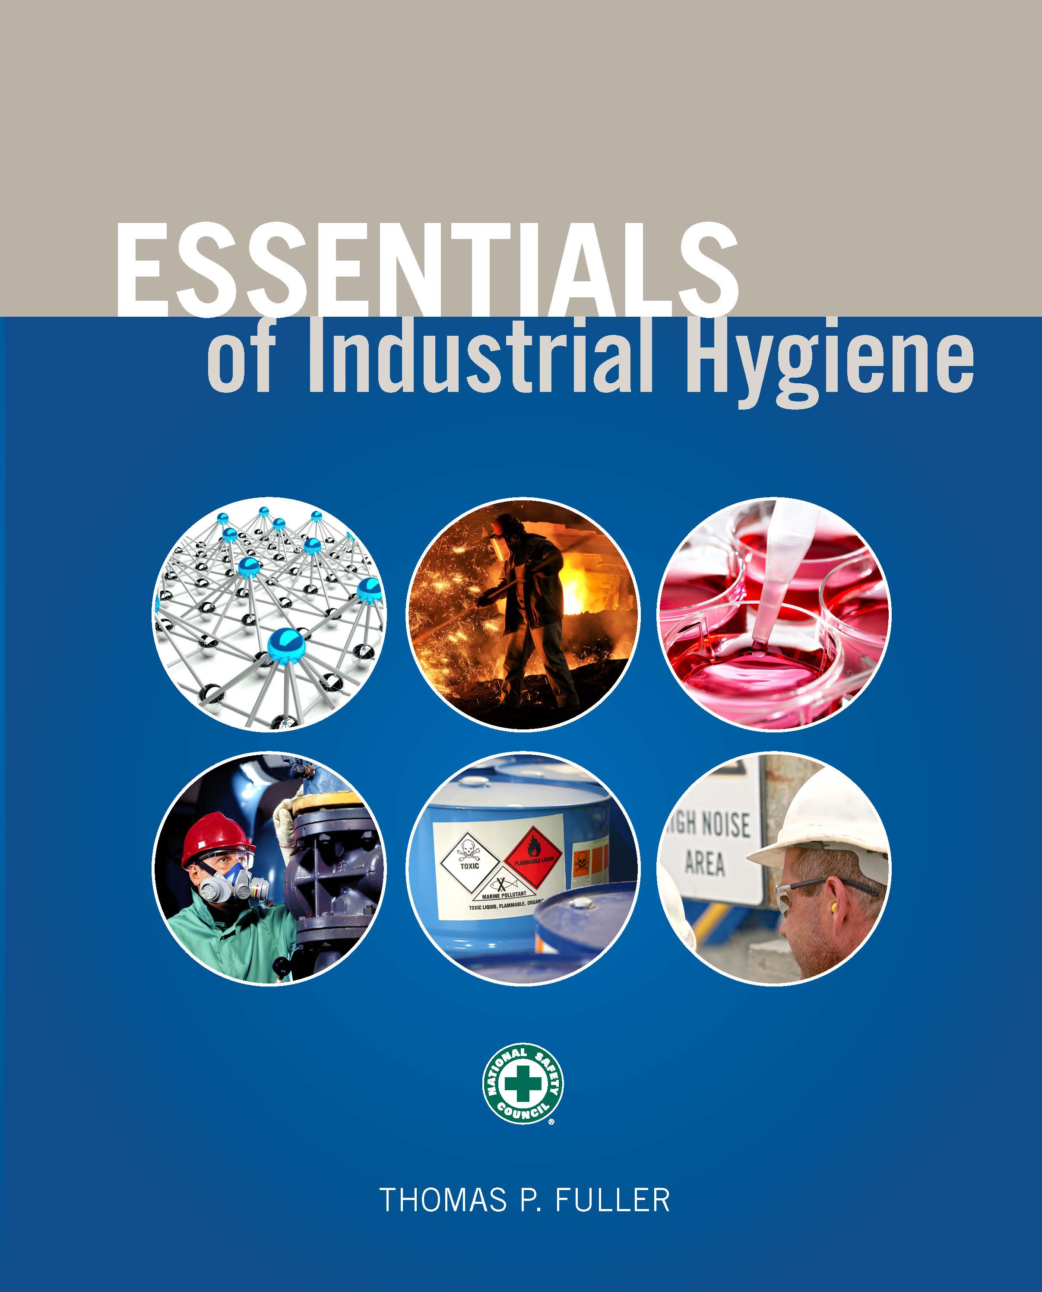
CHAPTER 9
Respiratory Protection

Slide 2
Learning Objectives
List Occupational Safety and Health Administration (OSHA) requirements for respiratory protection.
Describe basic human anatomy and function of the lungs.
Outline the requirements for medical clearance needed prior to wearing a respirator.
Understand how respirators work and the different types available.
Review the respirator fit-testing purpose and process.

Slide 3
OSHA 29 CFR 1910.134 Respiratory Protection
Used in general industry
When engineering controls are not feasible, employers must provide appropriate PPE.

Slide 4
Written Programs
Must include:
procedures for selecting respirators
medical evaluation of employees using respirators
fit-testing of respirators
procedures for proper use of respirators
procedures for cleaning and disinfecting respirators
procedures for air quality in using air-supplied respirators
training and training procedures
evaluating the effectiveness of the respiratory protection program
procedures where respirators are not required

Slide 5
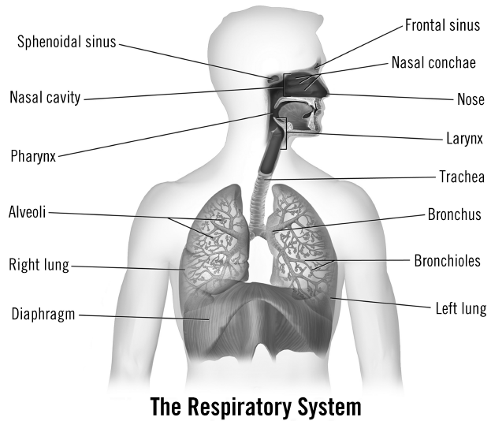
Respiratory System
Source: Blausen.com staff. Blausen gallery 2014. Wikiversity Journal of Medicine.

Slide 6
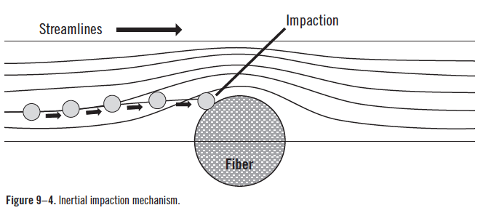
Inertial Impaction

Slide 7
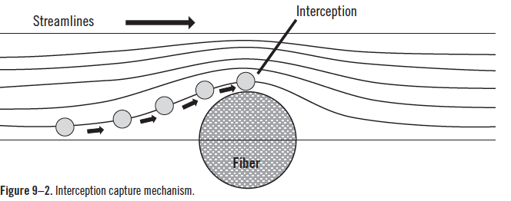
Interception

Slide 8
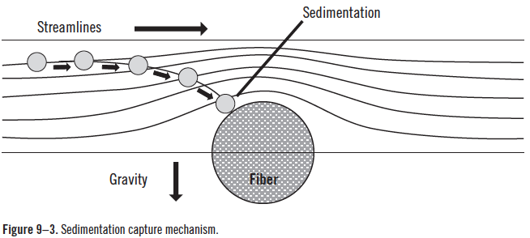
Sedimentation

Slide 9
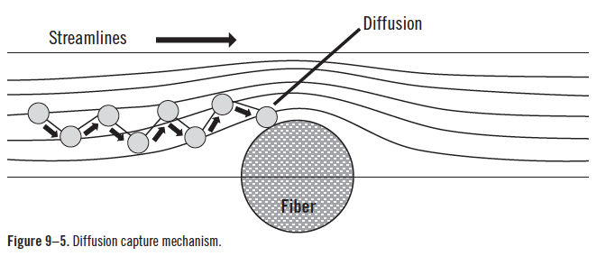
Diffusion/Brownian Motion

Slide 10
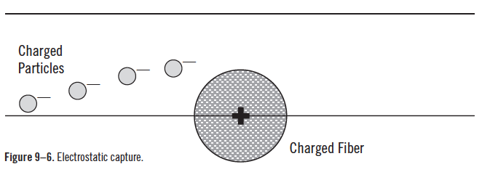
Electrostatic Precipitation

Slide 11
N-Series Filters
N95 particulate filter—at least 95% efficient
N99 (previously low efficiency) particulate filter—at least 99% efficient
N100 (previously high efficiency) particulate filter—at least 99.97% efficient

Slide 12
R-Series Filters
R95 particulate filter—at least 95% efficient
R99 (previously low efficiency) particulate filter—at least 99% efficient
R100 (previously high efficiency) particulate filter—at least 99.97% efficient

Slide 13
P-Series Filters
P95 particulate filter—at least 95% efficient
P99 (previously low efficiency) particulate filter—at least 99% efficient
P100 (previously high efficiency) particulate filter—at least 99.97% efficient

Slide 14
Vapor and Gas Removal Mechanisms
Adsorption
Absorption
Catalyst

Slide 15
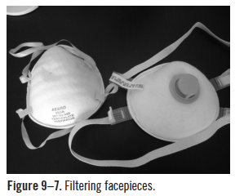
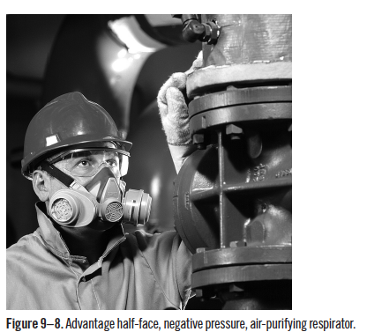
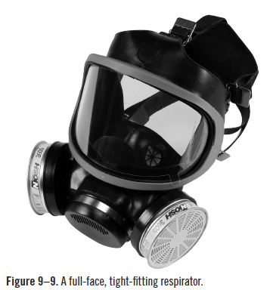
Air-Purifying Respirators
Source: Used with permission from MSA.
Source: Used with permission from MSA.

Slide 16
Air-Purifying Respirators (cont.)
Disposable air-purifying respirators
Reusable quarter-face, half-face, or full-face Respirators
Mouthpiece respirator

Slide 17
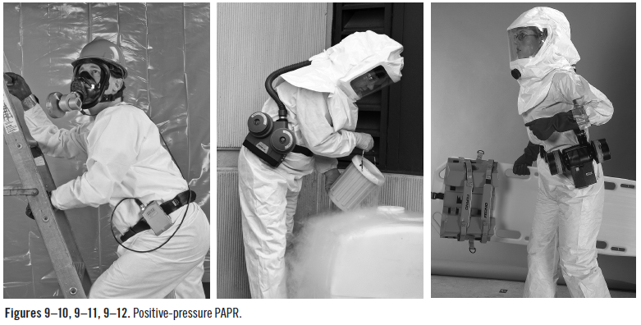
Air-Purifying Respirators (Cont.)
Powered air-purifying respirator (PAPR)
Source: Used with permission from MSA.

Slide 18
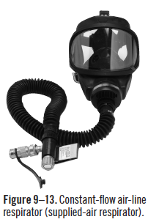
Atmosphere-Supplying Respirators
Self-contained breathing apparatus
Air-line respirators
Source: Used with permission from MSA.

Slide 19
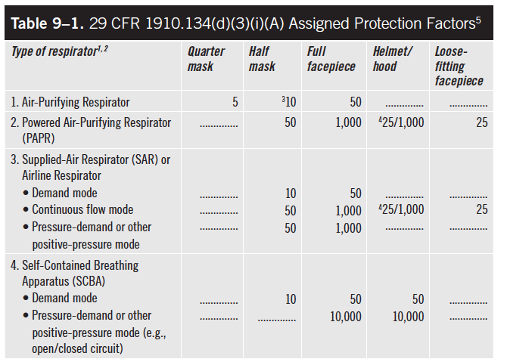
Assigned Protection Factors

Slide 20
Medical Evaluation
Evaluations determine
limitations of respirator use by the worker
additional or follow-up medical evaluations
that the worker can use the type of respirator being provided by the employer
that the employer must provide an additional type of respirator
whether the employee is medically fit to use a respirator

Slide 21
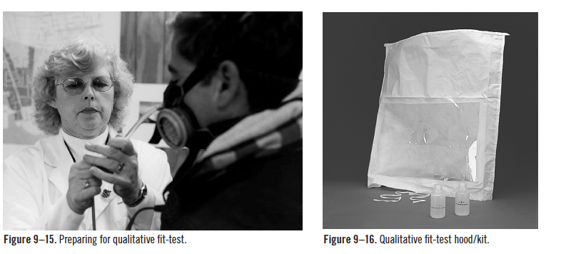
Fit-Testing Procedures
Qualitative fit-testing
Source: Used with permission from MSA.
Source: Used with permission from MSA.

Slide 22
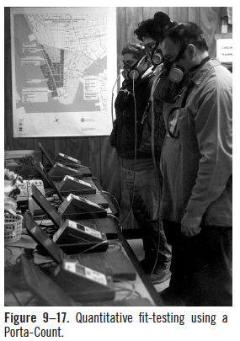
Fit-Testing Procedures (cont.)
Quantitative fit-testing
Source: Used with permission from MSA.

Slide 23
Fit-Testing Procedures (cont.)
Normal breathing
Deep breathing
Turning head side to side
Moving head up and down
Talking (reciting the rainbow passage)
Grimace (making faces)
Bending over or jogging in place
Normal breathing

