Slide 1
Fatigue
PowerPoint - For use in conjunction with 5-Minute Safety Talk

Slide 2
Fatigue
1 in 3 adults doesn’t get enough sleep
Approximately 37% of the U.S. workforce is sleep deprived
Notes:
Fatigue - Good sleep is something we all need, but a significant number of us aren’t getting enough of it. A 2016 Centers for Disease Control and Prevention (CDC) report states that 1 in 3 adults doesn’t get enough sleep. It is estimated that approximately 37 percent of the U.S. workforce is sleep deprived. Sleep is necessary to regain stamina and face the day. It affects our long and short-term health. A lack of proper sleep can reach into the workplace and affect employee safety and performance.

Slide 3
How Much Sleep Do You Need?
Varies by individual – no magic number
You should sleep as much as you need to
Most adults need between 7-9 hours each day
Teens need 9-10 hours
Younger children need 10-12 hours of sleep
Notes:
How much sleep do you need?
Sleep needs vary by individual, so there is no magic number-you should sleep as much as you need to. However, most adults need between 7-9 hours each day. Teens need 9-10 hours while younger children need anywhere from 10-12 hours of sleep.

Slide 4
Aside from getting enough sleep, special attention should be paid to the quality of sleep. There are steps you can take to promote regular, healthy sleep known as sleep hygiene.
Notes:
Aside from getting enough sleep, special attention should be paid to the quality of sleep. There are steps you can take to promote regular, healthy sleep known as sleep hygiene.

Slide 5
Tips from the National Sleep Foundation
Create and follow a sleep schedule. Go to bed and wake up at the same time every day
Ensure your bedroom or sleeping area is quiet and dark - keep the temperature moderate - neither hot nor cold
Make sure your bed is comfortable and remember that bedtime is for sleeping and not reading or watching TV
Avoid the use of gadgets that emit light, especially smartphones and tablets. Using these devices before going to bed can inhibit restful sleep
Don’t eat a heavy meal right before bedtime
Notes:
Here are some tips from the National Sleep Foundation:
• Create and follow a sleep schedule. Go to bed and wake up at the same time every day
• Ensure your bedroom or sleeping area is quiet and dark and keep the temperature moderate—neither hot nor cold
• Make sure your bed is comfortable and remember that bedtime is for sleeping and not reading or watching TV
• Avoid the use of gadgets that emit light, especially smartphones and tablets. Using these devices before going to bed can inhibit restful sleep
• Don’t eat a heavy meal right before bedtime

Slide 6
Effects of Sleep Deprivation
Chronic sleep deprivation has been shown to raise the risk for:
Depression
Obesity
Cardiovascular disease
Reproductive complications
These issues can lead to decreased productivity and increased healthcare costs for employee and employer alike.
Notes:
Effects of sleep deprivation
A sustained lack of sleep can have a serious impact on health. In the long term, chronic sleep deprivation has been shown to raise the risk for depression, obesity, cardiovascular disease and reproductive complications. These issues can lead to decreased productivity and increased healthcare costs for employee and employer alike.

Slide 7
Effects of Sleep Deprivation
In the short term, lack of sleep can cause issues with:
Tardiness
Absenteeism
Concentration
Listening to others
Solving problems
Making decisions
Decreased attention, memory recall & vigilance
Notes:
In the short term, lack of sleep can cause issues in the workplace including increased tardiness and absenteeism. Workers may also have problems with concentration, listening to others, solving problems and making decisions as well as decreased attention, memory recall and vigilance.

Slide 8
If lack of sleep continues, the body builds a “sleep debt” for every hour of lost sleep.
Getting extra sleep can reduce the debt, but if sleep deprivation becomes long term, it may not be possible to reverse the effects.
Notes:
If lack of sleep continues, the body builds a “sleep debt” for every hour of lost sleep. Getting extra sleep can reduce the debt, but if sleep deprivation becomes long term, it may not be possible to reverse the effects.

Slide 9
As your body’s sleep debt increases, the more likely you are to experience microsleeps—a brief episode of sleep which can last anywhere from a fraction of a second up to 30 seconds.
During a microsleep, you are temporarily unconscious.
Notes:
You can’t just play catch up on the weekends. As your body’s sleep debt increases, the more likely you are to experience microsleeps—a brief episode of sleep which can last anywhere from a fraction of a second up to 30 seconds. During a microsleep, you are temporarily unconscious.

Slide 10
The National Sleep Foundation reports…
Highly fatigued workers are 70% more likely to be involved in an incident resulting in injury
Workers who report disturbed sleep are nearly twice as likely to die in a work-related incident.
Notes:
This is especially dangerous in the workplace. The National Sleep Foundation reports that highly fatigued workers are 70 percent more likely to be involved in an incident resulting in injury and workers who report disturbed sleep are nearly twice as likely to die in a work-related incident.

Slide 11
Drowsy Driving
A recent AAA Foundation report estimated 328,000 crashes annually due to drowsy driving, with 109,000 resulting in injury and 6,400 resulting in a fatality.
Drowsiness affects drivers in
much the same way as
alcohol:
Reduced attentiveness
Slowed reaction time
Impaired judgment
Driving while drowsy increases crash risk by nearly 300%!
Notes:
Drowsy Driving
Lack of sleep also creates danger on the road. The problem is widespread. A recent AAA Foundation report estimated 328,000 crashes annually due to drowsy driving, with 109,000 resulting in injury and 6,400 resulting in a fatality. Drowsiness affects drivers in much the same way as alcohol: reduced attentiveness, slowed reaction time and impaired judgment. Driving while drowsy increases crash risk by nearly 300 percent.

Slide 12
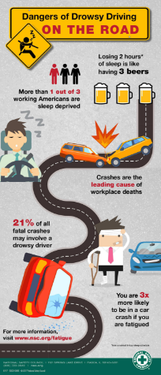
Whether you are driving on the job, commuting to or from work, or are off the clock…make sure you are not too drowsy to drive.
Pull over to a safe place and take a 15-20 minute nap if possible
If you are extremely fatigued, don’t attempt to drive; call a friend, family member, colleague, fleet dispatch, cab or ride share to complete your trip safely
Notes:
Whether you are driving on the job, commuting to or from work, or are off the clock, make sure you are not too drowsy to drive. Pull over to a safe place and take a 15-20 minute nap if possible. If you are extremely fatigued, do not attempt to drive; call a friend, family member, colleague, fleet dispatch, cab or ride share to complete your trip safely.

Slide 13
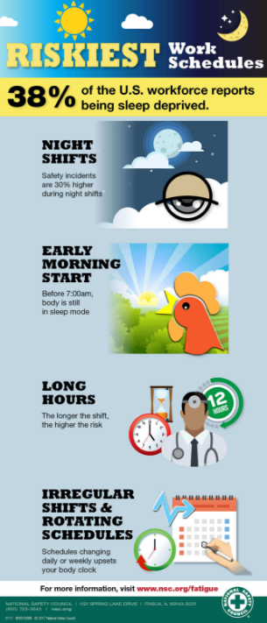
Shift Workers
About 15% of the U.S. workforce does not keep a traditional schedule.
Drivers
Law enforcement
First responders
Nurses and doctors
Because of this schedule, their body’s internal clock, or circadian rhythm, is out of sync. The circadian rhythm tells the body to become alert in morning and drowsy at night and produces sleep-promoting chemicals like melatonin.
Even though their schedules may be different, shift workers still need the same amount of sleep.
Notes:
Shift workers
About 15 percent of the U.S. workforce is comprised of workers who do not keep a traditional schedule. They include drivers, law enforcement, first responders, nurses and doctors. Because of this schedule, their body’s internal clock, also known as the circadian rhythm, is out of sync. The circadian rhythm tells the body to become alert in the morning and drowsy at night and produces sleep-promoting chemicals like melatonin. Even though their schedules may be different, shift workers still need the same amount of sleep.

Slide 14
National Sleep Foundation Recommendations for Shift Workers
Avoid long commutes and extending working hours
Take several short breaks throughout the shift and remain active during breaks
Drink—but don’t overdo—caffeinated beverages as needed throughout shift
Use a “buddy system” of other coworkers to keep each other alert
Wear dark glasses to block the sun on your commute home
Keep a consistent bedtime and wake schedule
Eliminate light and noise from your sleep environment
Notes:
The National Sleep Foundation recommends the following for shift workers:
• Avoid long commutes and extending working hours • Take several short breaks throughout the shift and remain active during breaks
• Drink—but don’t overdo—caffeinated beverages as needed throughout shift • Use a “buddy system” of other coworkers to keep each other alert
• Wear dark glasses to block the sun on your commute home • Keep a consistent bedtime and wake schedule • Eliminate light and noise from your sleep environment

Slide 15
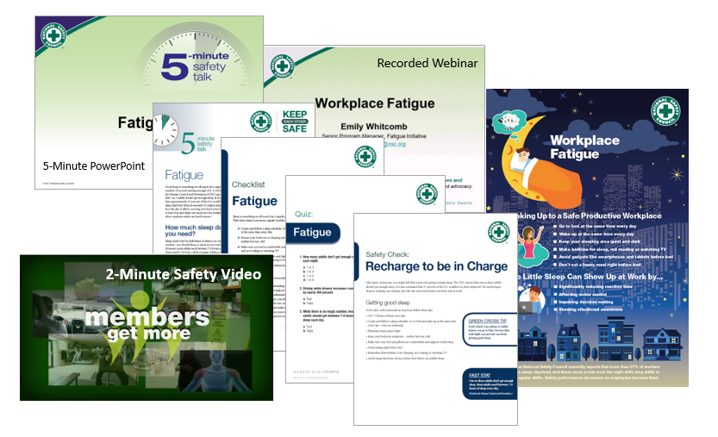
NSC Fatigue Safety Toolkit
Visit nsc.org/members to download this toolkit and other great resources.

Slide 16
Learn more at nsc.org/fatigue

Slide 17
For more member-exclusive safety presentations, webinars, posters and resources sign in at nsc.org/members
Customer Service – (800) 621-7619
Outside U.S. – +1-630-775-2056
Email us at:
MEMBERSHIPINFO@nsc.org

