Slide 1
CHAPTER 5
Occupational Exposure Limits and Assessment of Workplace Chemical Risks

Slide 2
Learning Objectives
Describe how occupational exposure limits (OELs) are used in workplace risk assessment.
Identify the key components of an OEL.
Identify the OELs created by various organizations.
Outline the process of OEL derivation.
Apply available information to working conditions to assess hazardous exposure levels.

Slide 3
Role of OELs In Workplace Risk Assessment
Hazard characterization
Dose-response assessment
Exposure assessment
Risk characterization

Slide 4
Importance of OELs
Provide a scientific basis to evaluate existing exposure control technologies and to identify worker health and medical surveillance needs
Promote risk communication by informing workers of potentially adverse health effects of chemical exposure
Provide a benchmark for exposure assessment comparisons

Slide 5
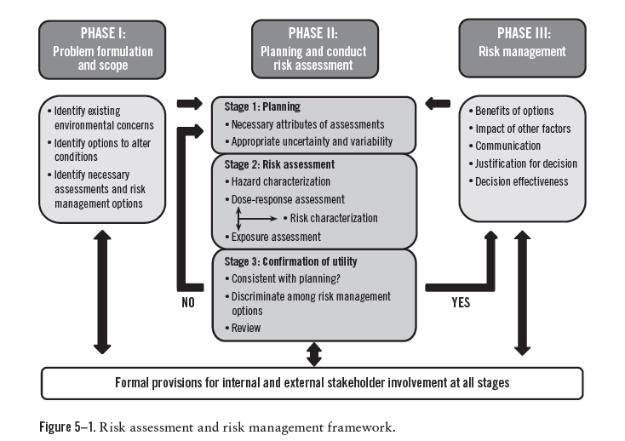

Slide 6
OEL Elements
Concentration units
Recommended Time Weighted Average (TWA)
Additional notations

Slide 7
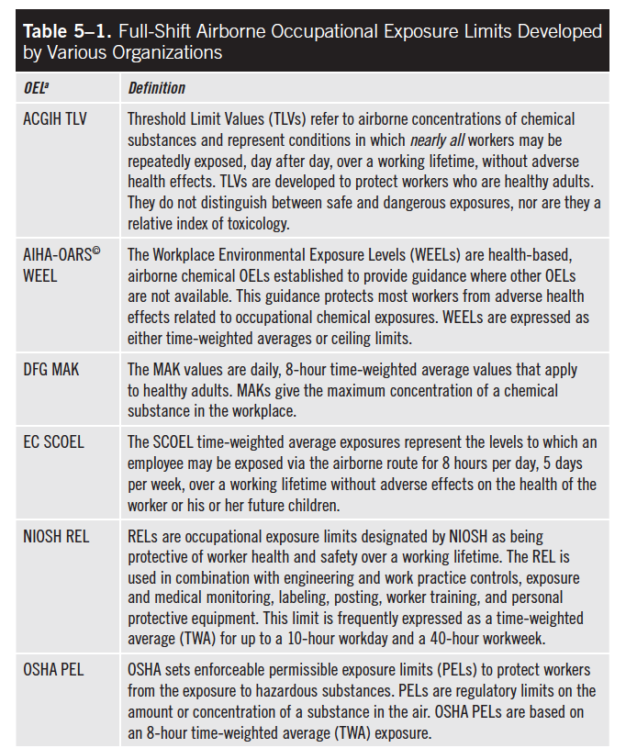

Slide 8
Short-Term Exposure Limit (STEL)
A time-weighted average exposure limit whose averaging time is short
In most organizations, a STEL is a 15-minute TWA exposure limit, although other averaging times can be specified for a given chemical.

Slide 9
Ceiling Limit
A maximum exposure, or ceiling limit that should not be exceeded at any time during the workday

Slide 10
Hazard Notations
Additional factors may affect the interpretation or use of OELs such as
toxicity via skin absorption
potential for sensitization
carcinogenicity

Slide 11
Fundamentals of OEL Derivation
Define the scenario and develop the problem formulation.
Gather and summarize the scientific literature.
Select a dose point that will protect workers from the chemical’s toxic effect.
Perform extrapolations to increase the relevance of the point of departure:
Adjust for route of exposure and exposure duration/patterns using default assumptions on rates of ingestion/inhalation or physiologically based pharmacokinetic (PBPK) models.
Perform animal-to-human extrapolations and human variability extrapolations
Apply any additional uncertainty factors
Submit the value for external review.

Slide 12
No Observable Adverse Effect Level (NOAEL)
The highest dose that does not cause an adverse effect

Slide 13
Lowest Observable Adverse Effect Level (LOAEL)
The lowest dose that causes an adverse effect

Slide 14
Point of Departure (POD)
The NOAEL or LOAEL that best identifies the boundary of the onset of adverse effects is selected for OEL derivation

Slide 15
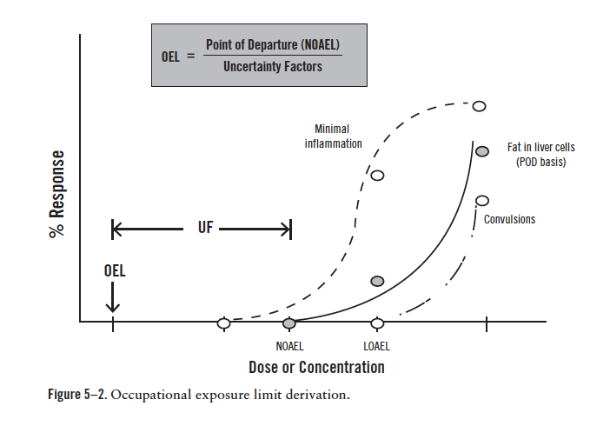

Slide 16
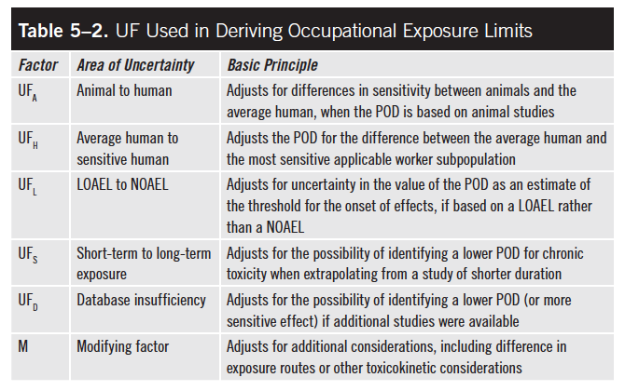

Slide 17
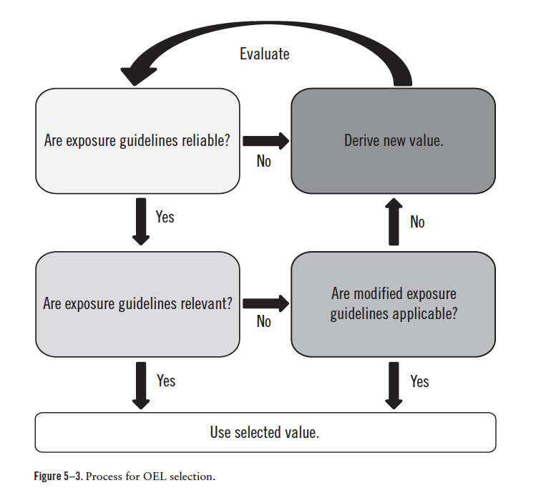

Slide 18
