Slide 1
Fundamentals of Industrial Hygiene 6th Edition
Part III: Recognition of Hazards
Chapter 10:
Ionizing Radiation
Compiled by Allen Sullivan,
Assistant Professor, Safety and Health Management Central Washington University

Slide 2
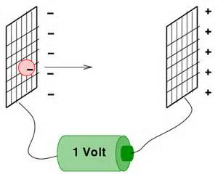
Introduction
Ionizing radiation is a general term used to refer to those particles energetic enough to knock electrons out of their orbits, generating ions in the process.
electron volts (eV)
kinetic energy gained by an electron falling through a potential of 1 volt
absorbed dose (ergs/gram)
the amount of energy ionizing radiation deposits in a target material (energy per mass)
health risk is proportional to absorbed dose

Slide 3
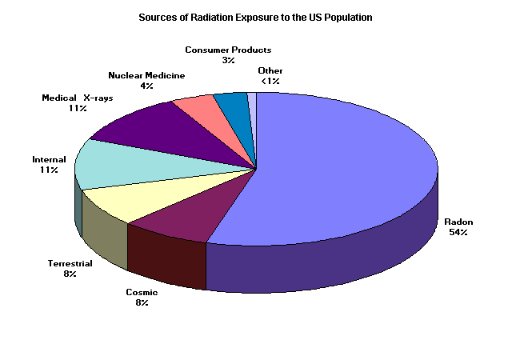
Ionizing Radiation Sources
Producers of ionizing radiation are commonly referred to as sources, some of which are natural and some man-made.
cosmos
magnetic field (exposure higher at poles)
atmosphere (exposure higher at high elevations)
radioactive materials
unstable forms of elements
radiation-producing machines
nuclear reactors
nuclear weapons and testing
immediate release and fall-out

Slide 4
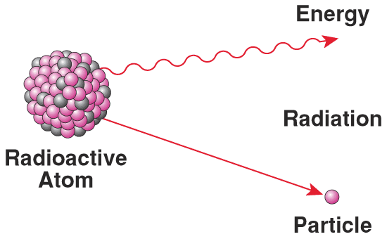
Radiation v. Radioactivity
These terms have different meanings, and it is important for the safety professional to understand the difference.
radioactivity: describes the characteristics of a material as having an unstable nucleus that decays, releasing ionizing radiation
radiation: energy and/or energetic particles released from a source

Slide 5
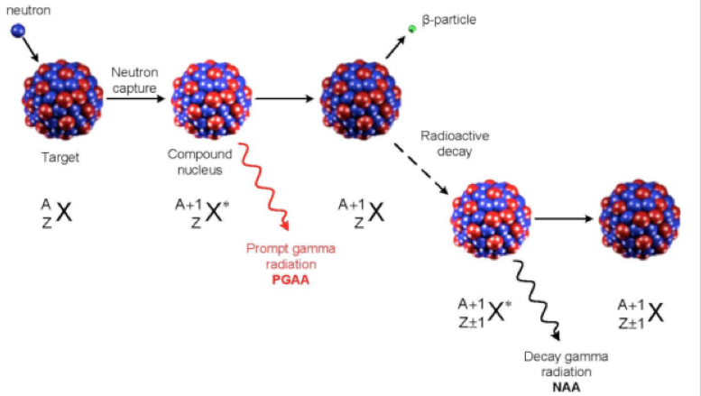
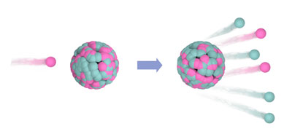
Production of Radioactive Material
There are several processes by which non-radioactive elements may become radioactive.
activation: bombarding something that is not radioactive with ionizing radiation
fission and spallation
Fission: breaking up of atoms in a reactor
Spallation: breaking up of atoms in non-reactor settings
contamination: spilling radioactive material onto something else (e.g., fall-out)
if radioactive contamination can be removed, the item will no longer be radioactive

Slide 6
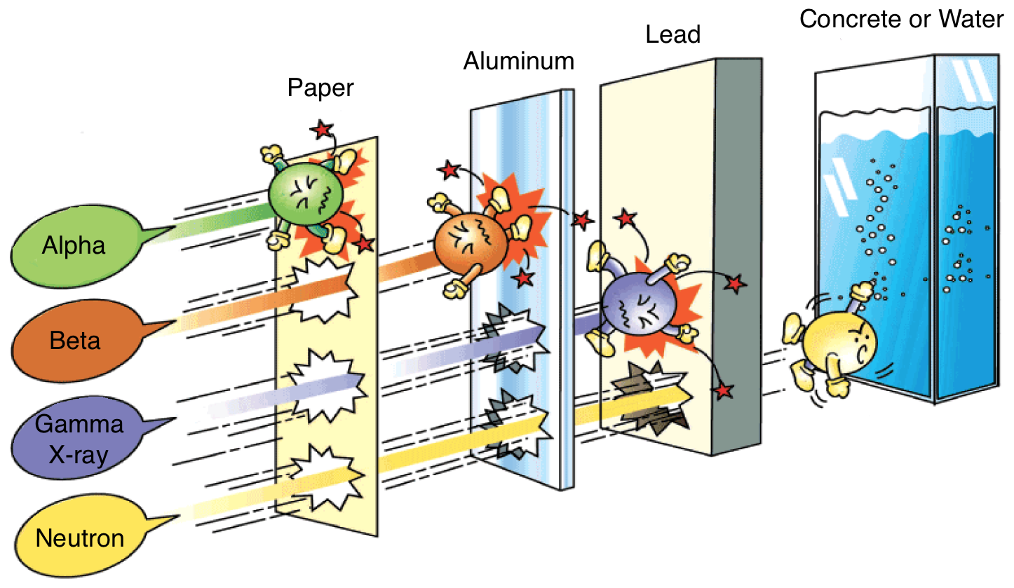
Linear Energy Transfer
Linear energy transfer (LET): The amount of energy ionizing radiation deposits per unit distance.
range: the distance travelled from its source until the particles have lost so much kinetic energy that they are no longer able to ionize materials.
range depends on:
mass and charge of the particle
energy of the particle
material through which it is travelling
high LET vs. low LET
Ionizing radiation with a high LET deposits its energy rapidly, thus, it has a short range.

Slide 7
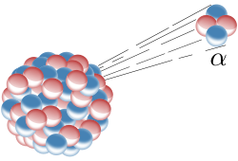
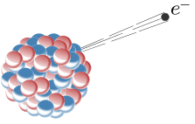
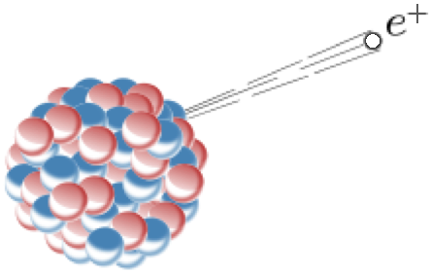
Types of Radiation
Directly ionizing
alpha particles
two protons and two neutrons (++)
high LET
shielding provided by a short distance of air, sheet of paper, epidermis
can provide a lethal dose if inhaled or ingested
beta particles
electrons (-) and positrons (+)
low LET
shielding provided by moderate thickness of plastic or aluminum
primarily an internal radiation hazard
can penetrate the skin and lens of the eye
can produce Bremsstrahlung
secondary radiation in the form of x-rays

Slide 8
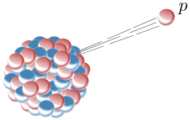
Types of Radiation (cont.)
protons (+)
low LET
near end of path through a material, it deposits a relatively large amount of energy (high LET)
Bragg Peak
major component of cosmic radiation
very difficult to shield

Slide 9
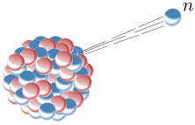
Types of Radiation (cont.)
Indirectly ionizing
neutrons (no charge)
high LET
may cause some encountered nuclei to break apart (spallation)
resulting in emission of positive ions
may undergo other reactions
resulting in emission of alphas, protons, more neutrons
difficult to shield; need thick layer of high-hydrogen content material (e.g., water, paraffin, concrete)

Slide 10
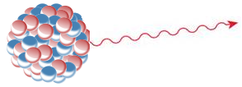
Types of Radiation (cont.)
ionizing electromagnetic radiation
gamma rays and x-rays
description of EMR
wave theory
particle theory (photons)
the more energetic the radiation, the shorter its wavelength and the higher its frequency
visible light ranges from 700 nm (red) to 400 nm (violet)
at wavelengths <300 nm, EMR begins to be capable of producing ionization
requires lead shielding

Slide 11
Radioactivity
Radioactive materials have some characteristics that present special safety challenges:
cannot be switched on or off
each radioisotope decays at its own rate (can’t be changed)
radioactive materials occur naturally and are everywhere
behave biologically identical to non-radioactive isotopes
are in a dispersible form when created artificially
human activities can increase exposures

Slide 12
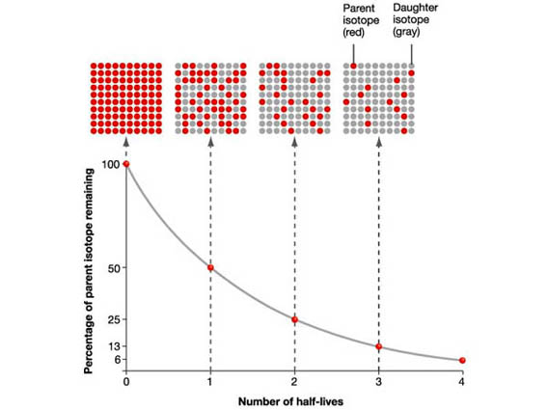
Half-Life
Half-life: The time it takes for half of the unstable nuclei of a radioisotope to decay to a different isotope (t_{1/2}(phys)).
a long half-life does not automatically make a radioactive material more of a hazard
radiation dose a person can receive is what matters
becquerel (Bq)
the SI unit of radioactivity
one radioactive decay per second

Slide 13
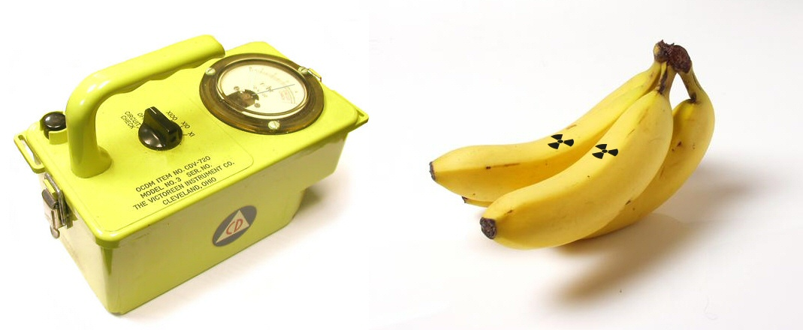
Effects of Radiation on the Body
All humans contain radioactive substances in their bodies.
The fact that a substance is radioactive does not affect how it is transported or used inside a plant or animal.
A radioactive substance that is taken in may be:
promptly exhaled or excreted
trapped in the lungs
distributed fairly uniformly throughout the body
concentrated in one or more particular organs

Slide 14
Radioactive Materials in the Body (cont.)
biological half-life (t_{1/2}(bio))
time it takes for half of any substance to be eliminated from the body as a result of natural biological processes
effective half-life (t_{1/2}(eff))
the time it takes for half of any radioactive substance to be eliminated from the body as a result of radioactive decay and natural biological processes
shorter than the physical half-life or biological half-life

Slide 15
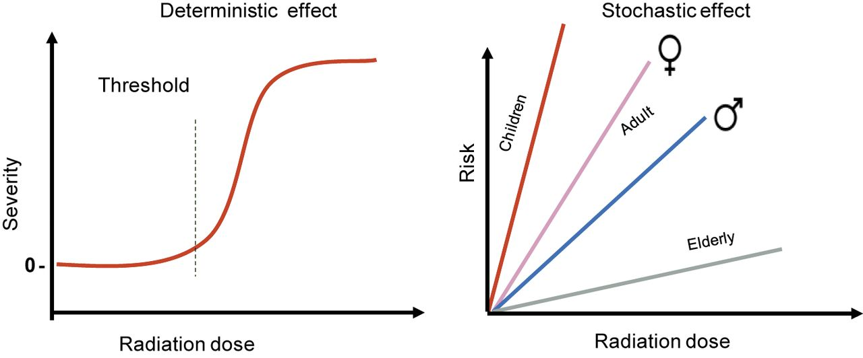
Radiation Health Effects
Deterministic effects: Health effects that all individuals will experience if the dose is large enough.
once the threshold for the effect has been exceeded, the severity depends on the magnitude of the agent
Stochastic effects: Health effects that only some individuals (pre-disposed) will experience.
the risk of developing a particular condition or disease increases with increasing exposure to an agent

Slide 16
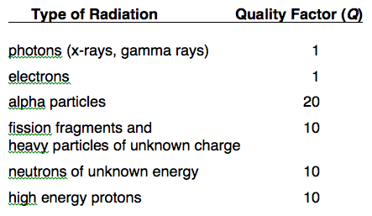
Radiation Biology
relative biological effectiveness
how effective a particular type of radiation is at producing a specific biological outcome (e.g., sterilizing instruments, causing lung cancer)
quality factor
used in radiation protection standards to allow the use of a single set of ionizing radiation limits, regardless of the type of ionizing radiation

Slide 17
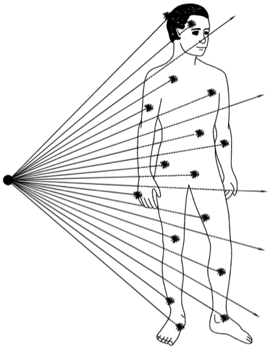
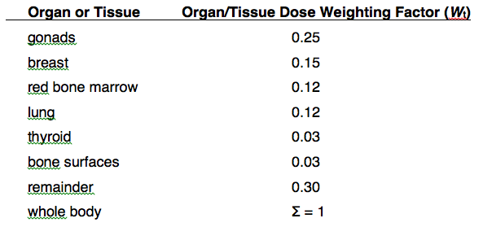
Radiation Biology (cont.)
tissue dose weighting factor
takes into account whether an individual received a total-body uniform dose, or if only certain organs were irradiated

Slide 18
Quantifying Radiation
External Radiation Sources
dose equivalent
identical doses of two different types of radiation may cause different health impacts
(this is where the radiation quality factor comes in)
deep dose equivalent (≥1 cm deep exposures)
lens dose equivalent (eye exposures)
shallow dose equivalent (skin exposures)

Slide 19
Quantifying Radiation (cont.)
Internal + External Radiation Sources
committed dose equivalent
the total dose equivalent delivered to a particular organ or tissue in the 50 years following the intake of the radioactive material
committed effective dose equivalent
takes takes into account which body tissues or organs receive the radiation
(this is where the tissue dose weighting factor comes in)

Slide 20
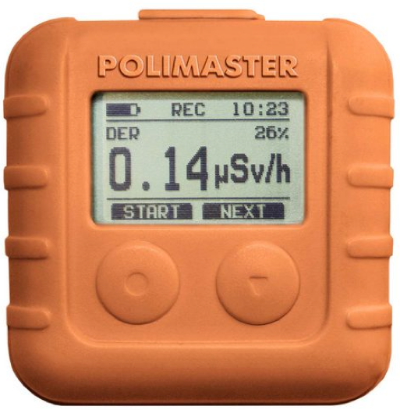
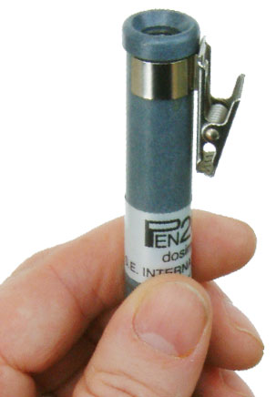
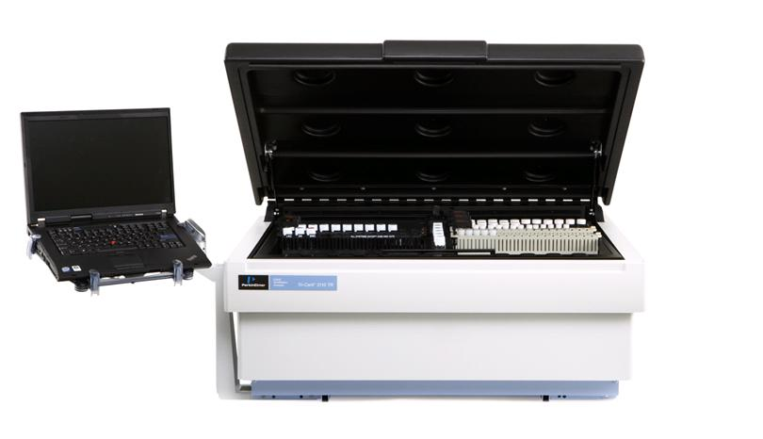
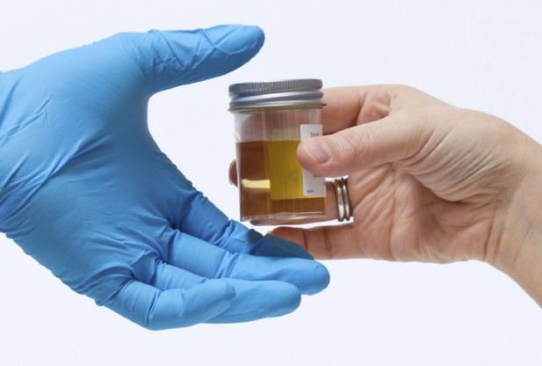
Detection and Measurement of Radiation
dosimeters
used for passive monitoring of personnel and areas
film badges, pen dosimeters, luminescent badges
multiple dosimeters may be placed on different body parts
liquid scintillation counters
used to check for contaminations (wipes)
bioassays
assess ingestion/inhalation through urinalysis, fecal analysis, etc.

Slide 21
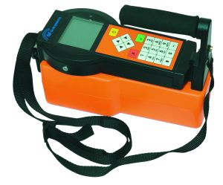
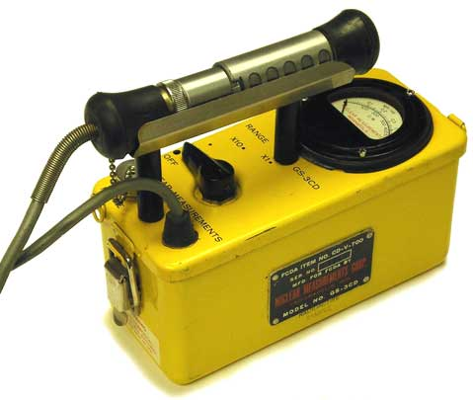
Detection and Measurement of Radiation (cont.)
gamma spectroscopy
examines the energies of detected photons to identify radionuclides
Geiger-Mueller counters
used to detect photons and electrons
usually calibrated for a single radiation type

Slide 22
Radiation Standards
scientists and advisory groups
Regulatory agencies worldwide base their radiation dose limits on the work of scientists and advisory groups.
Continually revising and updating their recommendations on:
dose determination methods
appropriate weighting factors
dose limits

Slide 23
Radiation Regulatory Agencies
Complicated framework in the United States
different regulations depending on:
location
facility/activity type (e.g., research, power production, medicine, transport)
kinds of radiation sources present
quantities of sources present
different agencies involved:
Nuclear Regulatory Commission (NRC)
Environmental Protection Agency (EPA)
Occupational Safety and Health Administration (OSHA)
Department of Transportation (DOT)
others

Slide 24
Radiation Regulations
Occupational doses
much consistency in the United States
Radiation safety standards also include requirements for:
registration and licensing of radiation sources
radiation monitoring
testing of safety features on containers
incident reporting
shipping and disposal of radioactive materials
training
security
labeling
record-keeping

Slide 25
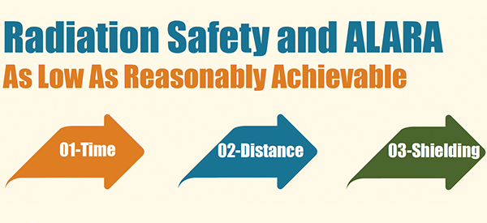
Radiation Protective Measures
U.S. regulations stress the goal of keeping radiation doses as low as reasonably achievable (ALARA).
Three factors are critical to reducing dose levels:
time
halving the exposure time halves the dose
distance
increasing the distance between a person and the source decreases the dose (inverse square law)
shielding
best material for shielding should be evaluated on a case-by-case basis

