Slide 1
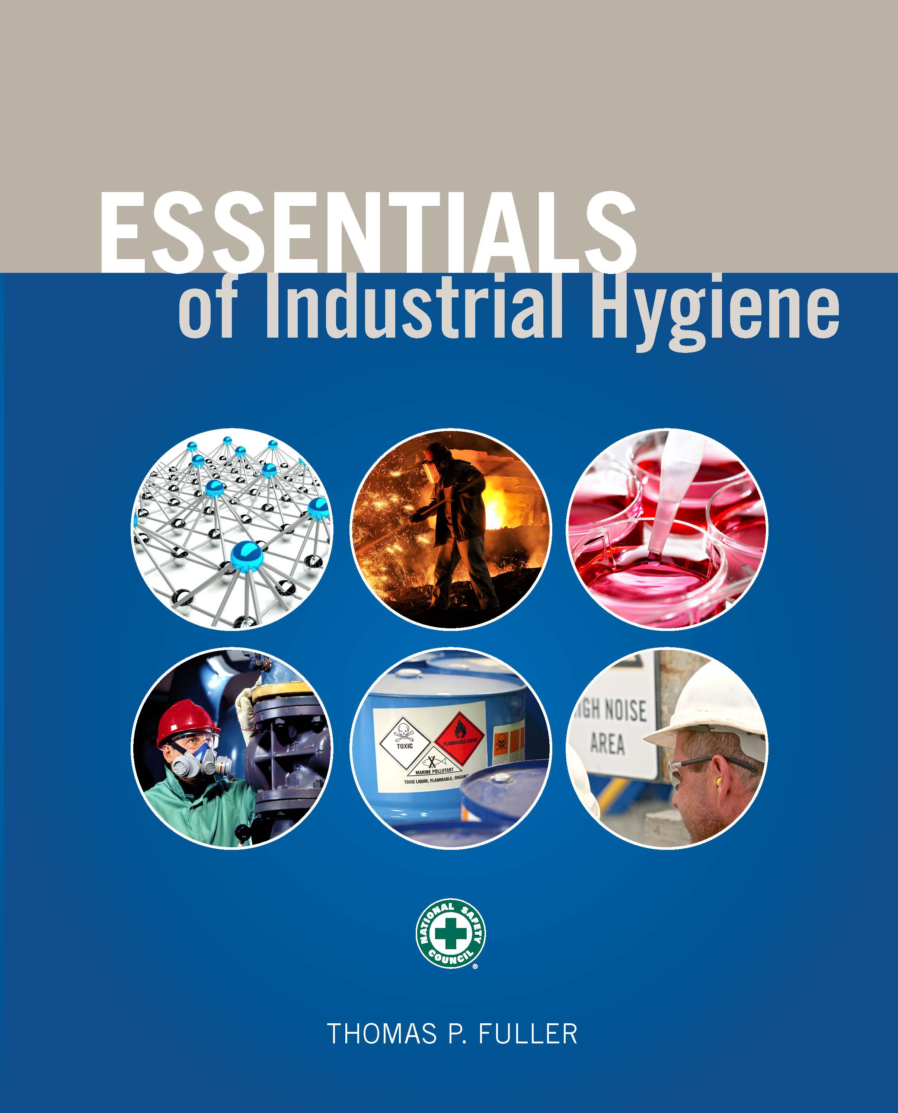
Chapter 2
The Occupational Safety and Health Act and Industrial Hygiene

Slide 2
Learning Objectives
Understand the various branches of the U.S. government and their respective roles in the development of industrial hygiene regulations.
Identify federal agencies and commissions and their responsibilities for occupational health and safety.
Describe how the Occupational Safety and Health Act (OSH Act) was created and what the various sections of the act require.
Explain the different types of rules, regulations, and standards and how they are created.
Understand OSHA inspection and enforcement programs and practices.
Identify other sources of important information available from OSHA.

Slide 3
The OSH Act
In 1970, the Occupational Safety and Health Act (OSH Act) was passed in order to prevent workers from being killed or seriously harmed while at work.

Slide 4
The Constitution
Fourth Amendment
protects citizens from unreasonable search and seizure
extends to organizations and businesses; a federal organization such as OSHA cannot enter property or conduct a search of an operation without a warrant or permission from the owner

Slide 5
The Constitution (cont.)
Fifth Amendment
prohibits citizens from being subject to criminal prosecution and punishment without due process
private property cannot be seized for public use without just compensation
protects a company’s operations or products from harm and sets specific limits on when the government can interfere with operations to protect the public health and safety

Slide 6
The Constitution (cont.)
The Sixth Amendment
provides the accused the right to compel testimony from witnesses and to legal representation
expert witnesses, such as industrial hygienists, may be a part of any judicial processes brought against a company
cases decided by facts and information through due process
preponderance of evidence is enough to convict

Slide 7
Branches of Government
Executive
Office of the President
Legislative
House of Representatives
Senate
Judicial
District, Appeals Courts (13), Supreme

Slide 8
Legislative Process
Introduction of a bill
Subcommittee review
Full Committee
House of Representatives/Senate
Federal Register
Code of Federal Regulations

Slide 9
Federal Agencies and Commissions
OSHA is not the only federal agency charged with protecting worker safety and health.
Any other federal agency with workers that are affected by the actions that fall under the purview of the agency are responsible for promulgating and enforcing regulations to protect workers, the general public, and the environment.

Slide 10
Federal Agencies and Commissions (cont.)
Federal Communications Commission
Nuclear Regulatory Commission
Mine Safety and Health Administration
Environmental Protection Agency

Slide 11
State Government
10th Amendment gives powers to the states.
“Agreement States” have taken on responsibilities for regulating and enforcing occupational safety on a state level.

Slide 12
Prior to OSHA
1911 – Triangle Shirtwaist Fire
1913 – Bureau of Labor
1918 – Federal Compensation Act/Office of Worker’s Compensations
1934 – Bureau of Labor Standards
1935 – National Labor Relations Act
1936 – Walsh-Healy Act

Slide 13
Contributory Negligence
Relieved employers of responsibility if the actions of their employees contributed to their own injuries

Slide 14
The Fellow Servant Rule
Stated that employers were not liable for workplace injuries that resulted from the negligence of other workers.

Slide 15
Assumption of Risk
The notion that workers who accept payment for work should assume that there will be risks involved in doing that work.

Slide 16
Williams-Steiger Occupational Safety and Health Act
Section 2 – Purpose
to assure so far as possible every working man and woman in the Nation safe and healthful working conditions and to preserve our human resources

Slide 17
Williams-Steiger Occupational Safety and Health Act (cont.)
Section 4 – OSH Act’s coverage
applies to employment performed in a workplace in a state, the District of Columbia, and territories of the United States
does not apply to working conditions in industries and areas in which other federal agencies exercise statutory authority to prescribe or enforce standards or regulations affecting occupational safety and health
does not apply to sole proprietors when the owner is the only worker, to farms with fewer than 10 workers, or to businesses in which workers are family members

Slide 18
Williams-Steiger Occupational Safety and Health Act (cont.)
Section 8 – inspections, investigations, and record keeping
Section 9 – citations
Section 10 – enforcement
Section 11 – judicial review
Section 12 – Occupational Safety and Health Review Commission

Slide 19
Williams-Steiger Occupational Safety and Health Act (cont.)
Section 13 – proceedings to counteract imminent dangers section
Section 17 – penalties
Section 18 – state plans section
Section 19 – federal agency safety programs and responsibilities
Section 20 – research and related activities

Slide 20
Williams-Steiger Occupational Safety and Health Act (cont.)
Section 21 – training and employee education
Section 22 – National Institute for Occupational Safety and Health
Section 27 – National Commission on State Workmen’s Compensation Laws

Slide 21
Types of Rules
Specification standards
rules that say exactly what engineering or design criteria must be met to protect workers from a particular hazard.
Performance standards
rules that require certain conditions to be met, such as the air concentrations of a chemical in the workplace

Slide 22
Types of Rules (cont.)
Vertical standards
apply only to the industry where a particular hazard exists
Example: rules only for grain handling facilities
Horizontal standards
apply to nearly any workplace or industry
Example: rules regarding walking and working surfaces in any workplace

Slide 23
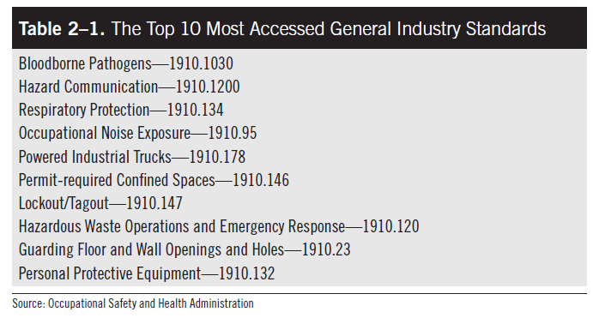
Types of Rules (cont.)

Slide 24
Important Subparts
D – walking and working surfaces
H – storing and handling hazardous materials
I – personal protective equipment, respiratory protection
J – environmental controls, postings, confined space, hazardous energy, lockout/tagout
K – medical services and first aid
L – fire protection
Z – limits for hazardous chemicals, training

Slide 25
Enforcement
Programmed
Special emphasis
Regional emphasis
Local emphasis
Severe violator enforcement

Slide 26
Inspection Priorities
Imminent danger of injury or illness
Fatality or catastrophe
Complaint or request
Programmed

Slide 27
Inspection Process
Opening conference
Site tours, review of records, workplace and worker observations and interviews
Site assessment including monitoring or conducting surveys
Closing conference
Written citations (within six months)
Post citations at the workplace
Contest citations in writing within 15 days

Slide 28
Other Important OSHA Information
Fatality and catastrophe reports
Occupational safety statistics
Frequent violations
Accident and injury rates by industry
Training materials
Guidance documents
E-learning tools

