Slide 1
Fundamentals of Industrial Hygiene 6th Edition
Part VII: Government Regulations and Their Impact
Chapter 30:
Government Regulations
Compiled by David C. May,
Associate Professor, Safety and Occupational Health Applied Sciences Keene State College

Slide 2
The OSHAct
“…to assure so far as possible every working man and woman in the Nation safe and healthful working conditions and to preserve our human resources.”
–OSHA Act of 1970"
Notes:
2

Slide 3
Key Provisions
Empower the Sec. of Labor to issue safety and health standards
Procedures for investigating violations at employer worksites, including
interview of employees, use of walk-around representatives
issue monetary penalties
require certain recordkeeping

Slide 4
Key Provisions
Provide up to 50/50 funding of states that wish to establish a program at least as effective as the federal OSHA program (State Plans)
Provide funds to state governments and other entities to conduct on-site consultations for employers upon request

Slide 5
Duties in the Act
General duty provision (section 5 (a)(1))
“Each employer shall furnish to each of his employees employment and a place of employment which are free from recognized hazards that are causing or are likely to cause death or serious physical harm to his employees.”
Notes:
5

Slide 6
Duties in the Act (cont.)
5(a)(2) Each employer shall comply with occupational safety and health standards promulgated under this Act.
Notes:
6

Slide 7
Duties in the Act (cont.)
5(b) Each employee shall comply with occupational safety and health standards and all rules, regulations, and orders issued pursuant to this Act which are applicable to his own actions and conduct.
Notes:
7

Slide 8
OSHA Coverage
Private sector employees
Federal employees
Not Covered
State/municipal workers (subject of occasional Congressional interest)
although OSHA requires it of State-Plan States
Self-employed
Workers covered by other agencies claiming safety and health coverage
Notes:
8

Slide 9
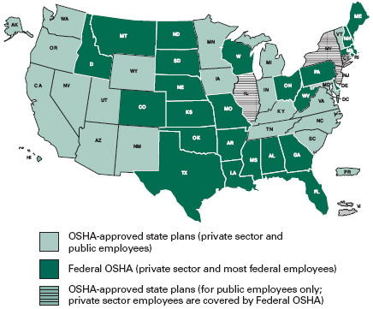
State Plans
State Plan States and Federal OSHA
Notes:
9

Slide 10
OSHA Standards
Specification standards – explicit details, construction/design
Performance standards – broad objective, flexible implementation

Slide 11
OSHA Standards (cont.)
Vertical standards – apply to a particular industry
Horizontal standards – apply to any industry where the hazard exists.

Slide 12
Standards Adoption
OSHA was given the authority to adopt consensus standards or existing federal standards – for the first two years (1971 & 1972)
Sources included
American Standards Association (now American National Standards Institute, or ANSI)
Walsh-Healy Act Public Law 91-54 of 1969 (Construction Safety Act)
Service Contract Act of 1965
Notes:
12

Slide 13
Rulemaking Milestones (after 1971)
Advanced notice of proposed rulemaking
Proposed rule
Final rule
Challenges to rule
U.S. Court of Appeals (affected parties)
Congressional disapproval
Notes:
13

Slide 14
Inspections
Without advanced notice (normally)
Conducted by OSHA compliance safety and health officers (trained in safety and/or industrial hygiene)
Source: OSHA

Slide 15
Inspection Priority
Imminent danger
Fatality/catastrophes
Complaints/Referrals
Programmed inspections
Notes:
15

Slide 16
Unprogrammed Activity
Imminent danger
Fatality /catastrophes
Emergency Response
Complaints/Referrals
Whistleblower Complaints
Follow-ups and Monitoring
Notes:
16

Slide 17
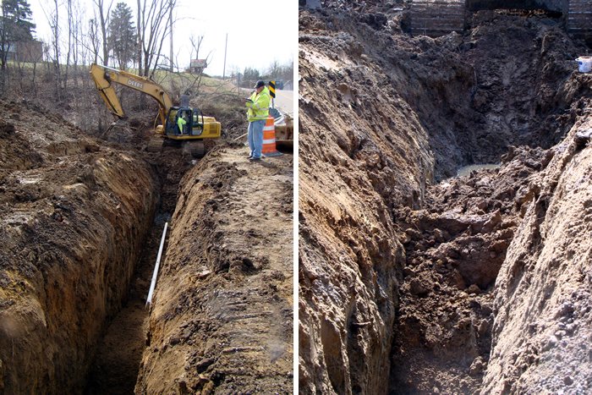
Programmed Inspections
Site-Specific Targeting (SST) Program
Construction Inspections
Special Emphasis Programs (SEPs)
Sever Violator Enforcement Program (SVEP)
Special Emphasis Program on Trenching and Excavation: Quick action by the OSHA inspector prevents possible death from this trench cave-in
Source: OSHA
Notes:
17

Slide 18
Inspection Procedures
Arrival and introduction (unannounced)
Opening conference
compulsory process if necessary (1903.4)
ex parte application
no waivers
review inspection procedures
review safety and health records
Notes:
18

Slide 19
Inspection Procedures (cont.)
Walk through, interviews with employees
Sampling (industrial hygiene inspections)
Evaluation of safety and health program
Closing conference
discuss apparent violations and abatement
Notes:
19

Slide 20
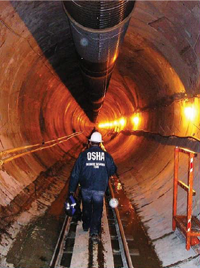
Citations
Standard violated
Abatement dates
can be adjusted by a Petition to Modify an Abatement date (PMA)
Penalties
Source: OSHA

Slide 21
Violations—Types
Other-than-serious
Serious
Willful
Repeat
Failure-to-Abate
Notes:
21

Slide 22
General Duty Clause Violations
The employer failed to keep the workplace free of a hazard to which employees of that employer were exposed.
The hazard was recognized.
The hazard was causing or was likely to cause death or serious physical harm
There was a feasible and useful method to correct the hazard
Notes:
22

Slide 23
Issuance of citation
Employer decision
Accept findings
Request informal conference
Notice of contest (within 15 working days)
OSHRC (independent commission) hearing
Commission (on appeal)
U.S. Court of Appeals
Supreme Court
Notes:
23

Slide 24
Employer Responsibilities
Find and correct hazards following all relevant OSHA standards
Notify OSHA of fatalities and/or catastrophes (i.e., three or more workers hospitalized) within 8 hours

Slide 25
Employer Responsibilities (cont.)
Inform and train employees
Provide necessary PPE
Post citations and OSHA Job Safety and Health Poster

Slide 26
Employee Rights
Employees can not be discriminated for:
asking OSHA to inspect their workplace or participating in the inspection
participating in safety and health activities
Workers have the right to
receive information about hazards in their workplace
get copies of
test results (hygiene sampling)
their medical record
OSHA injury and illness log of their workplace

Slide 27
OSHA Whistleblower Program Covers
Occupational Safety and Health Act
Surface Transportation Assistance Act
Asbestos Hazard Emergency Response Act
International Safe Container Act
Clean Air Act
Comprehensive Environ. Response, Compensation and Liability Act
Energy Reorganization Act
Federal Water Pollution Control Act
Pipeline Safety Improvement Act
Safe Drinking Water Act
Sarbanes-Oxley Act
Solid Waste Disposal Act
Toxic Substances Control Act
Wendell H. Ford Aviation Investment and Reform Act for the 21st Century
The Federal Rail Safety Act (FRSA)
National Transit Systems Security Act (NTSSA)
Consumer product safety Improvement Act
Affordable Care Act (ACA)
Dodd-Frank Wall Street Reform and Consumer Protection Act of 2010
Seaman’s Protection Act
FDA Food Safety Moderation Act (FSMA)
Notes:
27

Slide 28
Compliance Assistance and Resources
Compliance Assistance Specialist
OSHA Training Institute and Educational Centers
OSHA Website (www.osha.gov)
Consultation program (free on-site)
Voluntary Protection Programs (VPP)
Notes:
28

Slide 29
National Institute for Occupational Safety and Health (NIOSH)
Established by OSHAct (part of HHS)
Supports occupational safety and health research in academic centers
Responsible for identifying occupational safety and health
hazards and control recommendations

Slide 30
NIOSH Responsibilities
Training
NIOSH Education and Research Centers (ERCs)
Makes recommendations to OSHA and MSHA
Certifies Respirators (technical design review and tests)

Slide 31
NIOSH Initiatives
National Occupational Research Agenda
Establishes national OS&H priorities
Research-to-Practice (r2p)
Prevention through Design

Slide 32
NIOSH Initiatives
Total Worker Health
Health Hazard Evaluation Program
Conducts non-enforcement workplace health hazard assessments upon request, publishes findings

Slide 33
NIOSH Publications
NIOSH Pocket Guide to Chemical Hazards
Current Intelligence Bulletins and Alerts
NIOSH Manual of Analytical Methods
methods for sampling and analysis of contaminants in workplace air and in the blood and urine of workers

Slide 34
Other Regulatory Agencies
Mine Safety and Health Administration
Periodic inspection of mines, investigate mine accidents, develop mine standards
Environmental Protection Agency
Toxic Substances Control Act
PCBs, Asbestos (schools), Radon, Lead (residential)
Resource Conservation and Recovery Act
Solid waste
Cradle to grave approach
Comprehensive Environmental Response, Compensation, and Liability Act (CERCLA)
Super Fund
Worker Protection Standard for Agricultural Pesticides (pesticide safety standards)
Training, field reentry time
Indoor Air Quality
Research and Education

