Slide 1
Fundamentals of Industrial Hygiene 6th Edition
Chapter 21:
Dilution Ventilation of
Non-Industrial Workplaces
Compiled by Allen Sullivan,
Assistant Professor, Safety and Health Management Central Washington University

Slide 2
Introduction
Industrial hygienists usually get involved with heating, ventilating, and air conditioning (HVAC) systems in response to complaints about indoor air quality (IAQ).
HVAC systems are built to provide:
fresh air (provide sufficient oxygen)
clean air (maintain contaminant levels at acceptable levels)
tempered air (temperature and humidity regulation)
maintain odors at acceptable levels

Slide 3
Fresh Air Quantity
The recommended quantity of fresh air (cfm OA/person) has varied over the years.
In commercial buildings, heating, air conditioning, and ventilation account for about 50% of energy consumed by building.
buildings constructed in the 1970s and 1980s
OA supply rates as low as 5 cfm OA/person
also:
new building methods
new building materials
new furnishings
new maintenance/cleaning products

Slide 4
Fresh Air Quantity (cont.)
Since the 1980s, building and ventilation standards have been revised:
IAQ considerations now a selection criterion for materials and furnishings
building managers more aware of impacts of maintenance and landscaping activities on IAQ
elimination of smoking in most occupancies
more attention of role of microorganisms on IAQ
Note: Currently, the American Society of Heating, Refrigerating, and Air-Conditioning (ASHRAE) recommends 15–20 cfm OA/person.

Slide 5
HVAC Systems
HVAC implies mechanically ventilating, heating, cooling, humidifying, dehumidifying, and cleaning air for comfort, safety, and health.
HVAC systems also provide for odor control and maintenance of oxygen and carbon dioxide levels.
zoned systems
constant air-volume (CV) systems
variable air-volume (VAV) systems
relationship of horsepower and fan speed

Slide 6
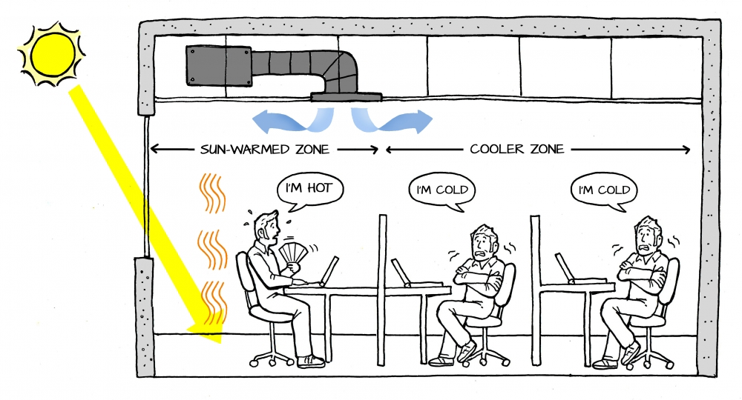
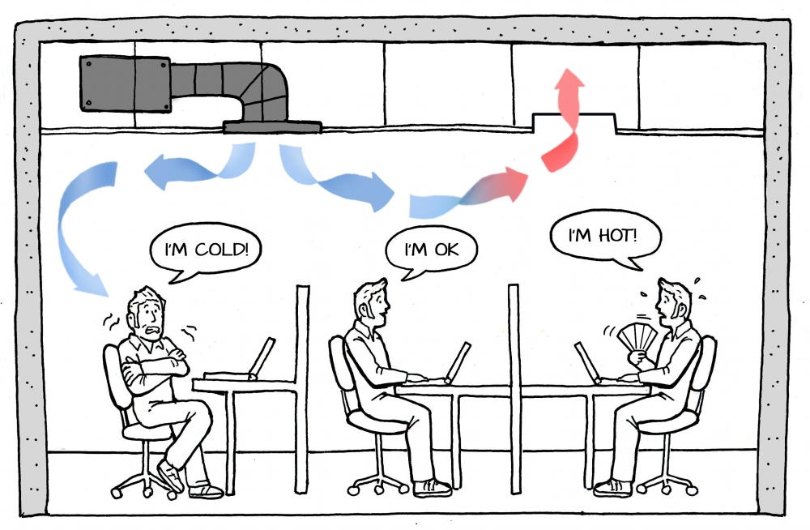
Zoning

Slide 7
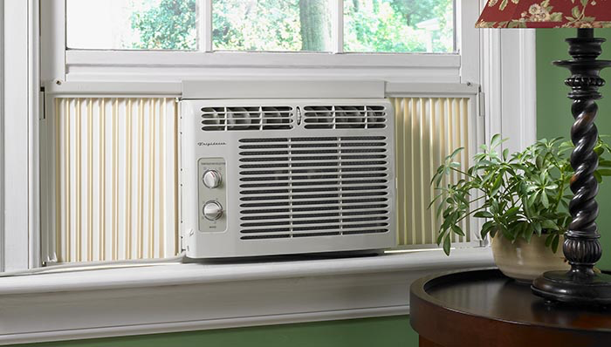
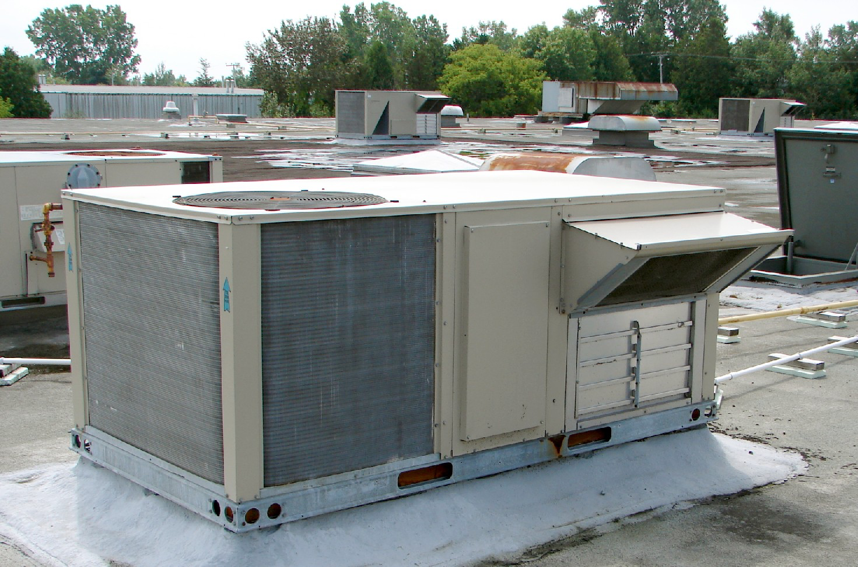
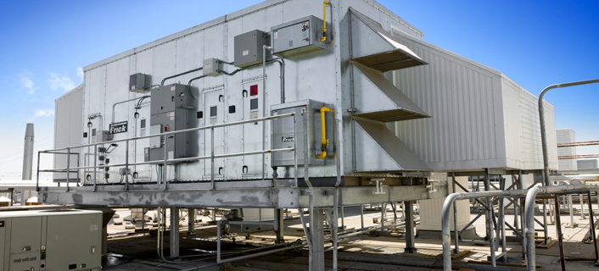
Terms
Heating, ventilating, and air conditioning (HVAC) system
Air-handling unit (AHU)

Slide 8
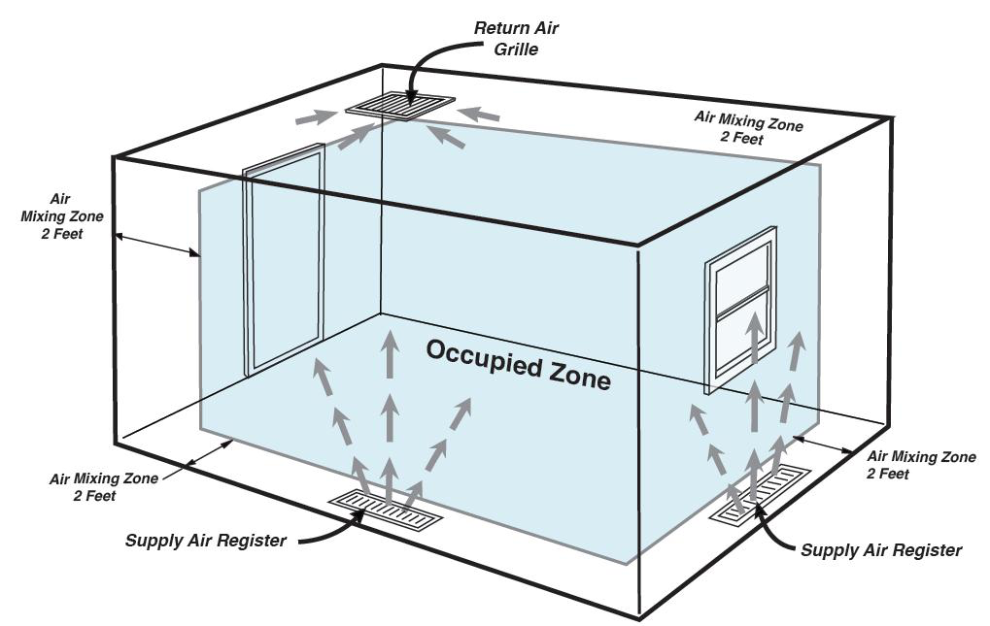
Terms (cont.)
Occupied zone
Acceptable indoor air quality

Slide 9
Terms (cont.)
Outdoor air (OA)
Return air (RA)
Exhaust air (EA)
Mixed air (MA)
Supply air (SA)
Bypass air (BA)

Slide 10
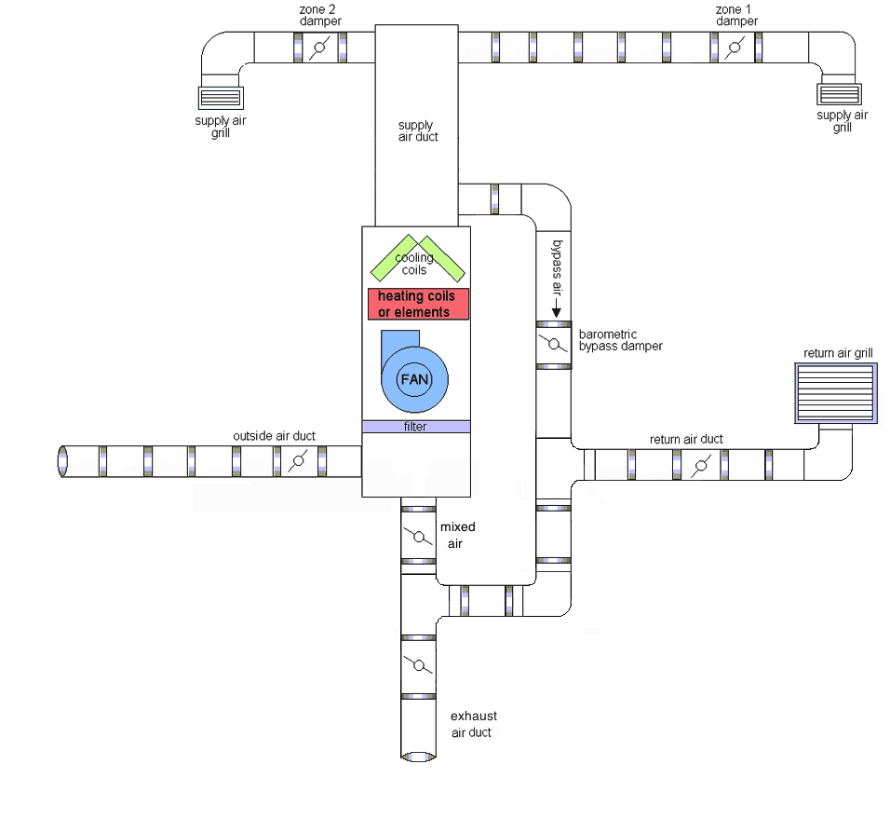
Air Circulation in an HVAC System

Slide 11
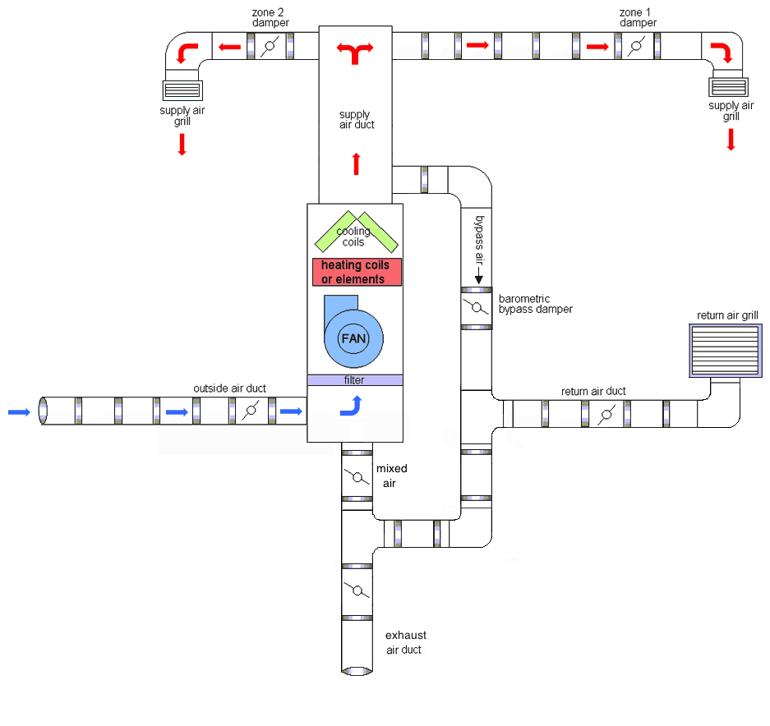

Slide 12
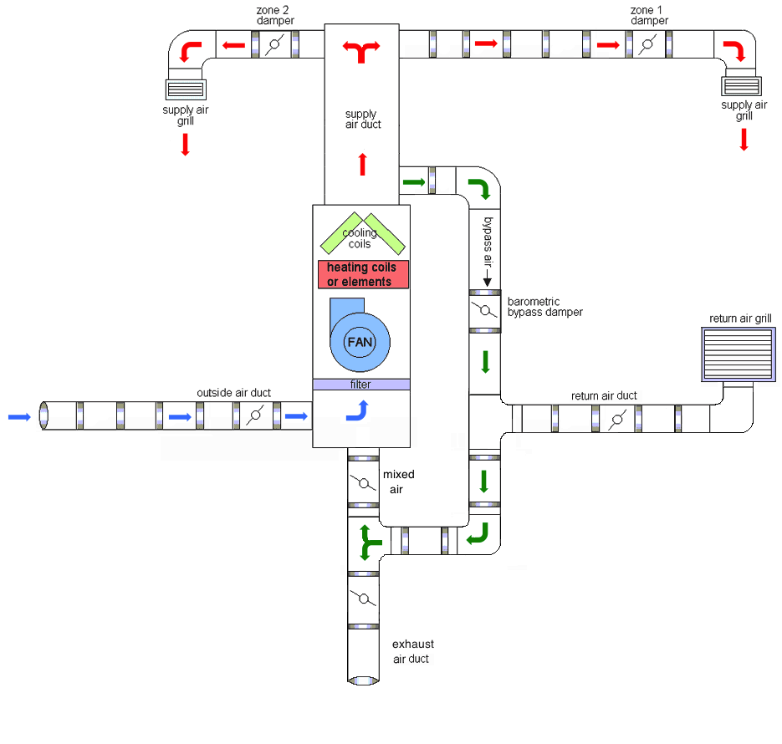

Slide 13
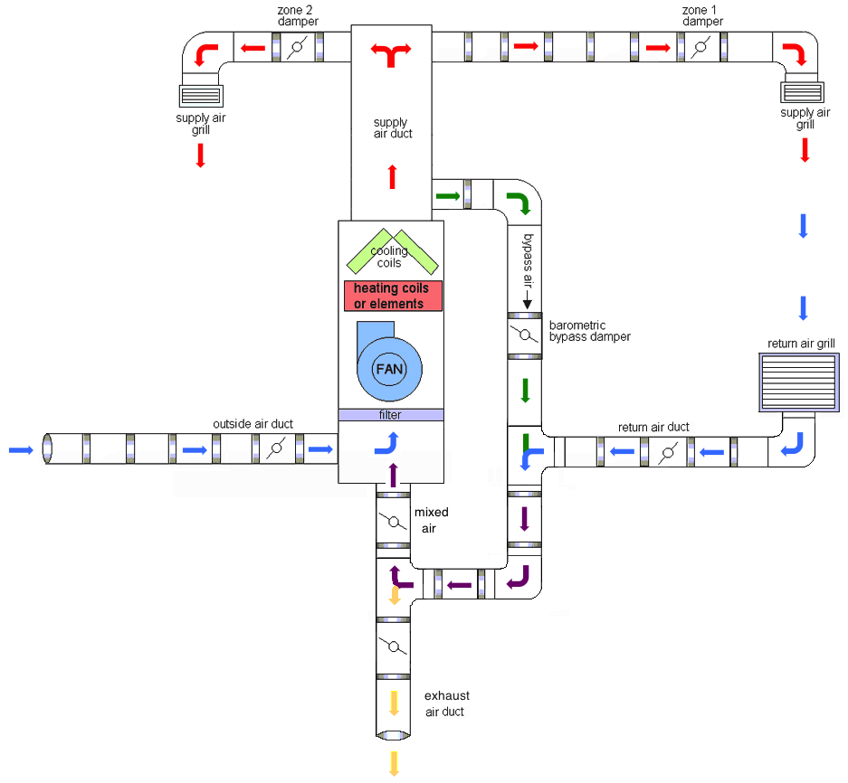

Slide 14
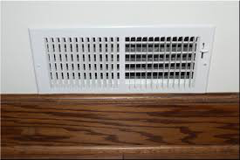
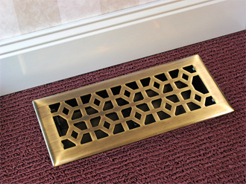
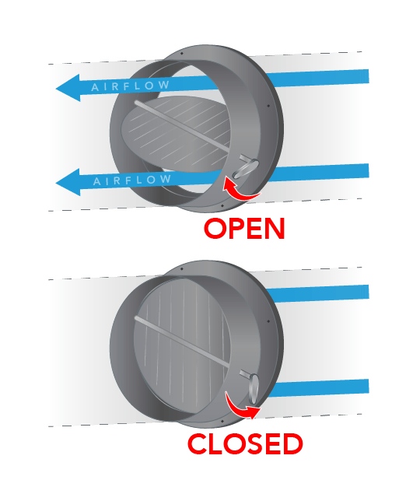
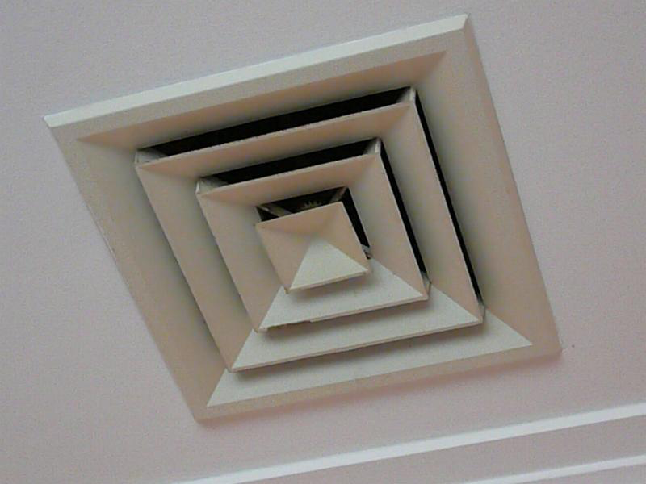
HVAC System Components
Unit ventilators
Dampers
fire dampers
Terminal devices
improper or malfunctioning devices
obtaining good air mixing
thermal comfort considerations
Return air systems
Ducts
cleaning

Slide 15
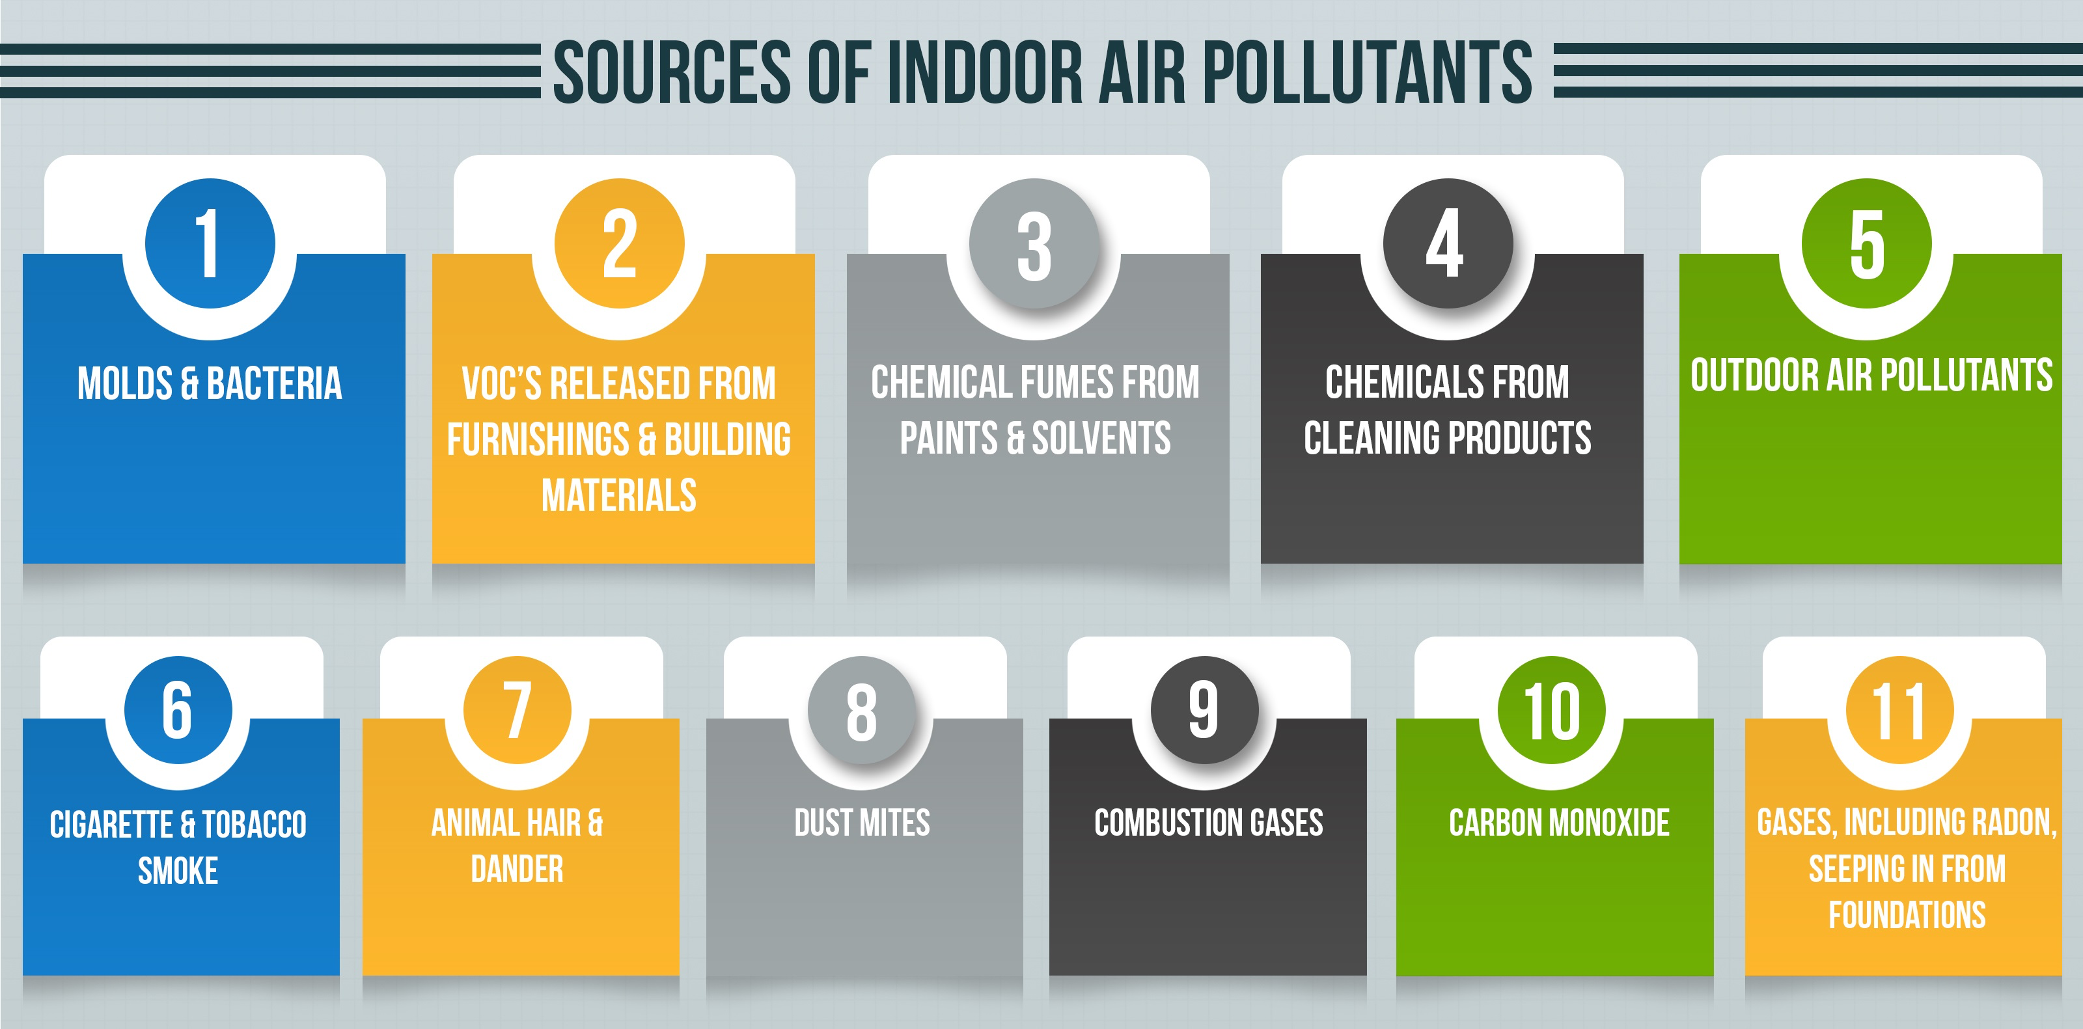
Indoor Air Quality Issues
The U.S. EPA attributes most IAQ problems in commercial buildings to:
indoor air pollutants
ventilation issues
unintended, unplanned, or poorly planned uses of buildings

Slide 16
HVAC Standards
ASHRAE is the primary consensus organization that develops standards regarding HVAC systems and indoor air quality:
ASHRAE 62.1: Ventilation for Acceptable Air Quality
ASHRAE 55: Thermal Environmental Conditions for Human
Occupancy
ASHRAE 52.2: Method of Testing General Ventilation Air-
Cleaning Devices for Removal Efficiency by
Particle Size

Slide 17
ASHRAE 62.1
Standard covers design and operating guidance to achieve satisfactory IAQ:
ventilation air shall be supplied throughout the occupied zone
ventilation systems should be designed to prevent growth and dissemination of microorganisms
where air-intensive activities occur (e.g., combustion sources, clothes dryers), adequate make-up air should be provided
relative humidity should be maintained between 30% and 60%
indoor air should not contain concentrations of contaminants known to impair health or cause discomfort

Slide 18
ASHRAE 55
Standard specifies conditions in which 80% or more of occupants should find the environment thermally acceptable.
It does not address other environmental factors (e.g., air quality, contaminants).
Attempts to predict appropriate conditions of:
temperature
humidity
activity
clothing
air movement
radiant heat sources

Slide 19
ASHRAE 52.2
Standard describes the test methods for two types of air filters used in HVAC systems:
roughing (arrestance) filters
remove large particles
dust spot filters
remove smaller particles
performance characteristics of greatest importance in selecting an air filter:
filter’s efficiency in removing particles from air stream
resistance to airflow through the air filter
time interval between filter cleaning or changing

Slide 20
Other Regulatory Standards
All existing buildings should have been built to comply with local building codes and fire codes in force at the time of construction or major remodeling.
Many jurisdictions have adopted some version of ASHRAE 62.1 and 55.
Note: The building owner or manager should have records of HVAC-related standards that applied when the building was constructed or renovated.

Slide 21
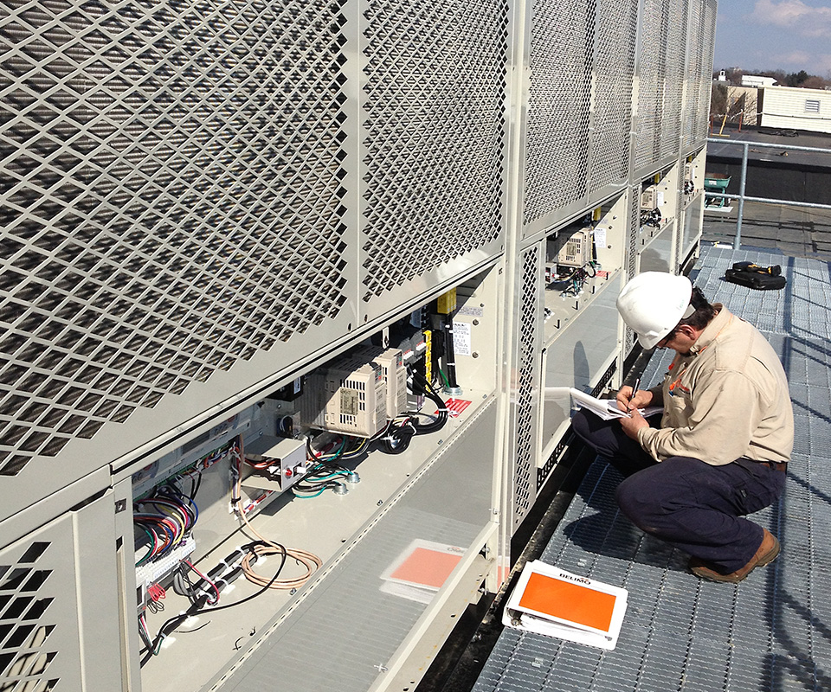
Ensuring Proper HVAC Performance
Most HVAC systems function properly and are never the cause of potential comfort or health problems.
For an HVAC system to function properly over its lifetime, the following checks are required:
commissioning (start-up)
testing and balancing (periodic)
maintenance (routine)

Slide 22
Diagnosing IAQ Issues
IAQ problems are often difficult to diagnose because of confounding factors:
arise from general complaints by a few affected individuals
odors, headaches, respiratory tract irritation
indoor air contaminant levels are generally very low compared to published allowable levels
individual health problems (e.g., flu, allergies) may be involved
general stress from work pressures may be involved

Slide 23
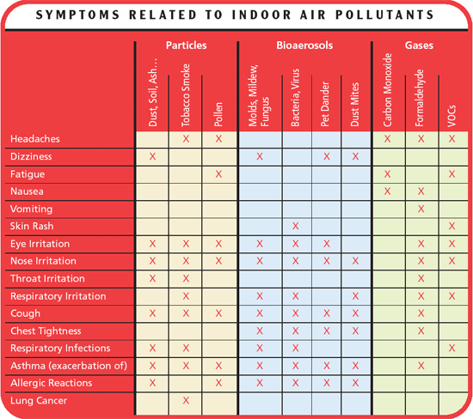
Diagnosing IAQ Issues (cont.)

Slide 24
IAQ Issue Investigation
IAQ investigation protocols usually consist of:
employees fill out a questionnaire or are interviewed
initial survey is conducted (see Table 21–D in text)
relevant records are collected and reviewed (see Table 21–C)
walkthrough inspection is conducted (see Table 21–E in text)
readings of temperature, relative humidity, CO₂ levels, and any common contaminants are taken

Slide 25
Measuring Building Ventilation Rates
HVAC ventilation rates are usually measured to estimate the amount of outdoor air (OA) being delivered to each area of a building.
Must first measure the total airflow to each area, and then determine the proportion of total that consists of outside air (rem. mixed air).
two methods
direct airflow measurements
use of tracer technique

Slide 26
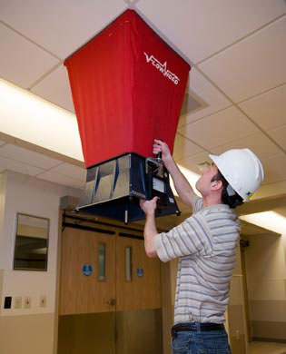
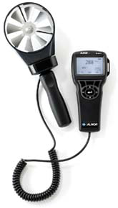
Airflow Measurements
Very similar to measurements taken to evaluate local exhaust systems (see Chapter 19 in text).
balometer
velometer

Slide 27
Determining Proportion of Outside Air
Temperature method
Carbon dioxide method

Slide 28
Example Calculation
Given balometer readings at the terminal devices serving a work area show the total air supplied to the space is 875 ft.³/min.
CO₂ readings at the specified locations were: CO_{2(return)} 610 ppm
CO_{2(mixed)} 465 ppm
CO_{2(outdoor)} 400 ppm
If there are 25 people in the work area, how much outdoor air is being supplied per person?

Slide 29
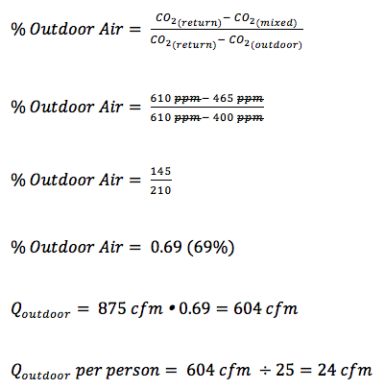
Example Calculation—Solution

Slide 30
Tracer Techniques
Utilize stable, nontoxic, easily measured gas, ideally with a density near that of air.
Ensure HVAC controls are set in a manner typical of the time period when workers are present.
Set up mixing fans to circulate the air to maintain constant concentrations of tracer gas.
Measure background levels of tracer gas (indoors and outdoors).
Release tracer gas and allow to thoroughly mix.
Take the initial reading and record concentration and time.
Periodically repeat concentration measurements and record.
Continue taking measurement until indoor and outdoor concentrations are notably different.
Calculate the air exchange rate.
Convert the air exchange rate into volumetric airflow by multiplying by the room volume.

Slide 31
Typical Approach (cont.)
Air exchange rate
Volumetric air flow

Slide 32
Example Calculation
A tracer study using released CO₂ (from a fire extinguisher) is to be performed in one large room in an office building. The test will begin after employees leave.
Room dimensions are 50 ft. × 25 ft. × 10 ft.
Room occupancy is usually 15, with the people performing sedentary office work.
Outdoor CO₂ level at test start was 425 ppm.
The following CO₂ levels were measured during the test:

Slide 33
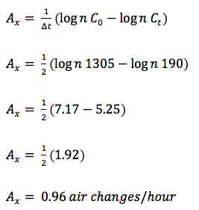
Example Calculation—Solution

Slide 34
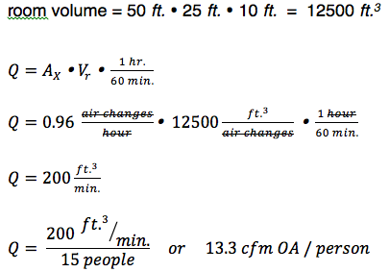
Example Calculation – Solution (cont.)

