Slide 1
Fundamentals of Industrial Hygiene 6th Edition
Chapter 19:
Local Exhaust Ventilation
Compiled by Allen Sullivan,
Assistant Professor, Safety and Health Management Central Washington University

Slide 2
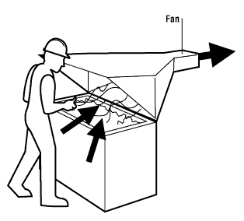
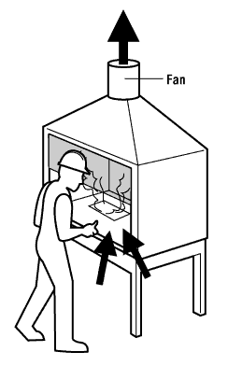
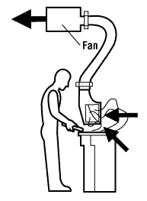
LEV System Components
A typical LEV system consists of:
hoods
point where air is drawn in to capture or control contaminants
hood types
capturing hoods
enclosures
receiving hoods
slot hoods
canopy hoods

Slide 3
LEV System Components (cont.)
ducts
carry air between hoods, air cleaners, fan, and discharge stack
duct considerations:
light weight, flexible fabric ducts are not recommended
(accumulate material and sag, collapse under suction)
air movement is always accompanied by friction
(contaminants tend to settle on walls of ducts)
turbulence occurs in ducts due to changes in direction and velocity
(may cause unnecessary pressure drops)
fans are most efficient if incoming air is straight and uniform
(elbows, dampers, duct junctions)

Slide 4
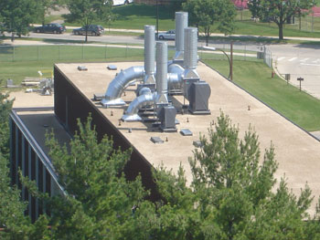
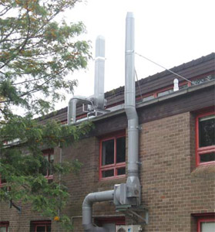
LEV System Components (cont.)
exhaust stacks
point where air is discharged
exhaust stack considerations:
roof boundary wake re-entry
(use high stack discharge velocity to address)
crosswind-induced downdraft re-entry
(best dispersion occurs when stack velocity is >150% wind velocity)
wind direction re-entry
(locate exhaust stack on downwind side of roof)

Slide 5
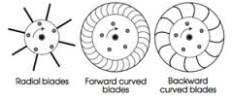
LEV System Components (cont.)
fans
generate the suction (negative air pressure) to draw contaminated air into hoods and through ducts
fan types
axial flow fans
centrifugal flow fans (quieter, cheaper, produce higher pressures)
radial-blade fans
forward-curved blade fans
backward-curved blade fans

Slide 6
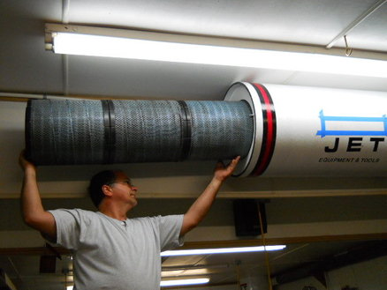
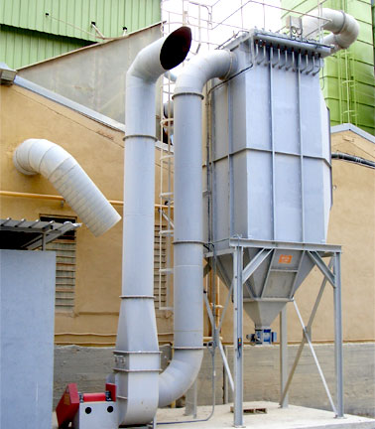
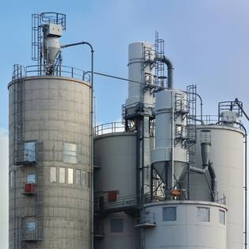
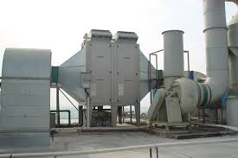
LEV System Components (cont.)
air-cleaning devices
remove contaminants prior to discharge to the environment
particulate air-cleaning devices
filters
electrostatic precipitators
cyclones
wet scrubbers

Slide 7
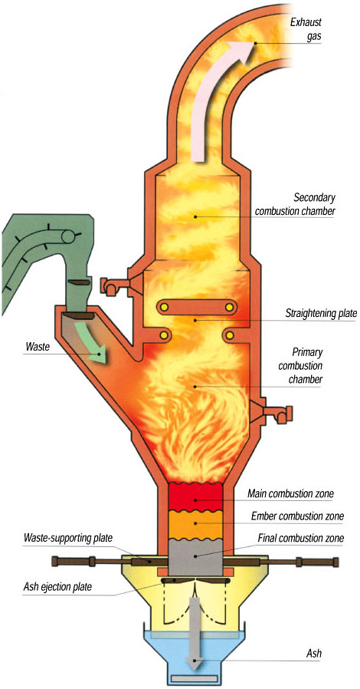
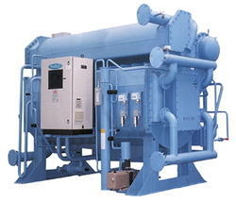
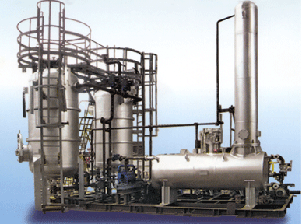
LEV System Components (cont.)
air-cleaning devices (cont.)
gas and vapor air-cleaning devices
absorption
adsorption
oxidation (combustion)

Slide 8
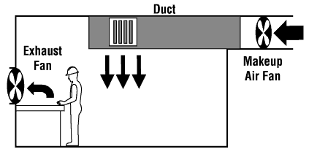
Make-Up Air
Air that enters the workroom to replace air exhausted through the ventilation system.
Should be supplied through a planned system rather than through random infiltration to prevent a workplace from becoming air bound.
should exceed exhaust rate by 10%
should flow from cleaner areas through contaminated areas
should flow from normal temperature areas to high-heat areas
should be introduced 8–10 feet above the floor
should be heated in winter to about 65°F
air inlets should be located to prevent contaminated air from entering

Slide 9
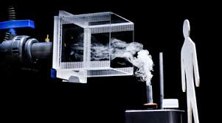
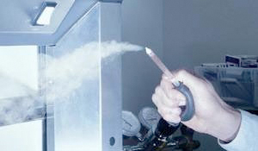
LEV Performance Evaluation
Typical tests used to evaluate LEV performance include:
smoke tube tests
capture range of hoods
identifying drafts and infiltrations into hoods
demonstrating capture distances to workers

Slide 10
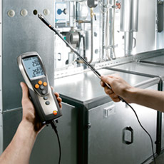
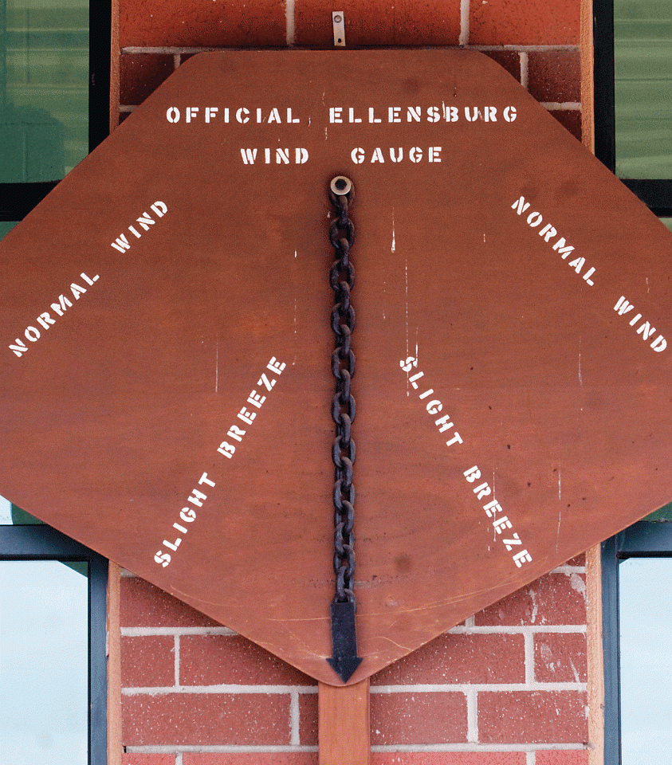
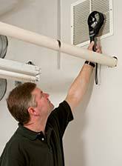
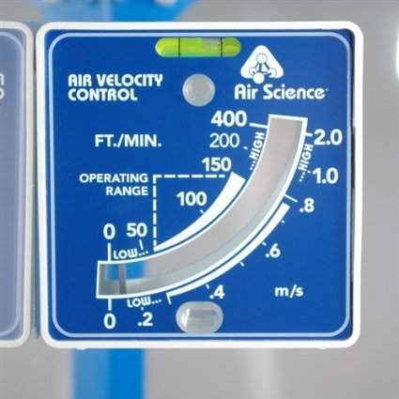
LEV Performance Evaluation (cont.)
velocity measures
thermo-anemometer
rotating vane anemometer
swinging vane anemometer

Slide 11
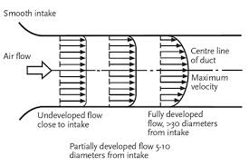
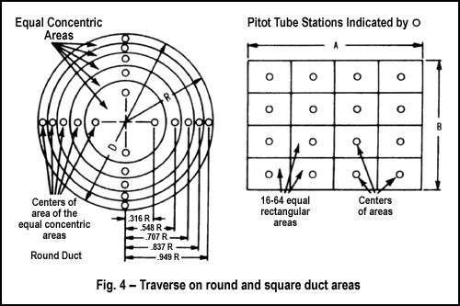
LEV Performance Evaluation (cont.)
duct velocity traverse
typically a velometer is used
multiple measuring points

Slide 12
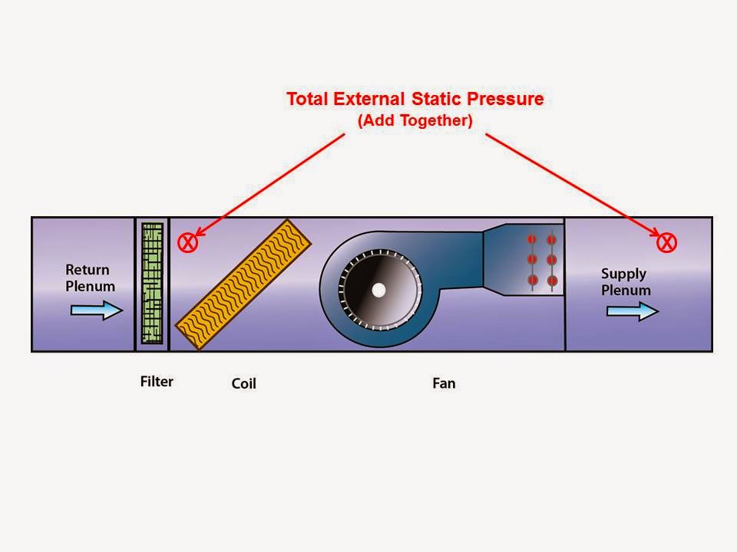
LEV Performance Evaluation (cont.)
static pressure measurements
potential energy available to move air

