Slide 1
Heat-Related Illness
For use in conjunction with 5-Minute Safety Talk
Notes:
Heat-Related Illness

Slide 2
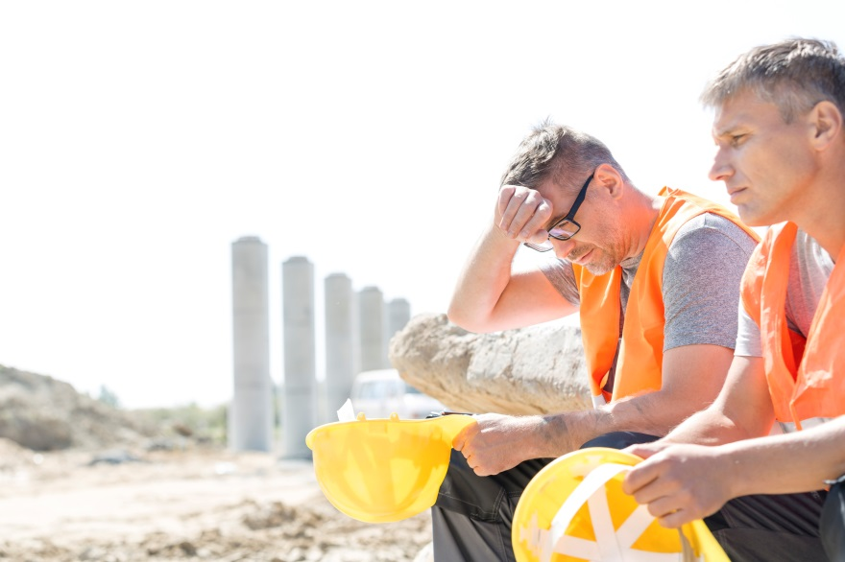
The body burns calories and produces heat to maintain 98.6 Fahrenheit temperature.
Two effective ways the body rids itself of heat are:
Sweating - Sweat evaporating
from skin cools the body
2. Dilation of blood vessels –
Blood is brought to the skin
surface to release heat
Notes:
The body burns calories and produces heat to keep its temperature at 98.6 degrees Fahrenheit. In a hot environment or during vigorous physical activity, the body will rid itself of excess heat. Two effective ways it does this are sweating and dilation of blood vessels. When sweat evaporates from the skin, you begin to cool off. When blood vessels dilate, blood is brought to the skin surface to release heat.

Slide 3

Warning Signs
Problems develop when the body’s
cooling mechanisms aren’t able to work
properly, such as when:
Air temperature exceeds body temperature - the body cannot easily cool itself
Air is humid - sweat doesn’t evaporate quickly
Sweat doesn’t evaporate easily from a person who works/exercises hard while wrapped in heavy clothing or protective gear
Heat-related illness is a concern in
any weather - anywhere!
Notes:
Problems develop when the body’s cooling mechanisms do not work properly. For example, when the air temperature exceeds body temperature, the body cannot easily cool itself. If the air is humid, sweat also does not evaporate quickly. Sweat also does not evaporate from a person who works hard or exercises while wrapped in heavy clothing or protective gear. That makes heat-related illness a concern in any weather, anywhere.

Slide 4
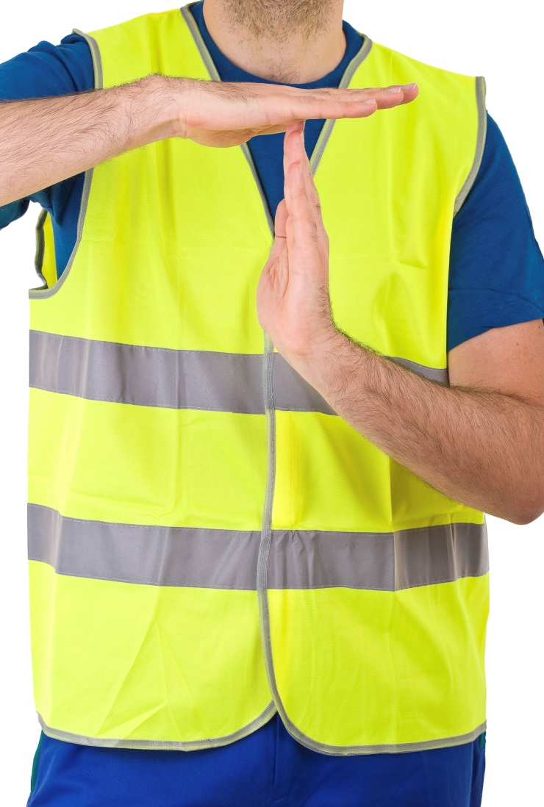
Heat Rash & Heat Cramps
Heat Rash
Occurs when sweat ducts get clogged
Heat Cramps
Painful muscle spasms caused by loss of electrolytes from heavy sweating
If workers develop these conditions, immediately get them out of the heat so they can rest.
Notes:
Heat-related illness takes several forms. Heat rash occurs when sweat ducts get clogged.
Heat cramps are painful muscle spasms caused by the loss of electrolytes from heavy sweating.
If workers develop these conditions, immediately get them out of the heat so they can rest.

Slide 5
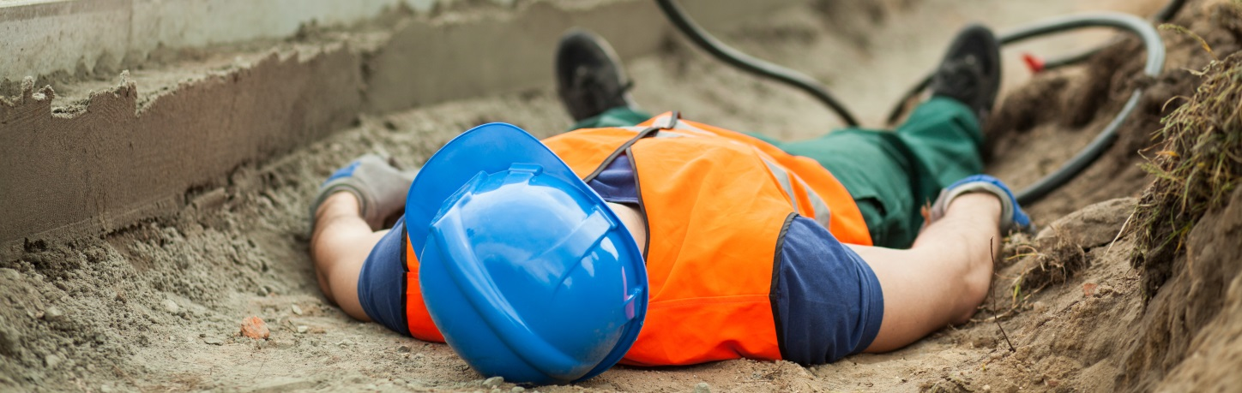
Heat Syncope
Victim becomes light-headed and faints when blood flow to the brain decreases. This is because blood pressure is lowered when blood vessels dilate to rid the body of heat.
Blood pressure lowers further when blood volume drops as water is evaporated from the blood.
Notes:
The next stage of heat-related illness may not be far away. Heat syncope, heat exhaustion and heatstroke develop from prolonged exposure to heat. A victim of heat syncope becomes light-headed and faints when blood flow to the brain decreases. This is because blood pressure is lowered when blood vessels dilate to rid the body of heat. Blood pressure lowers further when blood volume drops as water is evaporated from the blood.

Slide 6
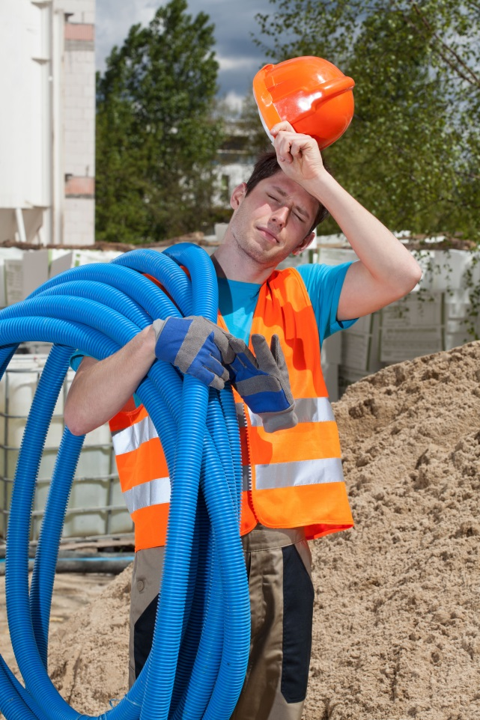
Heat Exhaustion
Occurs when the body loses too much water and salt
Signs include:
Weakness
Dizziness
Nausea
Headache
Heavy sweating
Clammy skin
Notes:
When the body loses too much water and salt, heat exhaustion sets in. Signs include weakness, dizziness, nausea, headache, heavy sweating and clammy skin.

Slide 7
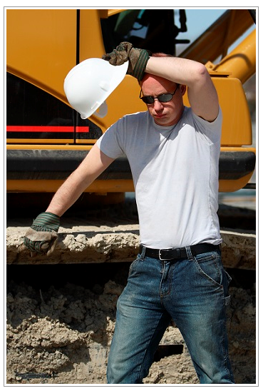
Heatstroke
Signs of heatstroke:
Rapid pulse
Hot, red skin
Victim stops sweating
Possible mental confusion, decreased alertness & blurred judgment
Heatstroke can be extremely serious and lead to brain damage or even death if not treated promptly and properly.
Notes:
A heatstroke victim has a rapid pulse, hot, red skin and has stopped sweating. The victim may show mental confusion, a decrease in alertness and blurred judgment. Heatstroke can be extremely serious and lead to brain damage or even death if not treated promptly and properly.

Slide 8
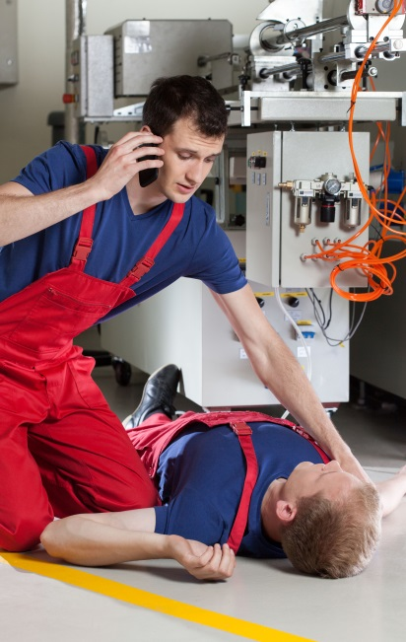
Recognize - Evaluate - Act
Know how to recognize a victim of heat-related illness, evaluate the symptoms and act!
Heat Cramps
  Have the worker sip water or a sports drink. Gently stretch, massage and ice the muscle. Seek medical
  attention if the worker has heart problems
  or if cramps don’t get better within an hour.
Heat Syncope
Have the worker lie down in a cool area.
Call for medical help.
Notes:
Hot tips to cool conditions
You should know how to recognize a victim of heat-related illness, evaluate the symptoms and act.
Heat cramps: Have the worker sip water or a sports drink. Gently stretch, massage and ice the muscle. Seek medical attention
if the victim has a heart problem or if the cramps don't get better in an hour.
Heat syncope: Have the worker lie down in a cool area. Call for medical help.

Slide 9
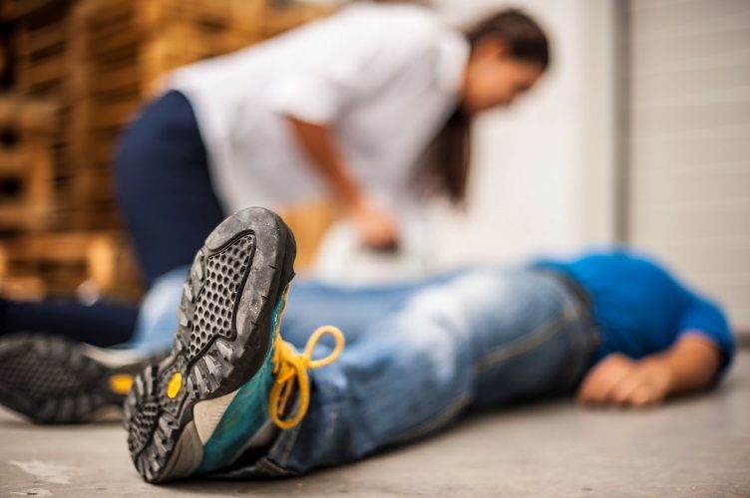
Heat Exhaustion
3. Heat Exhaustion
  Lay the worker down on his or her back in a cool area
  Call for medical help
  Remove excessive layers of clothing
  Give a sports drink or water – don’t give anything to drink if the worker vomits
  Cool the worker with a cool water spray or wet cloths and a fan
Notes:
Heat exhaustion:
Lay the worker down on his or her back in a cool area. Call for medical help. Remove excessive layers of clothing. Give a sports drink or water. Do not give anything to drink if the worker vomits. Cool the worker with a cool water spray or wet cloths and a fan.

Slide 10
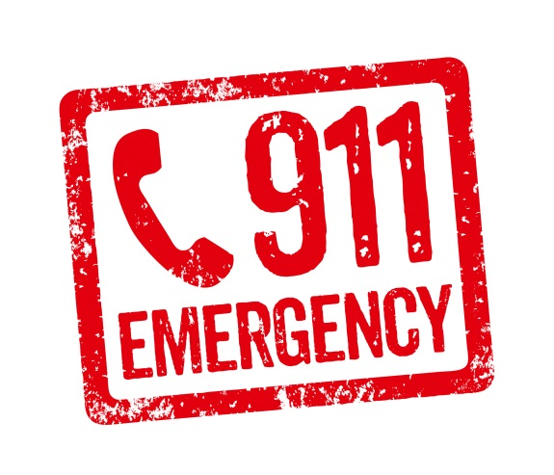
Heatstroke
4. Heatstroke - Call for medical help immediately!
While you wait for help to arrive, immediately
cool the victim with any means at hand,
preferably by immersing the victim up to the
neck in cold water.
Alternatively:
  Move the worker to a cool place and remove clothing down to the underwear, then apply ice packs at the neck, armpits and groin.
  Or, cover the worker with wet towels or cloths or spray him or her with cool water, and fan the worker to quickly evaporate the dampness on the skin.
Notes:
Heatstroke: Call for medical help immediately. While you wait for help to arrive, immediately cool the victim with any means at hand, preferably by immersing the victim up to the neck in cold water. Alternatively, move the worker to a cool place and remove clothing down to the underwear, then apply ice packs at the neck, armpits and groin. Or, cover the worker with wet towels or cloths or spray him or her with cool water, and fan the worker to quickly evaporate the dampness on the skin.

Slide 11
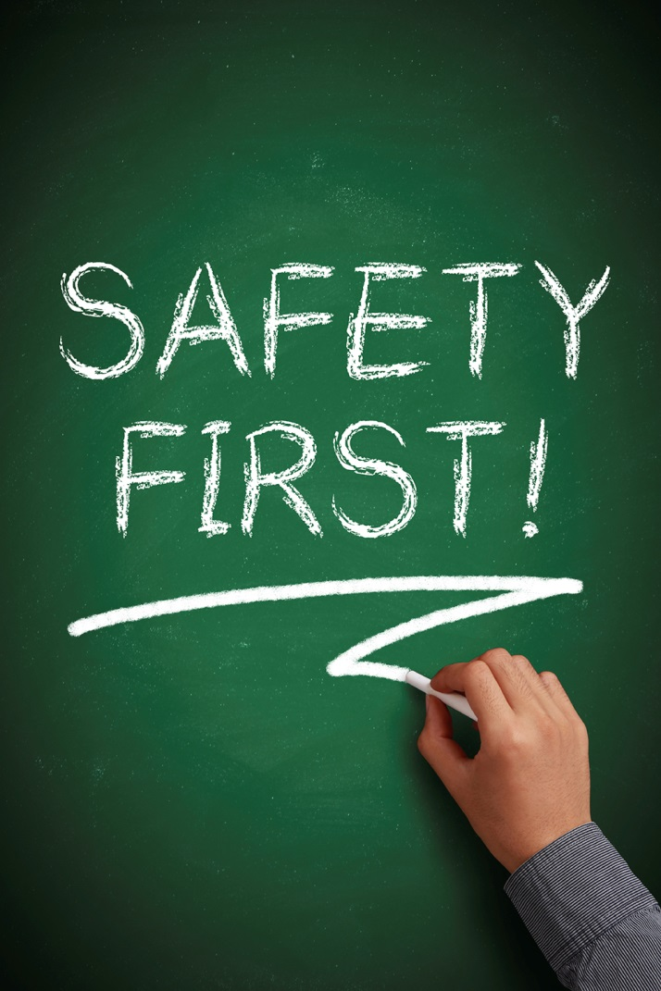
Catch it Early
Awareness is vital!
Both supervisors and workers
should be on the lookout for
warning signs of heat-related illness.
Safety is everyone’s responsibility.
Notes:
Catch it early
Awareness is vital to prevent heat-related illnesses. Supervisors need to watch for warning signs of heat illness in workers. Workers also should be educated on what to look for in victims.
Many companies that have workers exposed to heat year-round, provide supervisors with lectures, videos and even first aid training to prevent and treat heat-related illnesses.

Slide 12
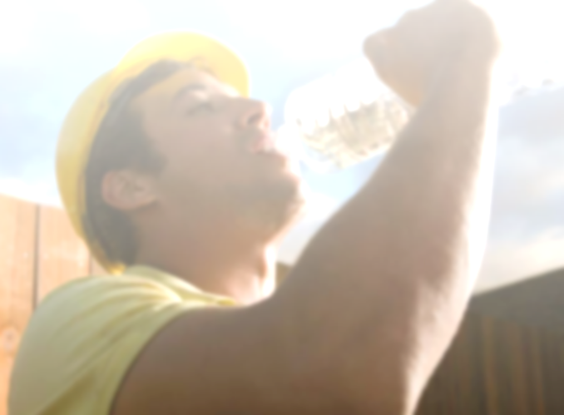
Preventive Measures
Eat light - The more calories you take in, the more body heat you produce
Drink plenty of fluids before work and throughout the day & avoid caffeine
Wear lightweight clothing
Wide-brimmed hats protect workers from direct sunlight
Notes:
Workers adapt to the heat, but they should know their limits and supervisors should never push beyond those limits. Workers can take other preventive measures to combat the heat:
Eat light. The more calories you take in, the more body heat you produce.
Drink plenty of fluids before work and throughout the day. Avoid caffeine.
Wear lightweight clothing.
Wide-brimmed hats protect workers from direct sunlight.

Slide 13

Heat illnesses are the consequence of not recognizing the warning signs on the job.
Hot conditions don’t have to be dangerous if you watch for the warning signs and get cooperation from workers to prevent heat-related illness.
Notes:
Heat illnesses, especially in the summer, are the consequence of not recognizing the warning signs on the job. Hot conditions don’t have to be dangerous if you watch for the warning signs, and get cooperation from workers to prevent heat-related illness.

Slide 14
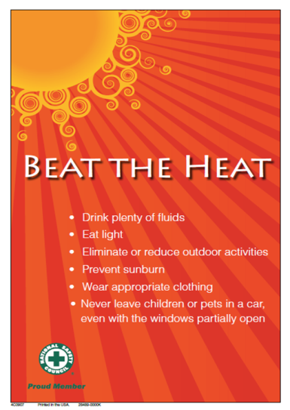
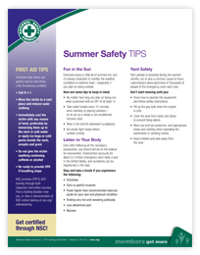
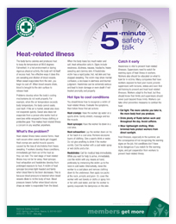
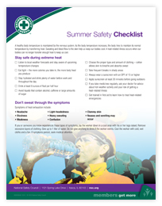
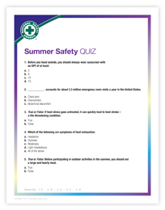
Heat-Related Illness Resources
Available in the Member-Exclusive section of NSC.ORG.

Slide 15

Poster
BEAT THE HEAT!
Hang this poster in high traffic areas to share tips about how everyone can help prevent heat-related illnesses
Notes:
BEAT THE HEAT
Hang this poster in high traffic areas to share tips about how everyone can help prevent heat-related illnesses

Slide 16
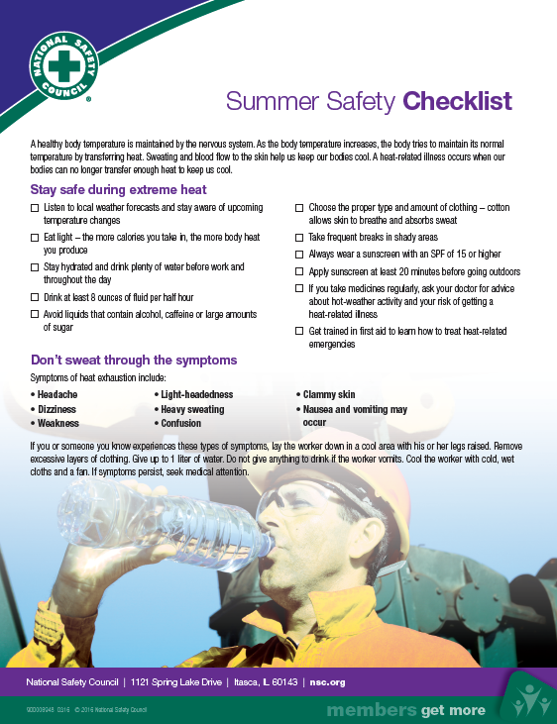
Summer Safety Checklist
Don’t Sweat It!
Share this checklist to help everyone stay safe during extreme heat!
Notes:
Summer Safety Checklist
Don’t Sweat It! Share this checklist to help everyone stay safe during extreme heat!

Slide 17
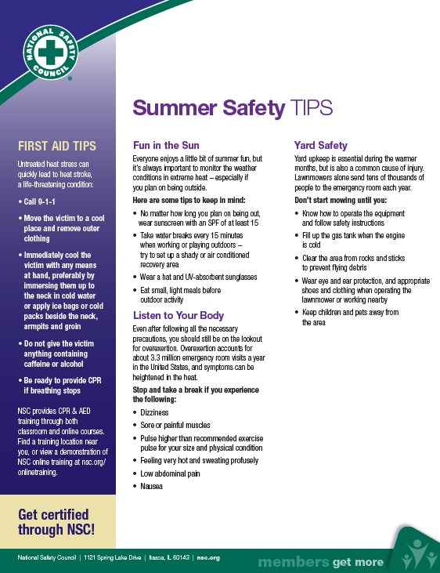
Summer Safety Tips
Bring these summer safety and first aid tips home and help keep the whole family safe.
Notes:
Summer Safety Tips
Be in the know. Bring these Summer Safety and First Aid Tips home and help keep the whole family safe.

Slide 18
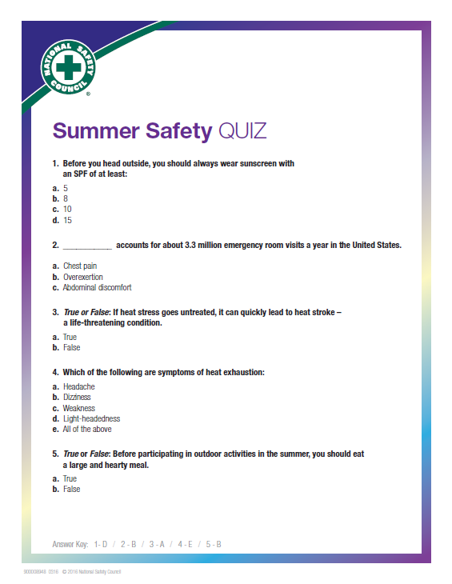
Summer Safety Quiz
Are you ready for the heat?
Brush up on summer safety using the Summer Safety Tips sheet and test your knowledge.
Notes:
Summer Safety Quiz
Are you ready for the heat? Brush up on summer safety using the Summer Safety Tips sheet and test your knowledge.

Slide 19
For more member-exclusive safety presentations, webinars, posters and resources visit: nsc.org/members
Customer Service – (800) 621-7619
Outside U.S. – +1-630-775-2056
Email us at:
MEMBERSHIPINFO@nsc.org
Notes:
Find more member-exclusive safety presentations, webinars, posters and resources at nsc.org/members
For discussion:
Questions
Observations & Concerns
Safety Action Plan

