Slide 1
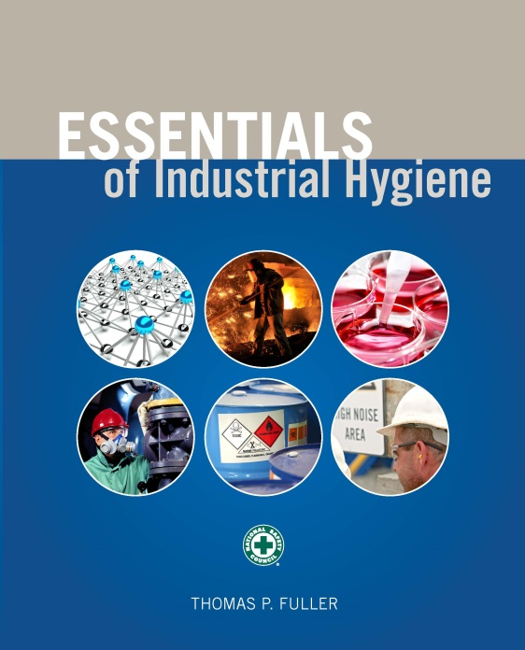
CHAPTER 13
Thermal Stressors

Slide 2
Learning Objectives
Describe the health effects and hazards associated with extremely hot or cold work environments.
Identify the thermal balance and the factors of heat exchange and metabolism in the human body.
Explain the various methods and instruments used to measure and analyze the thermal work environment.
Identify available engineering, administrative, and personal protective equipment controls that can minimize or reduce the hazards associated with thermal work environments.

Slide 3
Hot Indoor Occupations
Glass-manufacturing
Electrical utilities (particularly boiler rooms)
Iron and steel foundries
Smelters
Nonferrous foundries
Brick-firing and ceramic plants
Rubber-manufacturing plants
Chemical plants
Underground mines
Steam tunnels
Bakeries, confectioneries, commercial kitchens, and food-processing facilities
Laundries

Slide 4
Hot Outdoor Occupations
Construction
Farming
Hazardous waste site operations
Landscaping activities
Emergency response operations (e.g., fire fighting)
Oil and gas well activities

Slide 5
Physiological Factors
Weight
Age
Amount of acclimatization
Metabolic rate (activity)
State of physical fitness
Alcohol or drug consumption (prescription or not)
Individual susceptibility
Type of clothing worn
Medical circumstances (e.g., breathing problems, hypertension, and prior thermal injury)

Slide 6
Terms and Definitions
Heat: the measure of energy
Temperature: the measure of the intensity of heat
Specific heat: the quantity of heat that is necessary to raise 1 g of material from 16.5°C to 17.5°C
Heat capacity: the amount of heat necessary to raise one unit of mass of a substance 1°C

Slide 7
Terms and Definitions (cont.)
Heat of vaporization: the quantity of heat required to vaporize one unit mass of a liquid without changing its temperature
Heat of fusion: the quantity of heat necessary to melt one unit of mass of a solid without changing its temperature
Exothermic process: a process in which heat is given up
Endothermic process: a process in which heat is absorbed

Slide 8
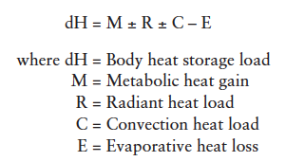
Thermal Balance

Slide 9
Body Heat Storage Load
To solve thermal equation for dH, at a minimum the following parameters should be determined:
Metabolic heat production (physical activity; W, kcal/h)
Air temperature (°C, °F)
Water vapor pressure in air (Pa, mmHg)
Wind speed (m/s, ft/min)
Mean radiant temperature (tr; °C, °F)
Type of clothing (Clo)

Slide 10
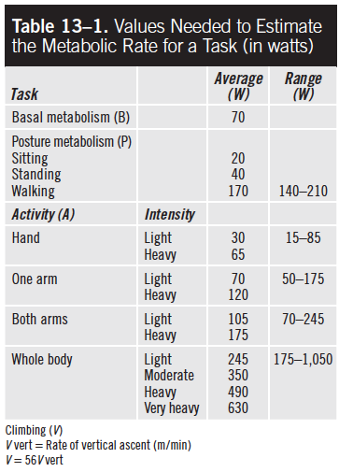
Estimating Metabolic Rate

Slide 11
Radiant Heat Exchange (R)
Clothed worker heat gain: R = 4.4(tr – tsk)
Unclothed worker heat gain: R = 7.3(tr – tsk)
When tr is > 35°C, there will be a gain in body heat by radiation from ambient air.
When tr is < 35°C, there will be a loss (negative gain) in body heat by radiation from ambient air.

Slide 12
Convection Heat Exchange (C)
Clothed worker heat gain: C = 4.6V0.6(ta– tsk)
Unclothed worker heat gain: C = 7.6V0.6(ta– tsk)
When ta is > 35°C, there will be a gain in body heat by convection from ambient air.
When ta is < 35°C, there will be a loss (negative gain) in body heat by convection from ambient air.

Slide 13
Evaporative Heat Loss (E)
Clothed worker heat loss: Emax = 7.0V^{0.6}(Psk – Pa)
Unclothed worker heat loss: Emax = 11.7V^{0.6}(Psk – Pa)

Slide 14
Heat Disorders
Heatstroke:
A serious illness characterized by an excessive rise in body temperature and a failure of the body’s temperature-regulating mechanism.
Symptoms of this acute medical emergency include a sudden and sustained loss of consciousness preceded by vertigo, nausea, headache, cerebral dysfunction, bizarre behavior, and core body temperature in excess of 40.5°C (104°F).

Slide 15
Heat Disorders (cont.)
Heat exhaustion:
Characterized by muscular weakness; distress; nausea; vomiting; dizziness; pale, clammy skin; and fainting.
Generally associated with an inadequate water intake, lack of heat acclimatization, and poor physical fitness.
Although the oral temperature may be normal or low, the core temperature often is elevated to 38.5°C (101.3°F).

Slide 16
Heat Disorders (cont.)
Heat cramps:
Characterized by spastic contractions of the voluntary muscles (mainly the hands, arms, feet, and legs).
Generally associated with insufficient salt intake and profuse sweating with no significant body dehydration.

Slide 17
Heat Disorders (cont.)
Heat rash:
The sweat glands are plugged with retention of sweat, and a rash is the inflammatory response.

Slide 18
Cold Disorders
Hypothermia:
The body core temperature drops below the normal range. The first symptoms are uncomfortable shivering and sensations of cold.
The heartbeat slows and sometimes becomes irregular, the pulse weakens, and the blood pressure drops.
Speech becomes vague or slow slurred; memory lapses; incoherence; and drowsiness.
When the core temperature drops down to about 29°C (85°F), significant drops in blood pressure and respiration occur, and serious health problems develop that can kill the exposed individual.

Slide 19
Cold Disorders (cont.)
Blood vessel abnormalities:
Raynaud’s phenomenon: The blanching of the distal portion of the digits. Numbness, itching, tingling, or a burning sensation during intermittent attacks. This reaction is triggered by the cooling of the skin.
Of great importance in industry is the association between this phenomenon and the use of vibrating hand tools, a condition sometimes called White Finger Disease.

Slide 20
Cold Disorders (cont.)
Acrocynosis:
A condition caused by exposure to cold, characterized by a reduced level of hemoglobin in the blood and by the hands and feet acquiring a slightly blue, purple, or gray coloring.

Slide 21
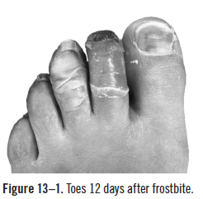
Cold Disorders (cont.)
Frostbite:
The freezing of the fluids around the cells of body tissues.
The symptoms include uncomfortable sensations of coldness, numbness, tingling, stinging, or aching.
Damage from frostbite can be serious and can lead to scarring, tissue death, and amputation.
Source: Dr. S. Falz / CC-BY-SA-3.0

Slide 22
Cold Disorders (cont.)
Trench foot:
Occurs when a foot is exposed to persistent dampness and cold (but without freezing).
Symptoms are swelling (edema), tingling, itching, severe pain, blistering, death of skin tissue, and ulceration.
Chilblain is the name of this condition when other parts of the body are affected.

Slide 23
Thermal Measurement
Factors related to environment
air temperature
V (air velocity)
radiant heat
relative humidity
Factors related to individuals
activity
clothing

Slide 24
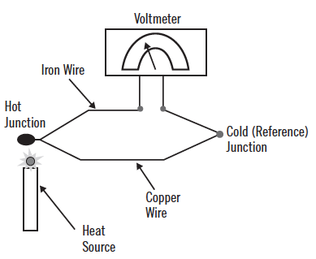
Thermal Measurement (cont.)

Slide 25
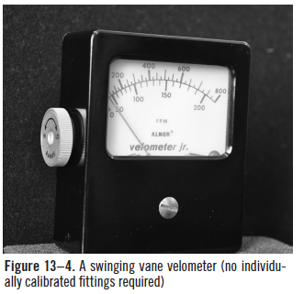
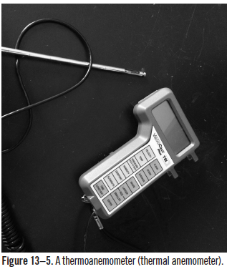
Thermal Measurement (cont.)

Slide 26
Thermal Measurement (cont.)
Air speed (V) can be estimated as follows:
No sensation of air movement V < 0.2 m/s
Sensation of light breeze 0.2 < V < 1.0 m/s
Sensation of moderate breeze 1.0 < V < 1.5 m/s
Sensation of heavy breeze V > 1.5 m/s

Slide 27
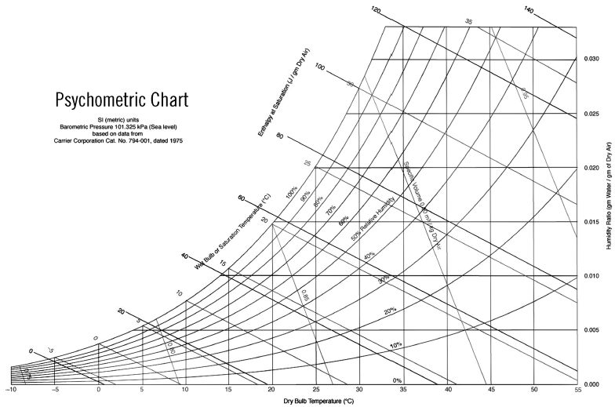
Relative Humidity

Slide 28
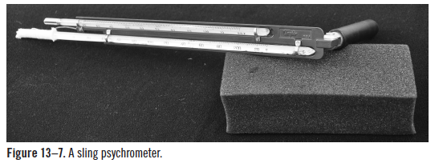
Relative Humidity (cont.)

Slide 29
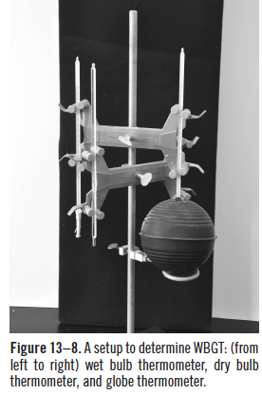
Thermal Stress Evaluation
WBGT values (°C or °F) are calculated using the following equations:
(1) Outdoors with solar load
WBGT = 0.7tnw + 2tg + 0.1ta
(2) Indoors or outdoors with no solar load
WBGT = 0.7tnw + 0.3tg
Where tnw = Natural wet-bulb temperature (°C or °F)

Slide 30
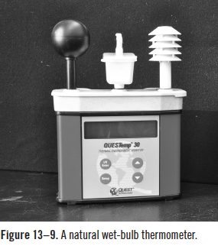
Thermal Stress Evaluation (cont.)

Slide 31
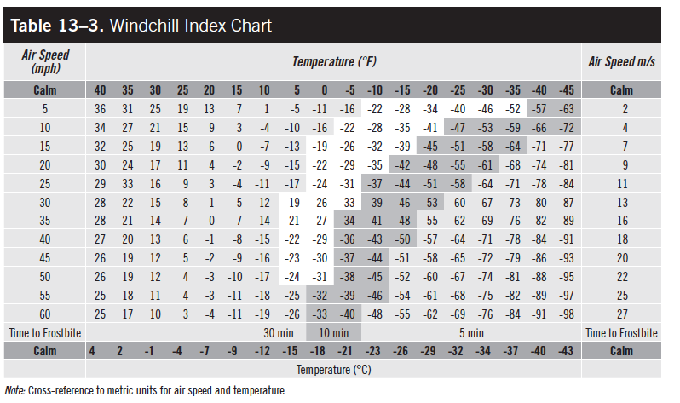
Windchill Index

Slide 32
Physiological Monitoring
Heart rate (HR)
HR increase capacity (CHR) is defined by the following:
CHR = 40% × (220 – Age) + 60% × Resting HR

Slide 33
Physiological Monitoring (cont.)
Body temperature
Adjusted maximum rate = 0.7 × (220 – Age)

Slide 34
Thermal Environment Control Methods
Engineering controls
Metabolic heat production
Provide powered assistance for strenuous tasks.
Reduce physical demands of the work.
Radiant heat load
Interpose line-of-sight barriers.
Provide furnace wall insulation, metallic reflecting screens, and heat reflective clothing.
Cover exposed parts of the body.

Slide 35
Thermal Environment Control Methods (cont.)
Convective heat load
If the air temperature is above 35°C (skin temperature), workers should do the following:
reduce air temperature
reduce air speed across the skin
wear more clothing
If the air temperature is below 35°C, workers should do the following:
increase air speed across the skin
wear less clothing
Evaporative cooling
decrease humidity
increase air speed

Slide 36
Administrative Controls for Hot Areas
Limit exposure times and temperature
Schedule hot jobs for the cooler part of the day.
Schedule routine repair and maintenance work for cooler seasons.
Design work-rest regimens and provide a cool area for rest and recovery.
Add extra personnel to reduce the exposure time of each member of the field crew.
Allow freedom to interrupt work when a worker feels severe heat discomfort.
Enforce water and rest breaks and encourage workers’ water intake.
Segregate (by location and time) hot operations from other operations.
Allow for acclimatization and physical conditioning.

Slide 37
Administrative Controls for Hot Areas (cont.)
Reduce metabolic heat load
Mechanize physical components of the job.
Reduce exposure time (reduce workday, increase rest time, restrict overtime work).
Increase work force.
Consider the effects of drugs, alcohol, and obesity.
Reduce the metabolic heat load by minimizing employees’ unnecessary activities.

Slide 38
Administrative Controls for Cold Areas
Substitute, isolate, or redesign the equipment and processes to minimize cold stress.
Use general or spot heating.
Minimize air velocity, reduce it to less than 1 m/s (200 ft/min), and shield the work area.
Cover metal handles of tools and control bars with thermal insulating material.
Do not use unprotected metal seats.
Use mechanical lifting aids to reduce manual workload.
Provide heated warming shelters and encourage workers to use them.
Provide personal protective equipment and warm clothing.
Monitor the workplace and design work-rest regimens accordingly.
Schedule and enforce rest and drink breaks and provide heated rest areas.

Slide 39
Administrative Controls for Cold Areas (cont.)
Schedule the work for a warmer time or a warmer work area.
Assign extra workers to do the job and allow the workers to pace themselves.
Provide workers with training and orientation on the basic principles of cold stress.
Allow new workers to become acclimatized to the cold environment.
Minimize sitting still or standing for long periods of time.
Maintain safety supervision and a buddy system.
Establish a medical surveillance program.
Establish emergency and first-aid procedures.
Pay special attention to older workers and those with circulatory or other chronic illnesses.
Encourage workers to stay physically fit, get sufficient sleep, and eat nutritious meals.
Provide emergency supplies in areas where storms are frequent.

