Slide 1
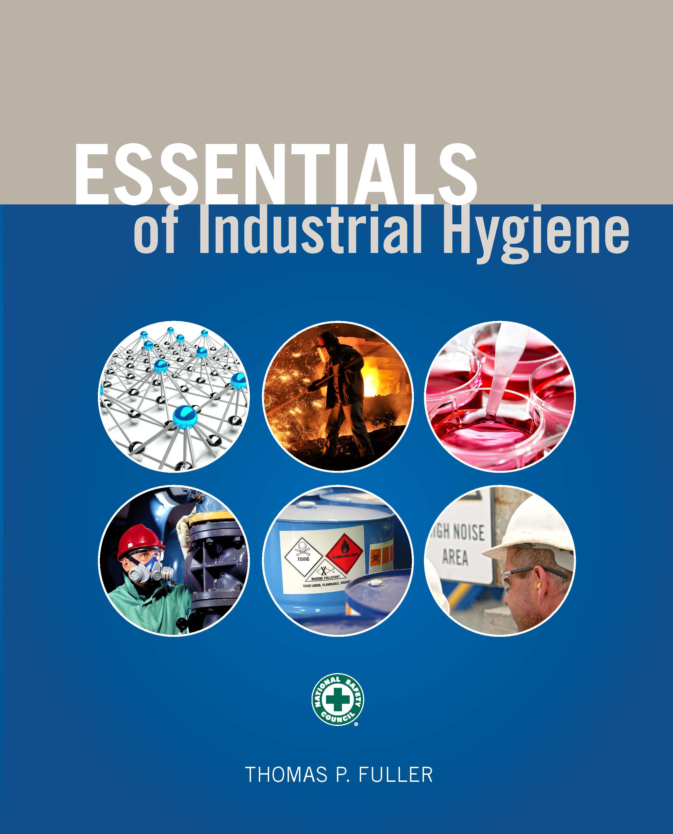
CHAPTER 7
Aerosols

Slide 2
Learning Objectives
Describe the different types of aerosols.
Understand the basic effects on the lungs associated with aerosol inhalation.
Assemble the appropriate equipment and perform calibration using primary and secondary standards on a general total nonfibrous contaminant sampling train.
List the basic steps to conduct aerosol monitoring on a worker.
Propose a strategy that can monitor the majority of nonfibrous contaminants based on sampling objectives.
Conduct nonfibrous aerosol monitoring, properly ship samples to the lab, and request pertinent analysis on the basis of sampling objectives.

Slide 3
Types of Aerosols
Dust
Mist
Fog
Fumes
Smoke
Fibers

Slide 4
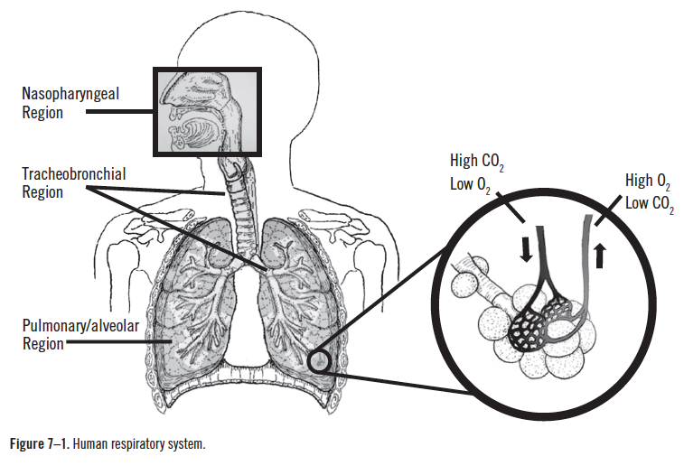
Aerosol Deposition

Slide 5
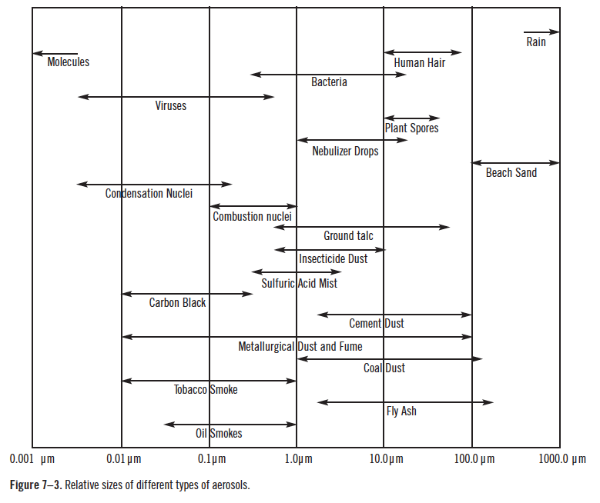
Relative Sizes of Aerosols

Slide 6
Aerodynamic Diameter and Impaction
Inhalable particulate mass—100 mm
Thoracic particulate mass—10 mm
Respirable particulate mass—4 mm

Slide 7
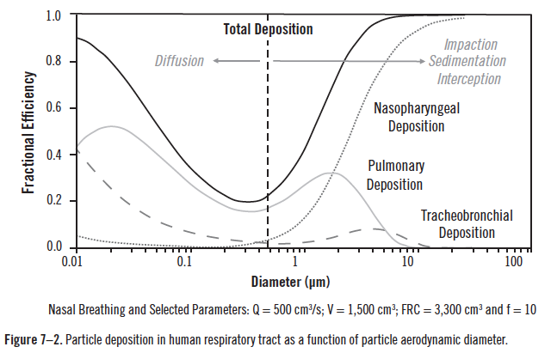
Particle Deposition
Source: Modified from Bugarski and Gautam 2014

Slide 8
Air Sampling Pump Calibration

Slide 9
Correcting for Temperature and Pressure

Slide 10
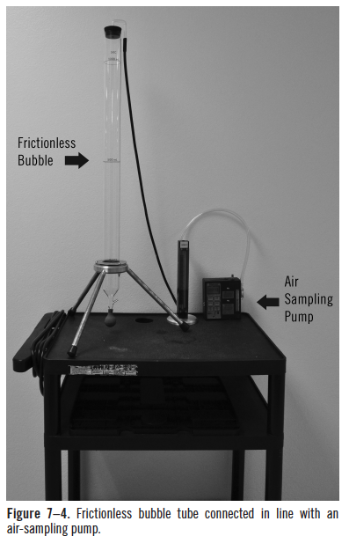
Calibration Techniques

Slide 11
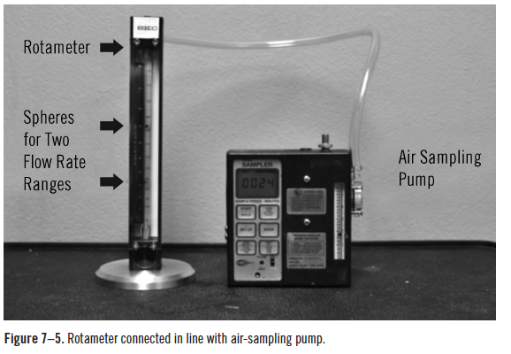
Calibration Techniques (cont.)

Slide 12
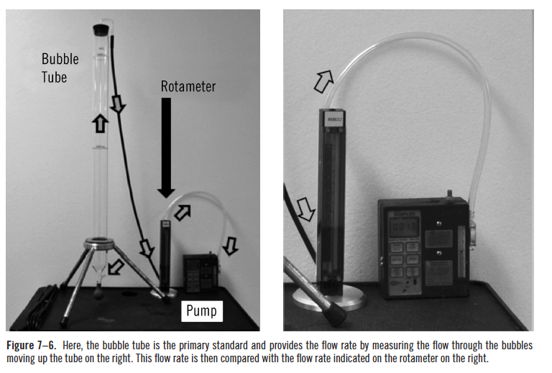
Calibration Techniques (cont.)

Slide 13
Rotameter Calibration

Slide 14
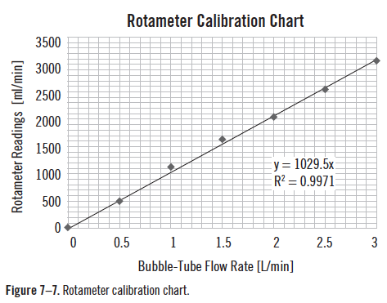
Rotameter Calibration (cont.)

Slide 15
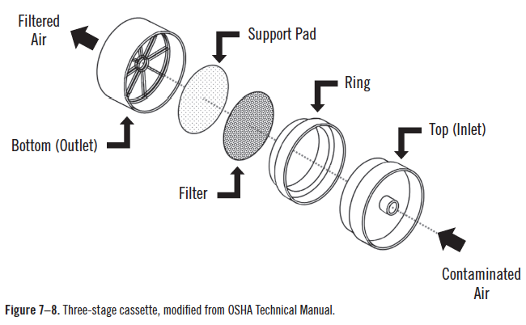
Particulate Sampling

Slide 16
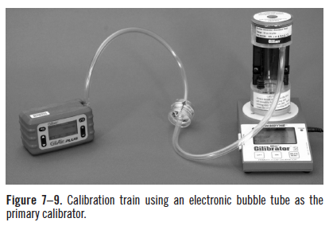
Particulate Sampling (cont.)

Slide 17
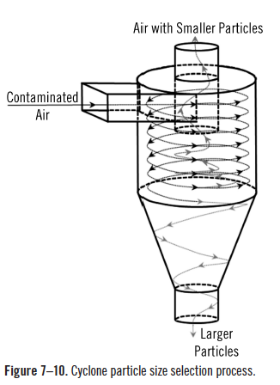
Cyclone Devices

Slide 18
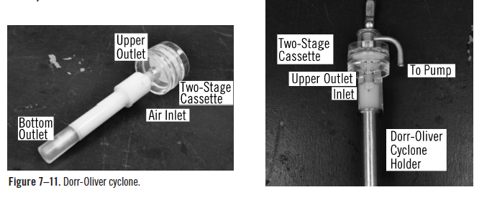
Cyclone Devices (cont.)

Slide 19
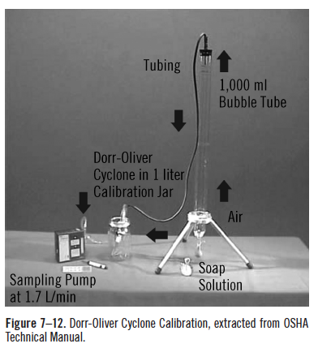
Cyclone Devices (cont.)

