Slide 1
Fundamentals of Industrial Hygiene 6th Edition
Chapter 11:
Non-Ionizing Radiation
Compiled by Allen Sullivan,
Assistant Professor, Safety and Health Management Central Washington University

Slide 2
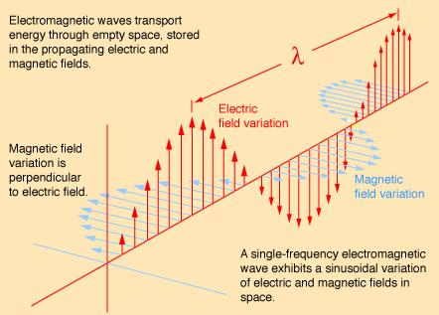
Introduction
One hallmark of the technological change since WWII has been the increasing use of the electromagnetic spectrum.
electric fields
polarity
electric force
amount of charge
polarity of charge
distance between
magnetic fields
electric current

Slide 3
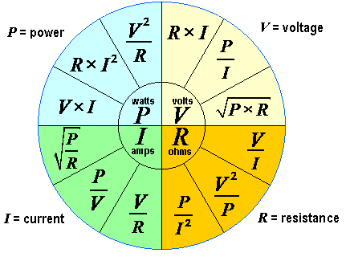
Current Flow
The amount of charge flowing past a given point in a defined period of time can be described:
Ohm’s Law
resistance
V = I × R
(voltage equals current times resistance)
P = V × I
(power equals voltage times current)
Joule’s Law
power
P = R × I²
(power equals resistance times the current squared)

Slide 4
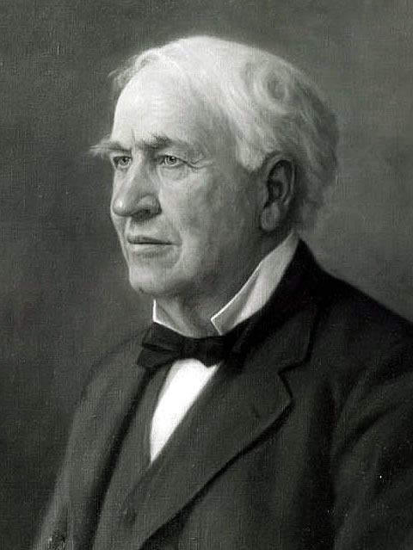
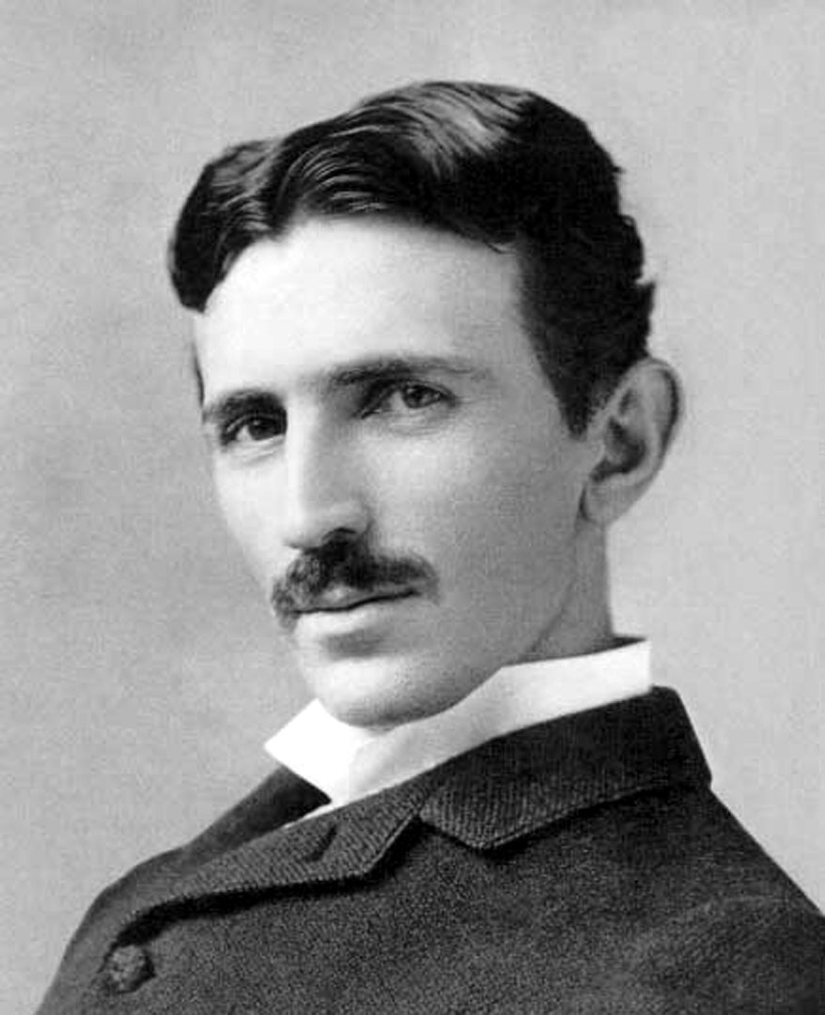
Electric Power Transmission
Generation
Transmission (generating plant to substation)
Distribution (substation to end-user)
Power grid
direct current (DC) - Edison
transmitted at same voltage as used (separate lines needed)
power losses (need high voltage + low current)
alternating current (AC) - Tesla
transformers
step-up (at generation facility) and step-down (distribution/ end-user)

Slide 5
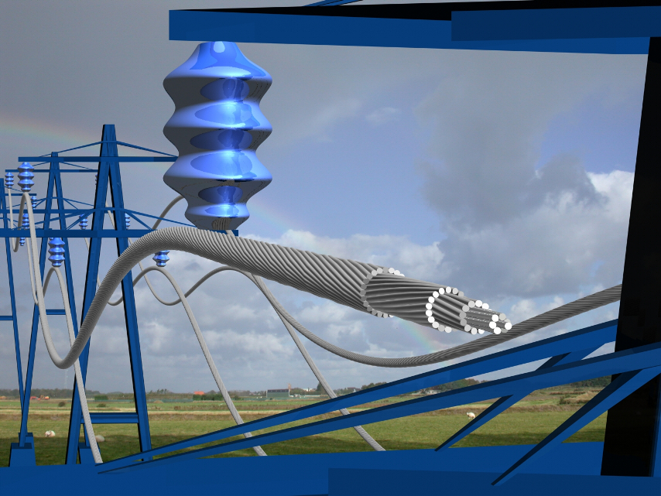
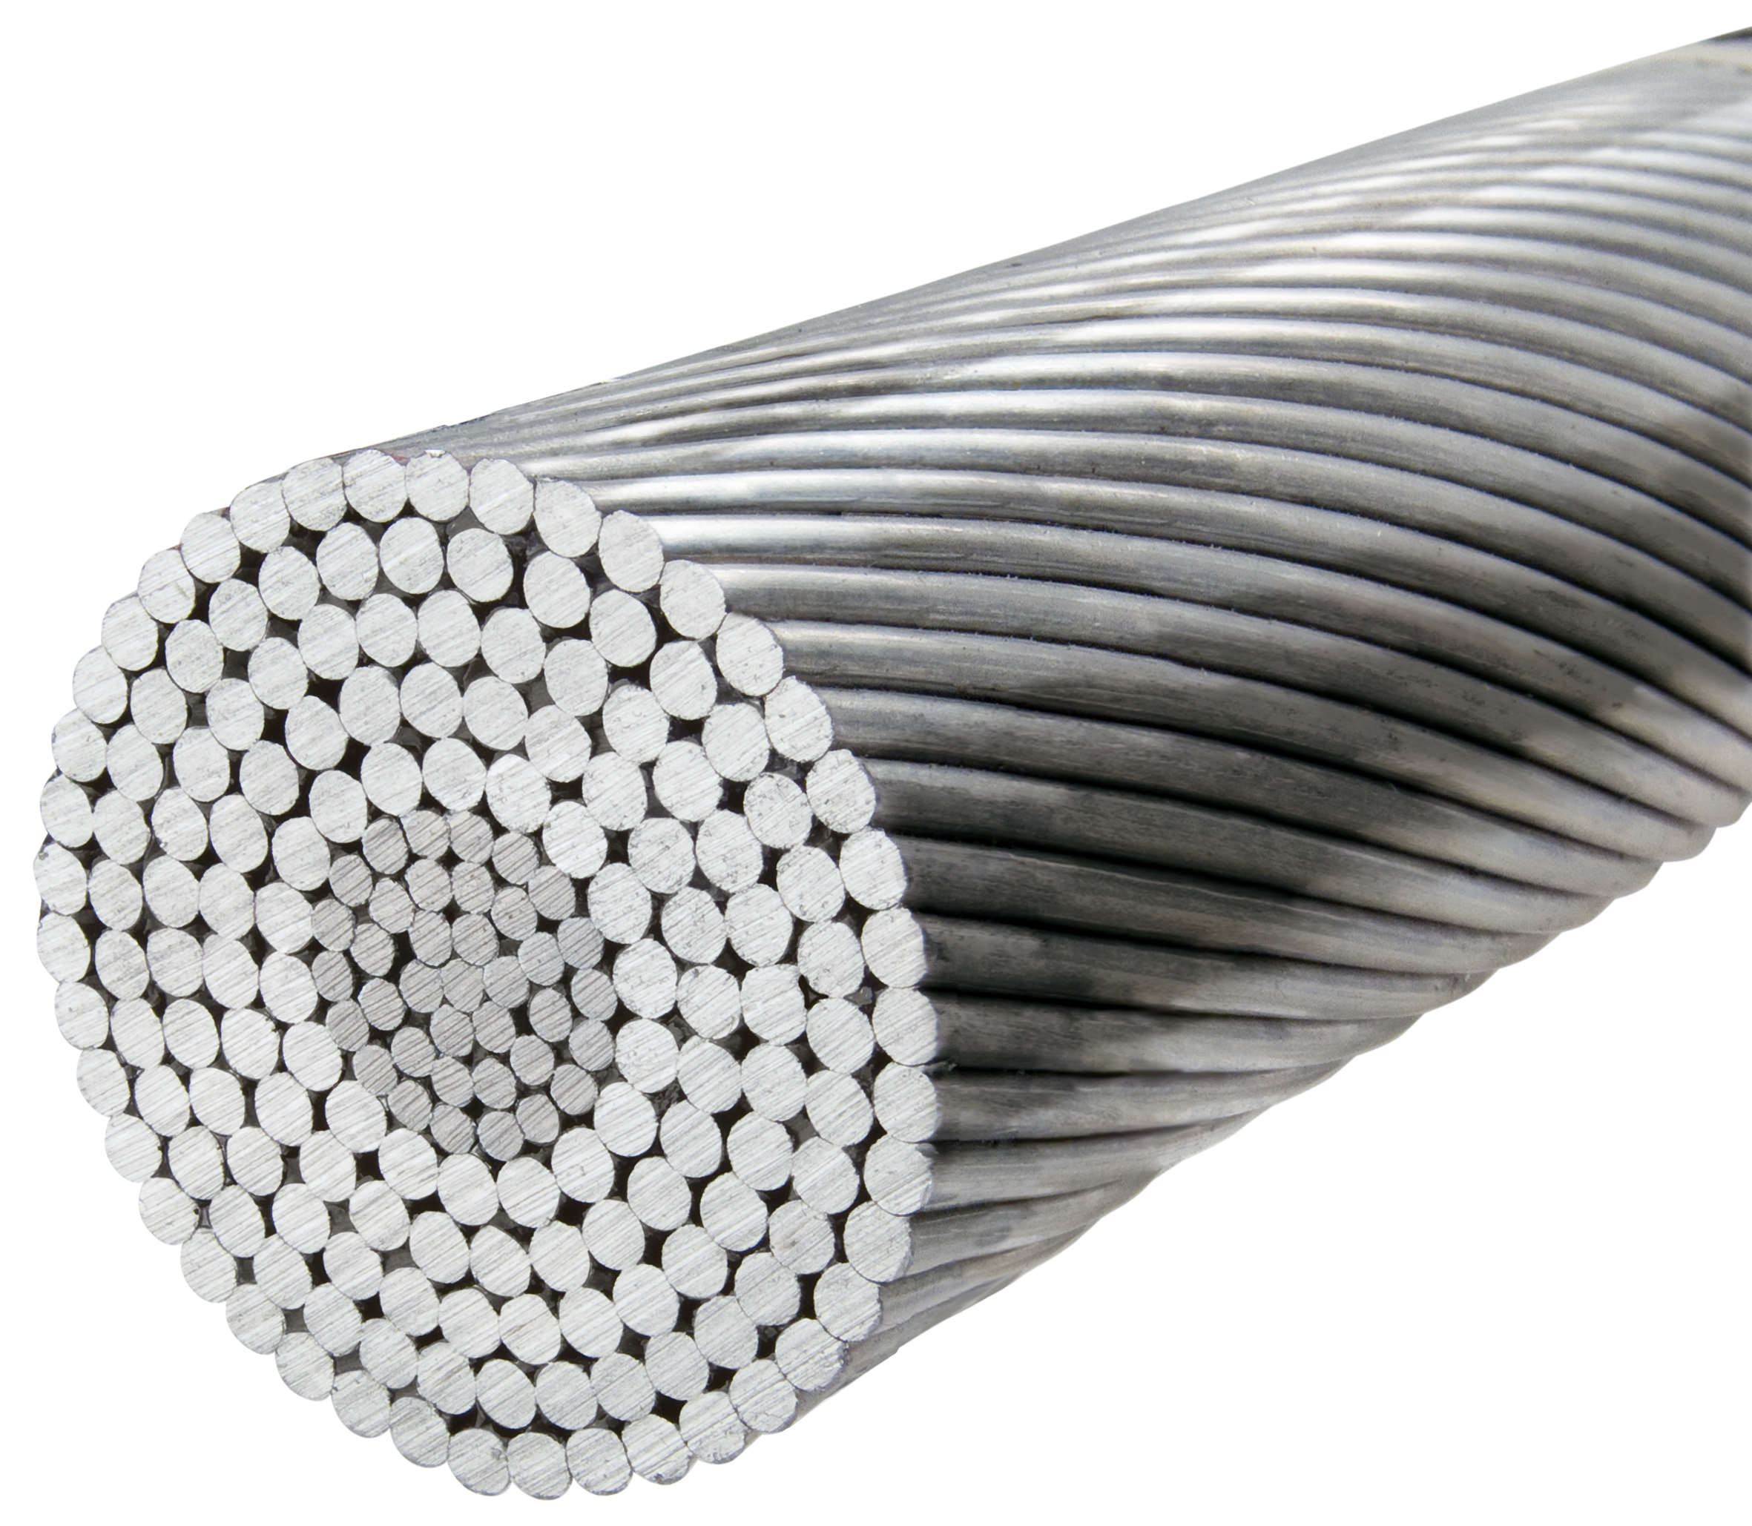
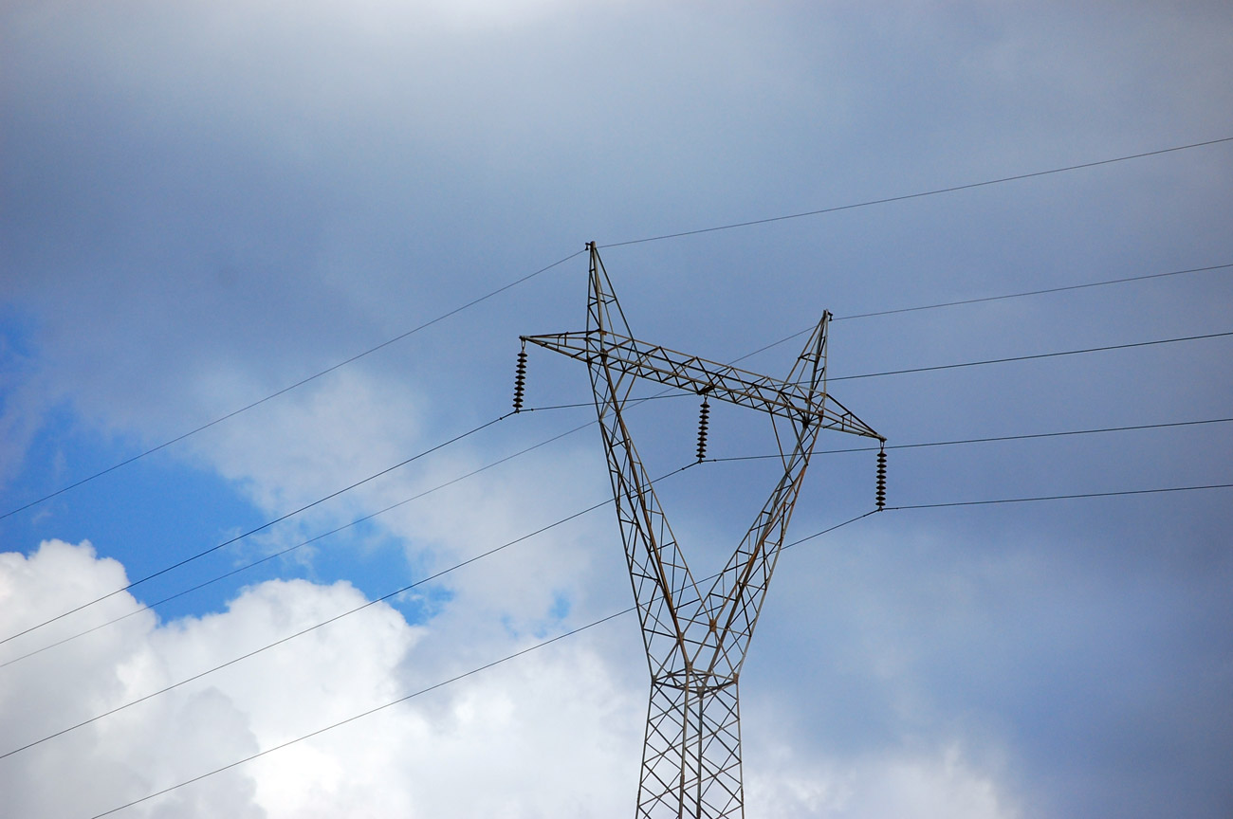
Electric Power Transmission (cont.)
Transmission lines
Conductor size
Pouillet’s Law
resistance increases with increasing length
resistance decreases with increasing cross-sectional area
aluminum-conductor steel-reinforced (ACSR)

Slide 6
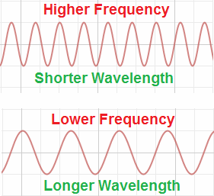
Electromagnetic Radiation
Electromagnetic radiation: describes the phenomenon where both electric and magnetic fields exist together.
frequency (f)
number of times a field reverses polarity (60 Hz)
wavelength (λ)
distance a wave travels in one cycle
Note: frequency × wavelength = speed of light (186,000 mi/sec)
if f, then λ must
if f, then λ must

Slide 7
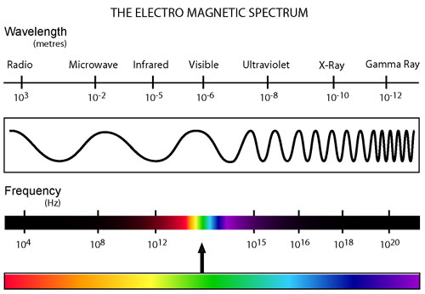
Electromagnetic Spectrum
The electromagnetic spectrum spans an immense range of frequencies.
Four types of radiation based on energies:
subradio 0 – 3 kHz
radio/microwave 3 kHz – 300 GHz
optical 300 GHz – 3 × 10¹⁵ Hz
ionizing > 3 × 10¹⁵ Hz
measured in milliwatts of power per square centimeter of area (mW/cm²)
power density
irradiance

Slide 8
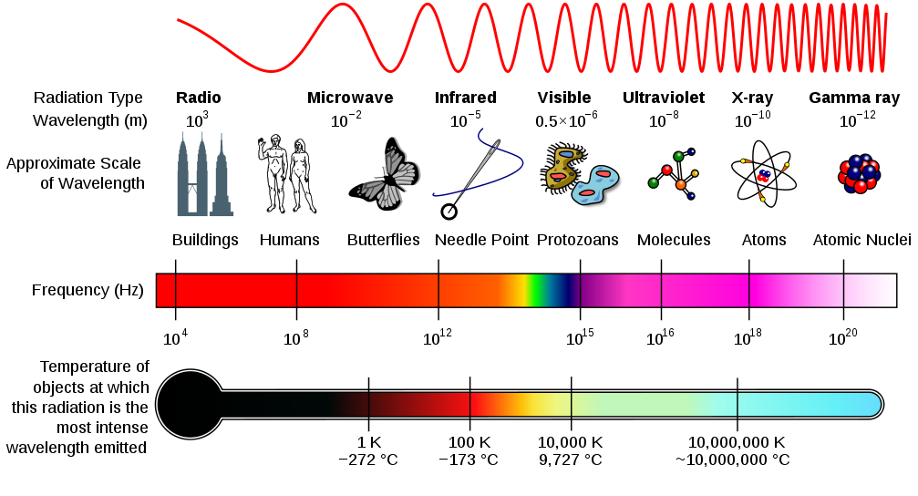

Slide 9
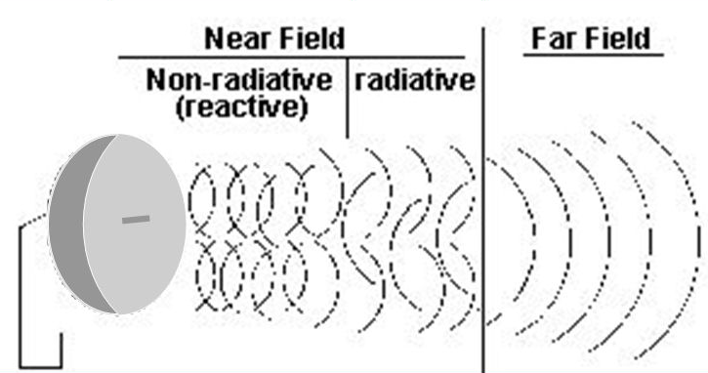
Near and Far Fields (What to Measure)
Separate electric and magnetic fields are commonly found at lower frequencies (longer wavelengths).
Radiation is commonly found at higher frequencies.
near fields
reactive near fields (λ > 1 m, 300 MHz)
electric fields and magnetic fields found
radiating near fields (λ < 1 m, 300 MHz)
electric and magnetic fields combine to form radiation
far fields
only radiation found

Slide 10
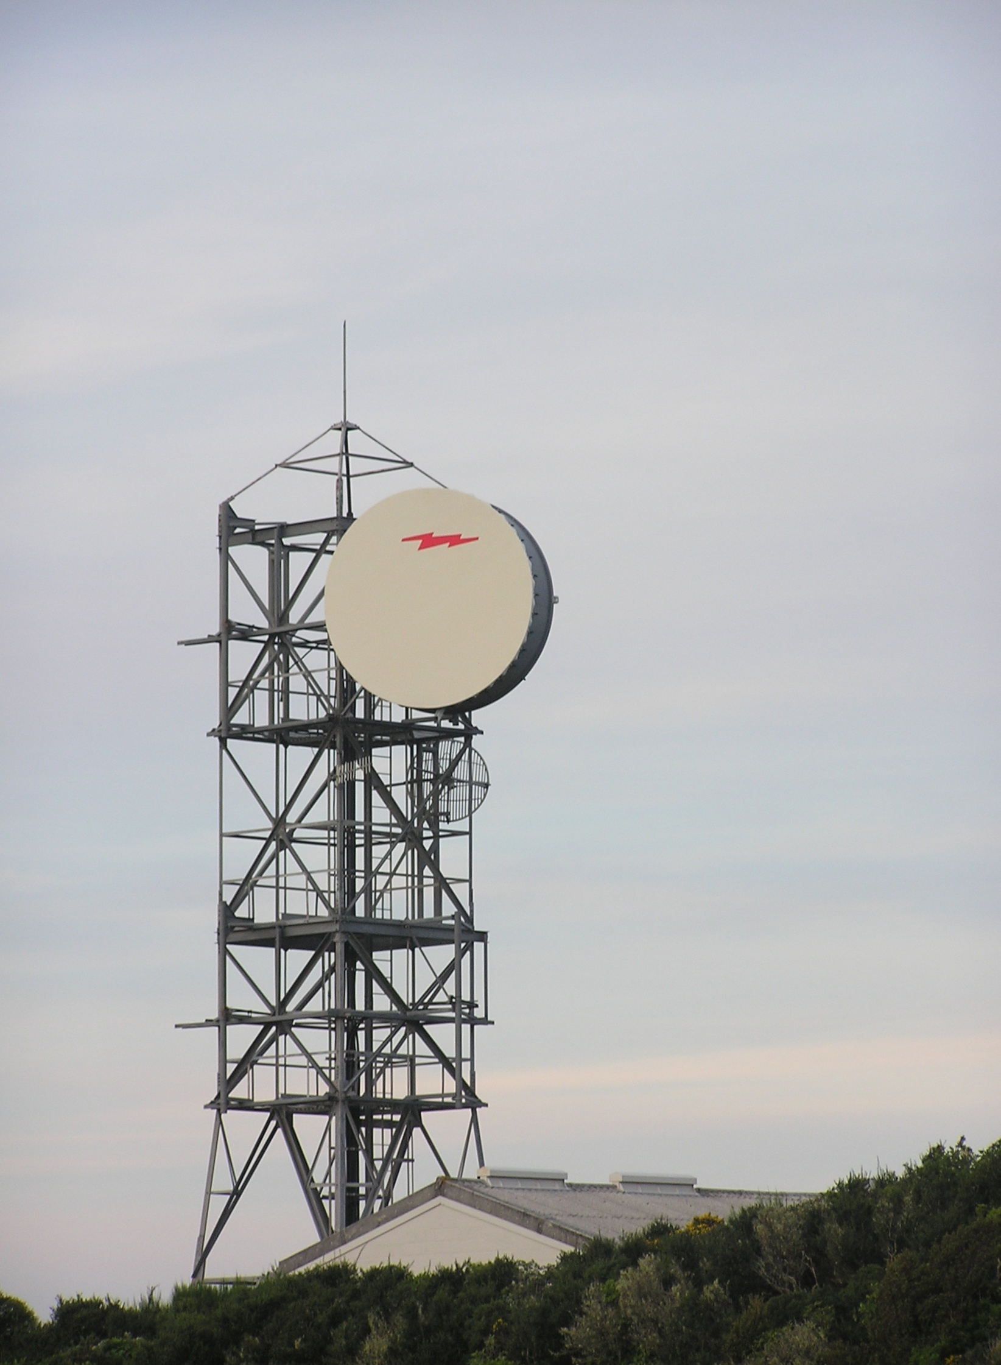
Parts of Electromagnetic Devices
Any electromagnetic device can be visualized as having three parts:
source
transmission pathway
receiver
Particular attention should be paid to the “transmission pathway” since it represents opportunities for worker exposure.

Slide 11
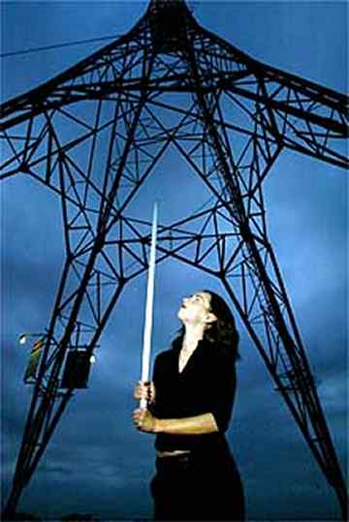
Measuring Field Strengths
electric fields
displacement sensor (dipole antennae)
pair of flat plates inserted into the field
measure electric potential between the plates
magnetic fields
magnetometer
contain loops of conducting wire
magnetic flux induces a current
can be ganged to become omni-directional

Slide 12
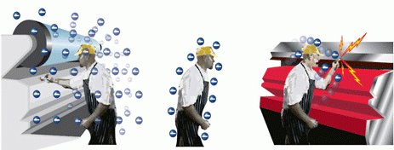
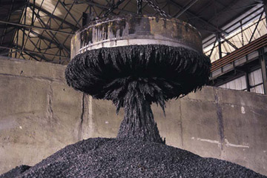
Biological Effects of Steady Fields
DC electric fields (do not change polarity)
sparks (irritating @ 5 kV/m, painful @ 15 kV/m)
TLV_{C} is 25 kV/m
Magnetic fields
nausea
metallic taste
dizziness
flashes in eyes
TLV 8-hr TWA is 2 tesla (T)

Slide 13
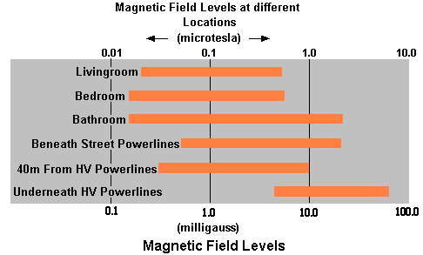
Biological Effects of Time-Varying Fields
Subradiofrequency Fields
possible human carcinogen
influence on cell membrane transport
circadian rhythm
Classic safety concerns
effects on cardiac pacemakers
movement of magnetized tools and equipment
wiping of magnetic media (e.g., discs, credit cards, hard drives)

Slide 14
Health Regulation Criteria
Difficult to establish—does not follow linear dose-response models.
exposure criteria
amount of individual exposure
emission criteria
how much can be released
prudent avoidance (similar to ALARA for ionizing radiation)
precautionary principle (limit exposures to extent practical)

Slide 15
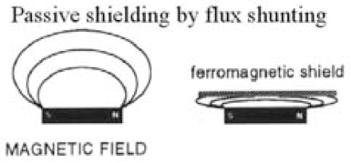
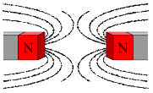
Subradiofrequency/Microwave Shielding
Electric fields
use of conductive screens/sheets with attached grounding conductor (mesh < ¼ λ)
Magnetic fields
permeable alloy to confine magnetic flux lines into shield material and around shielded area
active shielding (field cancellation)
uses an electric coil system and feedback controls to generate opposing fields
Note: This happens unintentionally with household wiring.
Current flows in one direction through wire and the returning current flows in opposite direction through an adjacent wire.

Slide 16
Biological Effects of Time-Varying Fields
Radiofrequency/Microwave
some scenarios involve fields and others involve radiation
absorption, scatter, transmission, reflection
dosimetry
The response of tissue to radiation and fields is determined by the electrical properties of the tissue
size of organism
40% λ and ungrounded, 20% λ and grounded
polarization of radiation
electric field parallel to long axis of organism
interaction of exposed tissue
specific absorption rate (SAR)

Slide 17
Biological Effects of Radiofrequency
Some scenarios involve fields and others involve radiation.
Only proven adverse human effects are eye cataracts, facial burns, and electric shocks and burns
Standards specify exposure limits for 6-minute intervals.
see ANSI/IEEE C95.1-2005 – incorporated by reference by OSHA
Sub-resonant Region (<3 MHz)
goal of standard is to prevent burns and excessive ankle heating
Resonant Region (3 MHz to 6 GHz)
peak absorption for humans occurs at 30 to 300 MHz
current flow and SAR both important considerations
Super-resonant Region (> 15 GHz)
skin absorption predominates (thermal damage to skin)

Slide 18
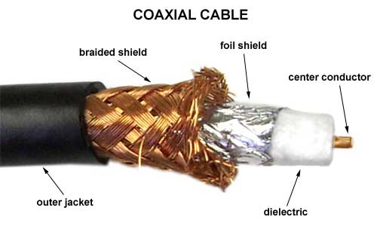
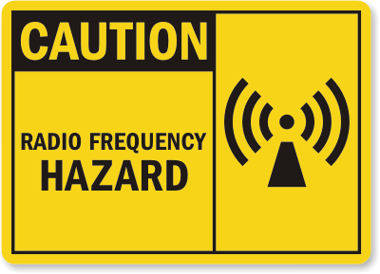
Radiofrequency/Microwave Controls
shielding
absorbing foams
metal screens or sheets (Faraday cages)
waveguides and coaxial cables
distance
far fields (inverse square law)
near fields (barricades, long-handled tools)
time limitation
based on 6-minute averaging time
signage

Slide 19
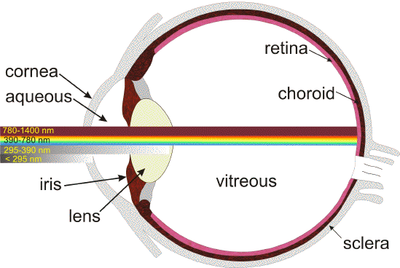
Biological Effects of Optical Radiation
Optical radiation includes IR, visible, and UV radiation.
The lens of the eye transmits visible and IR-A radiation but absorbs other IR bands and UV radiation.
eyes
thermal effects (IR)
photochemical effects (UV)
skin
skin toughening (UV-B)
skin cancer (UV-C)
Note: Exposure standards found in
ACGIH TLV booklet. Major concerns at frequencies < 1.4 μm due to retinal focusing.

Slide 20
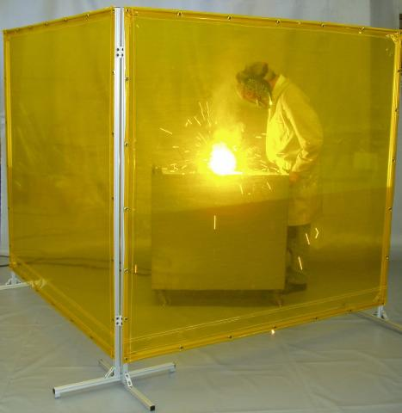
Visible (Non-Laser) Controls
optical density
log₁₀ of intensity of light leaving a filter v. entering the filter
if filter absorbs all but 1%: (1% = 1/100, log₁₀ of 100 = OD 2)
shade factor
variation of optical density used in ANSI A49.1 for welders
shade number = 1 + (2.33 × OD)
optical baffles and sight barriers
engineering controls
personal protective equipment
regular glass (UV-B and UB-C)
tinted glass (UV-A)
eye protection PPE must be distinctly marked

Slide 21
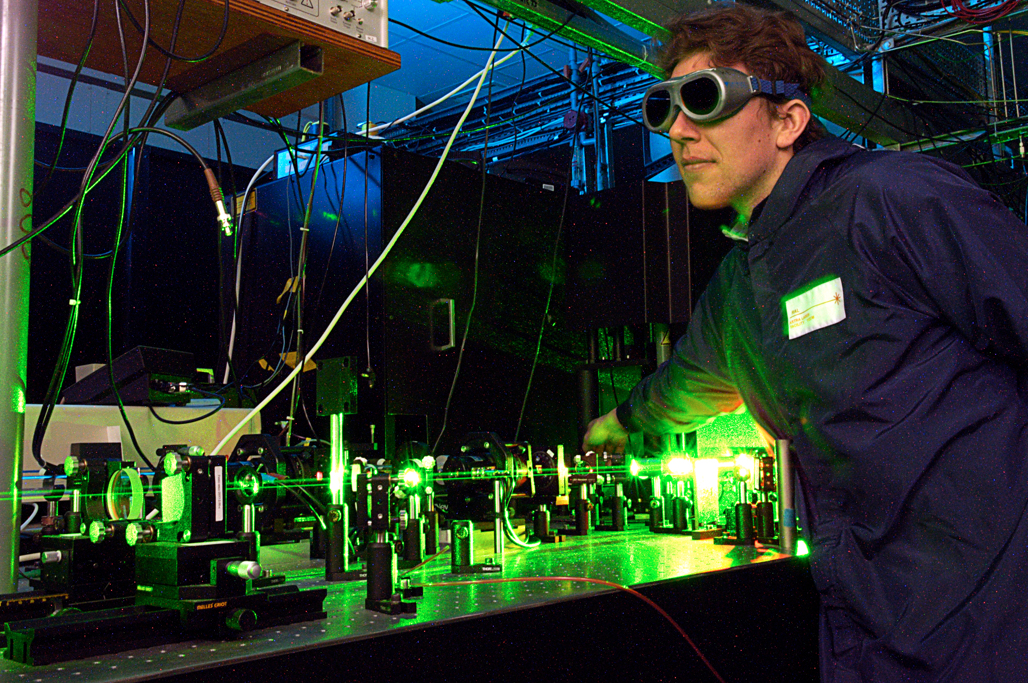
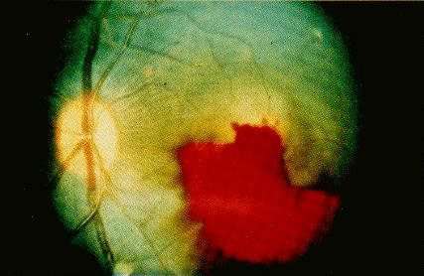
Biological Effects of Laser Radiation
Laser radiation has unique properties:
monochromatic (only one color/wavelength of light)
coherent (all waves in phase)
bright (very high irradiance, focused)
results in injury through:
thermal burns
photochemical effects
thermoacoustic tissue damage
brightness striking retina may be 300,000 times greater than that entering the eye
blood is toxic to nerve tissue

Slide 22
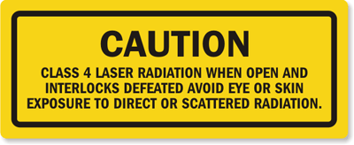
Laser Controls
Engineering and administrative controls and PPE are used for lasers.
engineering controls
enclosure
routing
fail-safe interlocks
remote interlock connections
key-in-lock control
administrative controls
exclusion (barriers, signs, beacons)
medical surveillance programs
training programs
personal protective equipment (PPE)
necessary to match optical density to wavelengths encountered

Slide 23
Non-Beam Hazards of Lasers
electricity (high-voltage currents, capacitor banks)
fire
ignition source
toxic pyrolysis products
carcinogenic polycyclic aromatic hydrocarbons (PAHs)
lacerations (exploding flash lamps)
biological (in plumes when used for cutting tissues)
toxicity/mutagenicity (original dyes used DMSO)
corrosiveness (gases used)
other radiation (electromagnetic fields, x-rays)
hazardous materials (heavy metals in detectors, heat sinks)

Slide 24
Laser Standards
Control class regulations—precautions become more stringent in a series of defined steps.
Class 1: extremely weak; intrinsically safe; no precautions needed
Class 2: low-power; hazardous if prolonged viewing; limited precautions
Class 3: moderate-power; hazardous if viewed briefly; more precautions
Class 4: high-power; harmful if glimpsed; rigorous precautions
Laser Institute of America
LIA/ANSI Z136.1-2007 (dominant standard)
Food and Drug Administration
standards for commercial laser products
OSHA
standard for construction workers

