Slide 1
Understanding Distracted Driving and Inattention Blindness

Slide 2
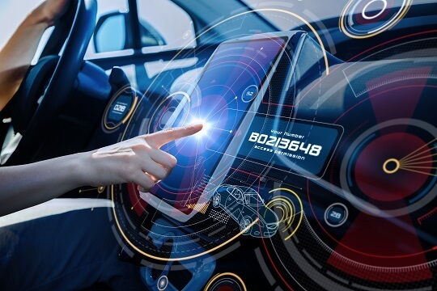
Fact:
More than 700 injury crashes involve distracted driving on a typical day in the U.S.

Slide 3
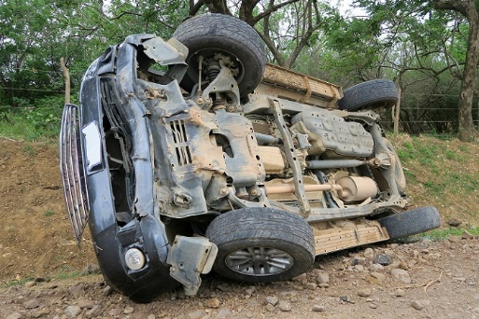
Distracted Driving is Dangerous
Drivers can be distracted long after they program a GPS device or send a text via a voice command system
Long enough to miss a stop sign or pedestrian? You bet
At 25 mph, you can travel the length of more than one football field in 10 seconds
New Vehicle Infotainment Systems Create Increased Distractions Behind the Wheel. AAA Foundation for Traffic Safety. October 2017. https://newsroom.aaa.com/2017/10/new-vehicle-infotainment-systems-create-increased-distractions-behind-wheel/
Notes:
While the percentage of drivers using handheld devices has decreased in recent years, many drivers still lose focus of the road. Their eyes drift and their minds wander as they connect on cellphones or other technologies built into vehicle dashboards.
In fact, studies indicate drivers can be distracted long after programming a GPS device or sending a text via a voice command system. Long enough to miss a stop sign or pedestrian? You bet. At 25 mph, you can travel the length of more than one football field in 10 seconds. What else could you miss during that time? (Pause to allow for answers)
New Vehicle Infotainment Systems Create Increased Distractions Behind the Wheel. AAA Foundation for Traffic Safety. October 2017. https://newsroom.aaa.com/2017/10/new-vehicle-infotainment-systems-create-increased-distractions-behind-wheel/

Slide 4
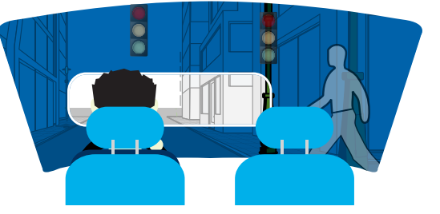
Distracted Drivers Can Miss Up to Half of What is in Their Driving Environment
Inattention blindness is defined as the failure to notice a visible hazard because your attention is focused elsewhere
This phenomenon occurs regularly when drivers are cognitively distracted
Notes:
So, let’s now talk about “inattention blindness,” defined as the failure to notice a visible hazard because your attention is focused elsewhere. This phenomenon occurs regularly when drivers are cognitively distracted.
Example: Let’s say a driver is using voice commands to order takeout food. The driver’s brain becomes lost that order (thin or thick crust pizza?). Instead of focusing on what’s ahead, the driver can miss up to half of what is in his or her driving environment, including slow or stopped vehicles up ahead.

Slide 5
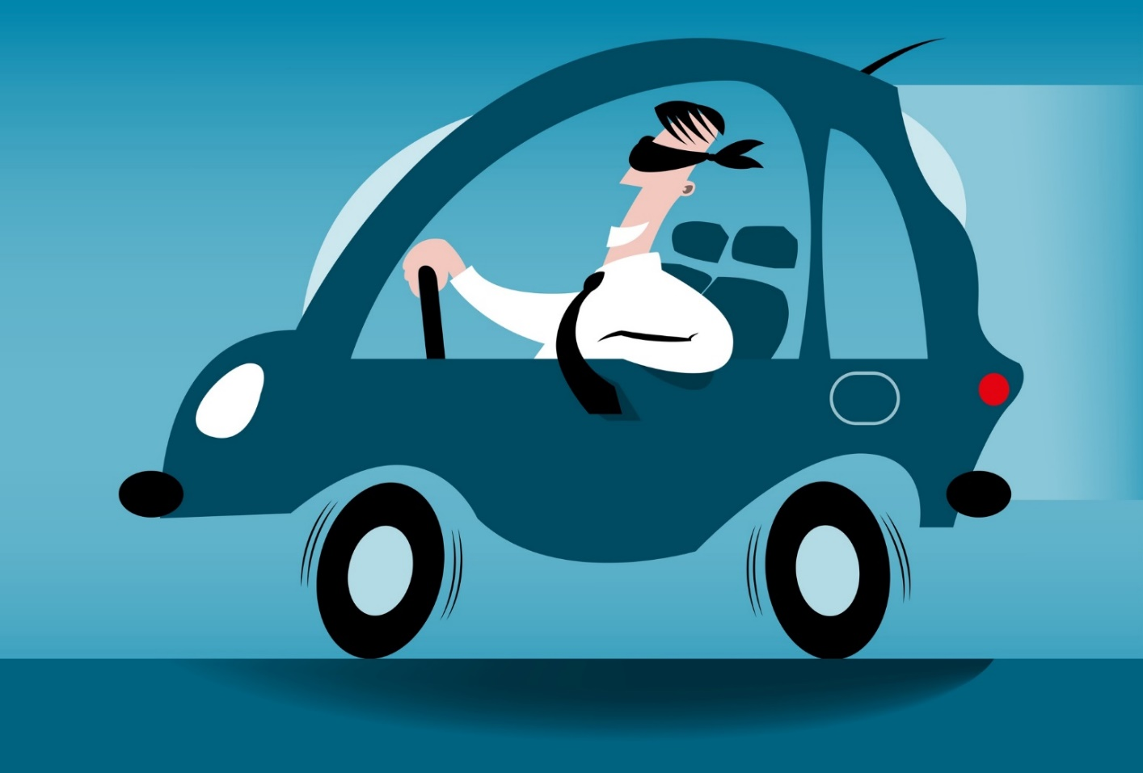
Distracted Driving Can Be Likened to Driving Blindfolded
Research shows simply listening to a phone conversation:
Decreases brain activity by more than one-third
Results in safety performance issues, like the inability to react quickly in congested driving zones
In America, eight people die every day in distracted driving crashes
Motor Vehicle Safety Issues: Distracted Driving. National Safety Council/Injury Facts. November 2019. https://injuryfacts.nsc.org/motor-vehicle/motor-vehicle-safety-issues/distracted-driving/

Slide 6
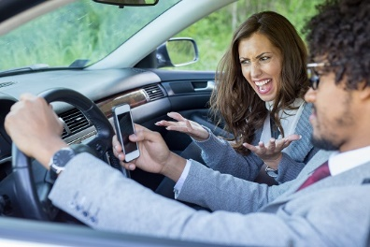
Discussion: What Ways Have You Noticed Drivers Being Distracted?
Notes:
Break into groups of 3-5 and encourage employees to come up with lists.

Slide 7
Examples of Distracted Driving
Talking or texting on the phone
Eating or drinking
Applying makeup or shaving
Reading a newspaper or book
Watching a video
Programming a GPS
Notes:
All of these examples fit under one of the following distraction categories: visual, manual (taking a hand off the wheel) or cognitive (taking your mind off driving). All can raise safety risks, not only for drivers but also for those sharing the road around them. Hands-free devices may be marginally safer than handheld ones, but the safest choice of all is not using your cellphone or other technology while you are driving.

Slide 8
Takeaways: Multitasking is a Myth
The human brain cannot handle two thinking tasks at the same time, such as driving and talking on the phone
Quickly toggling between thinking tasks can slow reaction time and cause crashes
Be safe by silencing your phone, programming your GPS and setting up your radio or music while parked
Take the National Safety Council pledge to drive distraction-free at nsc.org/pledge.
Notes:
The human brain cannot handle two thinking tasks at the same time, such as driving and talking on the phone. Your brain toggles quickly between these two tasks. When driving, this can slow reaction time and cause crashes.
Be safe by silencing your phone, programming your GPS and setting up your radio or music while you still are parked. Your life is much more valuable than any phone call, text or playlist. Let’s get on board with traffic safety.
Take the National Safety Council pledge to drive distraction-free at nsc.org/pledge.

