Slide 1
Fundamentals of Industrial Hygiene 6th Edition
Chapter 20:
Dilution Ventilation of
Industrial Workplaces
Compiled by Allen Sullivan,
Assistant Professor, Safety and Health Management Central Washington University

Slide 2
Introduction
Dilution occurs when contaminants released into a workplace mix with air flowing through the room.
general ventilation (HVAC) vs. dilution ventilation (control of contaminants)
dilution ventilation is used where:
small quantities of contaminants released at uniform rates
sufficient distance from source to worker to allow for dilution
contaminants are low toxicity or fire hazard
no air-cleaning device is needed before exhaust discharge
no corrosion or other problems from diluted contaminants

Slide 3
Dilution Ventilation Systems
Natural ventilation
no mechanical air mover is used
wind
temperature differences
Mechanical ventilation
fans or mechanical ventilators are used
efficient, so long as adequate make-up air is provided

Slide 4
Dilution System Design Considerations
Safety factors
rates for health protection or fire/explosion protection
assume complete mixing of contaminants
yield an airflow to keep contaminants at target concentrations
K_{factor} (safety airflow equations)
S_{factor} (fire/explosion airflow equations)

Slide 5
Discharge Ventilation System Layout
Dilution systems work best when air is supplied from a fan-driven supply, with the air:
discharged above or behind workers (air moves past worker)
then over source of contaminants,
then toward exhaust fans that remove mixed air from room
Note: The air inlet and exhaust fans should move air from cleaner areas to dirtier areas.

Slide 6
Calculating Dilution Airflow (safety)
The amount of dilution airflow (Q in ft.³/min.) required depends on:
physical properties of the contaminant
molecular weight (M)
specific gravity (sp gr)
rate of contaminant release (W in pints/min.)
target airborne concentration (L—PEL or TLV in ppm)
overall safety factor (S_{factor}, K_{factor}—dimensionless)
Q = 403 × sp gr × W × K_{f} × 1,000,000
M × L

Slide 7
Calculation Example
Cleaning operation uses methyl ethyl ketone (MEK) at rate of 2 pints per hour.
Sp gr = 0.81
W = 0.033
M = 74
L = 20
K_{f} = 5
Q = 403 × 0.81 × 0.033 × 5 × 1,000,000
74 × 20
Q = 53,860,950
1480
Q = 36,393 ft.³/min.

Slide 8
Calculating Dilution Airflow (Fire)
The amount of dilution airflow (Q in ft.³/min.) required depends on:
Q = 403 × sp.gr. × W × S_{f} × 100
M × LEL × B
S_{factor}
depends on percentage of LEL acceptable for safe conditions
if concentration should not exceed 25% of LEL, S_{f} = 100 ÷ 25 = 4
B
constant reflecting that the LEL decreases at elevated temperatures
B = 1.0 for temperatures ≤ 250°F
B = 0.7 for temperatures > 250°F

Slide 9
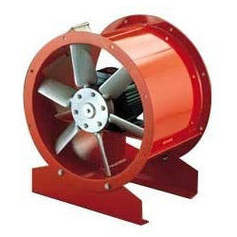
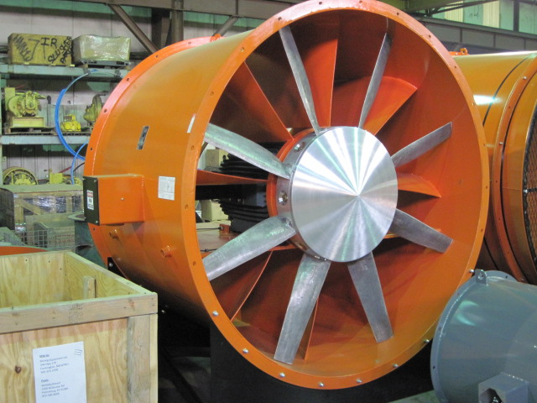
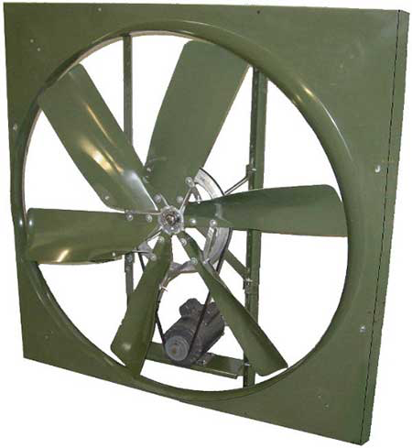
Fans for Dilution Ventilation
Dilution systems may use either centrifugal or axial flow fans.
Three types of axial flow fans:
propeller fans
tubeaxial fans
vaneaxial fans

Slide 10
Dilution Ventilation of Temporary Workspaces
Dilution is often used as temporary ventilation for:
workspaces that are usually unoccupied, but require workers to enter for inspection, cleaning, and maintenance
activities in normally occupied spaces when work performed generates contaminants
provide adequate outside air to maintain O₂ levels (19.5% – 23.5%)
maintain flammable gas/vapor/mist/dust at safe levels (<LEL)
control contaminants produced inside the space (e.g., welding fumes)
achieve compliance with OSHA regulations (e.g., confined space)
control temperature in hot climates or where activities produce excessive heat
two approaches:
using fans to bring fresh air in (forcing contaminants out)
using exhaust fans to remove contaminants (let make-up air in)

Slide 11
Confined Space Ventilation
Work in confined or enclosed spaces presents special hazards, including:
oxygen deficiency
toxic contaminants
risk of engulfment
risk of being trapped
Generally, OSHA standards for ventilation fall into:
general requirements
use engineering controls to ensure a safe environment
exposures must be below PELs
special requirements
welding, hot work, permit required confined spaces

Slide 12
Effective Ventilation Considerations
Effective use of dilution ventilation should follow these principles:
should be arranged to take advantage of natural airflow
chimney effect
air distribution inside spaces must be managed
avoid short-circuiting (obstacles to mixing of airflows)
exhaust ducting should be sealed to workplace
prevent re-incorporation of exhausted contaminants)

Slide 13
Temporary Dilution Ventilation Equipment
Ventilation systems for temporary installations are available as packages.
The performance of all air movers diminishes with increased airflow resistance:
insufficient openings to allow free air movement into and out of workspace
excessive duct length
number of elbows or sharp turns
restricted duct diameter (e.g., sagging, build-up)
Note: These issues can result in a 50% reduction of manufacturers’ claims. Prudent to select a confined space package with double the calculated airflow.

Slide 14
Typical Approach
A typical approach to proper dilution ventilation follows the following criteria:
determine the minimum ventilation rate
sufficient air changes per hour (ACH) to maintain acceptable conditions
use local exhaust ventilation where possible to control localized sources
fan capacity must be 1.5–2.0x greater than minimum ventilation rate
compensates for actual field performance

Slide 15
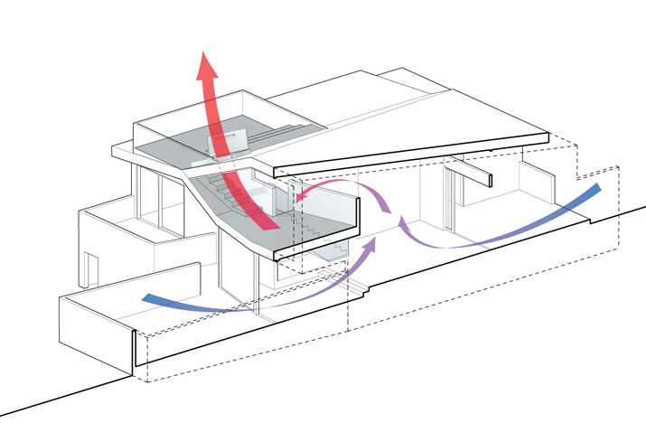
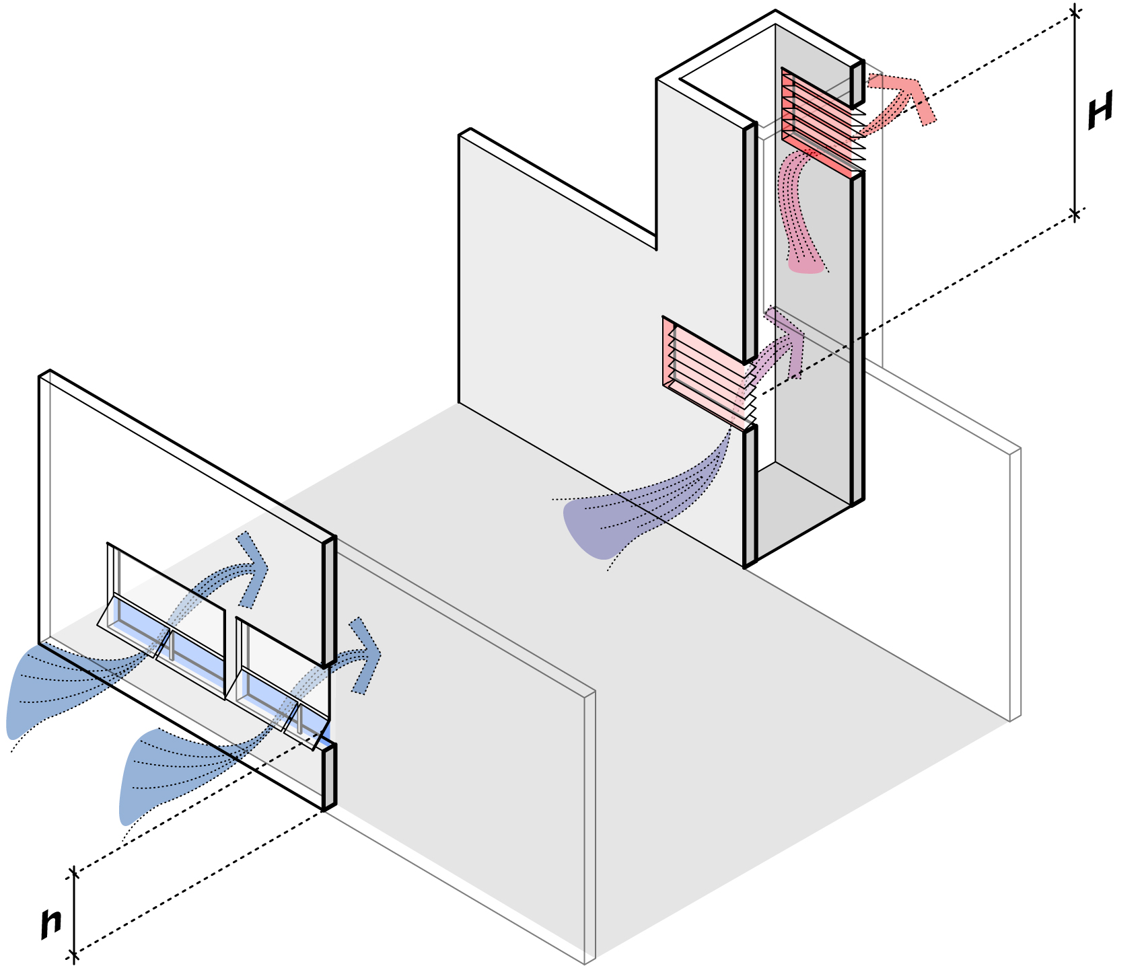
Typical Approach (cont.)
Consider forced ventilation to improve air distribution except where:
workspace should be maintained under negative pressure
velocity of supplied air might stir up contaminants
natural airflow can be used in conjunction with exhaust fans
Workspaces where contaminants rise due to thermal head should be exhausted near the top of the space.

Slide 16
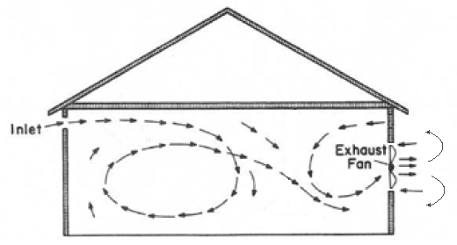
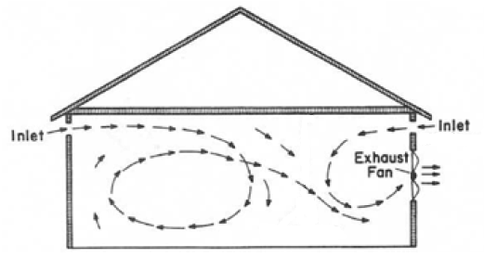
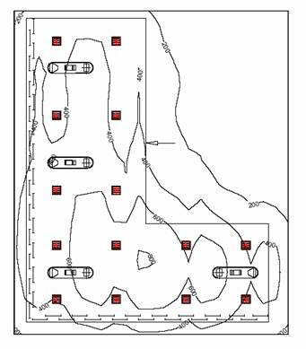
Typical Approach (cont.)
Avoid short-circuiting
locate fans to flush entire work zone
affix fan ducting to building to prevent recirculation of outside air

Slide 17
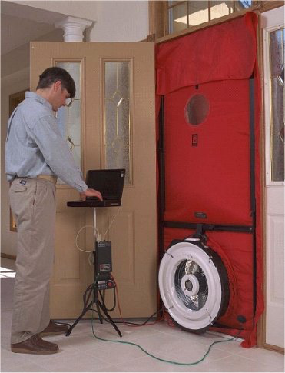
Typical Approach (cont.)
Measure differential static pressure between space and outside when ventilation is operating.
if >1 inch water-column difference, add additional inlets for make-up air
If using compressed-air driven fans, a pressure regulator must be installed to ensure proper air pressure to fan.

