Slide 1
Managing Stress at Work
For use in conjunction with 5-Minute Safety Talk
Notes:
Managing Stress at Work

Slide 2
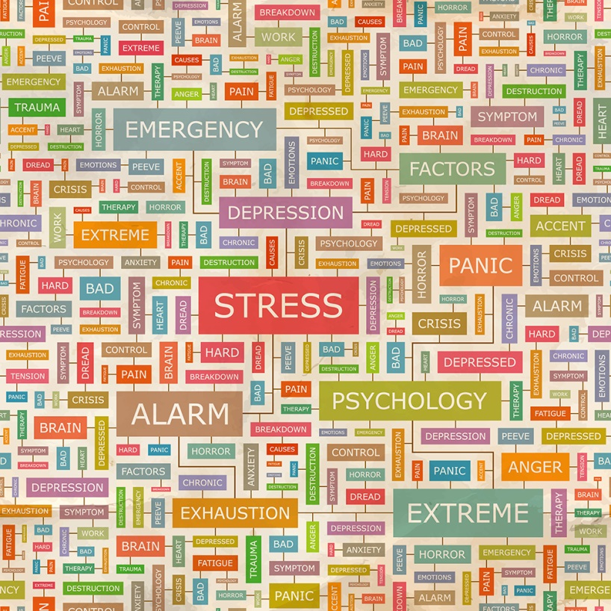
Stress
Too much can lead to…
Job burnout
Anxiety
Depression
Insomnia
Hypertension
Frequent illness
Exhaustion
Notes:
While many of us need a certain level of stress to achieve peak performance, too much stress can take its toll, increasing the risk of job burnout, anxiety, depression, insomnia, hypertension and frequent illnesses. The more an organization can do to reduce stress on the job – and the more individuals can do to better manage the stress in their lives – the more productive the workplace will be.

Slide 3

Contributors to Employee Stress
Downsizing or reorganization
Large workloads
Long work hours
24/7 technology
Work/Life obligations
Health related concerns
Notes:
There are many contributors to employee stress. Supervisors, in particular, are faced with numerous challenges, including:
• Downsizing or reorganization, often involving low morale and an unstable work environment
• Large workloads, high performance demands and long work hours
• 24/7 technology – e-mail, cell phones and wireless devices - which make it difficult to separate work from home
• Work/life obligations, especially in instances where there are two-career families, single-parent households and elder care responsibilities
Health related concerns

Slide 4

A Few Ways Employers Can Help
Allow some control over schedules
Include employee input in decision making
Balance responsibility & authority necessary for tasks
Set reasonable limits & timelines
Recognize a job well done
Resources - health club membership, elder-care & on-site or near- site child care
Employee Assistance Programs and Wellness Programs
Review work distribution process – Fair & effective?
Notes:
We can help create a less stressful work environment by applying the following practices:
• Allowing workers to have some control over their schedules
• Include their input in decision making
• Balance responsibility with the authority necessary to complete the task
• Set reasonable limits and timelines
• Remember to recognize a job well done
• Provide resources to help balance work/home issues, such as on-site/ near-site child care or elder care and Employee Assistance Programs
• Continually review policies, processes, and methods of organizing and distributing work; make sure they are fair and effective

Slide 5

7 Steps to Help Manage Stress
Eat a balanced and nutritious diet starting with breakfast
Get a good night’s sleep
Volunteer time and services
Seek professional help
Keep moving – Exercise 30 minutes a day
Express your feelings – you’re not alone
Get to the root of it - remove the stressor or try new coping strategies
Notes:
Employees can better manage workplace stress by implementing the following:
• Eat a balanced and nutritious diet starting with breakfast, and get a good night’s sleep
• Volunteer time and services; doing something for others can help a person forget their own problems and increase self-esteem
• Seek professional help; use employee assistance programs or participate in special therapy that can teach ways to better manage the problems that are causing stress
• Keep moving – studies show that exercising for 30 minutes a day reduces stress
• Learn to express your feelings – you don’t have to face problems alone
• Determine the source of the stress. If it can’t be removed from your life, learn to cope by developing a systematic and rational way of thinking through the situation and taking control by figuring out options to better handle the problem.

Slide 6

Managing Stress at Work
You will never completely remove stress from your life, but identifying and managing stressors can help maintain a positive and healthy lifestyle!
Notes:
You will never completely remove stress from your life, but identifying and managing stressors can help you maintain a positive and healthy lifestyle.

Slide 7
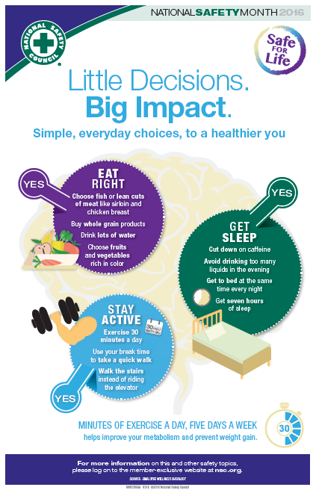
Poster
Little decisions. Big impact.
Hang this poster in high traffic areas to remind
everyone of the importance of making healthy decisions.
Notes:
Poster
Little decisions. Big impact.
Hang this poster in high traffic areas to remind
everyone of the importance of making healthy decisions.

Slide 8

Checklist
It’s Never Too Late to Form Healthy Habits
Eating Right?
Getting Enough Physical Activity?
Getting Enough Sleep?
Making slight adjustments to your routine can make a major impact on your health.
Use this checklist to check-up!
Notes:
Checklist
It’s Never Too Late to Form Healthy Habits
Eating Right?
Getting Enough Physical Activity?
Getting Enough Sleep?
Making slight adjustments to your routine can make a major impact on your health.
Use this checklist to check-up!

Slide 9

Wellness Tips
NEW 2-Minute Safety Video
Learn simple ways to incorporate healthy
habits into your daily routine
This 2-Minute Safety Video link can be found on the Member Exclusive Content page or at: http://www.nsc.org/members_get_more/MemberResources/Pages/Member-2Min-Videos.aspx
Notes:
Wellness 2-Minute Safety Video
Learn simple ways to incorporate healthy habits into your daily routine
Visit: http://www.nsc.org/members_get_more/MemberResources/Pages/Member-2Min-Videos.aspx

Slide 10
For more member-exclusive safety presentations, webinars, posters and resources visit: nsc.org/members
Customer Service – (800) 621-7619
Outside U.S. – +1-630-775-2056
Email us at:
MEMBERSHIPINFO@nsc.org
Notes:
For discussion:
Questions
Observations & Concerns
Safety Action Plan

Slide 11
Related 5-Minute Safety Talks
Find these and more at nsc.org/members
Bloodborne & Airborne Pathogens
Sudden Cardiac Arrest and AEDs
Know the Facts about Backs – Ergonomic Safety
Hot Weather Safety
Cold Weather Safety
Seizures
Employee Wellness
The Importance of Proper Sleep
Workplace Violence
Notes:
Here are additional 5-Minute Safety Talks you may be interested in.
These resources can be found at nsc.org/members along with webinars, posters, checklists, an audio library and much more.

