Slide 1
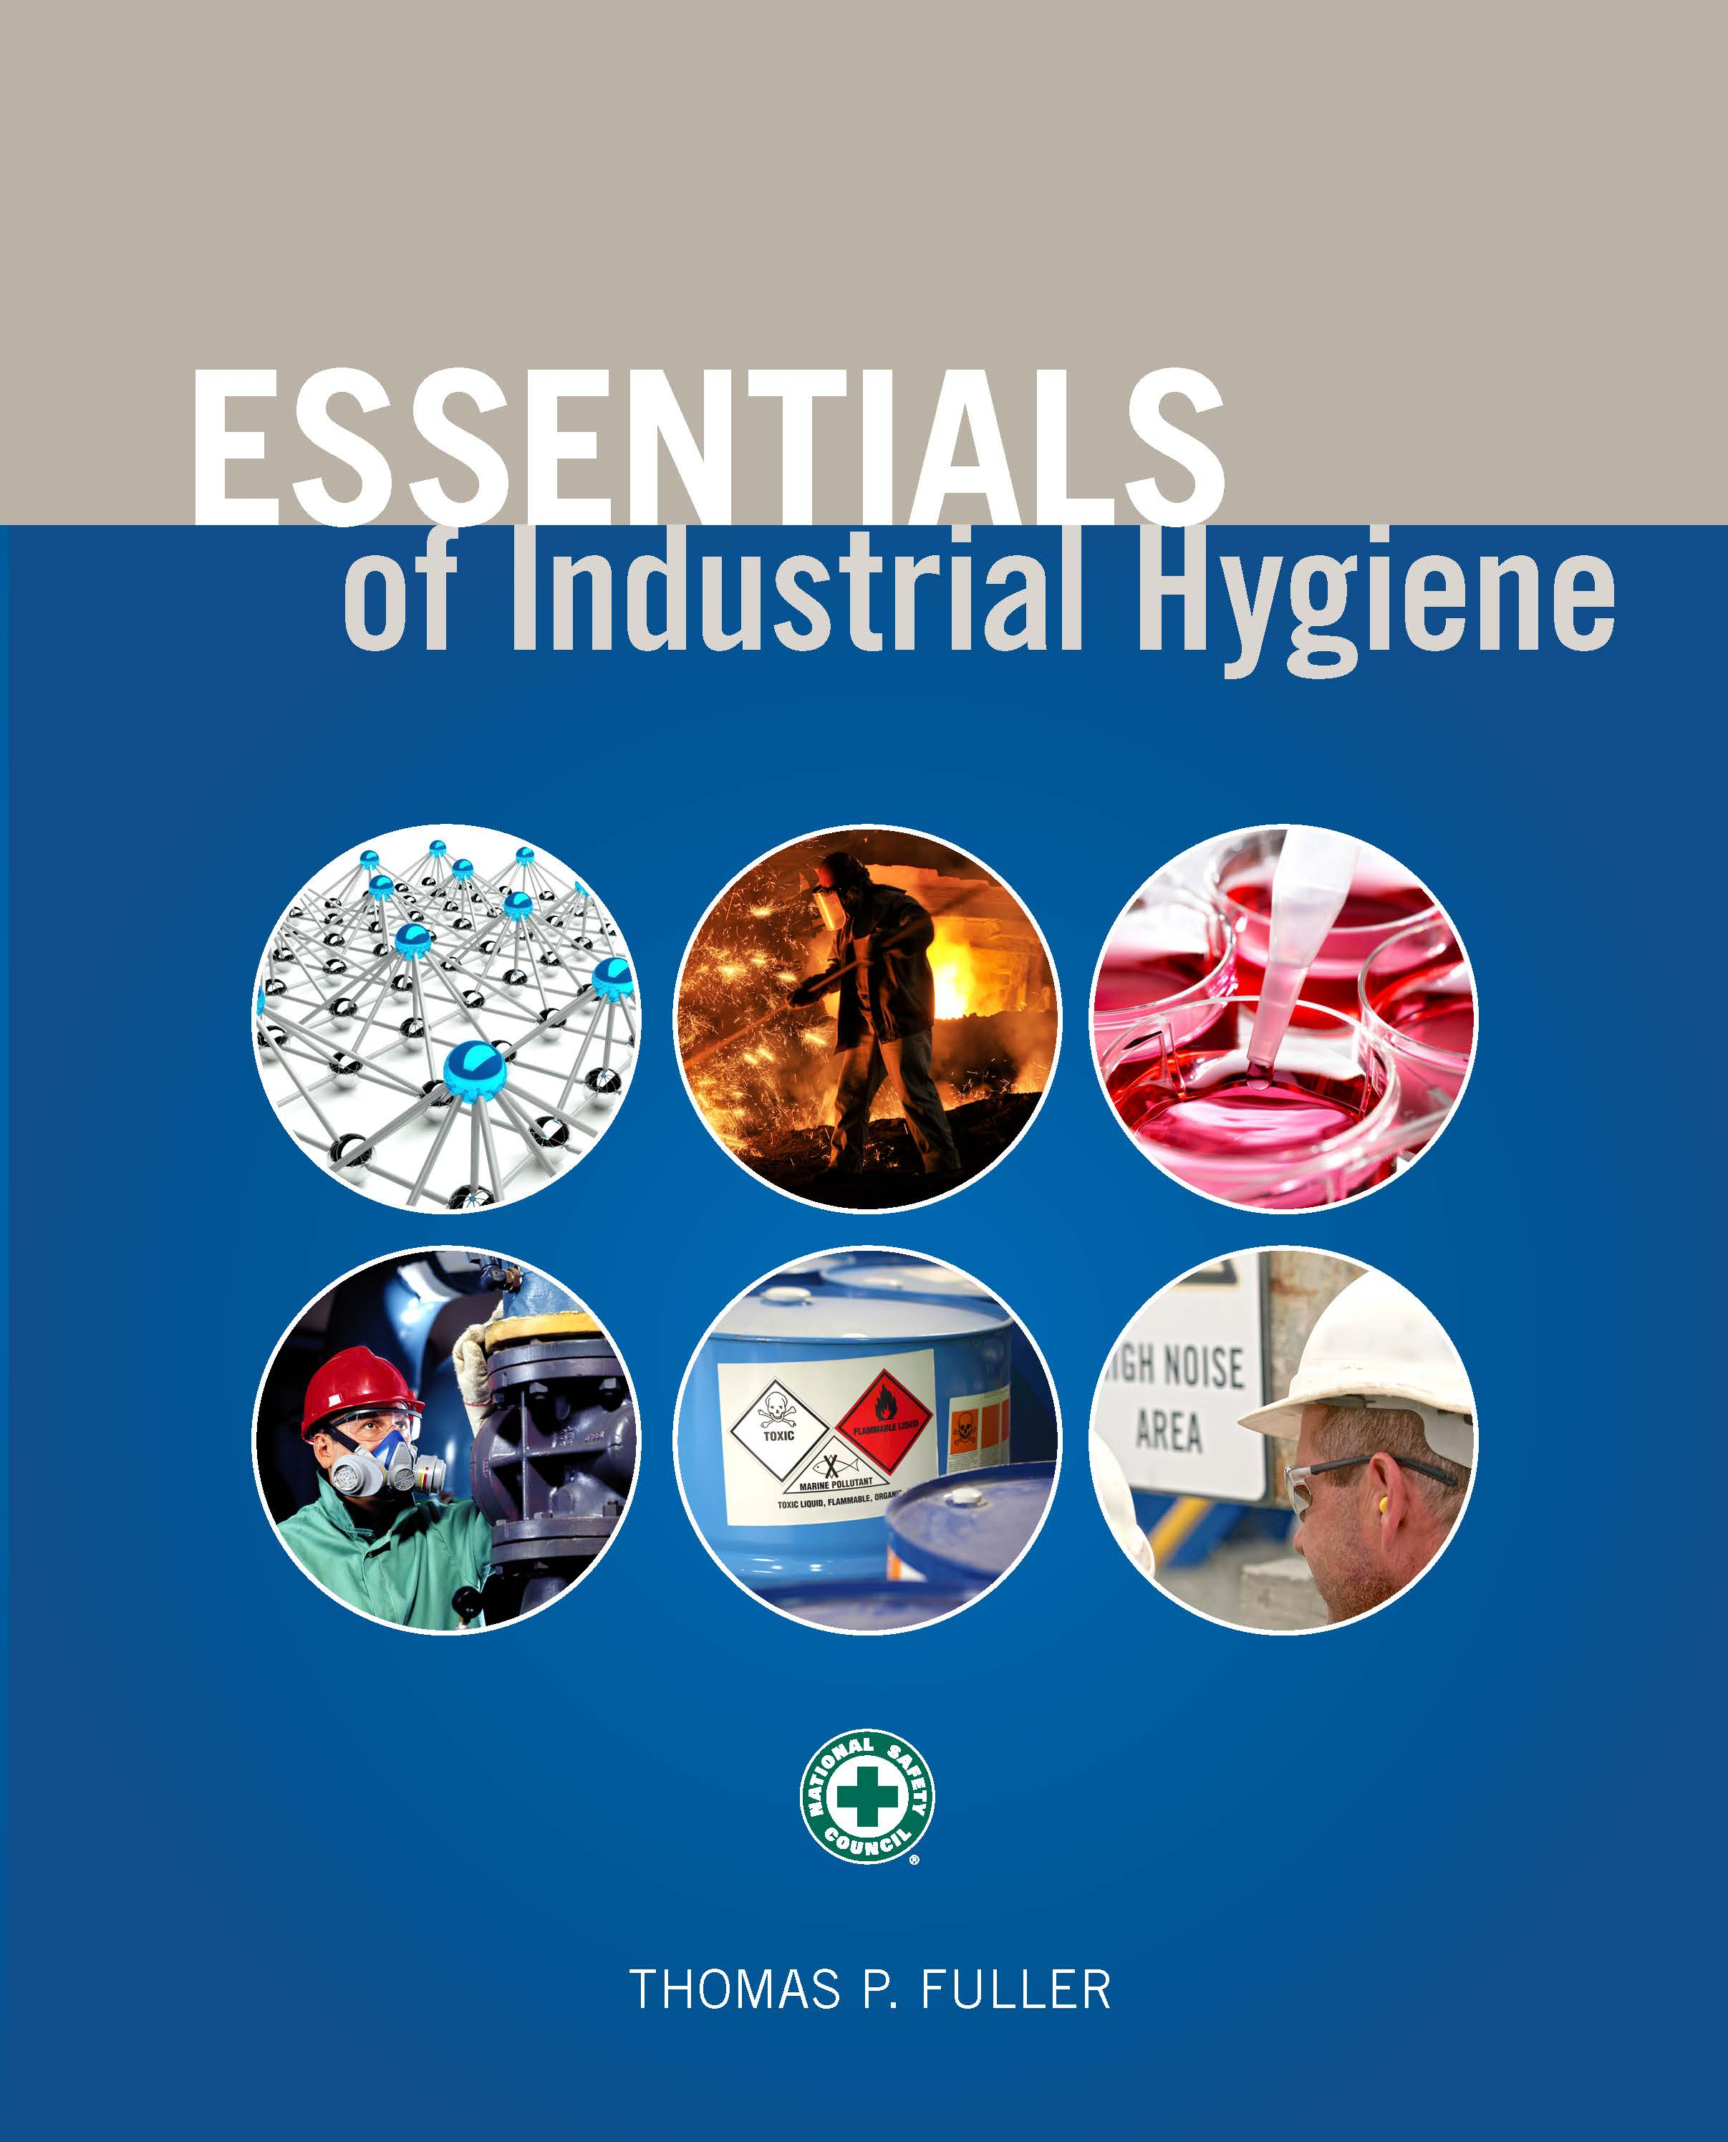
CHAPTER 6
Gases and Vapors

Slide 2
Learning Objectives
Describe the various properties of the chemicals that are most important to the practice of industrial hygiene.
Calculate the concentration of a chemical in the air when provided with the chemical’s basic parameters.
Describe the basic behaviors of gases and vapors in scientific and mathematic terms.
Identify various methods of collecting and analyzing gas and vapor concentrations in the air.
Identify the handheld and portable detectors used for direct measurement of gases and vapors in the environment.

Slide 3
Normal Temperature and Pressure (NTP)
Used for gas and vapor calculations
25ºC and 760 mmHg
At NTP, 1 mole of any gas will occupy 24.45 L.

Slide 4
Concentration of Gases and Vapors in Air
ppm = parts of contaminant per million parts of air
For a gas or vapor of a certain mass at NTP, the concentration in air can be calculated using:
Concentration calculated by volume comparisons:
$$ppm= \frac{(\frac{mg}{m^{3}})(24.45 L)}{(molecular weight)}$$
$$ppm= \frac{Vcontaminant}{Vair} ×{10}^{6}$$

Slide 5
Vapor Pressure
The amount of pressure that a liquid exerts on the inside of a closed container above the surface of the liquid
At equal temperatures, chemicals with higher vapor pressures tend to evaporate more quickly than chemicals with lower vapor pressures.
In general, chemicals will evaporate more quickly at higher temperatures.

Slide 6
Vapor Density
The measure of how heavy the vapor is in air
Chemicals with higher vapor densities tend to settle near the floor.
Chemicals with lower vapor densities tend to rise to the ceiling.
Vapors with high densities can displace oxygen from the workers’ breathing zones, which can lead to physical/simple asphyxiation.

Slide 7
Specific Gravity (SG)
The mass of a substance compared to the mass of an equal volume of water
Water has an SG of 1.0 gram per milliliter or centimeter cubed.

Slide 8
Flash Point
The lowest temperature at which a material gives off enough vapors to form an ignitable mixture.

Slide 9
Fire Point
The temperature at which the ignitable mixture will continue to burn.

Slide 10
Auto-Ignition Temperature
The point at which a material will ignite without an external source of ignition.

Slide 11
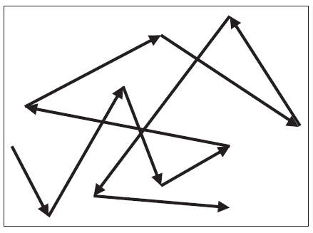
Brownian Motion
A measure of how much a gas or vapor molecule moves in the air.
The continuous ricocheting of molecules bouncing off one another which allows them to spread out in space.

Slide 12
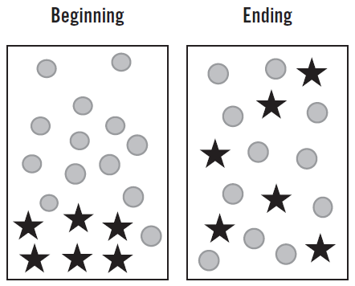
Diffusion
The ability of gases and vapors tend to spread out and move from locations of high density to those of low density.
This movement causes them to become equally distributed in a space.

Slide 13
Ideal Gas Law
When the amount of the chemical is known and it is entirely evaporated, use the following equation to calculate the volume that the chemical will occupy at a given temperature and pressure:
$$PV = nRT$$

Slide 14
Generalized Gas Law
Can be used to quickly determine the pressure, volume, or temperature of a system:
$$\frac{P_{1}V_{1}}{T_{1}}=\frac{P_{2}V_{2}}{T_{2}}$$

Slide 15
Charles’ Law
If the pressure in two different conditions remains the same and only the volume and temperature change, then the generalized gas law can be reduced to Charles’ Law with the following equation:
$$\frac{V_{1}}{T_{1}}=\frac{P_{2}}{T_{2}}$$

Slide 16
Boyle’s Law
If the volume and pressure in two different conditions change, but the temperature remains the same, then Boyle’s Law can be used to calculate the new values:
$$P_{1}V_{1}=P_{2}V_{2}$$

Slide 17
Four Reasons to Collect Air Samples
To obtain an accurate representation of air concentrations
To identify leaks or releases
To evaluate the effectiveness of controls
To assess exposures during particular work processes or activities

Slide 18
Limit of Detection (LOD)
The point at which the measurement of an agent first becomes possible

Slide 19
Limit of Quantitation (LOQ)
The concentration at which quantitative results can be measured with a high degree of confidence

Slide 20
Sampling and Analytical Error (SAE)
$$SAE= \sqrt{{(pump error)}^{2}+{(lab error)}^{2}}$$

Slide 21
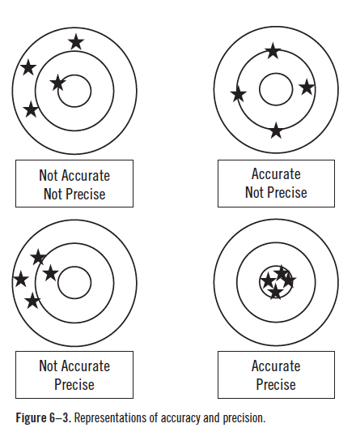
Accuracy and Precision

Slide 22
Determining Sampling Duration

Slide 23
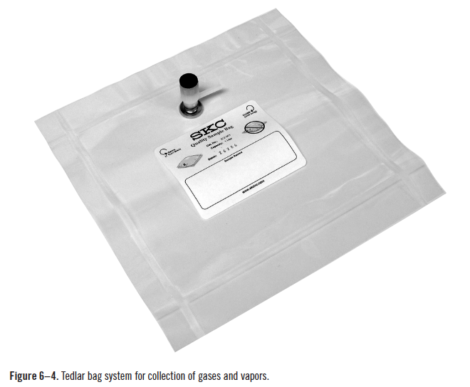
Grab Sampling
Source: SKC Inc.

Slide 24
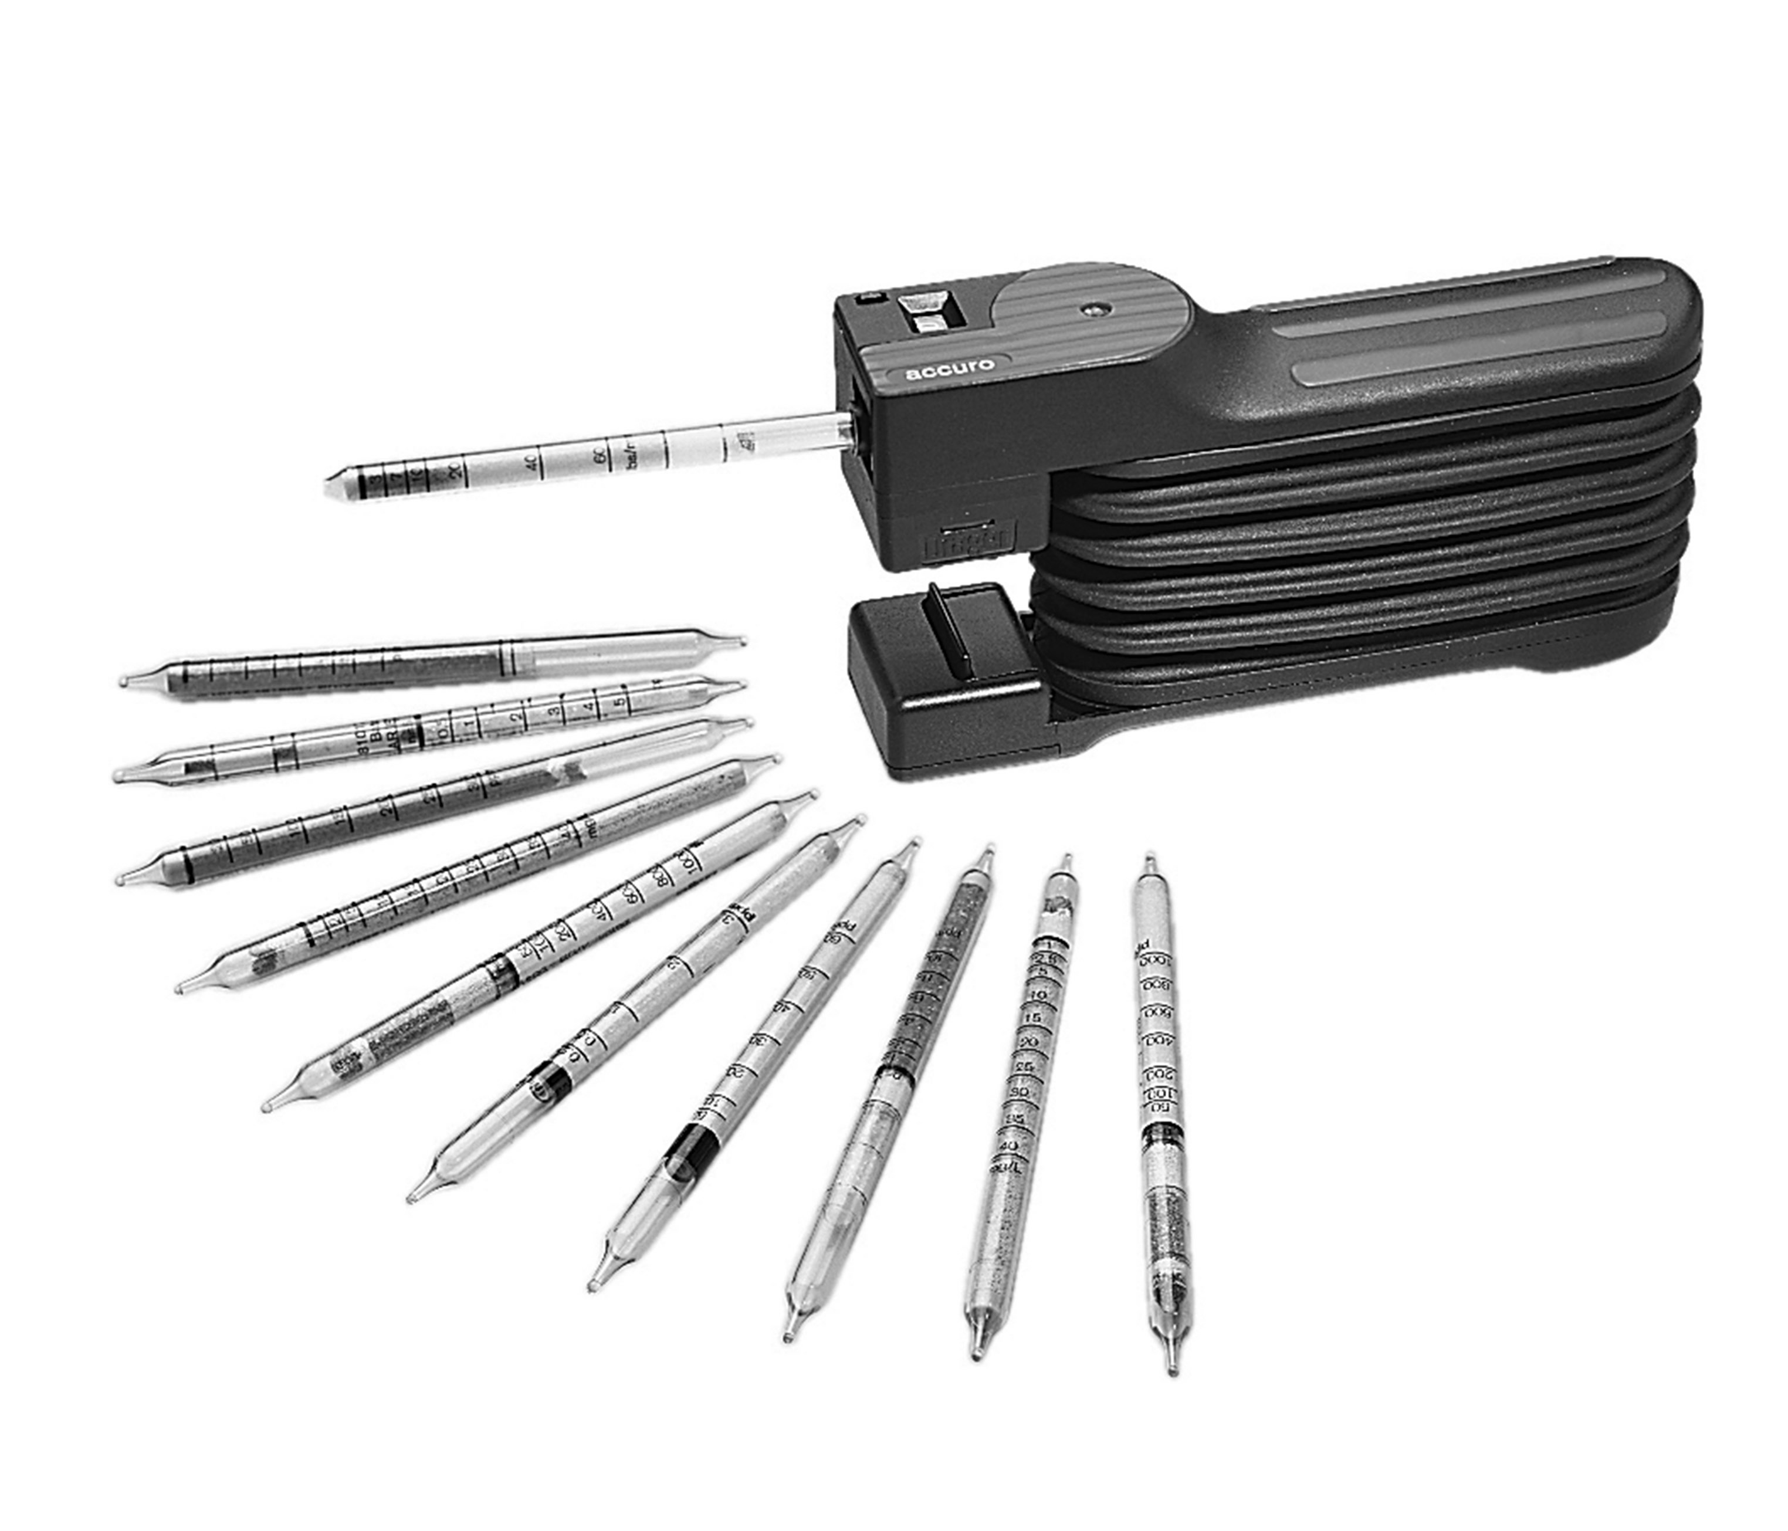
Detector Tubes, Colormetric Indicator Tubes, and Pumps
Source: SKC Inc.

Slide 25
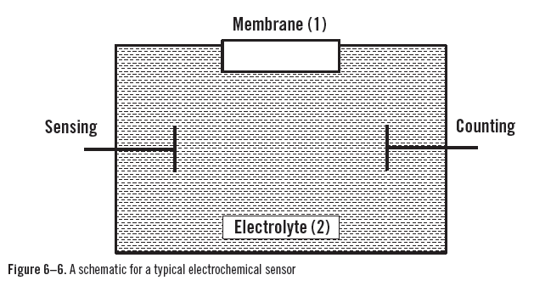
Real-time Detection Instruments
Combustible-gas/multiple-gas monitors
Thermochemical detectors
Electrochemical detectors

Slide 26
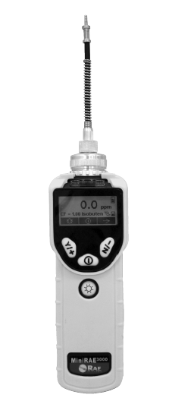
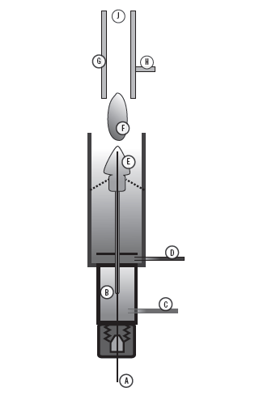
Real-time Detection Instruments (Cont.)
Coulometric detectors
Ionization detectors
Schematic of a flame ionization detector. (A) GC column exit; (B) detector oven; (C) hydrogen fuel enters; (D) oxidant enters; (E) positive bias voltage; (F) flame; (G) collector plates; (H) signal transmitter; (J) exhaust port.
Source: SKC Inc.

Slide 27
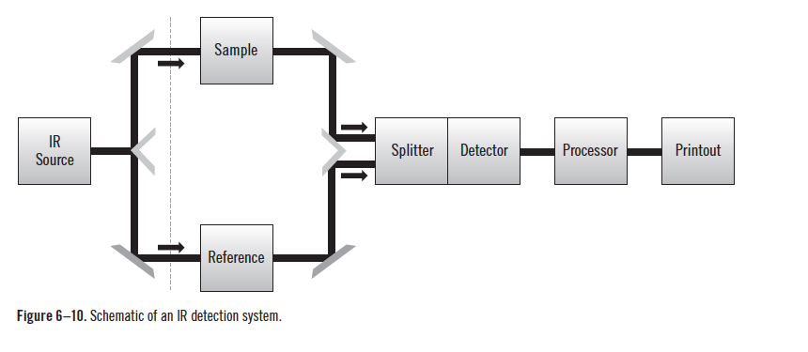
Spectrochemical Direct-Reading Instruments

Slide 28
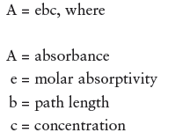
Spectrochemical Instruments

