Slide 1
CHAPTER 11
Noise

Slide 2
Learning Objectives
Explain the importance of noise control to protect worker hearing.
Understand the propagation of sound through space and perform associated calculations.
Relate the concept of sound pressure levels to how noise is detected by the human ear and interpreted by the brain.
Describe how excessive noise levels damage hearing.
Identify safe levels of noise in the workplace and determine whether they are being exceeded.
Use monitoring equipment to measure noise in the workplace and perform job site surveys.
Perform mathematical calculations of noise levels.
Implement controls to reduce or eliminate excessive noise in the workplace.

Slide 3
Hearing Loss
30 million workers in the U.S. are exposed to excessive workplace noise on a regular basis.
No. 1 area of worker compensation claims, with a total annual cost of $242 million.

Slide 4
Three Important Factors
Hearing loss is irreversible.
Damaging noise levels are easy to access.
Overexposure is always avoidable.

Slide 5
Sound Propagation and Characteristics

Slide 6
Wavelength
Because frequency (f) and wavelength (λ) are interdependent, they can each be expressed by this formula:
λ = c/f
As frequency increases, wavelength decreases.

Slide 7
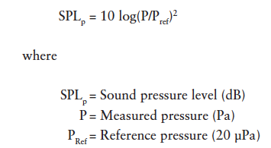
Sound Pressure Levels

Slide 8
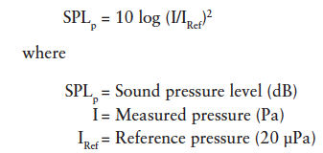
Sound Intensity

Slide 9
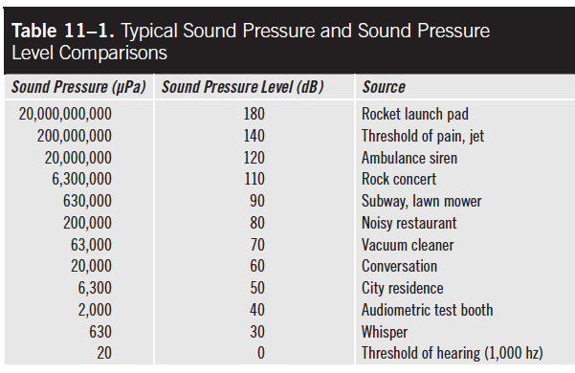
Sound Levels and Sources

Slide 10
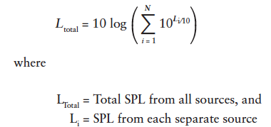
Total Noise from Multiple Sources

Slide 11
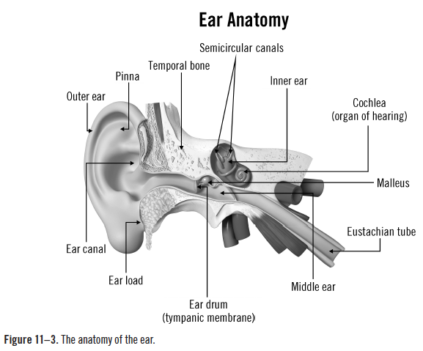
Anatomy of the Ear
Source: pixologicstudio/iStock

Slide 12
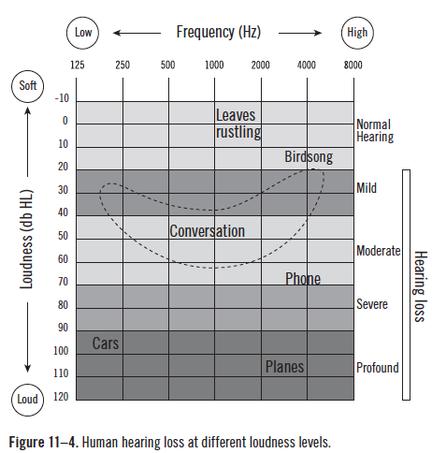
Hearing Loss
Source: ©Thomas Haslwanter/Wikimedia Commons/CC-BY-SA-3.0/ GFDL

Slide 13
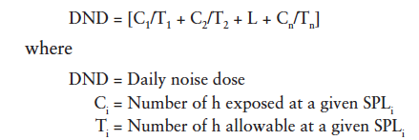
Calculating Daily Noise Dose

Slide 14
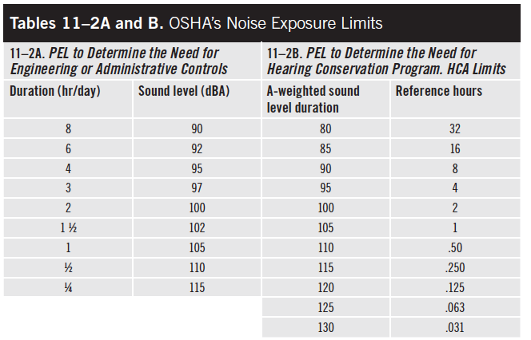
Noise Exposure Limits

Slide 15
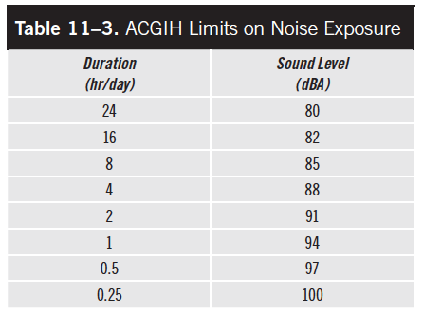
Noise Exposure Limits (cont.)

Slide 16
Allowable Duration for a Given Noise Level

Slide 17
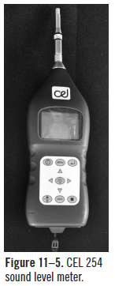
Sound Level Meters
Microphone
Amplifier
Attenuator
Weighting network
Metering system

Slide 18
Controlling Noise Levels
Benefits of controlling workplace noise include:
conservation of worker hearing
fewer workers’ compensation claims
better OSHA compliance
fewer EPA or public health department issues
better employee morale and productivity
improved public relations

Slide 19
Control at the Source
Quiet motors and mechanisms
Reduce force, length, friction
Lower rotational speeds
Isolate vibrating parts
Use more but smaller fan blades

Slide 20
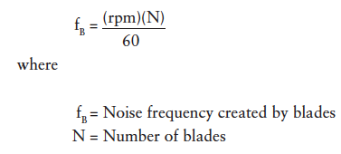
Blade Noise Frequency

Slide 21
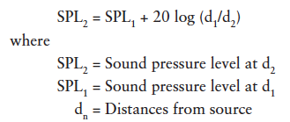
Using Distance to Reduce Noise Levels

Slide 22
Using Barriers to Reduce Noise Levels
They must be airtight.
Acoustical absorption must be added to the interior and be the correct type and shape.
The correct wall materials must be used; heavier walls absorb sound better.
Absorption must take place on the interior.
Enclosures should be dampened.

Slide 23
Using Barriers to Reduce Noise Levels (cont.)

