Slide 1
Fundamentals of Industrial Hygiene 6th Edition
Chapter 12:
Thermal Stress
Compiled by Allen Sullivan,
Assistant Professor, Safety and Health Management Central Washington University

Slide 2
Introduction
Thermal stress is a significant physical agent in many workplace environments.
Just considering routine out-of-doors work, air temperatures ranging from -20°F to 110°F can reasonably be expected in many places throughout the United States.

Slide 3
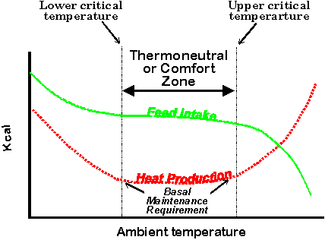
Degrees of Thermal Stress
Conceptually, work can occur in one of five zones along the continuum of thermal stress:
heat health risk zone
heat discomfort zone
physiological adaptions great
behavioral adaptations modest-to-great
comfort zone
physiological adaptations modest
behavioral adaptations minor
cold discomfort zone
physiological demands great
behavioral adaptations modest-to-great
cold health risk zone

Slide 4
Model of Thermal Balance
Three factors influence the degree of thermal stress:
climatic factors
air temperature, relative humidity, wind chill
work demands
substantial contributor to heat gain
clothing
insulation (resistance to heat flow)
permeability (water vapor movement)
ventilation (air movement)
chimney effect + bellows effect

Slide 5
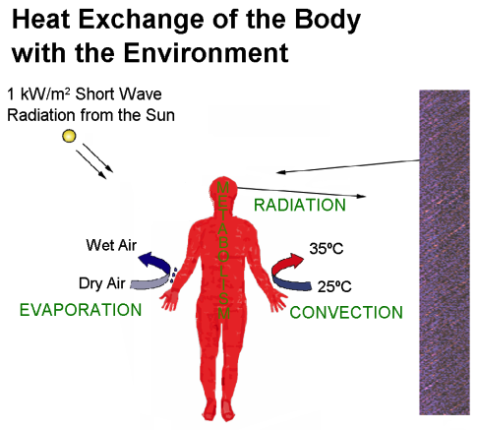
Model of Thermal Balance (simplified)
S = M + R + C – E
where: S = heat storage rate (gain [+] or loss [-])
M = metabolic rate (internal heat generation [+])
R = radiant heat exchange rate (gain [+] or loss [-])
C = convective heat exchange rate (gain [+] or loss [-])
E = evaporative heat loss (always loss [-])

Slide 6
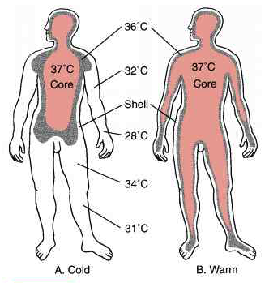
Heat Stress
A combination of factors tends to increase body temperature, heart rate, and sweating.
The physiological adaptations to heat stress are known as heat strain.
core body temperature
heart rate
sweat rate
acclimation
adaptive working (pacing)

Slide 7
Recognition of Heat Stress
Heat stress in the workplace can be recognized in terms of:
workplace risk factors
hot or humid environments
high work demands
protective clothing requirements
effects on workers
low-end: worker behaviors (shedding clothes, work pacing)
middle: redness of face/skin, profuse sweating, rapid breathing
high-end: heat-related disorders (nausea, cramps, heat exhaustion)

Slide 8
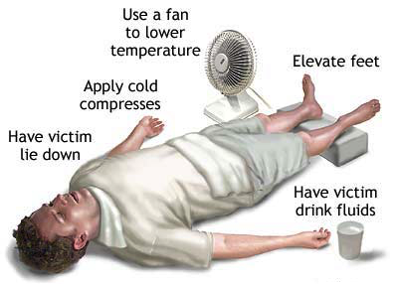
Heat-Related Disorders
Heat-related disorders are the manifestations of over-exposure to heat stress.
see Table 12–A in text for information on:
signs a trained observer may see
symptoms a worker may report
likely causes of the disorder
first aid
steps for prevention
physiological markers
measuring temperature (100.4°F)
measuring heart rate (< 110 bpm average or < 160 bpm)
measuring water loss (> 1.5% loss of body weight)

Slide 9
Worker Behaviors
Heat stress not only induces physiological changes, but also affects behavior:
actions that reduce exposures
adjusting clothing to increase evaporative losses
slowing work rate
taking small breaks
taking shortcuts in work methods
changes in attitudes
irritability
low morale
absenteeism
unsafe acts
increased number of errors
increased number of machine breakdowns
taking short cuts in work methods

Slide 10
Evaluation of Heat Stress
The World Health Organization set the tone for worker protection in 1969.
forms the basis for NIOSH and ACGIH heat stress guidelines
long-duration exposures
core temperatures should not exceed 100.4°F
short-duration exposures (with recovery periods)
core temperatures should not exceed 102.2°F
average heart rate
not over 110 bpm

Slide 11
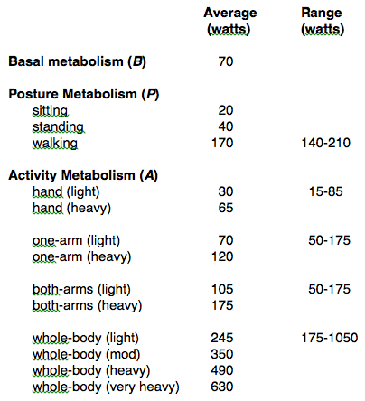
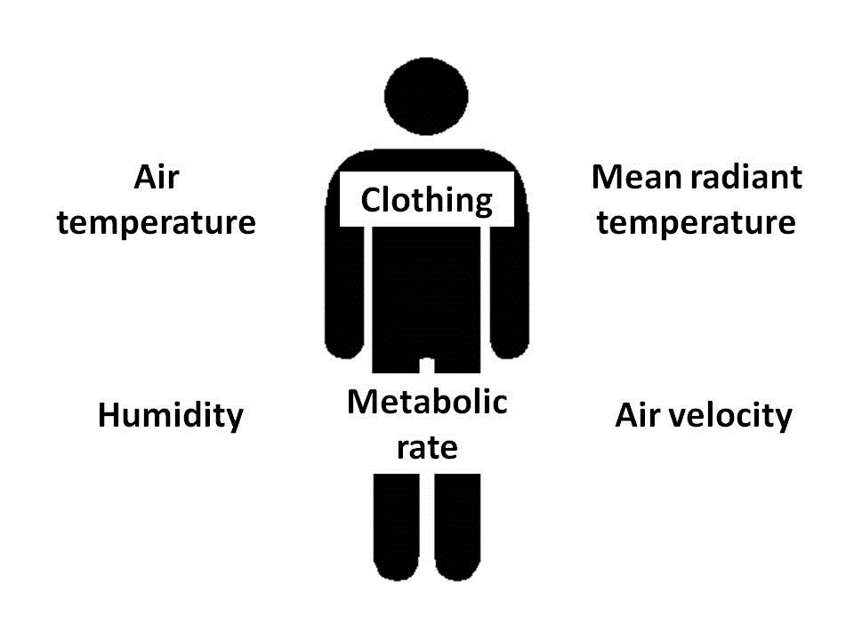
ACGIH® TLV ® for Heat Stress
Recognizes the difference between eight-hour and short-duration exposures.
assessment of metabolic rate
basal metabolism
posture
activity (based on body movement)
horizontal travel
vertical travel
assessment of environmental conditions
air temperature
humidity
air speed
average temperature
clothing adjustment factor (CAF)

Slide 12
Control of Heat Stress
The control of heat stress centers around the causes and their resulting physiological strain.
Takes the form of:
general controls
applicable to all heat-related jobs
specific controls
evaluated and selected based on constraints of the working conditions

Slide 13
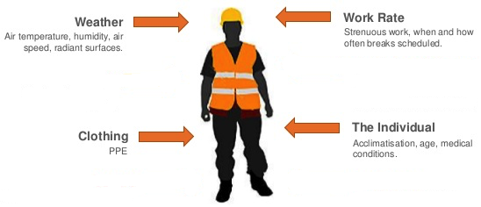
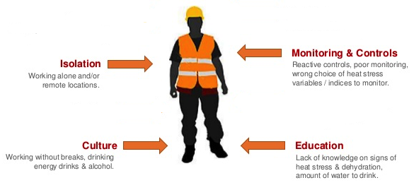
Control of Heat Stress (cont.)
General Controls
training
pre-placement training
periodic training
heat stress hygiene practices
fluid replacement
self-determination
diet
lifestyle
health status
acclimation
medical surveillance
evaluation of risk
response to heat-related disorders
emergency plan

Slide 14
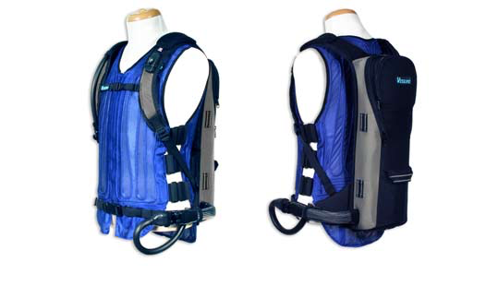
Control of Heat Stress (cont.)
Specific Controls
engineering controls
reducing physical work demands
adjusting clothing requirements
reducing external heat gain
enhancing external heat loss
administrative controls
acclimation
work-pacing
work-sharing
work scheduling
pre-determined work times
self-determination
personal monitoring
personal protection
circulating air systems
circulating water systems
ice garments
reflective clothing

Slide 15
Cold Stress
Cold stress is a fundamentally different kind of problem than heat stress.
Physiological adaptations to cold stress have less dramatic effects.
Human responses to cold stress
physiological
reduced blood circulation to skin
increased metabolic activity (shivering)
behavioral
increased activity
seeking warm locations
increased clothing insulation
insulation value
moisture
ventilation

Slide 16
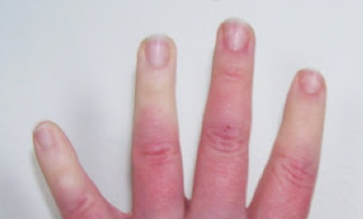
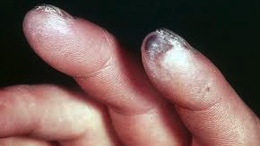
Cold Stress Hazards
Hazards associated with cold stress are manifested in two distinct fashions:
systemic (hypothermia)
depression of central nervous system
local (localized tissue damage)
restriction of flood flow to extremities
Note: There is also a concern for manual dexterity.

Slide 17
Model of Thermal Balance (simplified)
S = M + (R + C) + K – E
where: S = heat storage rate (gain [+] or loss [-])
M = metabolic rate (internal heat generation [+])
R = radiant heat exchange rate (gain [+] or loss [-])
C = convective heat exchange rate (gain [+] or loss [-])
K = conductive heat exchange (loss [-])
E = evaporative heat loss (always loss [-])
Note: The goal of systemic cold-stress control is to avoid hypothermia by limiting reduction in core temperatures to:
- 96.8°F for prolonged exposures
- 95°F for occasional, short-duration exposures

Slide 18
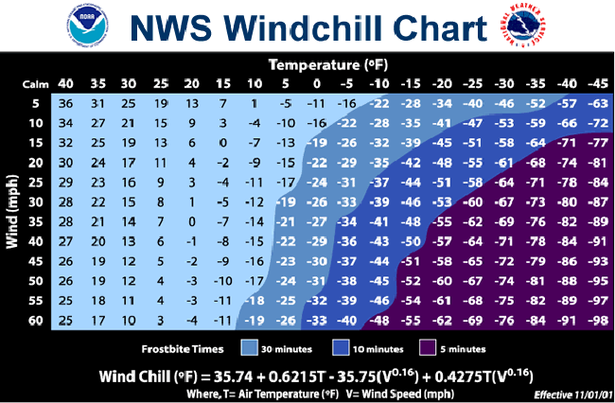
Measurement of Cold Stress
Two climatic factors influence the rate of heat exchange between a person and the environment:
air temperature
air speed
Note: The Wind Chill Index was developed by the National Weather Service to reflect the effect of these variables on heat exchange.

Slide 19
Recognition of Cold Stress
Subjective responses of workers are a good tool for recognition of cold stress in the workplace:
seeking warm locations
adding layers of clothing
increasing the rate of work
loss of manual dexterity
shivering
accidents
unsafe behaviors

Slide 20
Evaluation for Cold Stress
Workplace monitoring
should be conducted when temperatures fall below 61°F
Systemic cold stress
hypothermia can occur with air temperatures up to 50°F
ACGIH recommends employers invoke protective measures when air temperatures fall to 41°F

Slide 21
Control of Cold Stress
General controls
training
additional topics for colder exposures
cold stress hygiene practices
fluid replacement
warm, sweet, non-caffeinated
diet
self-determination
wet clothing replacement
medical surveillance
medical restriction for those unable to adequately thermoregulate

Slide 22
Control of Cold Stress (cont.)
Specific Controls
engineering controls
general or spot heating
minimizing air movement
reducing conductive heat transfer
provision of warming shelters
administrative controls
acclimation
work/rest cycle
work-sharing
work scheduling
allow for production declines
avoid long periods of sedentary work
personal monitoring
personal protection
insulated clothing
wind barriers
special attention to extremities
face shields
gloves/mittens
socks/footwear
active warming systems
eye protection

