Slide 1
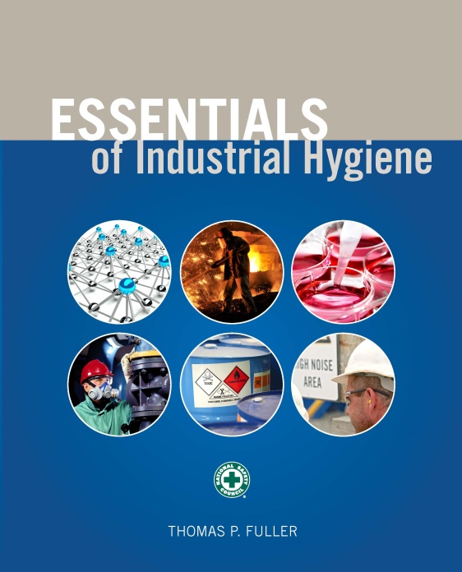
CHAPTER 10
Dermal Hazards

Slide 2
Learning Objectives
Identify key anatomy and physiology of the skin.
Understand how toxic agents are absorbed into the body through the skin.
Describe several of the most significant adverse health effects of skin exposure to hazardous agents.
Explain some of the latest methods of dermal exposure assessment.
Develop controls necessary to minimize skin exposure to hazardous agents.

Slide 3
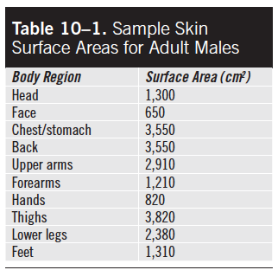
Anatomy of the Skin
Source: Franklin and Morgan 2005

Slide 4
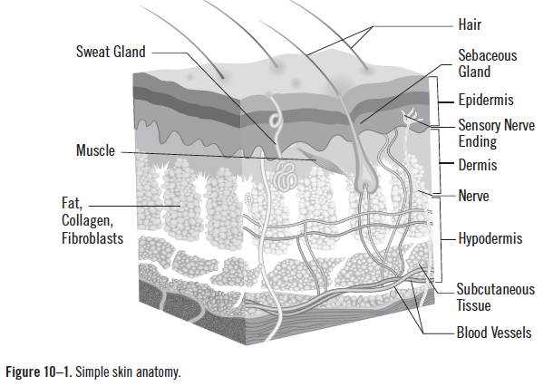
Anatomy of the Skin (cont.)
Source: snapgalleria/iStock

Slide 5
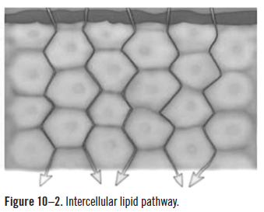
Main Mechanisms of Diffusion
Travel on the intercellular lipid pathway
Source: Centers for Disease Control and Prevention

Slide 6
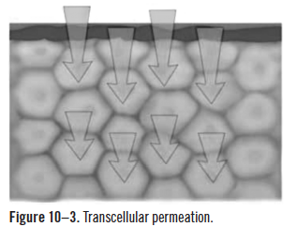
Main Mechanisms of Diffusion (cont.)
Trans-cellular permeation
Source: Centers for Disease Control and Prevention

Slide 7
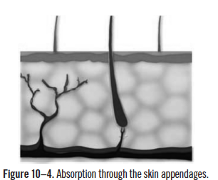
Main Mechanisms of Diffusion
Through appendages of the skin
Source: Centers for Disease Control and Prevention

Slide 8
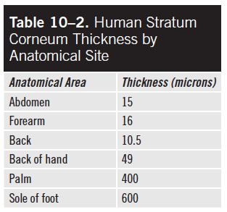
Main Mechanisms of Diffusion (cont.)
Source: Scheuplein 1971

Slide 9
Chemical Exposure
Touching contaminated surfaces
Being immersed in containers with liquids or semisolids
Sedimentation, impact, electrostatic attractions, or chemical splashes depositing aerosols on the skin

Slide 10
Chemical Factors of Absorption
Molecular weight
Hydrophylic
Lipophylic
Volatility/vapor pressure

Slide 11
Skin Injury and Illness
33,000 cases per year
>$1 billion in costs

Slide 12
Contact Dermatitis
Known as eczema
An inflammation of the superficial regions of the skin that appears in large localized areas
Characterized by inflammation and erythema (reddening) or the formation of scales
Symptoms of dermatitis include itching, swelling, pain, burning, rashes, redness, blisters, and dry or flaky skin.

Slide 13
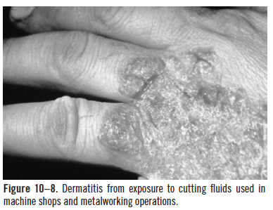
Contact Dermatitis (cont.)
Source: Centers for Disease Control and Prevention

Slide 14
Irritant Contact Dermatitis
A nonimmunologic reaction that results from direct damage following exposure to a hazardous agent and manifests as inflammation of the skin
80% of all cases of occupational contact dermatitis

Slide 15
Phototoxic Contact Dermatitis
Develops only after exposure to UV light, such as sunlight

Slide 16
Allergic Contact Dermatitis
An inflammation of the skin caused by an immunologic reaction triggered by dermal contact with a skin allergen or sensitizer
Plants (gardening), antibiotics (pharmaceutical industry), dyes (paint and cosmetics industry), metals, chromates (cement industry), adhesives, fragrances, rubbers, resins, pesticides, fertilizers, and cutting oils used in machining

Slide 17
Exposure Pathways
Immersion
Splashes
Deposition
Contact with contaminated surfaces

Slide 18
Urticaria
A transient skin condition that often appears as a wheal (swelling) and raised patches accompanied by intense itching
Caused by skin irritants or allergens and is different from dermatitis because it typically occurs rapidly following exposure and often goes away soon after exposure ceases
Caused by detergents, pesticides, rubbers, minerals, and animal toxins such as from caterpillars, jellyfish and certain plants

Slide 19
Acne
An inflammatory disease of the sebaceous glands and hair follicles in the skin, leads to pimples and pustules (white-centered bumps) on the surface of the skin
Often develops in jobs where workers are exposed to materials like oil, grease, pitch and tar

Slide 20
Systemic Diseases That Result from Skin Exposure
Diseases that result in other parts of the body after a dermal exposure
Can cause respiratory and neurological effects
May lead to bladder cancer, scrotal cancer, and heart or kidney disease

Slide 21
Physical Damage to Skin
Can represent a significant hazard in many industries and should not be forgotten.
Cuts, abrasions, burns, rashes, cysts, frostbite

Slide 22
Skin Cancer
Most common form of cancer
Treatment in the U.S. costs $8.1 billion per year
10,000 people die from melanoma each year
Polycyclic aromatic hydrogen compounds, creosote and mineral oils have been associated with benign skin cancer.
Ultraviolet and ionizing radiations have been closely associated with malignant melanoma

Slide 23
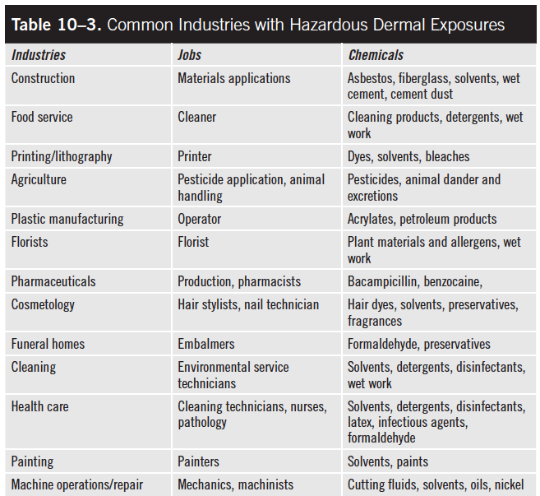
Common Dermal Exposures

Slide 24
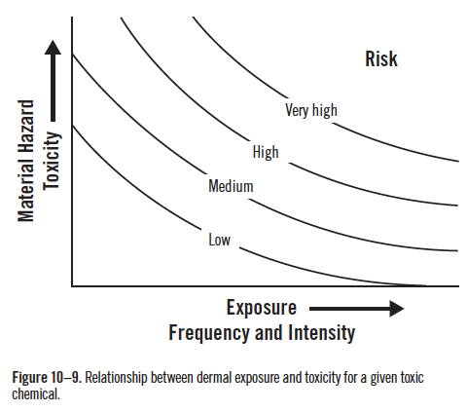
Dermal Exposure and Toxicity

Slide 25
Controlling Skin Exposure
Elimination and substitution
Engineering controls
splash guards, glove boxes, isolation booths
Administrative or work practice controls
training, good hygiene, access control, procedures
PPE
footwear, aprons, face shields, overalls, and gloves

Slide 26
Skin Care Products
Certain creams can be used to provide a barrier to hazardous chemicals.
Moisturizers can be used to treat damaged skin.
Cleaners can be used to remove skin contamination.
Sun block can be used to reduce effective dose to UV radiation.

