Slide 1
CHAPTER 14
Ergonomics

Slide 2
Learning Objectives
Describe the study and goals of occupational ergonomics.
Identify the signs and symptoms of musculoskeletal injuries.
Recognize and describe the different types of common musculoskeletal injuries and illnesses.
Define various aspects of anatomy and anthropometry as they relate to the study of ergonomics.
Identify categories of contributing risk factors for musculoskeletal hazards.
Understand various methods for assessing and quantifying musculoskeletal risks and hazards in working environments, activities, and conditions.
Develop controls that can minimize or reduce workplace musculoskeletal hazards.
Use the NIOSH lifting equation to analyze working conditions and compare them with lifting guidelines.
Establish an ergonomics workplace safety program and associated training materials.

Slide 3
Definition of Ergonomics
The study of the relationship among the human body, the human mind, and the physical environment.
Ergonomists evaluate a person’s size, shape, and neural/cognitive abilities and match them to the materials, equipment, structures, tools, and systems the person interacts with.

Slide 4
Definition of Ergonomics (cont.)
Ergonomics builds upon several core sciences, including anatomy, physiology, mathematics, and physics and incorporates anthropometry, psychology, statistics, biomechanics, and engineering.
The primary goals of ergonomics are to help humans perform tasks more efficiently, be more comfortable, and have fewer injuries.

Slide 5
Areas of Study
Physical
Cognitive
Organizational

Slide 6
Musculoskeletal Hazards
Highest rates: health care, transportation and warehousing, retail and wholesale trades, and construction
30 percent of all workers’ compensation claims are for overexertion and repetitive-motion injuries, and claims for these injuries typically occur more than twice as often as those for other workplace injuries.

Slide 7
Musculoskeletal Injuries
Often difficult to diagnose
Joint pain, numbness, tingling, swelling, restricted motion
Musculoskeletal disorders (MSDs)

Slide 8
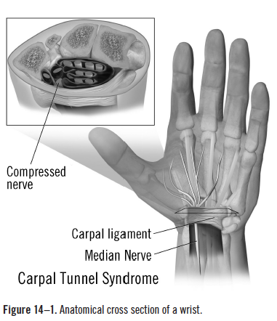
Carpal Tunnel Syndrome
One of the most common musculoskeletal workplace injuries
Source: Blausen.com staff. “Blausen Gallery 2014.” Wikiversity
Journal of Medicine. DOI:10.15347/wjm/2014.010.

Slide 9
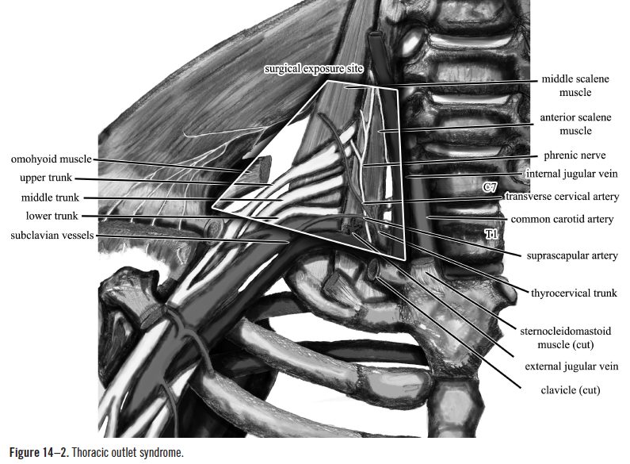
Thoracic Outlet Syndrome
Source: Nicholas Zaorsky, M.D.

Slide 10
Other Musculoskeletal Injuries
Tendinitis
Tendonitis
Lower back strain
Hand-arm vibration syndrome/white finger syndrome
Trigger finger
Rotator cuff damage
Epicondylitis

Slide 11
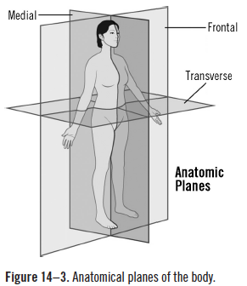
Anatomy

Slide 12
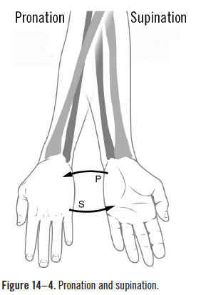
Pronation and Supination
Source: OpenStax College. “Anatomy & Physiology.” Connexions Web site. http://cnx.org/content/col11496/1.6/, June 19, 2013.

Slide 13
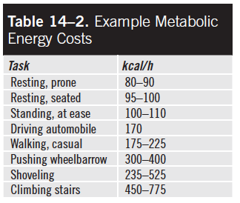
Capacity for Work

Slide 14
Musculoskeletal Workplace Hazards
Repetitive/long durations
Awkward postures
Static postures
Excessive force
Vibration
Temperature extremes

Slide 15
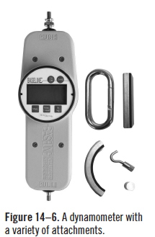
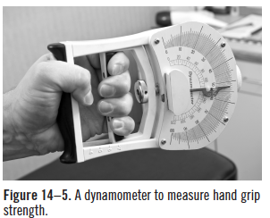
Hazard Assessment
Source: BanksPhotos/iStock
Source: Used with permission
from 3B Scientific.

Slide 16
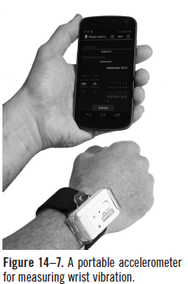
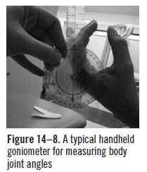
Hazard Assessment (cont.)
Source: EmmaLDavis/Wikimedia
Commons
Source: Agricultural Technology
Research Program at Georgia Tech

Slide 17
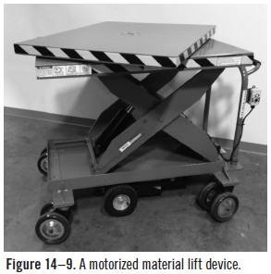
Control of Musculoskeletal Hazards
Workplace design
Fit the job to the worker
Adjust the work space
Place work at same level
Forward Facing
Reduce the Force
Improve grip strength
Use tools to support the task
Special equipment
Source: Electro Kinetic Technologies

Slide 18
Control of Musculoskeletal Hazards (cont.)
Administrative controls
Programs and procedures
Worker training
Job site assessment
Job rotation/shift length/work pace/rest breaks
Reduce organizational stressors/stress
Control ancillary hazards (noise, radiation, excessive temperatures, biological, chemical)

Slide 19
Recommended Weight Limits (RWLs)

Slide 20
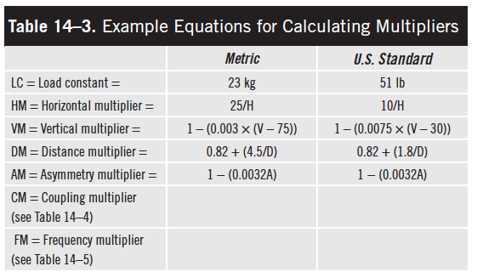
Calculating Multipliers

Slide 21
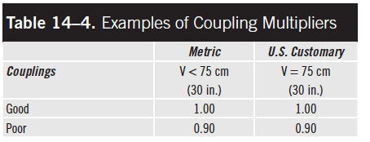
Coupling Multipliers

Slide 22
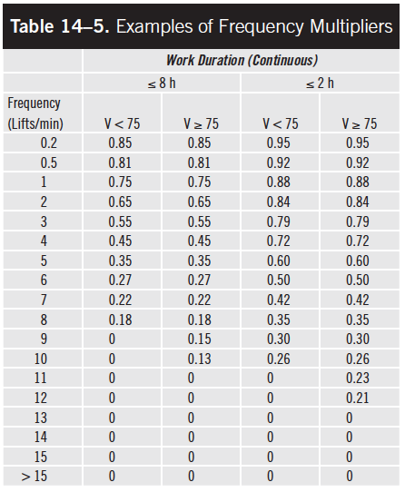
Frequency Multipliers

