Slide 1
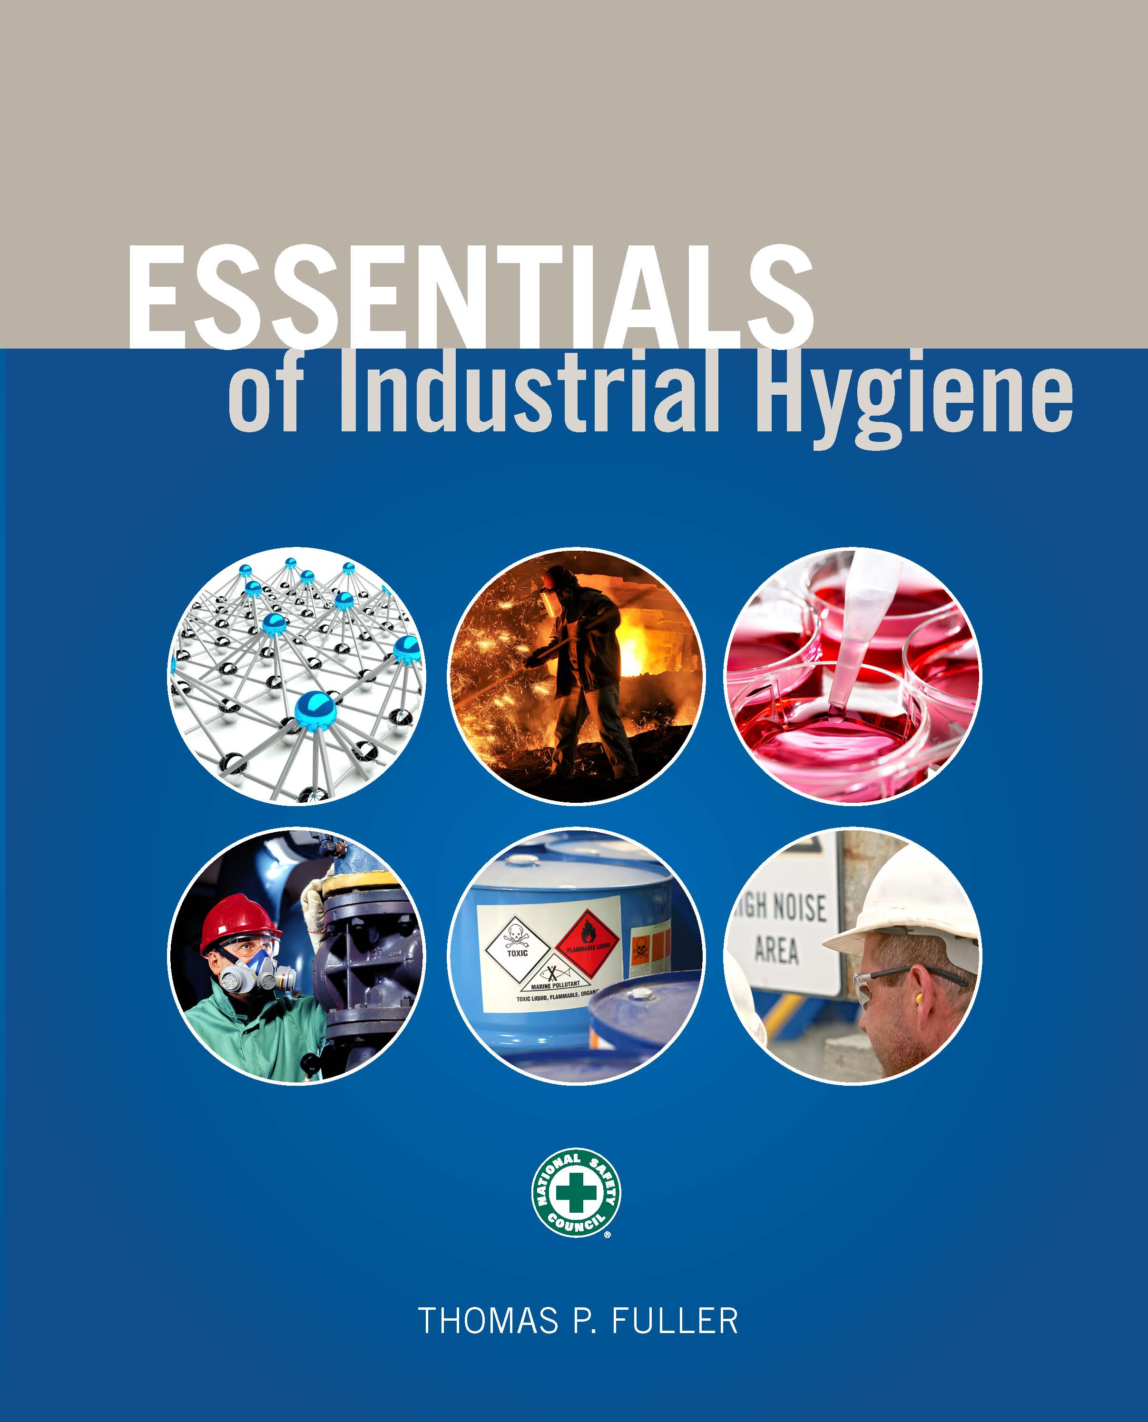
CHAPTER 8
Ventilation

Slide 2
Learning Objectives
Identify the main types and purposes of different types of workplace ventilation systems.
List the environmental factors that influence ventilation system operations.
Make ventilation calculations using standard formulas.
Explain the relationships among different types of pressures within a duct that are related to air movement.
Recognize various parts of a ventilation system.
Identify different types of air capture device hoods and their appropriate uses and limitations.
Differentiate among the various types of ventilation fans.
Describe standard air cleaning devices and filters.
Calculate air exchange rates using provided parameters.

Slide 3
Objectives of Ventilation
To maintain an adequate oxygen supply in the work area
To prevent hazardous concentrations of toxic materials in the air
To remove any undesirable odors from a given area
To control temperature and humidity
To remove undesirable contaminants at their source before they enter the workplace air

Slide 4
Operational and Environmental Factors Affecting Ventilation
Manufacturing processes
Exhaust air system and local air extraction
Climate requirements (tightness, plant aerodynamics, etc.)
Cleanliness requirements
Ambient air conditions
Heat emissions
Terrain around the plant
Contaminant emissions
Regulations

Slide 5
Components of Supply Systems
Outdoor air intake
Filters
Heating and cooling units
Fans
Ducts
Registers/grilles for distribution

Slide 6
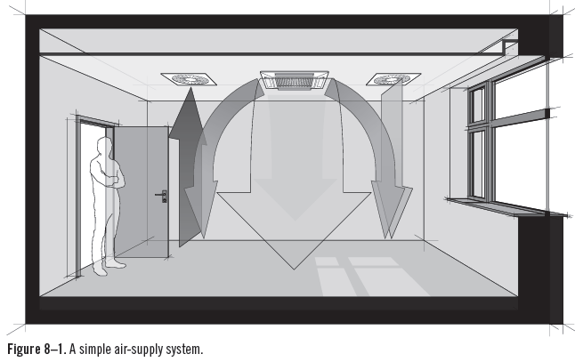
Air-Supply System
Source: valigursky/iStock

Slide 7
General Ventilation
General ventilation is most often used:
When more cost-effective options are not available.
When gases, vapors, or small aerosols with low toxicity are present.
When emissions occur uniformly in time and space.
When emissions are not near the workers’ breathing zones.
When the supply air is clean.

Slide 8
Local Exhaust Ventilation
LEV systems are most effective when the following conditions exist:
More cost-effective methods do not work.
The contaminant is toxic.
The worker is near the emissions source.
Emission rates vary with time.
Sources of emissions are large and few.
Sources are stationary.
Regulations require sources to be exhausted.

Slide 9
Volumetric Flow Rate
Q = VA
Where:
Q = Volumetric air-flow rate, in cubic feet per minute
V = Average velocity, in feet per minute
A = Duct cross-sectional area, in square feet

Slide 10
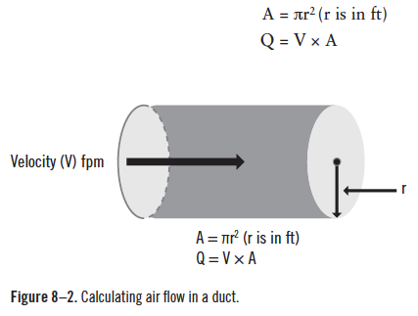
Calculating Air Flow in a Duct

Slide 11
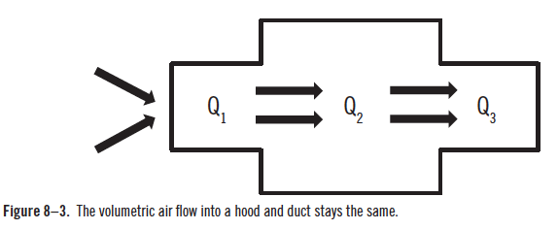
Continuity Equation
Because air in a duct is incompressable, the quantity of air flowing in a duct always stays the same.

Slide 12
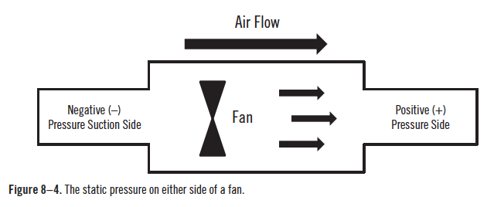
Static Pressure

Slide 13
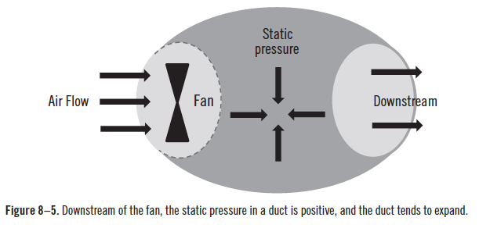
Static Pressure (cont.)

Slide 14
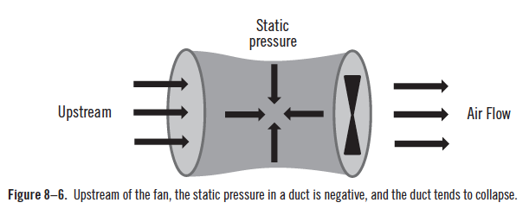
Static Pressure (cont.)

Slide 15
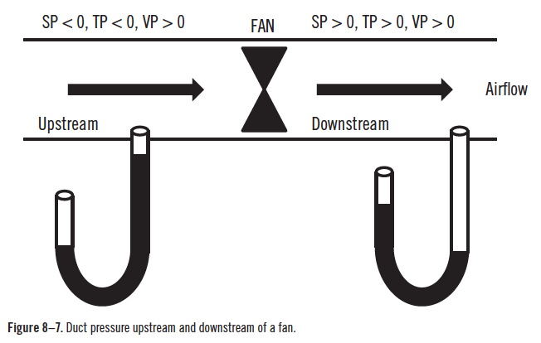
Static Pressure (cont.)

Slide 16
Duct Pressure Balance
TP = VP + SP
Where:
TP = Total Pressure
VP = Velocity Pressure
SP = Static Pressure

Slide 17
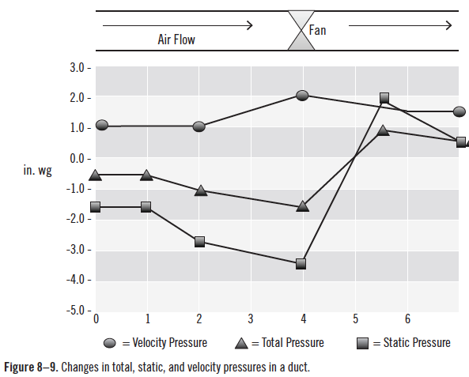
Duct Pressure Changes

Slide 18
Calculating Velocity of Air Flow

Slide 19
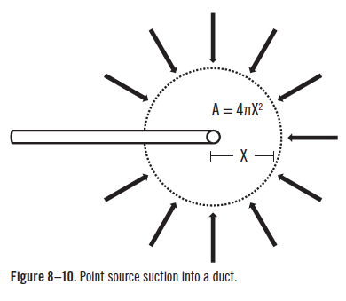
Point Source Suction

Slide 20
Capture Velocity
The capture velocity is the speed that the air needs to move toward the duct at any given distance in order to gather the toxic vapors into the duct.
Q = VA
A = 4πX²
V = Q/(4πX²)

Slide 21
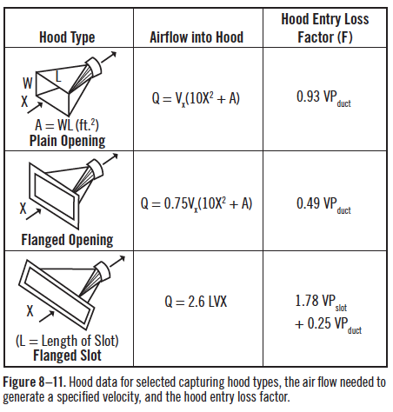
Hood Designs and Capture Equations

Slide 22
Factors to Consider When Designing a Ventilation System
Location
Relative contribution of each source to the exposure
Characterization of each contributor
Characterization of ambient air
Worker interaction with emission source
Work practices

Slide 23
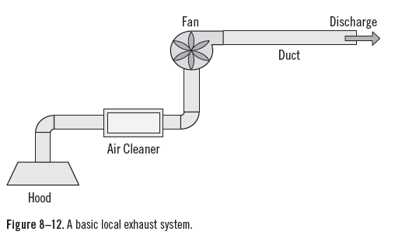
Basic Local Exhaust System

Slide 24
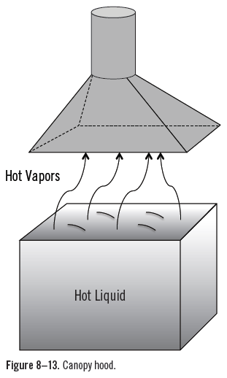
Basic Local Exhaust System

Slide 25
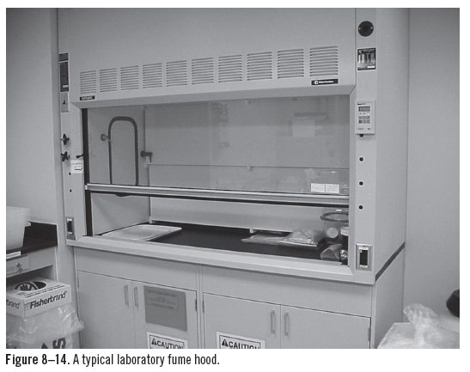
Typical Laboratory Fume Hood

Slide 26
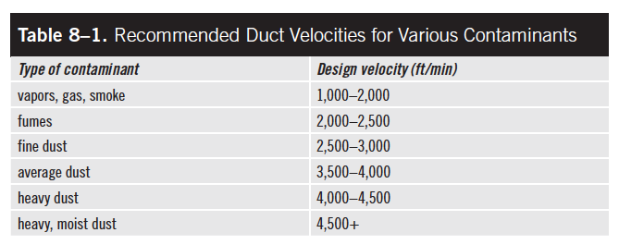
Minimum Duct Velocities

Slide 27
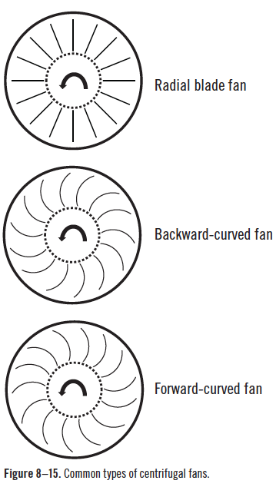
Centrifugal Fans

Slide 28
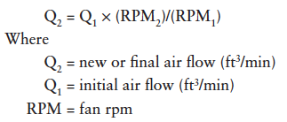
Fan Speed and Flow Rate

Slide 29
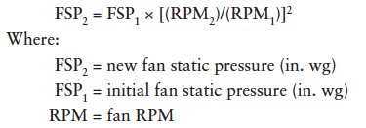
Fan Speed and Fan Static Pressure

Slide 30
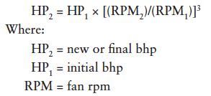
Fan Speeds and Horse Power

Slide 31
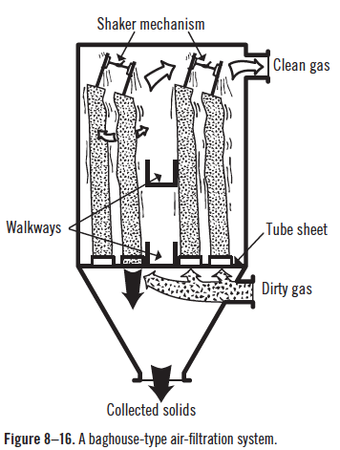
Air Cleaning Devices
Source: © User:Goran tek-en/Wikimedia Commons/CC-BY-SA-3.0

Slide 32
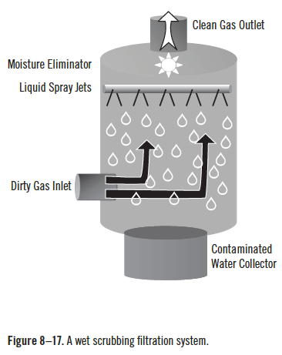
Air Cleaning Devices (cont.)

Slide 33
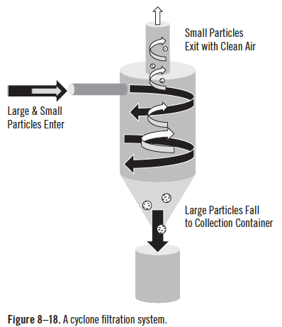
Air Cleaning Devices (cont.)

Slide 34
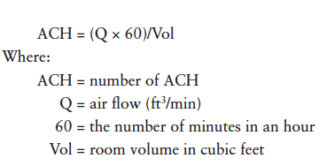
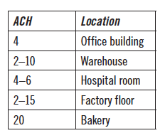
General Ventilation Systems

