Slide 1
SIF Prevention
Moving Beyond OSHA Recordable Rates for
Prevention of Serious Incidents and Fatalities (SIF)

Slide 2
Problem Statement
Historically, Companies Focused on OSHA Recordables to Demonstrate HSE Performance
Serious Incidents and Fatalities (SIFs) Have Been Flat Or Increasing Over the Past Decade While OSHA Recordable Rates Have Continued to Trend Down
“The Things that Hurt People Are Not the Same as the Things that Kill People”

Slide 3
Preventable Deaths vs Total Recordable Cases: 2002 – 2022
Total Recordable Cases Have Fallen Even as Preventable Deaths Have Remained Flat or Increased

Slide 4

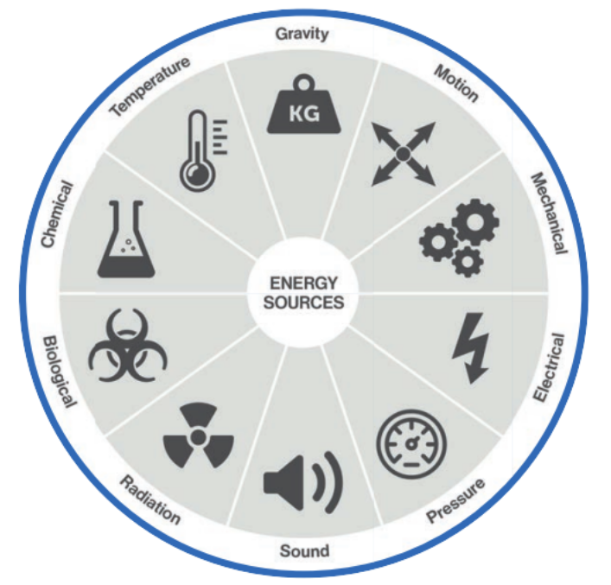
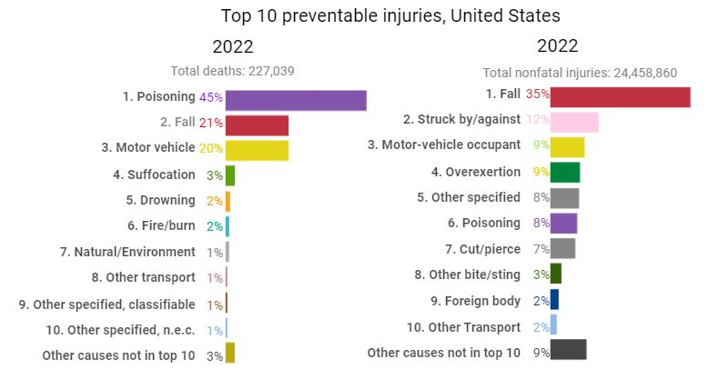
Stuff that Kills You
Only Three Injury Causes Are in the Top 10 for Both Deaths and Nonfatal Injuries:
Poisoning
Motor Vehicle
Falls
Notes:
The top three leading causes of preventable injury-related death (poisoning (including overdoses), falls, and motor vehicle) account for 86% of all preventable deaths. No other preventable cause of death (including suffocation, drowning, fires and burns, and natural or environmental disasters) accounts for more than 3% of the total. In contrast, nonfatal emergency department visits are dominated by fall-related injuries, accounting for 35% of all preventable nonfatal injuries. Struck by or against is the only other injury event accounting for more than 10% of the total (12%). Motor-vehicle occupant injuries account for 9% of the visits while overexertion accounts for 8%.
*STKY from Edison Electric Institute and Quanta Services
** Top 10 Preventable Injuries from Injury Facts

Slide 5
What We Now Know
SIF Prevention Requires an Expanded View of Key Leading and Lagging Metrics
Top Companies Are Expanding Performance Targets, Clearly Identifying and Reducing the Highest Risks, and Engaging Employees at All Levels
A Single Fatality Costs an Employer an Average of $1.4 Million in Lost Wages, Medical Expenses, Administrative Expenses and More
Notes:
Cost per medically consulted injury in 2022 was $40,000, while the cost per death was $1,390,000. *Injury Facts

Slide 6
SIF Prevention Experience from Successful Companies
Focused Resources on controlling High Hazard Activities and Stuff that Can Kill You or Permanently Impact People/Communities
Supervisors and Leaders Must Actively Engage with All Employees, Finding Ways to Build Trust and Reduce Risk
Organizations Need to Build and Sustain an Improvement and Learning Culture
Metrics: Leading SIF Prevention Metrics and Programs Are Critical
Notes:
“Only using TRIR for HSE performance is like only using blood pressure for cardiovascular health”

Slide 7
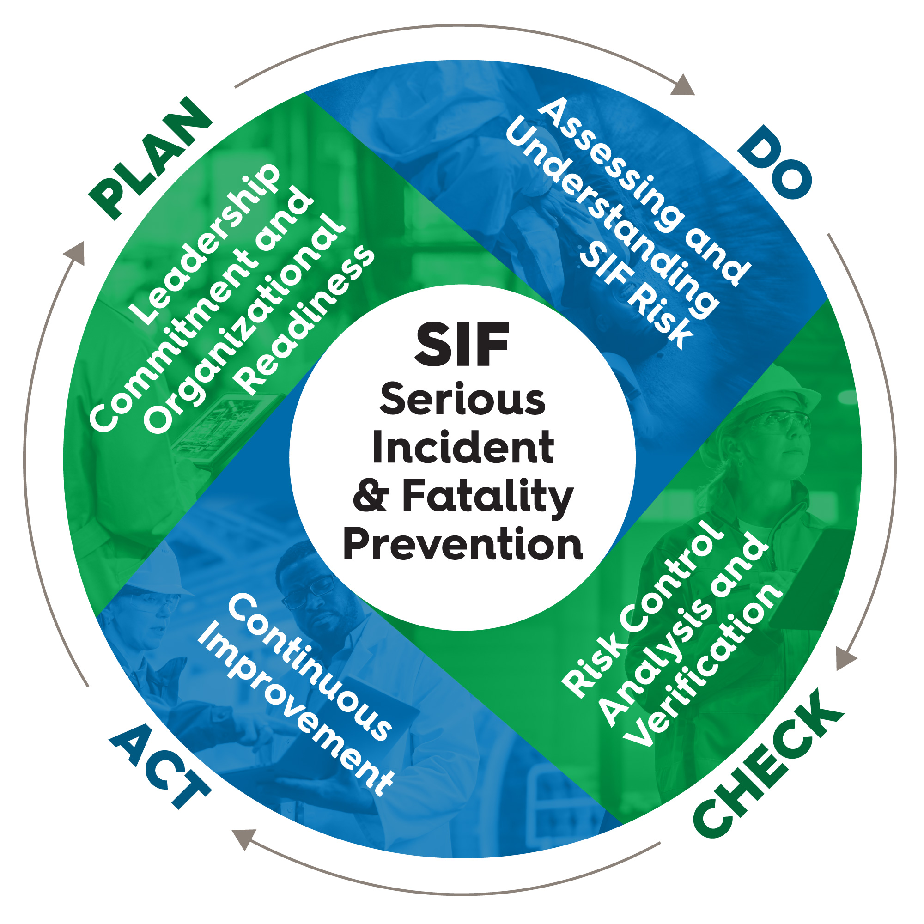
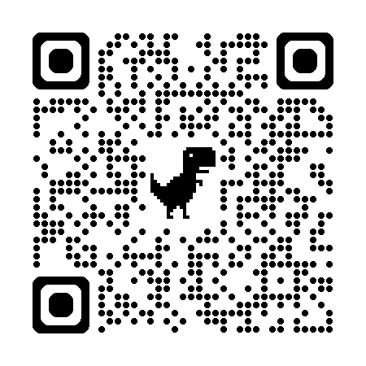
Next Steps
Your Leadership Is Critical to Engage Your Team and Industry in SIF Prevention
Work with Your Safety Team to Identify Key SIF Metrics and Incorporate Them into Safety Status Presentations
Educate Your Board on the Need for More Than OSHA Reportable Metrics
Engage with NSC SIF Prevention Model to Help Identify Hazards, Implement Controls and Provide Monitoring

