Slide 1
Fundamentals of Industrial Hygiene 6th Edition
Part VI: Evaluation of Hazards
Chapter 15:
Evaluation
Compiled by Allen Sullivan,
Assistant Professor, Safety and Health Management Central Washington University

Slide 2
General Principles
In 2009, 3.3 million occupational work-related injuries and illnesses occurred in private industry.
actual number is much larger:
many occupational illnesses are unrecognized
many injuries and illnesses are not reported
public sector not included in the count
Given the weaknesses of the data systems, a focus on evaluation of hazards is even more important.

Slide 3
General Principles (cont.)
The evaluation of the nature and severity of hazards relies on many factors:
toxicity;
exposure levels or dose;
duration of exposure
process or operation analysis;
maintenance activities, spills, and accidents;
epidemiology and risk assessment;
interview;
unequal distribution of risks; and
variability of response

Slide 4
Basic Approach to Hazard Recognition
Three-step, systematic procedure:
consider the raw materials being used
consider how raw materials are modified during use
evaluate the finished products and by-products (wastes)
Note: Should be evaluated under normal conditions and under anticipated emergency conditions.

Slide 5
Basic Approach (cont.)
Any job can include multiple forms of hazards (physical, chemical, biological).
The evaluator must note each of these, and be aware of possible interactions.
acute traumatic
vehicles
sources of energy
cumulative, long-term
work postures
vibration
radiation
biological
infectious agents
toxins
psychosocial
machine pacing
repetitive tasks
shift work

Slide 6
Basic Approach (cont.)
A first step is becoming familiar with typical hazards associated with the industry.
review of literature
pamphlets, reports, technical bulletins
industry-sector common violations
mailing lists, e-newsletters

Slide 7
Basic Approach (cont.)
Next, a list of all chemicals present in the facility should be developed and reviewed.
Inventory
legal standards (OSHA PELs)
guidelines (NIOSH RELs, ACGIH TLVs)
Be careful—there are many chemicals for which there is no OEL.
inventory can be expanded to include:
physical hazards
ergonomic hazards
biological hazards
psychosocial hazards

Slide 8
Basic Approach (cont.)
Lastly, information about industrial operations is needed to link hazardous materials, their use in production, and worker contact with them.
Process Description
quantity of amounts used
how and where materials are used
exposure potential
when
via what route
for how long

Slide 9
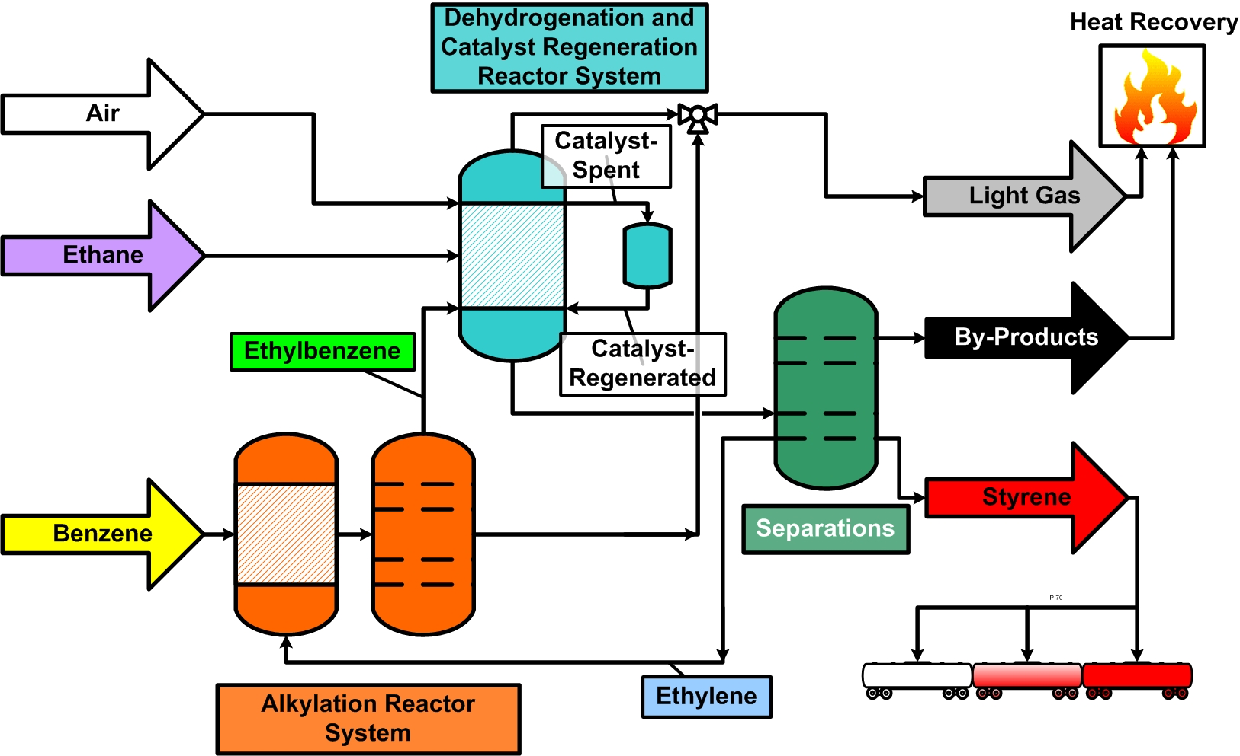
Process Flow Sheets
Although chemicals used in closed systems are not normally released into the atmosphere, exposures can arise from:
leaks
charging the system
intentional releases (e.g., sampling points)
recirculation of stack gases
accidental releases (e.g., equipment malfunction)
maintenance and repair activities

Slide 10
Checklists
A checklist for evaluating environmental hazards arising from industrial operations can be created.
Should be modified to fit each organization’s particular situation.
overall process or operation
list all hazardous agents used during the process
equipment
list all equipment that contain hazardous materials or energy that could be suddenly released
cleaning methods
list all hazardous materials used
list all contaminants that could be displaced

Slide 11
Process Safety Management
29 CFR 1910.119 recognizes that catastrophic releases could occur wherever large quantities of highly hazardous chemicals are used or stored.
evaluation of potential causes and consequences of:
fires
explosions
releases
spills
includes requirements for:
written operating procedures
training
inspection and testing
safety reviews

Slide 12
Field Surveys
Evaluation requires on-site and direct observation, measurement, interviews, and interpretation of data:
walk-through
follows the flow of material through a facility
include non-production areas
sensory perception
visual, auditory, olfactory
control measures in use
engineering, administrative, personal protective equipment
observation and interview
observation
interview

Slide 13
Monitoring and Sampling
There are a number of reasons why environmental measurements should be taken in the workplace:
evaluating degree of worker exposure
identification of sources for peak exposures
evaluation of control-measure effectiveness
compliance with occupational and environmental regulations
deciding if an area is clear for re-occupancy
establishing background concentrations
warning of peak releases

Slide 14
Monitoring
Monitoring is a continuous program of observation, measurement, and judgment—it is more than just sampling.
personal monitoring
active sampling
passive sampling
environmental (area) monitoring
ambient air sampling
biological monitoring
measurement of the contaminant
measurement of metabolites
measurement of enzymes or functions that reflect harm
medical monitoring
screening, early detection, preventative

Slide 15
Sampling
Preliminary research and initial field surveys help identify potential hazards to which workers may be exposed.
strategy
worst-case approach
typical-condition approach
how it will be used
what to sample
should represent workers’ exposures
how to sample
time-weighted averages
grab sampling
direct-read instruments

Slide 16
Sampling (cont.)
where to sample
personal monitoring
area monitoring
whom to sample
proximity
work habit
when to sample
season-to-season variations
air-conditioning
work-shift

Slide 17
Sampling (cont.)
how long to sample
sensitivity of instrument
estimated air concentration
OSHA PEL or ACGIH TLV
what to note while sampling
fundamental records
supplemental records
how many samples to take
purpose of sampling
number of tasks performed
contaminant generation variability

Slide 18
Sampling (cont.)
when to stop sampling
regulated contaminants (ongoing, routine)
results from most recent sampling (compared to baseline)
who should conduct sampling
adequately trained workers
supervised by professional industrial hygienist
needs knowledge of:
potential errors
proper calibration and maintenance of equipment
potential problems
sampling limitations
how to integrate observations and interviews
when it is not necessary to sample

Slide 19
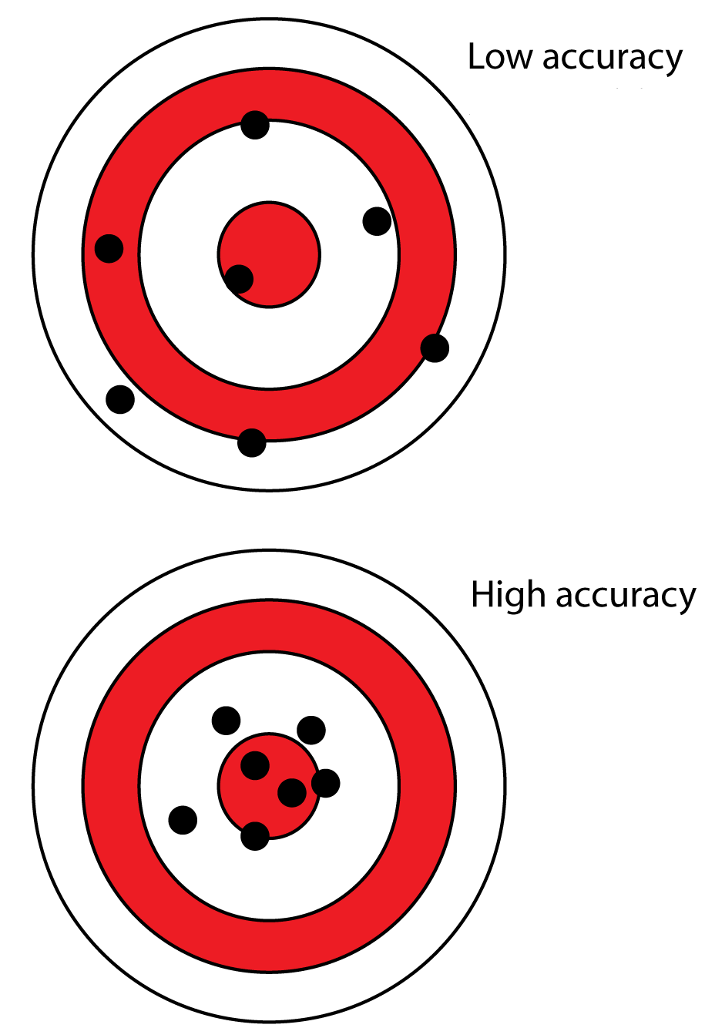
Sampling Accuracy and Precision
To sample means to measure only a part of the environment, and, from the measurements taken, infer conclusions about the whole.
accuracy
relationship between measured value and true value
systematic errors
method error
personal error
instrument error
consistent bias to results

Slide 20
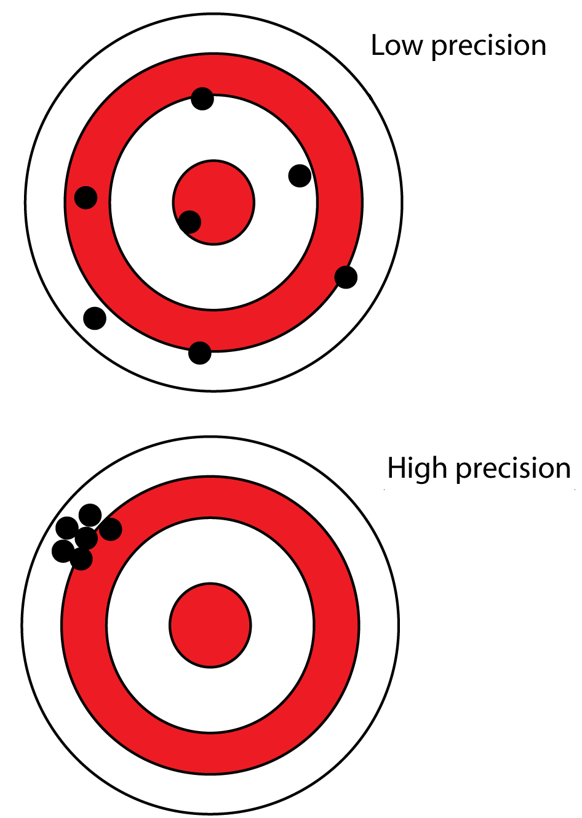
Sampling Accuracy and Precision (cont.)
precision
degree of agreement among results from repeated measurements
random errors
intra- or inter-day concentration fluctuations
sampling equipment variations
analytical method fluctuations
variability among results

Slide 21
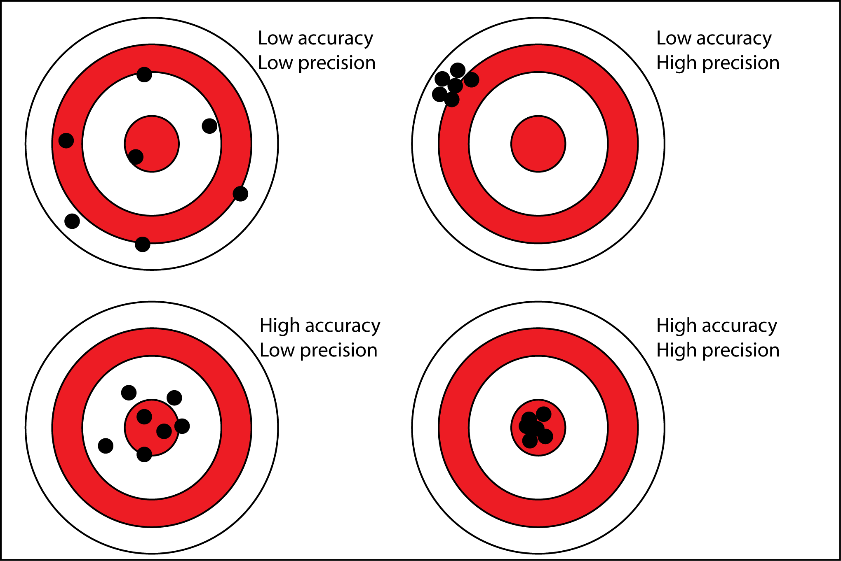
Sampling Accuracy and Precision (cont.)

Slide 22
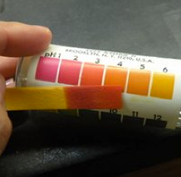
Interpretation of Results
There are times when the interpretation of results is not a completely straightforward process.
It is always important to keep in mind why the sampling was done:
compliance
OSHA PELs
good practices and worker protection
ACGIH TLVs and NIOSH RELs

Slide 23
Limitations of Standards
While any sampling result that is less than the PEL is considered to be in compliance with the law, this shouldn’t be interpreted as a “clean bill of health.”
only evaluate inhalation exposures (not dermal or ingestion)
out of date (most based on 1968 TLVs)
based on inadequate research (do not address chronic toxicity)
based on white, male workers
allow a level of risk not tolerated for general environmental exposure
fail to account for multiple exposures (ignore additive or synergistic)
fail to offer comprehensive protections (only 10% of chemicals have PELs)
represent a political compromise (regarding economic feasibility)

