Slide 1
Fundamentals of Industrial Hygiene
6th Edition
Chapter 23:
Personal Protective Equipment
Compiled by David C. May,
Associate Professor, Safety and Occupational Health Applied Sciences
Keene State College

Slide 2
Hierarchy of Controls
Most Effective | Engineering
 | Administrative
Least Effective | Personal Protective Equipment

Slide 3
Personal Protective Equipment Program
To ensure that employees have appropriate PPE for each job task with hazards to mitigate risk
Complexity of program varies with types of hazards and size of the organization
Programs typically include the following nine elements

Slide 4
1 — Hazard Assessment
Job task analysis
  Identify each step
  Assess the magnitude of the hazard(s) at each step
  Include other workers that may be affected
  Determine if PPE is necessary as well as feasibility of engineering / administrative controls

Slide 5
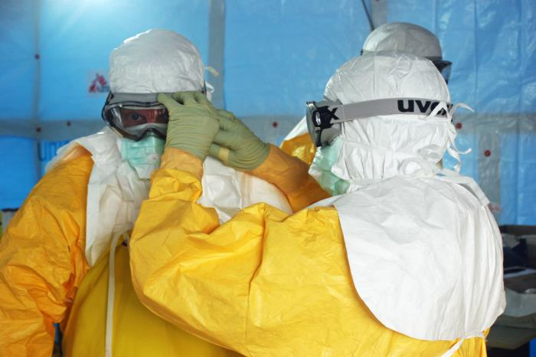
Identify All Routes of Entry
Consider all parts of the worker’s body
  Inhalation
  Skin absorption
  Ocular
  Ingestion
  Injection
(Source: NIOSH)

Slide 6
2 — PPE Selection
PPE must
  provide necessary protection
  not restrict the worker from doing the task
    Sufficient dexterity
  not create new hazards
    new hazards could include heat stress, ergonomic issues, communication interference, limited mobility, etc.
  provide a degree of comfort (so that it will be used)

Slide 7
3 — Develop Standard Operating Procedures
Typically written and includes:
  specificity of what PPE is required for what hazard and when it is to be used
  when replacement of PPE is necessary to prevent breakthrough or degradation
  care of PPE

Slide 8
4 — Fitting PPE to the Worker
Proper fit is critical for both effective protection and continued use.
Adjustable size features should be identified and workers trained in the appropriate adjustments.

Slide 9
5 — Training
So workers know
  When to use PPE (which task or operation)
  The magnitude of the hazard and what PPE to use based on the hazard assessment
  How to inspect PPE for damage or non-functioning issues
  How to put it on and take it off (don and doff)
  When to replace the PPE
  How to check fit and effectiveness
  How to store and maintain when not in use

Slide 10
6 — Maintenance of PPE
Maintenance – see manufacturer’s recommendations
Inspection – wear and damage
Storage – to assure effectiveness when needed
Cleaning – to keep clean and sanitary (or alternatively use disposable PPE)
Shelf life – often specified by manufacturer

Slide 11
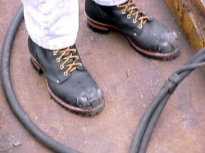
7 — Employer Provided and Employee-Owned PPE
Normally employers are required to provide/pay for PPE although OSHA allows some exceptions (non-specialty safety-toe footwear, etc.).
Employers are also responsible
for ensuring that employee-owned
PPE meets necessary protection
and prohibit its use when it is
defective or unsanitary.
(Source: OSHA)

Slide 12
8 — Recordkeeping
Additional records should be maintained for:
  PPE selection and worker training program
  Written certification for the workplace PPE/hazard assessment (required by OSHA)

Slide 13
Voluntary Use of PPE
Includes situations where workers choose to utilize PPE even though its use is not required by the hazard assessment.
Employer maintains the responsibility that PPE is used correctly and does not pose additional hazards.

Slide 14
9 — Program Evaluation
Annual evaluation based on:
  experience and accidents
  changes in work environment
  changes in PPE
  evaluation to assure PPE continues to provide necessary protection
  complaints and feedback from users

Slide 15
Specific Personal Protective Equipment

Slide 16
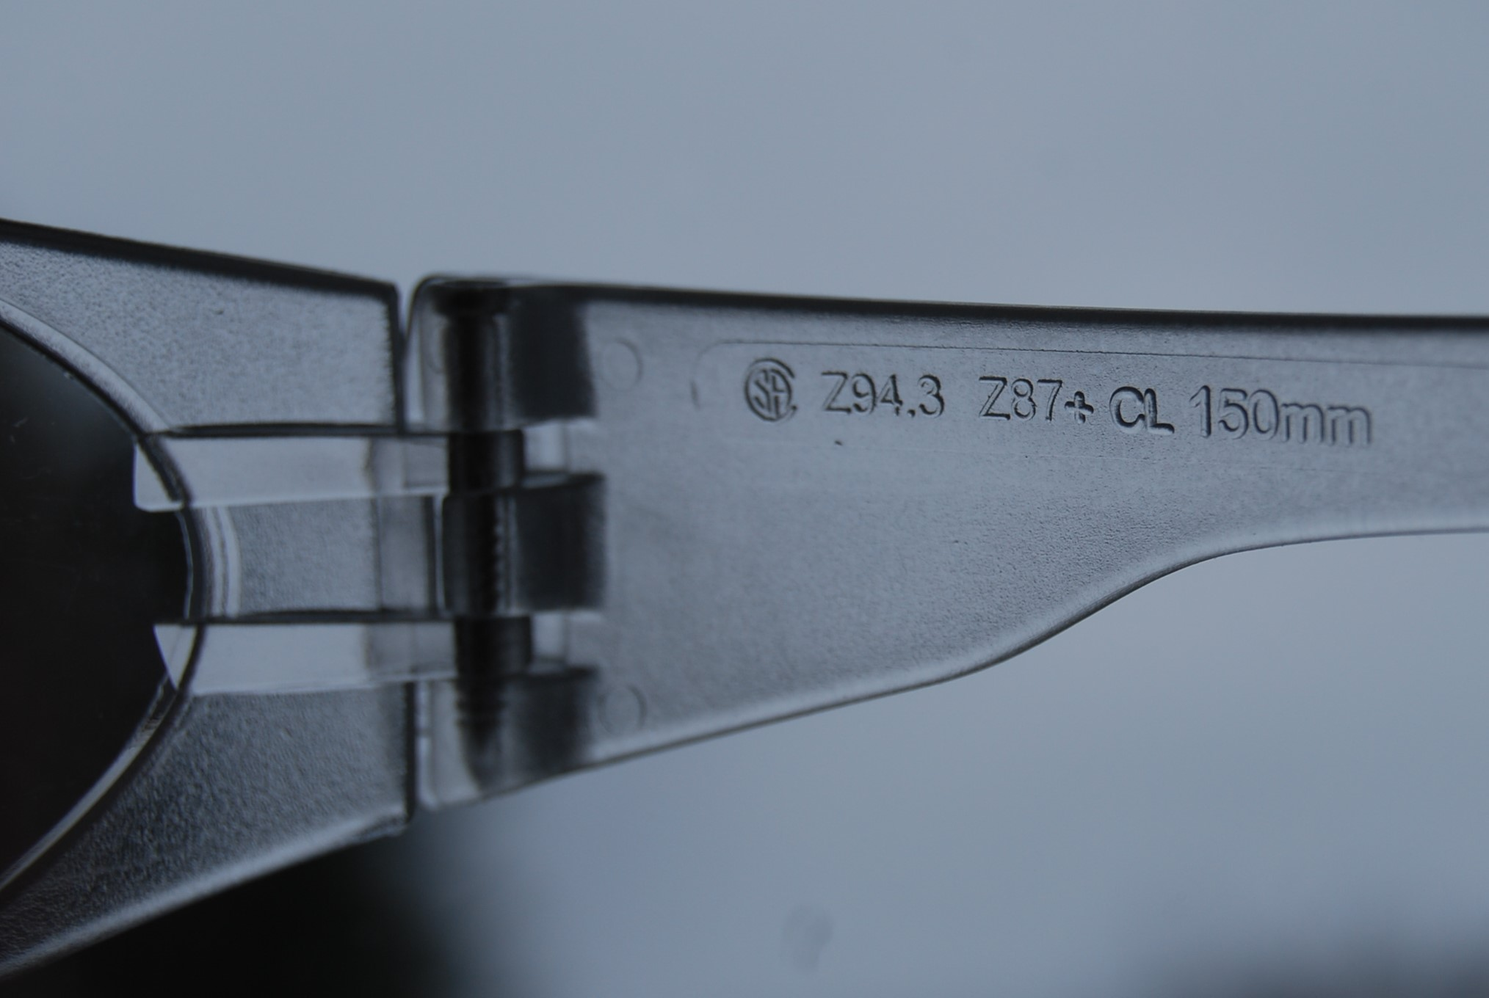
Eye and Face Protection
Impact-resistant eyewear for protection against flying objects (chips and particles)
  marked with a plus sign (e.g., Z 87+ or Z 87-2+, if prescription)
  integral lateral protection (side shields)
Reference: ANSI Z87.1

Slide 17
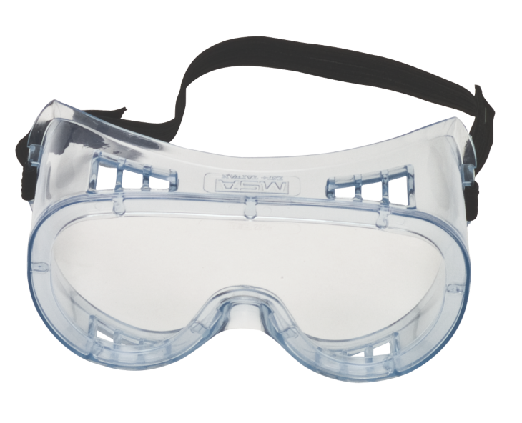
Eye and Face — Dust and Chemicals
Designed to give additional protection from dust or droplets typically utilizing a seal against the face
Chemical face shield worn over spectacles
Chemical goggles; marked as
  Splash and droplet protection (D3)
  Dust (D4)
  Fine dust (D5)
Chemical face shield worn over goggles
Full-face respirator
Courtesy MSA

Slide 18

Eye and Face — Optical Radiation Hazards
Protect against infrared, ultraviolet and visible light
Include direct or reflected light
Marked “W” for welding, “R” for infrared, “U” for ultraviolet and “L” for visible light and glare
Shade numbers indicate the optical density
(Source: NIOSH)

Slide 19

Head Protection — Type and Class
Type 1, Class E
Courtesy MSA
ANSI Z89.1
  Type I – Impact or penetration protection from above
  Type II Additional protection from side, front, rear or off-center
  Class C (conductive but no electrical protection)
  Class G – tested to 2,200 V
  Class E – tested to 20,000 V

Slide 20
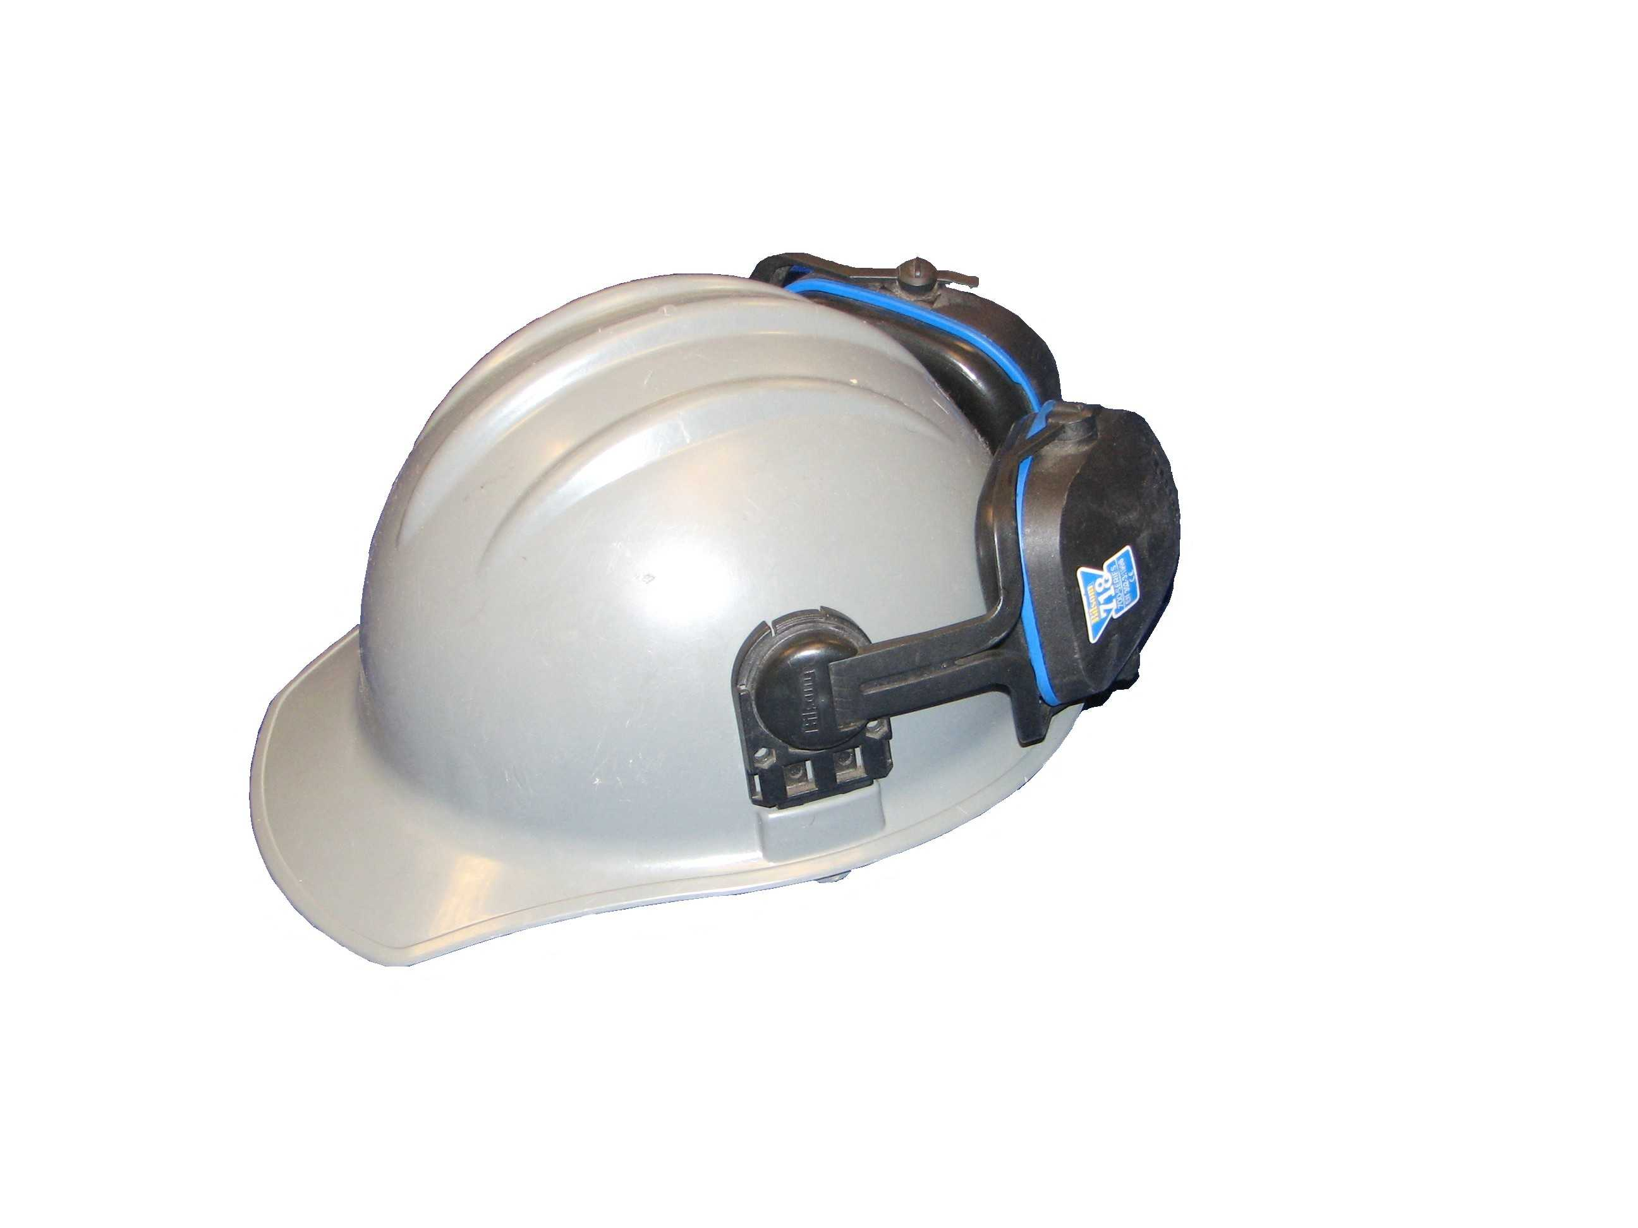
Head Protection — Optional Features
Reverse donning—must be designed for that feature—see manufacturer's literature
High visibility choice
Option for mounting for additional PPE: face shield, ear muffs, goggles, head-lamps, etc.
Head protection with ear muffs

Slide 21
Head Protection Use
Fitting
Replace if damaged, cracked, chalked from UV (sun) exposure
Decals, painting—see manufacturer recommendations
Service life of head protection—see manufacturer recommendations

Slide 22
Foot Protection — Electrical Hazards
Electrical shock resistant shoes—tested to14,000 V (dry conditions)
Static dissipative—some electrical shock protection
Conductive footwear—minimize the build-up of electrical charge
  See ASTM F1116, F1117

Slide 23
Foot Protection — Design Options
ASTM F-2412, F2413
  Impact and compression resistant (toe caps) for falling or rolling objects.
  Protection against objects piercing the sole
Chain saw cutting resistance
  ASTM F1458, F1818
Metatarsal protection
Slip resistance

Slide 24
Hand Protection
Hazards that potentially can be reduced by gloves/PPE
  abrasion
  temperature extremes
  puncture/cuts
  biological (infectious)
  electrical
  radiation
  vibration
  low visibility (where high reflectivity is needed)
  chemical

Slide 25
Hand Protection
When choosing hand protection, consider:
  Size/fit
  Potential for glove material to be caught in machinery
  Loss of dexterity and tactile feedback
  Sensitization (e.g., latex) and dermatitis (from certain chemical accelerators used in rubber glove manufacture)
  Internal contamination resulting in occlusion of chemical against the skin
  Need to frequently assure protection integrity of the material (e.g., electrical gloves and sleeves)

Slide 26
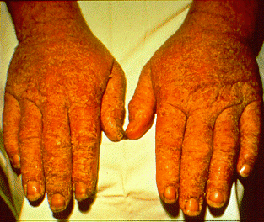
Chemical-Protection Clothing/PPE
Hazards of chemical contact potentially include:
  significant absorption hazard leading to systemic effects
    “skin” notation in ACGIH TLVs or OSHA PELs indicates dermal absorption warning
  tissue destruction (local effects)
    necrosis of tissue, e.g., corrosives, caustics
  dermal sensitivity (allergic dermatitis)
    includes chemicals with D-SEN
    notation in ACGIH TLVs
Cement dermatitis
(Source: NIOSH)

Slide 27
Chemical-Protection Clothing
Decisions on type of protective clothing and the choice of material from which it is made depend on:
  job task requirements
  chemicals involved
  integration of other PPE
  potential to create additional hazards (ergonomic, heat stress)

Slide 28
Chemical-Protection Clothing (cont.)
Effectiveness:
  No single material/fabric offers protection against all chemicals nor unlimited protection against any specific chemical
Concerns:
  penetration of chemicals through clothing or ensemble mechanics such as through seams, zippers, stitching, etc.
  degradation—damage caused by chemical on the fabric
  permeation of chemicals through fabric at molecular level

Slide 29
Chemical-Protection Clothing (cont.)
Penetration of chemicals
  fabric seams provide varying amounts of protection depending on type of connection (stitched, cemented, heat sealed, etc.)
Tape
  keeps seams or ensemble components in proper alignment
  some chemical-resistant tapes have been tested
  not appropriate for rip repairs on material/fabric

Slide 30
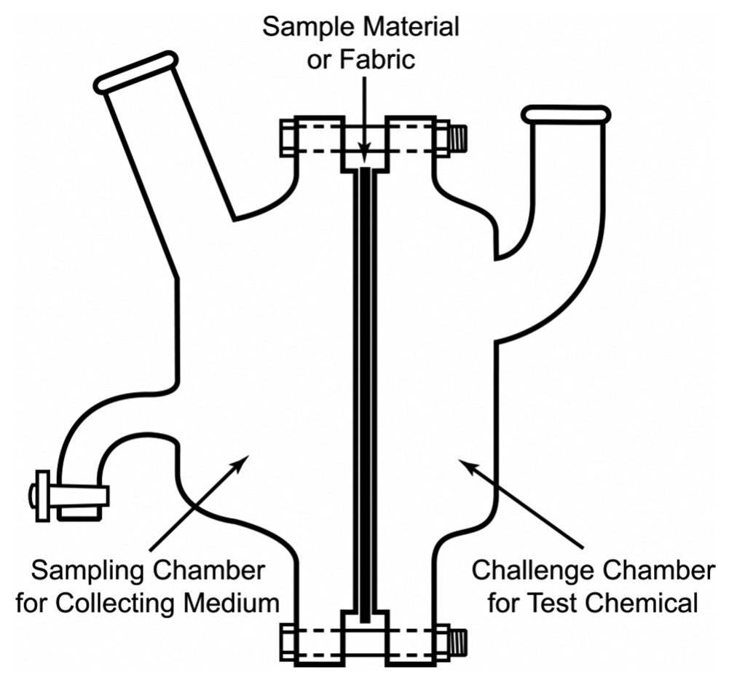
Chemical-Protection Clothing (cont.)
Permeation: chemical specific
  Manufacturers’ permeation test typically measured by:
    Break-through detection time (hours)
    Permeation rate (µg/cm²/min)
    Cumulative break-through in 1 hour
    (gm or drops per hour)
Permeation test cell

Slide 31
Levels of Protection
Level | Protective suit
A | Totally encapsulating, vapor-protective suit
B | Hooded chemical resistant clothing
C | Hooded chemical resistant clothing
D | Coveralls

Slide 32
PPE and Ionizing Radiation
PPE must be able to reduce the penetration and the workers’ exposure to ionizing radiation by absorbing the energy in the PPE material.
  choice dependent on the type and magnitude of the radiation
    Not feasible for several types of radiation, e.g., high energy x-ray or gamma
  protection dependent on the density and thickness of the PPE material

