Slide 1
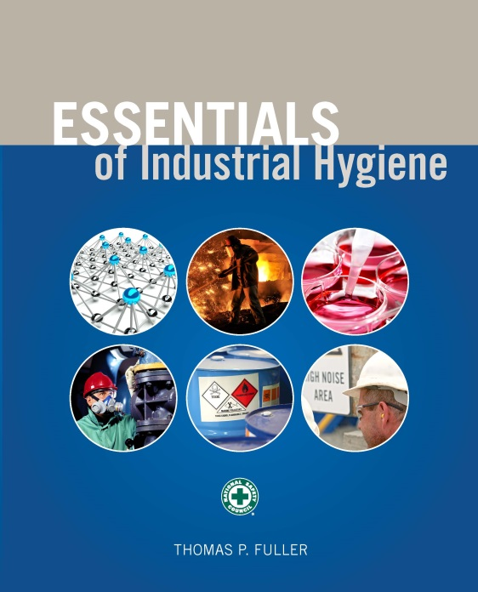
CHAPTER 12
Radiation

Slide 2
Learning Objectives
Describe electromagnetic radiation.
Perform calculations demonstrating the relationship among the speed of light, frequency, and wavelength.
Use the inverse-square law to calculate radiation intensity at different distances.
Understand the basic principles of radiation shielding and the concept of the Half Value Layer.
Describe radioactive decay, and perform relevant calculations.
Discuss physical and biological half-lives and perform relevant calculations.

Slide 3
Learning Objectives (cont.)
Understand how radiation quality factors affect the hazard levels of different types of radiation.
Describe how ionizing radiation causes biological damage and how occupational exposure limits are determined.
Demonstrate the use of the ALARA principle.
Identify different levels of laser hazards and devices.
Calculate power levels for microwave transmission devices.
Identify hazard levels, biological effects, and safety controls for various nonionizing sources of radiation including radiofrequency, microwaves, optical light, UV light, and lasers.

Slide 4
Frequency and Wavelength

Slide 5
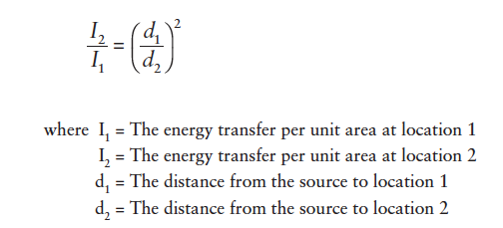
Inverse-Square Law

Slide 6
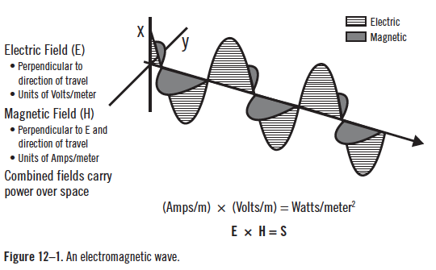
Electromagnetic Wave
Source: Plog 2012

Slide 7
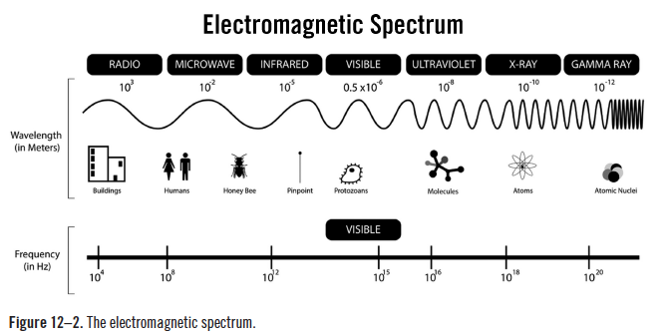
Electromagnetic Spectrum
Source: Jonathan S. Urie / CC-BY-SA-3.0

Slide 8
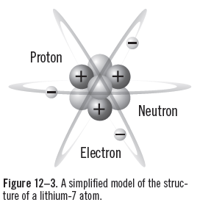
Atomic Structure
Source: Oliver Hoffmann/iStock

Slide 9
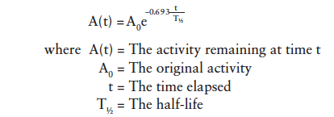
Radioactive Decay

Slide 10
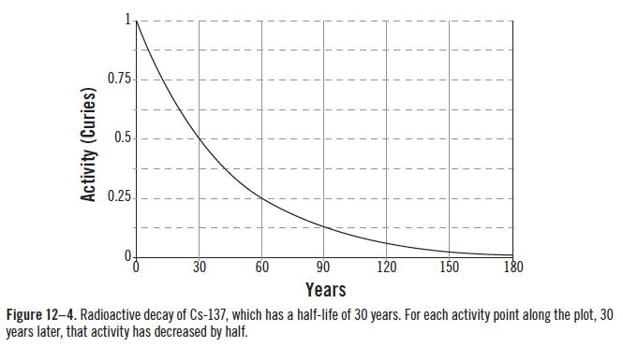
Radioactive Decay Curve

Slide 11
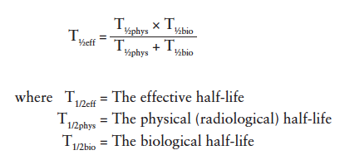
Effective Half-life

Slide 12
Biological Effects
0.25 Gy – reduced blood counts may be detected due to damage to the hematopoietic system.
1 Gy – damage to the hematopoietic system may cause mild flulike symptoms such as nausea and malaise, as well as increased susceptibility to infection.
3–6 Gy – more severe flulike symptoms, risk of infection, hemorrhage, hair loss, and diarrhea may also occur. If not treated, about 50% of people who receive doses in this range will die, typically within 1–2 months.
5 Gy – lethal dose to 50% of an exposed population.
6 Gy – damage to the intestinal epithelium is damaged; death is likely within 1–2 weeks.
10 Gy – damage to the central nervous system, resulting in disorientation, convulsions, and loss of consciousness, followed by death within 1–2 days.

Slide 13
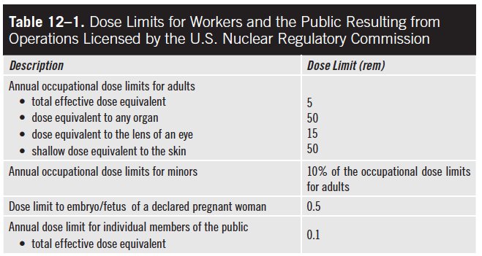
Dose Limits

Slide 14
ALARA
ALARA = As Low As Reasonably Achievable
An administrative and philosophical approach to weighing the economic and sociological costs and benefits when considering radiological exposures with the goal of minimizing radiation exposures whenever practical.

Slide 15
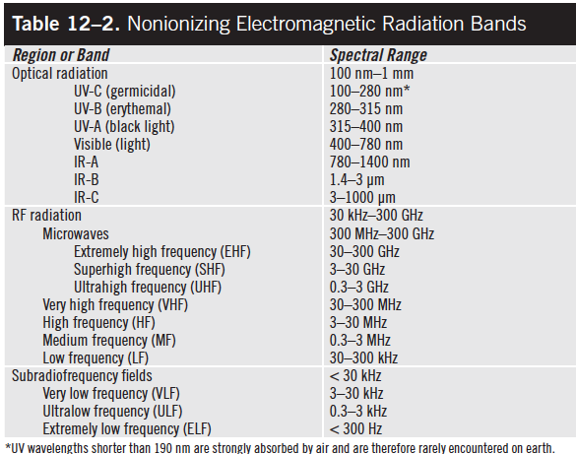
Nonionizing Electromagnetic Spectrum

Slide 16
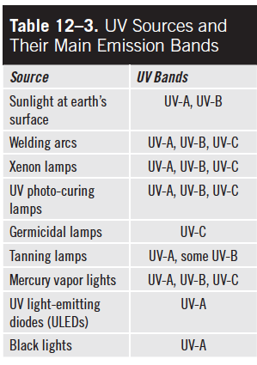
UV Sources and Emission Bands

Slide 17
UV Radiation Dose

Slide 18
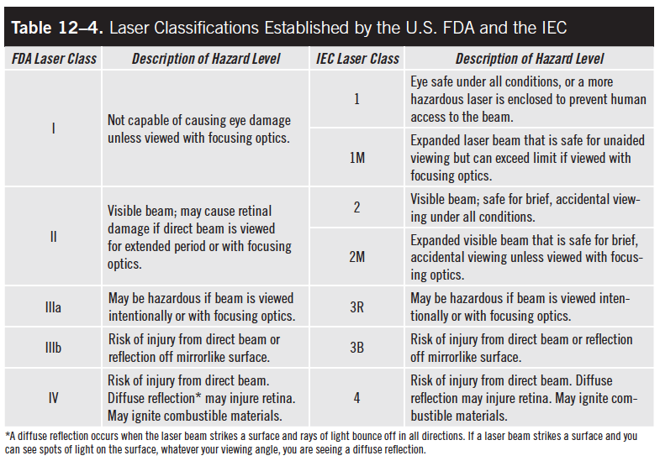
Laser Classifications
Source: U.S. Food and Drug Administration; International Electrotechnical Commission

Slide 19
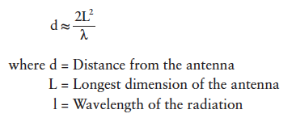
Near Field, Far Field Boundary

Slide 20
Microwave Power Density

