Slide 1

Road Safety Grants: Lessons from the UN Decade of Action
Road to Zero Coalition Meeting
NTSB, June 28, 2018
Marc Shotten
Senior Transport Specialist
Global Road Safety Facility
The World Bank Group

Slide 2
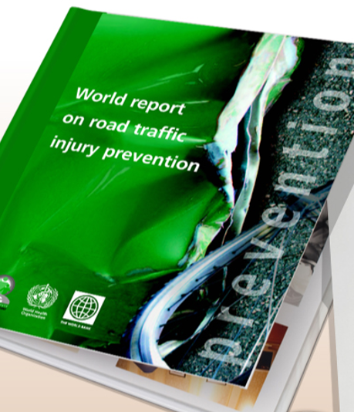
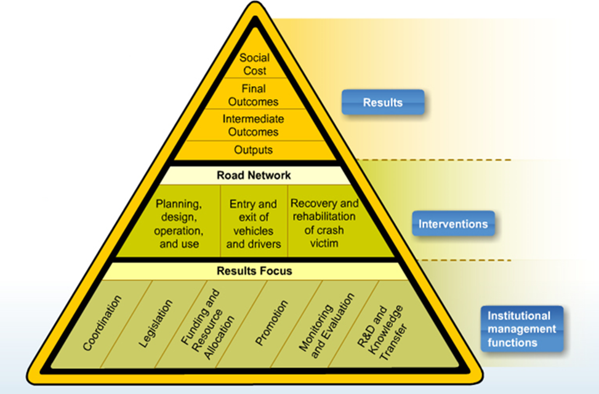
Legacy Pieces Can Drive Grants Process

Slide 3
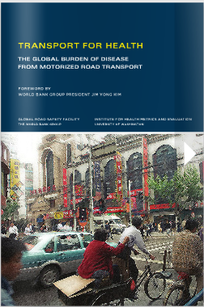


Grant Types: A Quick Comment
Partnership building, research, interventions, political, etc.

Slide 4
Action-GRSF’s Influence: World Bank Road Safety Lending
GRSF was established in FY06. In the 10 years after GRSF, World Bank road safety lending increased 240%. GRSF’s impact played a substantial role in this process.

Slide 5
Looking Down the Road to 2020
-Target 2020 to 2030
-Next Global Ministerial Conference
-UN Fund for Road Safety
-USA Vision Zero: It is the Best of Times, the Worst of Times, and Maybe Just in Time

