Slide 1
How can the Management by Objective approach be used for planning and measuring Vision Zero Programs? Ylva Berg

Slide 2
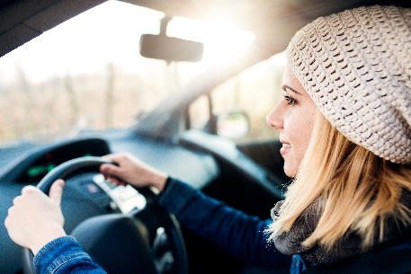
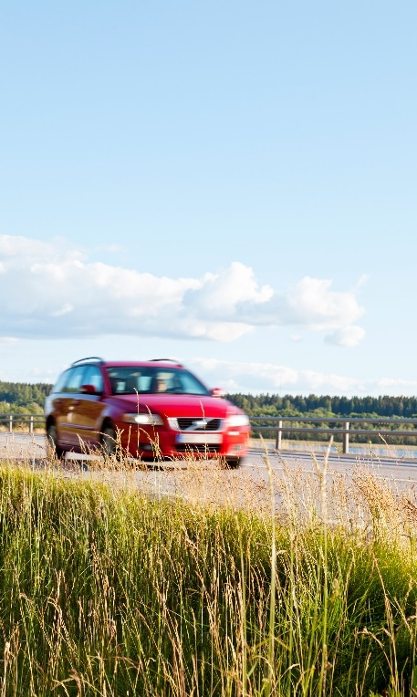
Why Management by objectives?
Because we have to break Vision zero down into reachable short term objectives

Slide 3
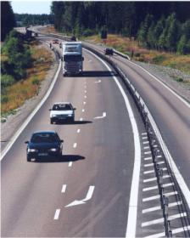
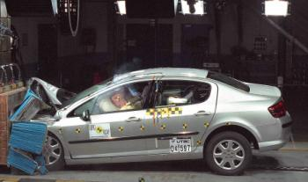
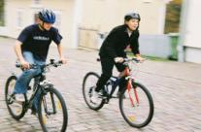
Identify the safe system!
The Vehicles
The roads and streets
The road use

Slide 4
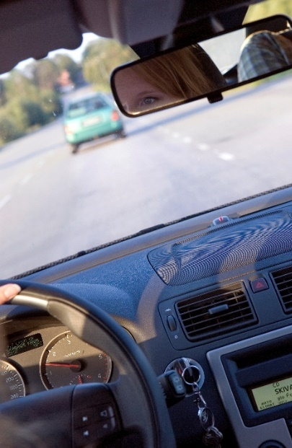
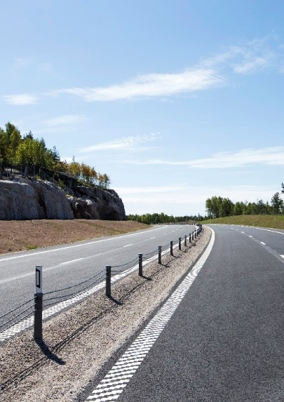
Monitor progress towards a safe system
Stakeholder’s objectives
Shared objectives
Measures
Performance indicators
Consequences
Road safety camera
Median barriers
Etc…
% of traffic complying with speed limits
% of traffic on safe state roads
Number of deaths in traffic

Slide 5
Performance indicator | Target for 2020
1. Speed compliance, state roads | 80 %
2. Speed compliance, municipal streets | 80 %
3. Sober traffic | 99,90 %
4. Seat belt use | 99 %
5. Helmet use
- Bicycle helmet | 70 %
- Moped helmet | 99 %
6. Safe passenger cars | 80 %
7. Motorcyclist compliance | New indicator
8. Safe state roads | 75 % - 90 %
9. Safe pedestrian passages across streets | 35 %
10. Safe bicycle lanes | 70%
11. Systematic road safety work | New indicator

Slide 6
Performance indicator | Target for 2020
1. Speed compliance, state roads | 80 %
2. Speed compliance, municipal streets | 80 %
3. Sober traffic | 99,90 %
4. Seat belt use | 99 %
5. Helmet use
- Bicycle helmet | 70 %
- Moped helmet | 99 %
6. Safe passenger cars | 80 %
7. Motorcyclist compliance | New indicator
8. Safe state roads | 75 % - 90 %
9. Safe pedestrian passages across streets | 35 %
10. Safe bicycle lanes | 70%
11. Systematic road safety work | New indicator

Slide 7
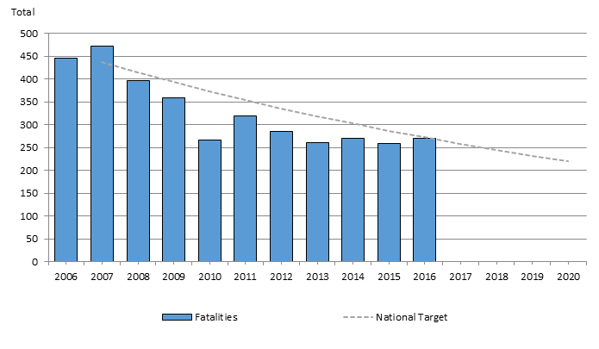
Road traffic fatalities in Sweden, and target for 2020

Slide 8
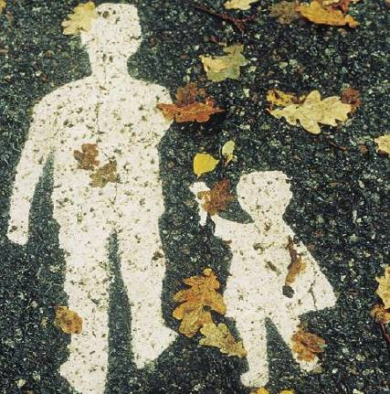
Thank You!
Ylva Berg
Safety Strategist
Director-General’s office Direct: +46 10 123 58 37 Trafikverket Swedish Transport Administration S-781 89 Borlänge Röda vägen 1 www.trafikverket.se

